Slide 1
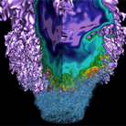
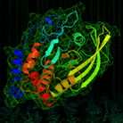





Antisocial Parallelism:
Avoiding, Hiding and Managing Communication
Kathy Yelick
Associate Laboratory Director of Computing Sciences
Lawrence Berkeley National Laboratory
EECS Professor, UC Berkeley

Slide 2
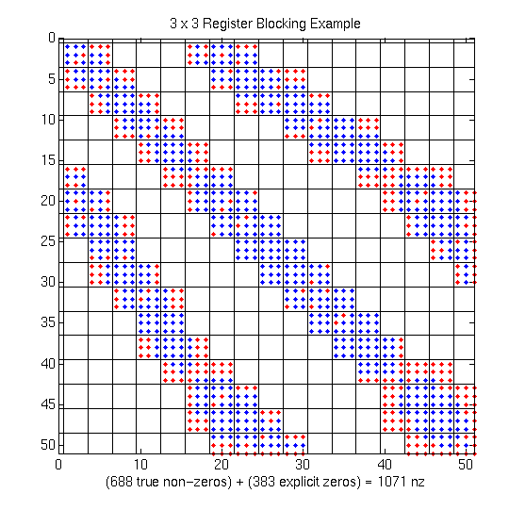
Extra Work Can Improve Efficiency!
Optimizing Sparse Matrix Vectory Multiply (fill)
Example: 3x3 blocking
  Logical grid of 3x3 cells
  Fill-in explicit zeros
  Unroll 3x3 block multiplies
  “Fill ratio” = 1.5
  Takes advantage of registers
On Pentium III: 1.5x speedup!
  Actual mflop rate 1.5² = 2.25 higher
See Eun-Jin Im PhD Thesis (Sparsity Library) and Rich Vuduc PhD thesis (OSKI Library)
Notes:
The main point is that there can be a considerable pay-off for judicious choice of “fill” (r x c), but that allowing for fill makes the implementation space even more complicated.
For this matrix on a Pentium III, we observed a 1.5x speedup, even after filling in an additional 50% explicit zeros. Two effects:
Filling in zeros, but eliminating integer indices (overhead)
(2) Quality of r x c code produced by compiler may be much better for particular r’s and c’s.
In this particular example, overall data structure size stays the same, but 3x3 code is 2x faster than 1x1 code for a dense matrix stored in sparse format.

Slide 3
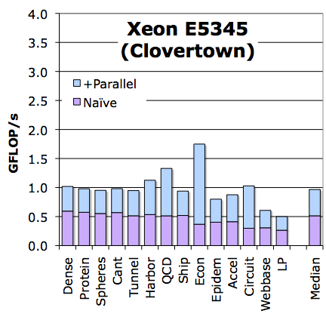
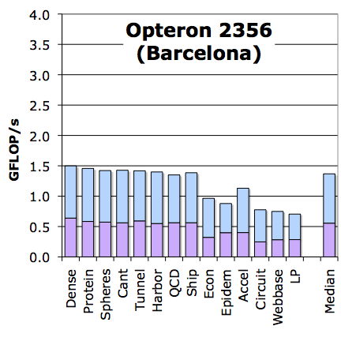
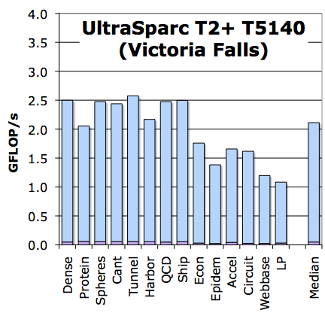
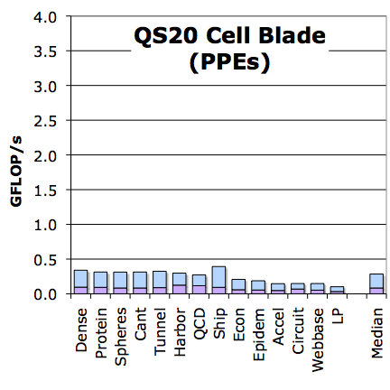
SpMV Performance
(simple parallelization)
4 GF
Out-of-the box SpMV performance on a suite of 14 matrices
Scalability isn’t great
Is this performance good?
Naïve Pthreads
Naïve
See Sam Williams PhD thesis + papers
3
Notes:
3
NOTE: on Cell, I’m just using the PPEs (for portability)

Slide 4
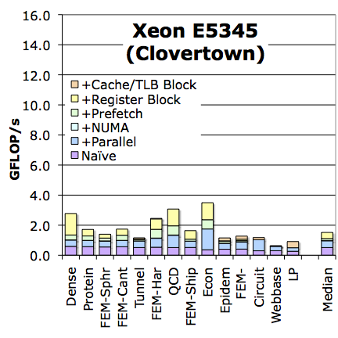
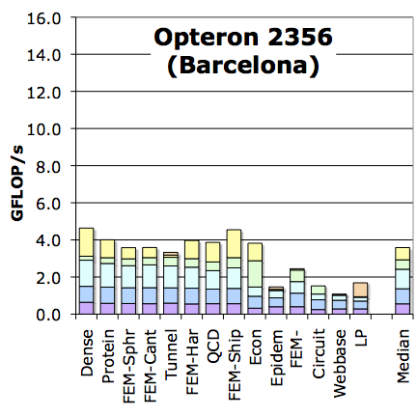
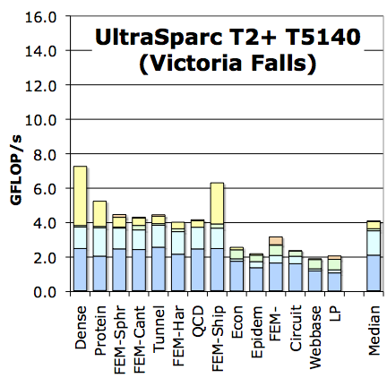
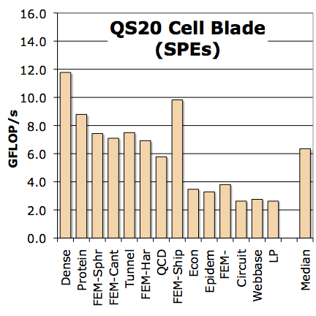
Auto-tuned SpMV Performance
(architecture specific optimizations)
16 GF
Fully auto-tuned SpMV performance across the suite of matrices
Included SPE/local store optimized version
Why do some optimizations work better on some architectures?
+Cache/LS/TLB Blocking
+Matrix Compression
+SW Prefetching
+NUMA/Affinity
Naïve Pthreads
Naïve
4
Notes:
4

Slide 5
The Roofline Performance Model
See Sam Williams PhD Thesis
256.0
Generic Machine
128.0
Roof structure determined by machine
Locations of posts in the building are determined by algorithmic intensity
Will vary across algorithms and with bandwidth-reducing optimizations, such as better cache re-use (tiling), compression techniques
Can use DRAM, network, disk,…
64.0
peak DP
32.0
mul / add imbalance
16.0
w/out SIMD
attainable Gflop/s
peak BW
8.0
w/out ILP
w/out SW prefetch
4.0
w/out NUMA
2.0
1.0
0.5
¹/₈
¹/₄
¹/₂
1
2
4
8
16
actual flop:byte ratio

Slide 6
Roofline model for SpMV
(matrix compression)
Intel Xeon E5345
(Clovertown)
Opteron 2356
(Barcelona)
128
128
Inherent FMA
Register blocking improves ILP, DLP, flop:byte ratio, and FP% of instructions
peak DP
peak DP
64
64
32
w/out SIMD
32
w/out SIMD
16
16
attainable Gflop/s
attainable Gflop/s
8
dataset dataset fits in snoop filter
w/out ILP
w/out ILP
8
4
mul/add imbalance
4
mul/add imbalance
w/out SW prefetch
w/out NUMA
2
2
1
1
¹/₁₆
¹/₈
¹/₄
¹/₂
1
2
4
8
¹/₁₆
¹/₈
¹/₄
¹/₂
1
2
4
8
flop:DRAM byte ratio
flop:DRAM byte ratio
Sun T2+ T5140
(Victoria Falls)
IBM QS20
Cell Blade
128
128
64
64
32
32
peak DP
peak DP
16
16
w/out SIMD
attainable Gflop/s
attainable Gflop/s
25% FP
bank conflicts
8
w/out SW prefetch
8
w/out ILP
w/out NUMA
w/out NUMA
4
12% FP
4
w/out FMA
2
2
1
1
¹/₁₆
¹/₈
¹/₄
¹/₂
1
2
4
8
¹/₁₆
¹/₈
¹/₄
¹/₂
1
2
4
8
flop:DRAM byte ratio
flop:DRAM byte ratio

Slide 7
Roofline model for SpMV
(matrix compression)
Intel Xeon E5345
(Clovertown)
Opteron 2356
(Barcelona)
128
128
peak DP
peak DP
SpMV should run close to memory bandwidth
  Time to read matrix is major cost
Can we do better?
Can we compute A^{k}*x with one read of A?
If so, this would
  Reduce # messages
  Reduce memory bandwidth
64
64
32
w/out SIMD
32
w/out SIMD
16
16
attainable Gflop/s
attainable Gflop/s
8
w/out ILP
8
w/out ILP
4
dataset fits in snoop filter
4
mul/add imbalance
mul/add imbalance
w/out SW prefetch
w/out NUMA
2
2
Performance is
bandwidth limited
1
1
¹/₁₆
¹/₈
¹/₄
¹/₂
1
2
4
8
¹/₁₆
¹/₈
¹/₄
¹/₂
1
2
4
8
flop:DRAM byte ratio
flop:DRAM byte ratio
Sun T2+ T5140
(Victoria Falls)
IBM QS20
Cell Blade
128
128
64
64
32
32
peak DP
peak DP
16
16
w/out SIMD
attainable Gflop/s
attainable Gflop/s
25% FP
bank conflicts
8
w/out SW prefetch
8
w/out ILP
w/out NUMA
w/out NUMA
4
12% FP
4
w/out FMA
2
2
1
1
¹/₁₆
¹/₈
¹/₄
¹/₂
1
2
4
8
¹/₁₆
¹/₈
¹/₄
¹/₂
1
2
4
8
flop:DRAM byte ratio
flop:DRAM byte ratio

Slide 8
Autotuning: Write Code Generators
Autotuners are code generators plus search
Avoids two unsolved compiler problems: dependence analysis and accurate performance models
Popular in libraries: Atlas, FFTW, OSKI,…
Xeon X5550 (Nehalem)
NVIDIA C2050 (Fermi)
1024
1024
single-precision peak
512
Peak compute
512
double-precision peak
256
single-precision peak
256
DGEMM
DP add-only
128
double-precision peak
128
RTM/wave eqn.
Gflop/s
Gflop/s
64
DP add-only
DGEMM
64
Device bandwidth
STREAM bandwidth
RTM/wave eqn.
27pt Stencil
32
Peak bandwidth
32
16
7pt Stencil
27pt Stencil
16
7pt Stencil
GTC/pushi
SpMV
GTC/pushi
8
SpMV
8
4
GTC/chargei
4
GTC/chargei
2
2
¹/₃₂
¹/₁₆
¹/₈
¹/₄
¹/₂
1
2
4
8
16
32
¹/₃₂
¹/₁₆
¹/₈
¹/₄
¹/₂
1
2
4
8
16
32
Algorithmic intensity: Flops/Word
Algorithmic intensity: Flops/Word
Work by Williams, Oliker, Shalf, Madduri, Kamil, Im, Ethier,…

Slide 9
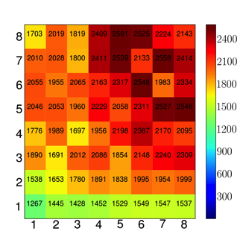
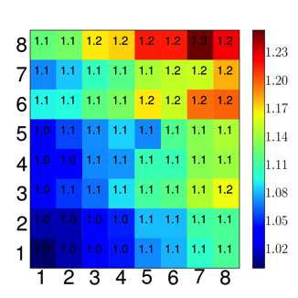
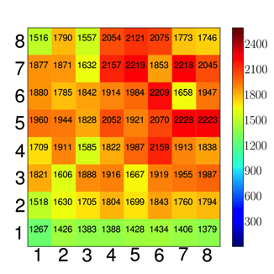
Finding Good Performance is like finding the Needle in a Haystack
OSKI sparse matrix library: offline search + online evaluation: adding zeros can reduce storage in blocked format
Dense: MFlops(r,c) / Tsopf: Fill(r,c) = Effective_MFlops(r,c)
r (num. of rows)
c (num. of cols)
c (num. of cols)
c (num. of cols)
Work by Im, Vuduc, Williams, Kamil, Ho, Demmel, Yelick…
Selected RB(5x7) with a sample dense matrix

Slide 10
OSKI and pOSKI: Auto-tuning Sparse Matrix Kernels
      Our approach uses Empirical modeling and search
Off-line auto-tuning
At Install Time
+
Run-time auto-tuning
(analysis & modeling)
Sample Dense Matrix
1. Build for
Target Arch.
2. Benchmark
User’s
Matrix
User’s
hints
Workload
from program
monitoring
Generated
Code
Variants
Benchmark
data
1. Evaluate
Models
Heuristic
models
(r,c)
(r,c)
2. Select
Data Struct.
& Code
History
To user: Matrix handle for kernel calls
Notes:
Since OSKI successfully support many sparse matrix kernels on single core architectures, the basic goal of pOSKI is to extend current OSKI with multicore optimizations.
Our proposed pOSKI will support to identify “tuning design space” using off-line or run-time auto-tuning,
And to exploit user’s hints to modify search space including benchmark data,
Also, support additional functions beside SpMV,
And the performance history and benchmark data will be handled by using SQLite,
Also will support interfaces with productivity languages or specializers.

Slide 11
SEJITS: Selective Embedded Just-in-Time Specialization
(beyond Perl code generators)
Productivity app
ASP is SEJITS for Python:
Python provides
  Front-end parsing
  Tools for building strongly-typed IR
  Visitor pattern for IR transformation to backend AST
  Code “templates” (like webapps)
  Code generation
  External compiler support (C++, CUDA, OpenMP, pthreads, MPI, Scala)
  Caching
.py
.c
f()
B.h()
cc/ld
cache
Interpreter
SEJITS Framework
DSEL Compiler
.so
OS/HW
Armando Fox’s group, including Shoaib Kamil and Michael Driscoll
Notes:
F() is a GUI or I/O function that is well suited for your runtime

Slide 12
Lessons Learned
Optimizations (not all in OSKI)
  Register blocking, loop unrolling, cache blocking, thread blocking, reordering, index compression, SIMDization, manual prefetch, NUMA (“PGAS” on node), matrix splitting, switch-to-dense, sparse/bit-masked register blocks
  See http://bebop.berkeley.edu for papers
  Straight line code failed to work on Spice ~10 years ago
    64-bit instructions: 1 load (x), 1 store (y), 1 op
    Vs 1 op and fraction of load/store depending on reuse
Good news
  Autotuning helps save programmer time
But the operation is bandwidth limited
  With hardware optimizations (NUMA, prefetch, SIMDization, threading)
  The rest is about matrix compression
A problem for local memory and network

Slide 13
Avoiding Communication in Iterative Solvers
Consider Sparse Iterative Methods for Ax=b
  Krylov Subspace Methods: GMRES, CG,…
Solve time dominated by:
  Sparse matrix-vector multiple (SPMV)
    Which even on one processor is dominated by “communication” time to read the matrix
  Global collectives (reductions)
    Global latency-limited
Can we lower the communication costs?
  Latency: reduce # messages by computing multiple reductions at once
  Bandwidth to memory, i.e., compute Ax, A²x, … A^{k}x with one read of A
Joint work with Jim Demmel, Mark Hoemmen, Marghoob Mohiyuddin; See 2 PhD thesis for details

Slide 14
Communication Avoiding Kernels
The Matrix Powers Kernel : [Ax, A²x, …, A^{k}x]
Replace k iterations of y = A⋅x with [Ax, A²x, …, A^{k}x]
Idea: pick up part of A and x that fit in fast memory, compute each of k products
Example: A tridiagonal matrix (a 1D “grid”), n=32, k=3
General idea works for any “well-partitioned” A
A³·x
A²·x
A·x
x
1 2 3 4 …
… 32
Notes:
C. J. Pfeifer, Data flow and storage allocation for the PDQ-5 program
on the Philco-2000, Comm. ACM 6, No. 7 (1963), 365366.
Referred to in paper by Leiserson/Rao/Toledo/ in 1993 paper on blocking covers

Slide 15
Communication Avoiding Kernels (Sequential case)
The Matrix Powers Kernel : [Ax, A²x, …, A^{k}x]
Replace k iterations of y = A⋅x with [Ax, A²x, …, A^{k}x]
Sequential Algorithm
Example: A tridiagonal, n=32, k=3
Saves bandwidth (one read of A&x for k steps)
Saves latency (number of independent read events)
Step 1
Step 2
Step 3
Step 4
A³·x
A²·x
A·x
x
1 2 3 4 …
… 32

Slide 16
Communication Avoiding Kernels:
(Parallel case)
The Matrix Powers Kernel : [Ax, A²x, …, A^{k}x]
Replace k iterations of y = A⋅x with [Ax, A²x, …, A^{k}x]
Parallel Algorithm
Example: A tridiagonal, n=32, k=3
Each processor works on (overlapping) trapezoid
Saves latency (# of messages); Not bandwidth
But adds redundant computation
Proc 1
Proc 2
Proc 3
Proc 4
A³·x
A²·x
A·x
x
1 2 3 4 …
… 32

Slide 17
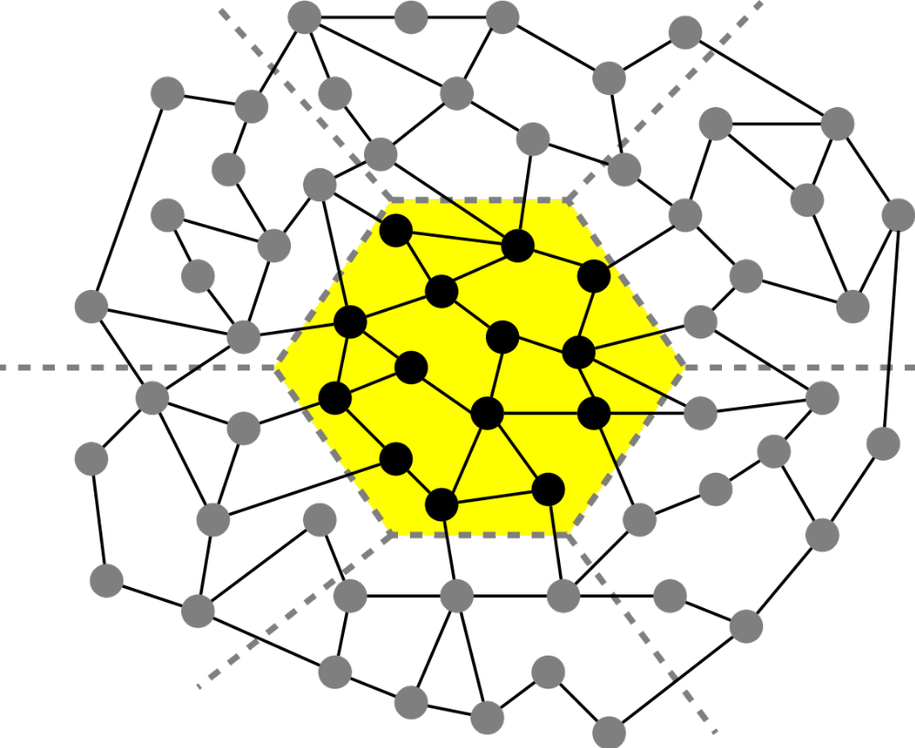
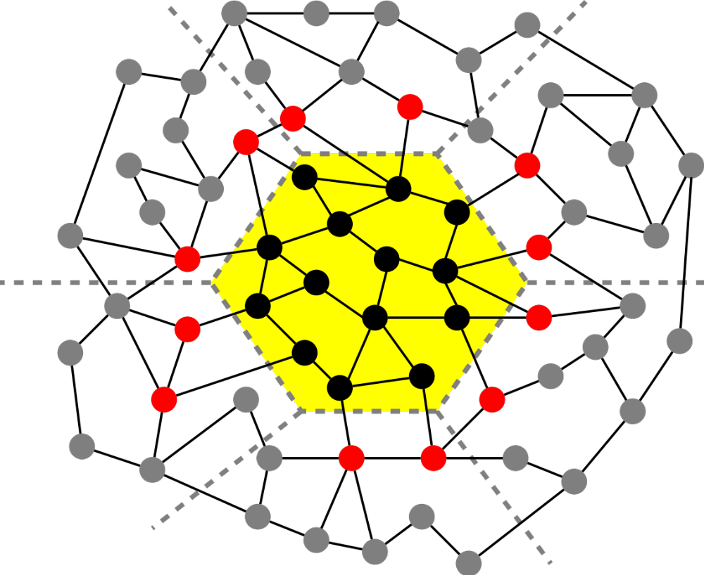
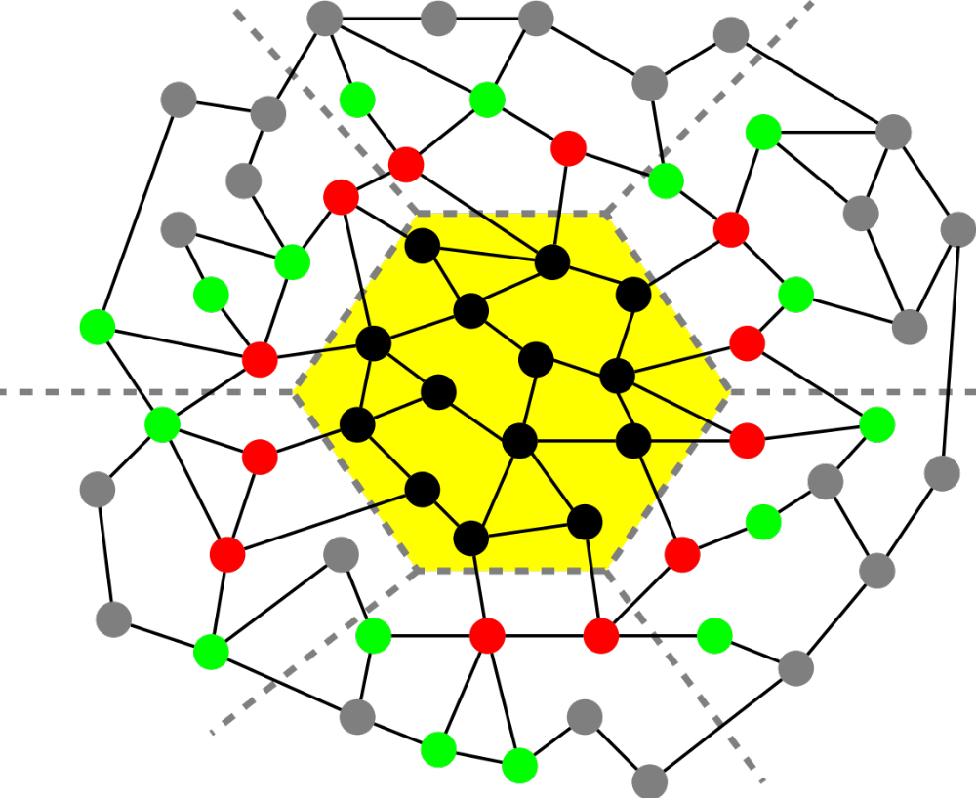
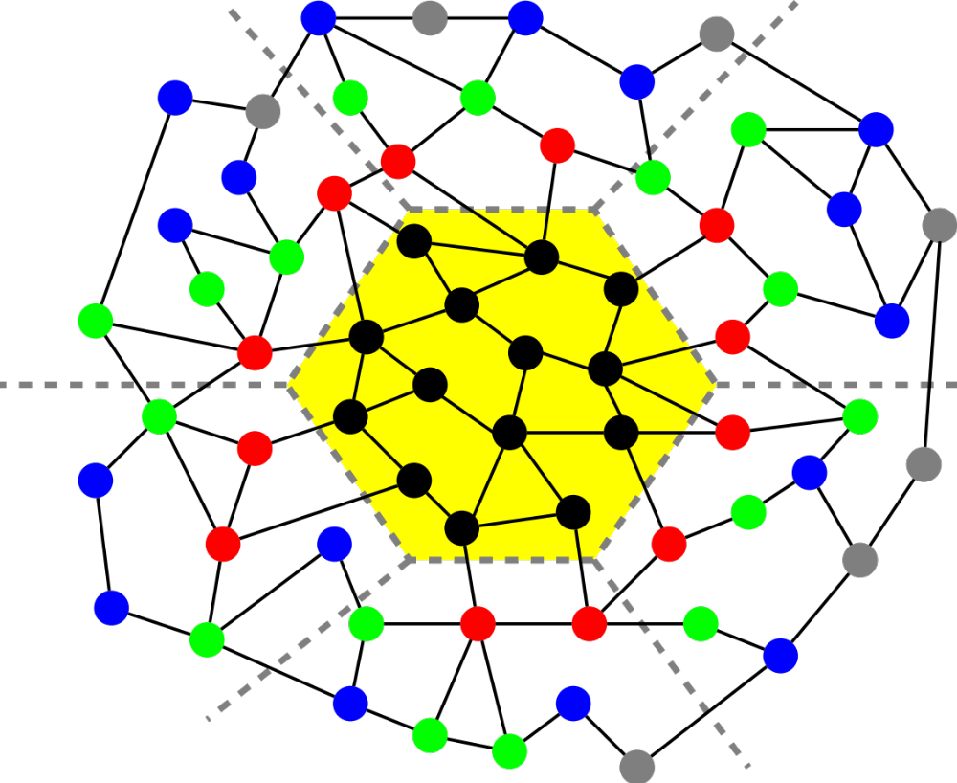
Matrix Powers Kernel on a General Matrix
For implicit memory management (caches) uses a TSP algorithm for layout
Joint work with Jim Demmel, Mark Hoemman, Marghoob Mohiyuddin
Saves communication for “well partitioned” matrices
    Serial: O(1) moves of data moves vs. O(k)
    Parallel: O(log p) messages vs. O(k log p)

Slide 18
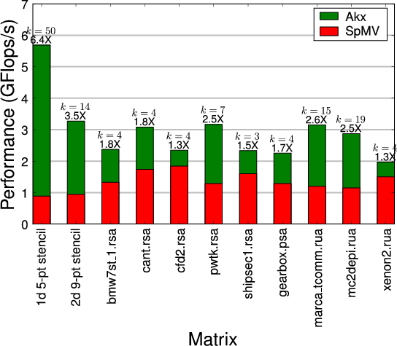
A^{k}x has higher performance than Ax
Speedups on Intel Clovertown (8 core)
Jim Demmel, Mark Hoemmen, Marghoob Mohiyuddin, Kathy Yelick

Slide 19
Minimizing Communication of GMRES to solve Ax=b
GMRES: find x in span{b,Ab,…,A^{k}b} minimizing || Ax-b ||₂
Standard GMRES
for i=1 to k
w = A · v(i-1) … SpMV
MGS(w, v(0),…,v(i-1))
update v(i), H
endfor
solve LSQ problem with H
Communication-avoiding GMRES
W = [ v, Av, A²v, … , A^{k}v ]
[Q,R] = TSQR(W)
… “Tall Skinny QR”
build H from R
solve LSQ problem with H
Sequential case: #words moved decreases by a factor of k
Parallel case: #messages decreases by a factor of k
Oops – W from power method, precision lost!
Mark Hoemmen, PhD thesis
Notes:
19

Slide 20
TSQR: An Architecture-Dependent Algorithm
W₀
W₁
W₂
W₃
R₀₀
R₁₀
R₂₀
R₃₀
R₀₁
Parallel:
W =
R₀₂
R₁₁
W₀
W₁
W₂
W₃
R₀₀
Sequential:
R₀₁
W =
R₀₂
R₀₃
W₀
W₁
W₂
W₃
R₀₀
R₀₁
Dual Core:
R₀₁
W =
R₀₂
R₁₁
R₀₃
R₁₁
Multicore / Multisocket / Multirack / Multisite / Out-of-core: ?
Can choose reduction tree dynamically
Work by Laura Grigori, Jim Demmel, Mark Hoemmen, Julien Langou
Notes:
Oldest reference for idea of tree: Golub/Plemmons/Sameh 1988,
But didn’t avoid communication

Slide 21
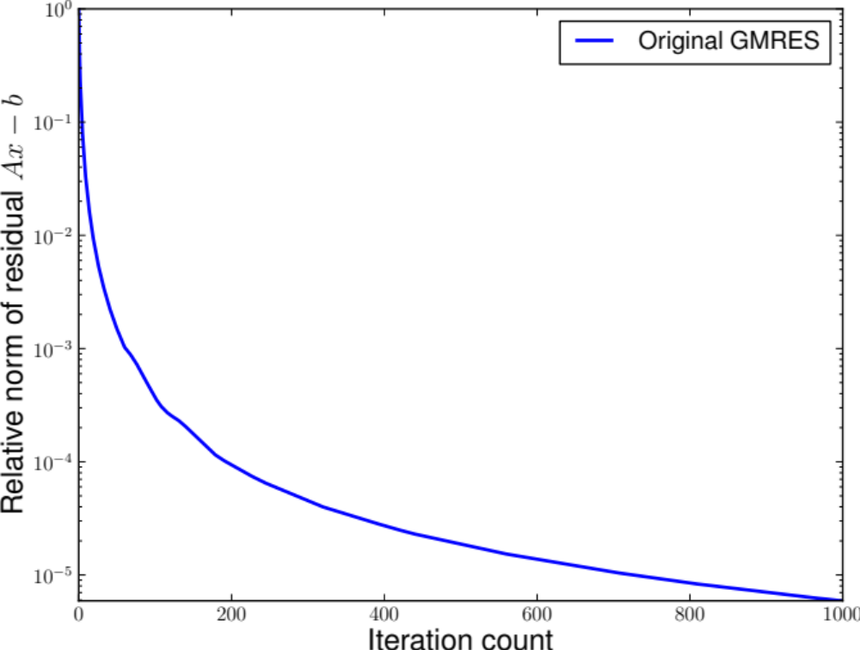
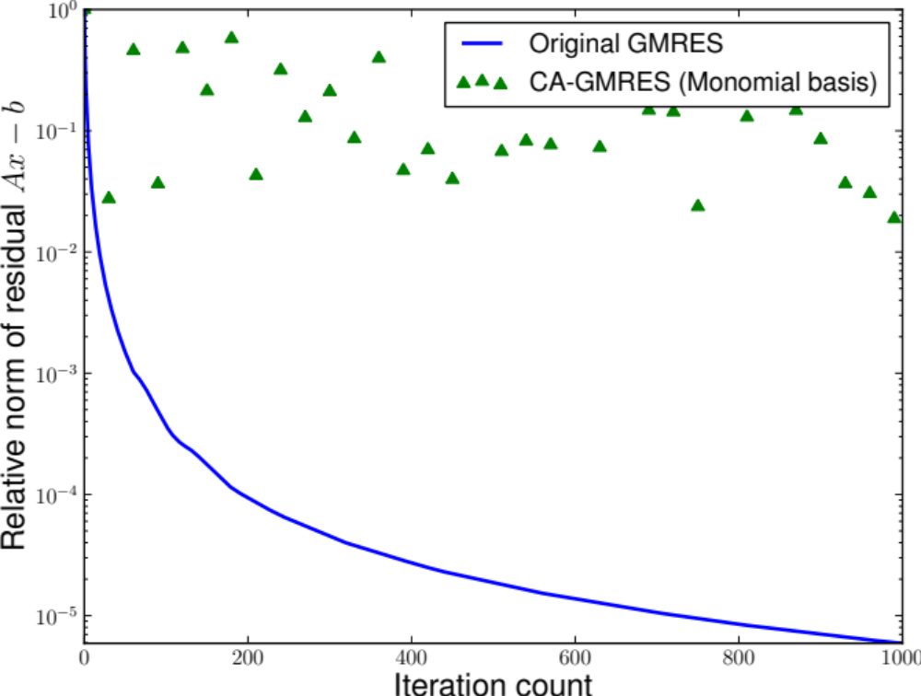
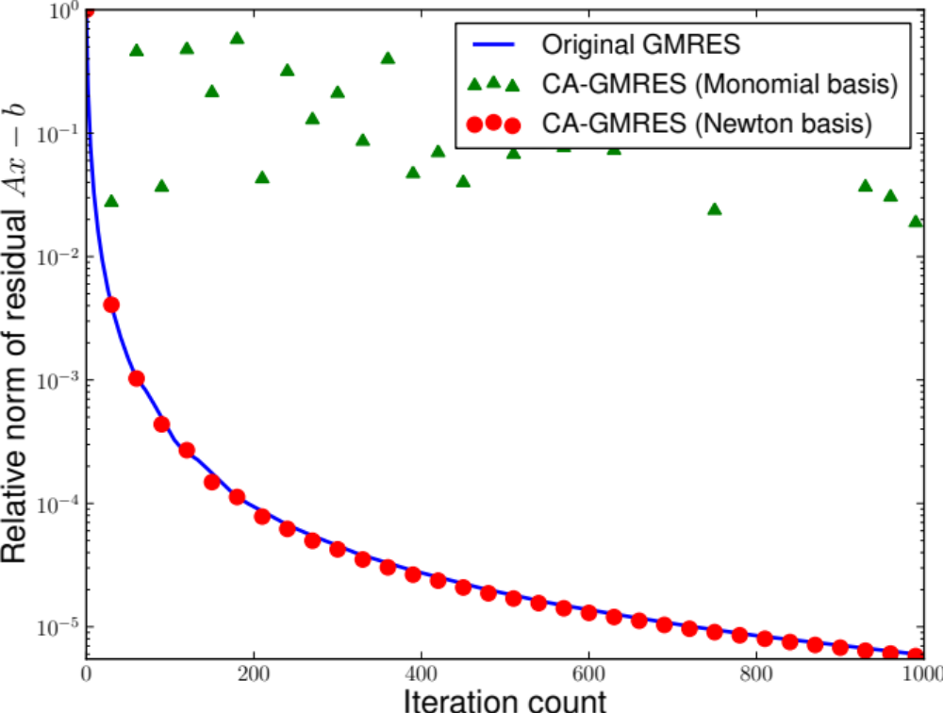
Matrix Powers Kernel (and TSQR) in GMRES
Jim Demmel, Mark Hoemmen, Marghoob Mohiyuddin, Kathy Yelick

Slide 22
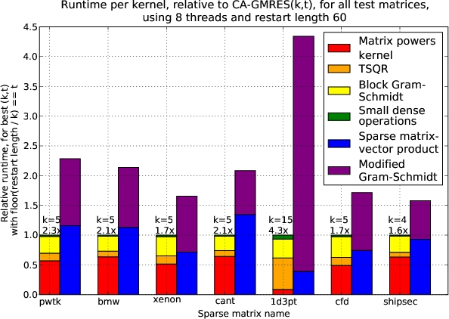
Communication-Avoiding Krylov Method (GMRES)
Performance on 8 core Clovertown

Slide 23
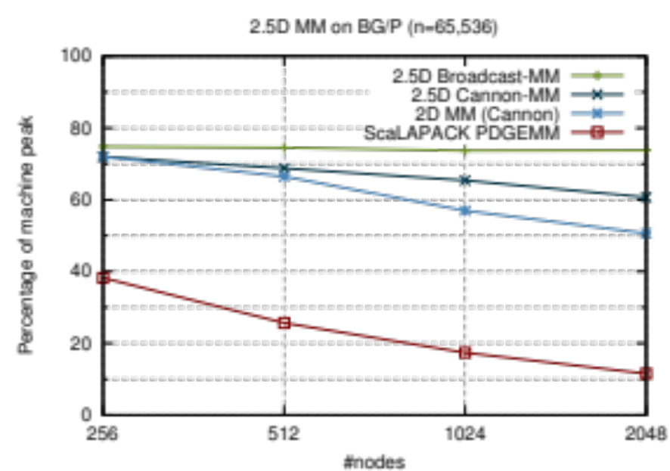
Towards Communication-Avoiding Compilers: Deconstructing 2.5D Matrix Multiply
x
k
y
z
y
z
j
x
i
Matrix Multiplication code has a 3D iteration space
Each point in the space is a constant computation (*/+)
for i, for j, for k
C[i,j] …
A[i,k] …
B[k,j] …
These are not just “avoiding,” they are “communication-optimal”

Slide 24
Generalizing Communication Optimal Transformations to Arbitrary Loop Nests
1.5D N-Body: Replicate and Reduce
The same idea (replicate and reduce) can be used on (direct) N-Body code:
1D decomposition → “1.5D”
Speedup of 1.5D N-Body over 1D
Does this work in general?
Yes, for certain loops and array expressions
Relies on basic result in group theory
Compiler work TBD
A Communication-Optimal N-Body Algorithm for Direct Interactions, Driscoll et al, IPDPS’13

Slide 25
Generalizing Communication Lower Bounds and Optimal Algorithms
For serial matmul, we know #words_moved = Ω (n³/M^{1/2}), attained by tile sizes M^{1/2} x M^{1/2}
  Where do all the ½’s come from?
Thm (Christ,Demmel,Knight,Scanlon,Yelick): For any program that “smells like” nested loops, accessing arrays with subscripts that are linear functions of the loop indices, #words_moved = Ω (#iterations/Me), for some e we can determine
Thm (C/D/K/S/Y): Under some assumptions, we can determine the optimal tiles sizes
Long term goal: All compilers should generate communication optimal code from nested loops
Notes:
Linear functions of the loop indices means subscripts can be j, j+3*k, 7*i-2*j+4*k, etc.
“Smells like” nested loops means sparse accesses, pointer references, etc are ok.
For example, this includes not just linear algebra, but direct n-body, database join, etc.
The theory to determine e requires some recent deep mathematical results using functional analysis
and group theory, due to a team of pure mathematicians including Mike Christ @ Berkeley, Terry Tao @UCLA, others.
The original characterization of e was not necessarily even decidable (Hilbert’s 10th problem over rationals), but
We think it is now decidable (still writing it up).
The assumptions in the second theorem are that
Dependencies permit us to reorder loop iterations as needed (matmul being an example)
Array subscripts are just subset of the loop indices (again like matmul, where loop indices are i,j,k, and
Subscripts are A(i,k), B(k,j), C(i,j)
We are still working on generalizing these assumptions.

Slide 26
Communication Overlap Complements Avoidance
Even with communication-optimal algorithms (minimized bandwidth) there are still benefits to overlap and other things that speed up networks
Communication Avoiding and Overlapping for Numerical Linear Algebra, Georganas et al, SC12

Slide 27
Optimality of Communication
Lower bounds, (matching) upper bounds (algorithms) and a question:
Can we train compilers to do this?
See: http://www.eecs.berkeley.edu/Pubs/TechRpts/2013/EECS-2013-61.pdf

Slide 28
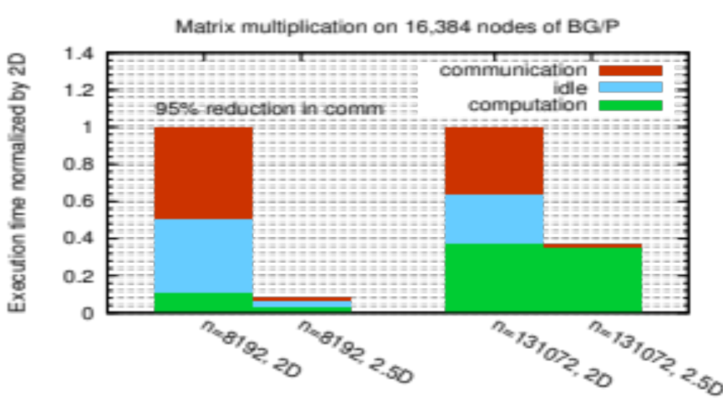
Beyond Domain Decomposition
2.5D Matrix Multiply on BG/P, 16K nodes / 64K cores
c = 16 copies
Surprises:
Even Matrix Multiply had room for improvement
Idea: make copies of C matrix (as in prior 3D algorithm, but not as many)
Result is provably optimal in communication
Lesson: Never waste fast memory
Can we generalize for compiler writers?
EuroPar’11 (Solomonik, Demmel)
SC’11 paper (Solomonik, Bhatele, Demmel)

Slide 29
Towards Communication-Avoiding Compilers: Deconstructing 2.5D Matrix Multiply
k
Tiling the iteration space
Compute a subcube
Will need data on faces (projection of cube, subarrays)
For s loops in the nest ➔ s dimensional space
For x dimensional arrays, project to x dim space
j
i
Matrix Multiplication code has a 3D iteration space
Each unit cube in the space is a constant computation (*/+)
for i
for j
for k
C[i,j] …
A[i,k] …
B[k,j] …

Slide 30
Deconstructing 2.5D Matrix Multiply
Solomonik & Demmel
x
Tiling in the k dimension
k loop has dependencies because C (on the top) is a Left-Hand-Side variable
C += ..
Advantages to tiling in k:
  More parallelism →
  Less synchronization
  Less communication
y
k
z
y
z
x
j
i
What happens to these dependencies?
All dependencies are vertical k dim (updating C matrix)
Serial case: compute vertical block column in order
Parallel case:
  2D algorithm (and compilers): never chop k dim
  2.5 or 3D: Assume + is associative; chop k, which implies replication of C matrix

Slide 31
Beyond Domain Decomposition
Much of the work on compilers is based on owner-computes
  For MM: Divide C into chunks, schedule movement of A/B
  In this case domain decomposition becomes replication
Ways to compute C “pencil”
  Serially
  Parallel reduction
  Parallel asynchronous (atomic) updates
  Or any hybrid of these
For what types / operators does this work?
  “+” is associative for 1,2 rest of RHS is “simple”
  and commutative for 3
x += …
x += …
x += …
Standard vectorization trick
x += …
Using x for C[i,j] here

Slide 32
Lower Bound Idea on C = A*B
Iromy, Toledo, Tiskin
x
“C shadow”
k
y
z
y
j
z
“B shadow”
x
“A shadow”
i
“Unit cubes” in black box with
side lengths x, y and z
= Volume of black box
= x*y*z
= (#A□s * #B□s * #C□s )^{1/2}
= ( xz * zy * yx)^{1/2}
(i,k) is in “A shadow” if (i,j,k) in 3D set
(j,k) is in “B shadow” if (i,j,k) in 3D set
(i,j) is in “C shadow” if (i,j,k) in 3D set
Thm (Loomis & Whitney, 1949)
# cubes in 3D set = Volume of 3D set
≤ (area(A shadow) * area(B shadow) *
area(C shadow)) ^{1/2}

Slide 33
Lower Bound: What is the minimum amount of communication required?
Load
Proof from Irony/Toledo/Tiskin (2004)
Assume fast memory of size M
Outline (big-O reasoning):
  Segment instruction stream, each with M loads/stores
  Somehow bound the maximum number of flops that can be done in each segment, call it F
  So F · # segments ≥ T = total flops = 2·n³, so # segments ≥ T / F
  So # loads & stores = M · #segments ≥ M · T / F
How much work (F) can we do with O(M) data?
Load
Segment 1
Load
FLOP
Store
FLOP
Segment 2
Load
Load
Load
Time
FLOP
FLOP
Segment 3
FLOP
Store
Store
FLOP
Store
Load
FLOP
...

Slide 34
Recall optimal sequential Matmul
Naïve code
for i=1:n, for j=1:n, for k=1:n, C(i,j)+=A(i,k)*B(k,j)
“Blocked” code
for i1 = 1:b:n, for j1 = 1:b:n, for k1 = 1:b:n
for i2 = 0:b-1, for j2 = 0:b-1, for k2 = 0:b-1
i=i1+i2, j = j1+j2, k = k1+k2
C(i,j)+=A(i,k)*B(k,j)
Thm: Picking b = M^{1/2} attains lower bound:
#words_moved = Ω(n³/M^{1/2})
Where does 1/2 come from? Can we compute these for arbitrary programs?
b x b matmul

Slide 35
Generalizing Communication Lower Bounds and Optimal Algorithms
For serial matmul, we know #words_moved = Ω (n³/M^{1/2}), attained by tile sizes M^{1/2} x M^{1/2}
Thm (Christ,Demmel,Knight,Scanlon,Yelick): For any program that “smells like” nested loops, accessing arrays with subscripts that are linear functions of the loop indices
#words_moved = Ω (#iterations/Me)
for some e we can determine
Thm (C/D/K/S/Y): Under some assumptions, we can determine the optimal tiles sizes
  E.g., index expressions are just subsets of indices
Long term goal: All compilers should generate communication optimal code from nested loops
Notes:
Linear functions of the loop indices means subscripts can be j, j+3*k, 7*i-2*j+4*k, etc.
“Smells like” nested loops means sparse accesses, pointer references, etc are ok.
For example, this includes not just linear algebra, but direct n-body, database join, etc.
The theory to determine e requires some recent deep mathematical results using functional analysis
and group theory, due to a team of pure mathematicians including Mike Christ @ Berkeley, Terry Tao @UCLA, others.
The original characterization of e was not necessarily even decidable (Hilbert’s 10th problem over rationals), but
We think it is now decidable (still writing it up).
The assumptions in the second theorem are that
Dependencies permit us to reorder loop iterations as needed (matmul being an example)
Array subscripts are just subset of the loop indices (again like matmul, where loop indices are i,j,k, and
Subscripts are A(i,k), B(k,j), C(i,j)
We are still working on generalizing these assumptions.

Slide 36
New Theorem applied to Matmul
for i=1:n, for j=1:n, for k=1:n, C(i,j) += A(i,k)*B(k,j)
Record array indices in matrix Δ
Solve LP for x = [xi,xj,xk]^{T}: max 1^{T}x s.t. Δ x ≤ 1
  Result: x = [1/2, 1/2, 1/2]^{T}, 1^{T}x = 3/2 = s_{HBL}
Thm: #words_moved = Ω(n³/M^{SHBL-1})= Ω(n³/M^{1/2})
Attained by block sizes M^{xi},M^{xj},M^{xk} = M^{1/2},M^{1/2},M^{1/2}
 | i | j | k
 | 1 | 0 | 1 | A
Δ = | 0 | 1 | 1 | B
 | 1 | 1 | 0 | C

Slide 37
New Theorem applied to Direct N-Body
for i=1:n, for j=1:n, F(i) += force( P(i) , P(j) )
Record array indices in matrix Δ
Solve LP for x = [xi,xj]^{T}: max 1^{T}x s.t. Δ x ≤ 1
  Result: x = [1,1], 1^{T}x = 2 = s_{HBL}
Thm: #words_moved = Ω(n²/M^{SHBL-1})= Ω(n²/M¹)
Attained by block sizes M^{xi},M^{xj} = M¹,M¹
 | i | j
 | 1 | 0 | F
Δ = | 1 | 0 | P(i)
 | 0 | 1 | P(j)

Slide 38
New Theorem applied to Random Code
for i1=1:n, for i2=1:n, … , for i6=1:n
A1(i1,i3,i6) += func1(A2(i1,i2,i4),A3(i2,i3,i5),A4(i3,i4,i6))
A5(i2,i6) += func2(A6(i1,i4,i5),A3(i3,i4,i6))
Record array indices
in matrix Δ
Solve LP for x = [x1,…,x7]^{T}: max 1^{T}x s.t. Δ x ≤ 1
  Result: x = [2/7,3/7,1/7,2/7,3/7,4/7], 1^{T}x = 15/7 = s_{HBL}
Thm: #words_moved = Ω(n⁶/M^{SHBL-1})= Ω(n⁶/M^{8/7})
Attained by block sizes M^{2/7},M^{3/7},M^{1/7},M^{2/7},M^{3/7},M^{4/7}
 | i1 | i2 | i3 | i4 | i5 | i6
 | 1 | 0 | 1 | 0 | 0 | 1 | A1
 | 1 | 1 | 0 | 1 | 0 | 0 | A2
Δ = | 0 | 1 | 1 | 0 | 1 | 0 | A3
 | 0 | 0 | 1 | 1 | 0 | 1 | A3,A4
 | 0 | 1 | 0 | 0 | 0 | 1 | A5
 | 1 | 0 | 0 | 1 | 1 | 0 | A6

Slide 39
General Communication Bound
Given S subset of Z^{k}, group homomorphisms φ₁, φ₂, …, bound |S| in terms of |φ₁(S)|, |φ₂(S)|, … , |φ_{m}(S)|
Def: Hölder-Brascamp-Lieb LP (HBL-LP) for s₁,…,s_{m}:
for all subgroups H < Z^{k}, rank(H) ≤ Σ_{j} s_{j}*rank(φ_{j}(H))
Thm (Christ/Tao/Carbery/Bennett): Given s₁,…,s_{m}
|S| ≤ Π_{j} |φ_{j}(S)|^{sj}
Thm: Given a program with array refs given by φ_{j}, choose s_{j} to minimize s_{HBL} = Σ_{j} s_{j} subject to HBL-LP. Then
#words_moved = Ω (#iterations/M^{sHBL-1})
Notes:
Note: there are infinitely many subgroups H, but only finitely many possible constraints
Michael Chris (UCB), Terry Tao (UCLA), Anthony Carbery (Edinburgh), Jonathan Bennett (Birmingham),
Published in Geometric Functional Analysis, 2008

Slide 40
Comments
Attainability depends on loop dependencies
Best case: none, or associative operators (matmul, nbody)
Thm: When all φ_{j} = {subset of indices}, dual of HBL-LP gives optimal tile sizes:
HBL-LP: minimize 1^{T}*s s.t. s^{T}*Δ ≥ 1^{T}
Dual-HBL-LP: maximize 1^{T}*x s.t. Δ*x ≤ 1
Then for sequential algorithm, tile i_{j} by M^{xj}
Ex: Matmul: s = [ 1/2 , 1/2 , 1/2 ]^{T} = x
Generality:
  Extends to unimodular transforms of indices
  Does not require arrays (as long as the data structures are injective containers)
  Does not require loops as long as they can model computation

Slide 41
Conclusions
Communication is expensive and (relative) cost is growing
  Avoid bandwidth (data volume)
  Hide latency or reduce number of messages
Conceptual model
  Think of computation a set of points in a volume in d-space (d = # loops in nest)
  What is maximum amount you can do for a fixed surface area
Theory
  Lower bounds are useful to understand limits
  Many programs (index expressions) still open for upper bounds

Slide 42
Bonus Slide #1: Beyond UPC
DAG Scheduling in a distributed (partitioned) memory context
Assignment of work is static; schedule is dynamic
Ordering needs to be imposed on the schedule
  Critical path operation: Panel Factorization
General issue: dynamic scheduling in partitioned memory
  Can deadlock in memory allocation
  “memory constrained” lookahead
Uses a Berkeley extension to UPC to remotely synchronize
some edges omitted

Slide 43
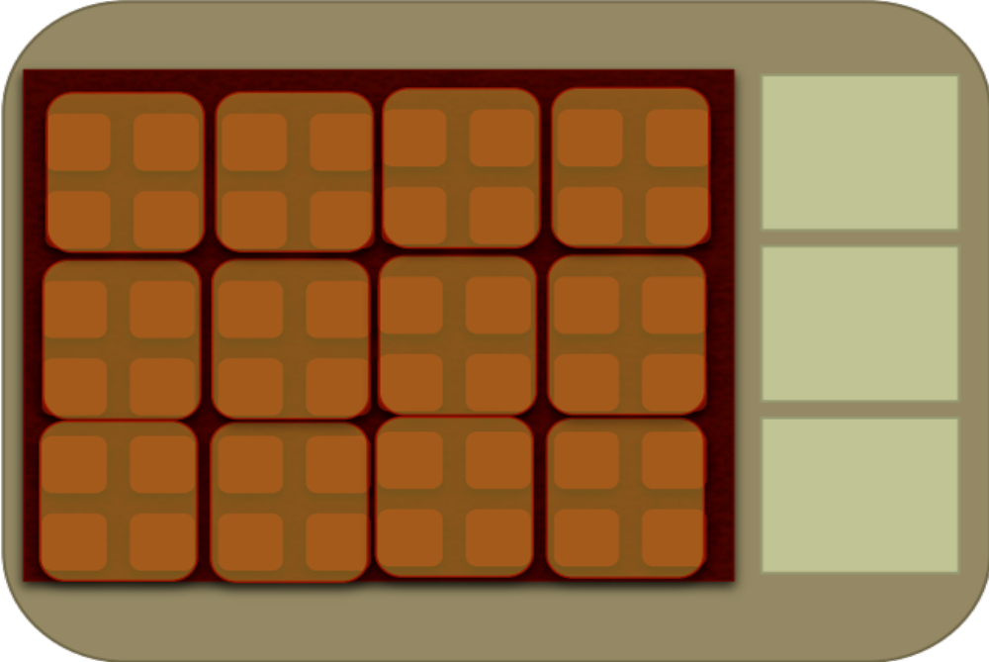
Bonus slide #2: Emerging Fast Forward Exascale Node Architecture
System on Chip (SoC) design coming into focus
Memory Stacks
on package
Low Capacity
High Bandwidth
Slide from John Shalf
Fat Core
Latency
Optimized
Thin/Accelerator Cores
(tiny, simple, massively parallel)
Throughput -Optimized
Memory
DRAM/DIMMS
Memory
High Capacity Low Bandwidth
NVRAM: Burst Buffers / rack-local storage
NIC on Board

