Slide 1
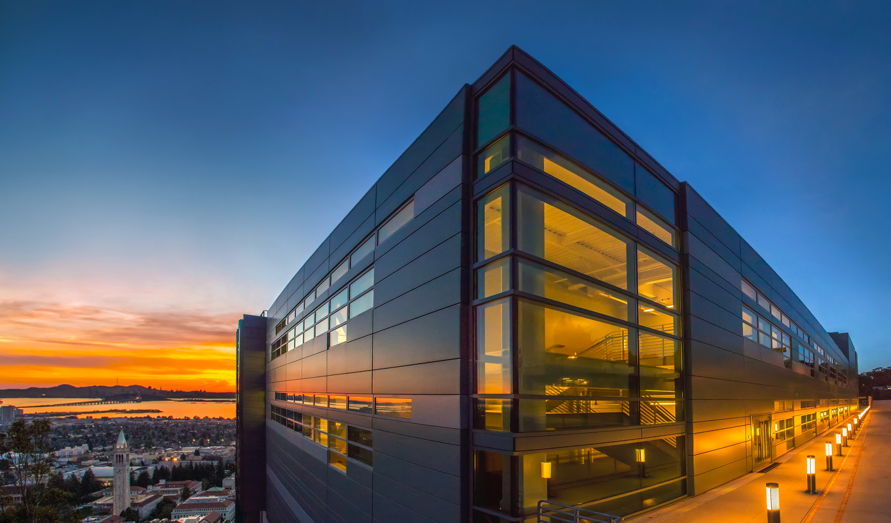


HPC for Genomic Data at Scale
Kathy Yelick
Associate Laboratory Director
Computing Sciences
Professor of Electrical Engineering and Computer Sciences, UC Berkeley

Slide 2
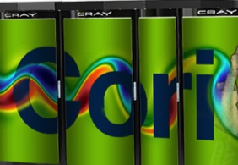
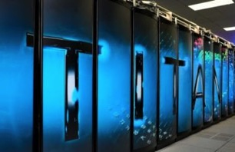
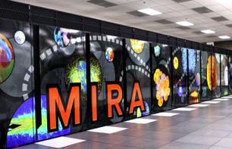

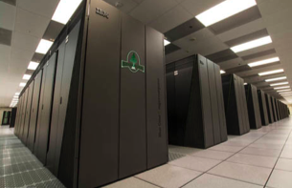
DOE leadership in HPC
Cori at LBNL
Titan at ORNL
Mira at ANL
Cielo at LANL/SNL
Sequoia at LLNL
DOE leads High Performance Computing in the US
Capabilities for science, engineering, and defense
Expertise in mathematics, computer science, modeling and simulation and data analytics

Slide 3

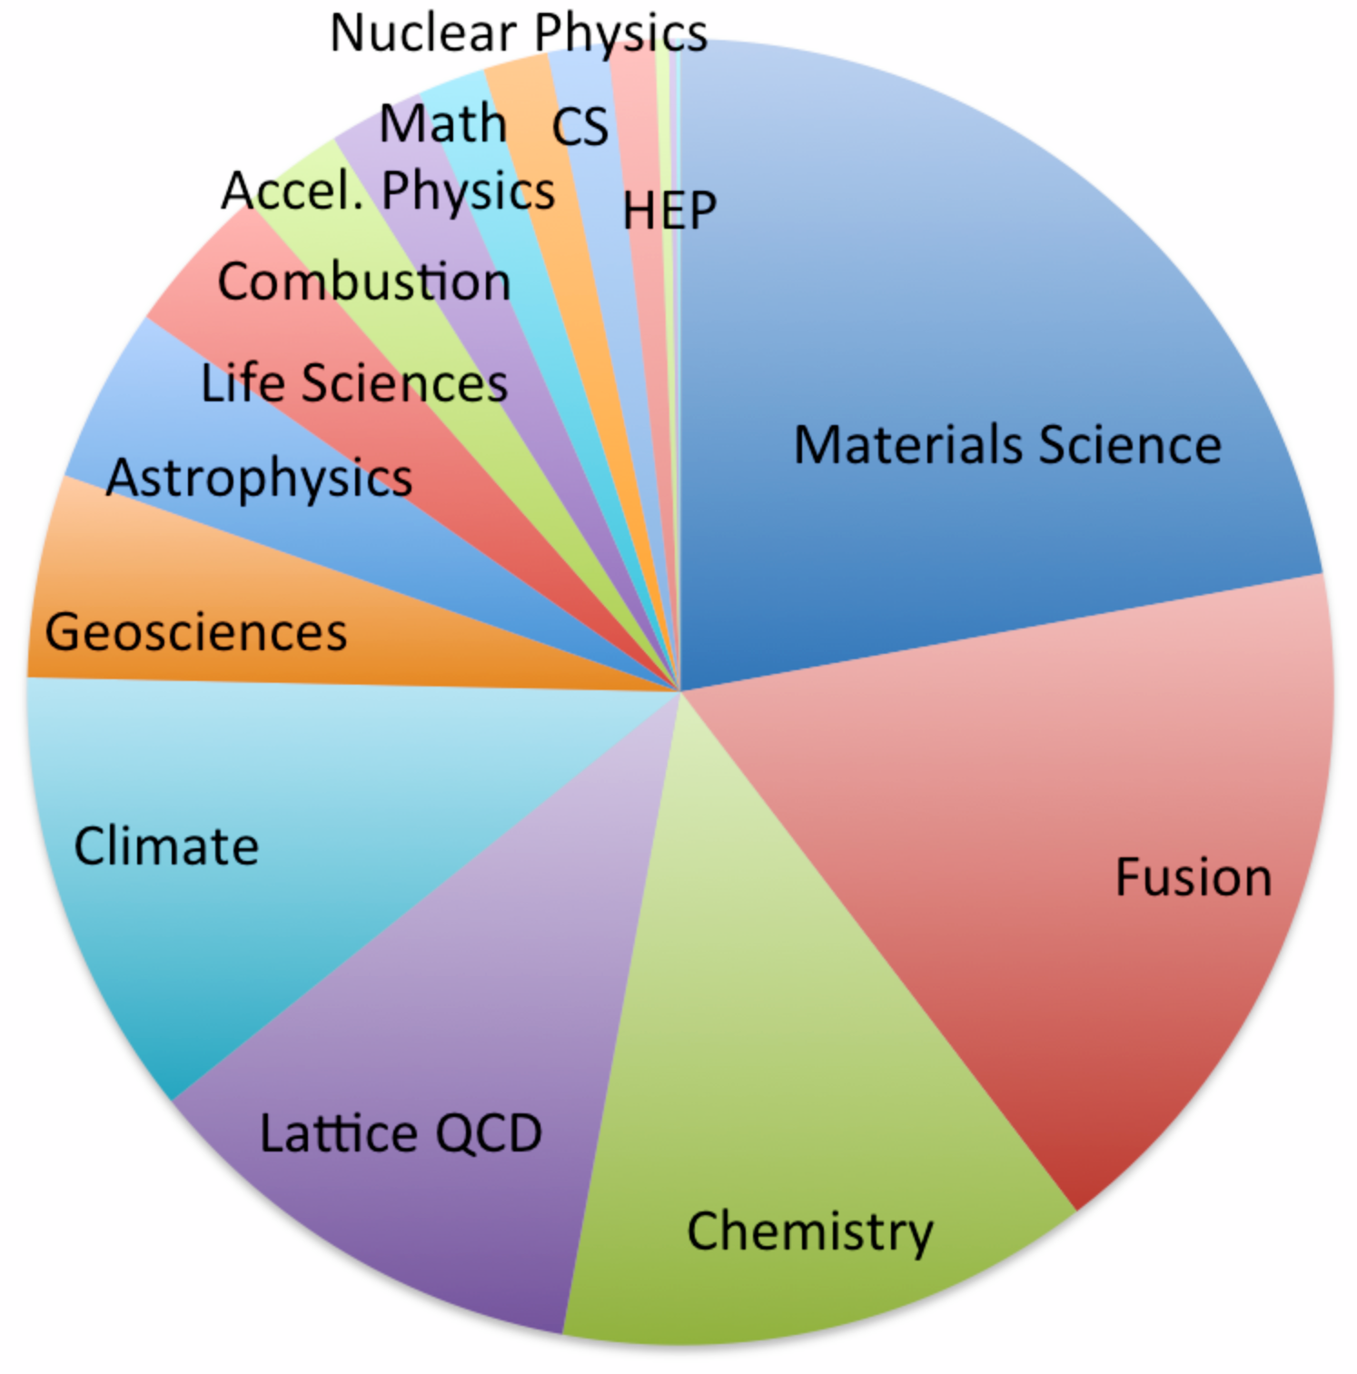
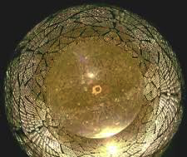
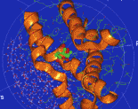

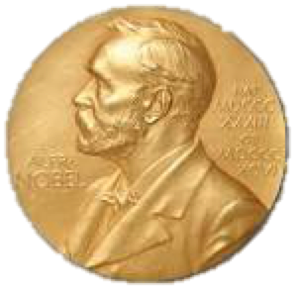
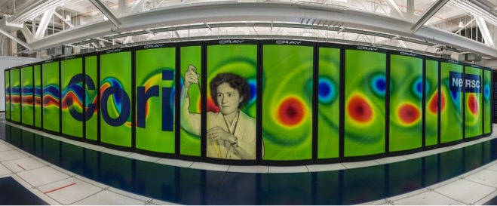
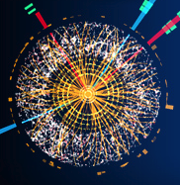
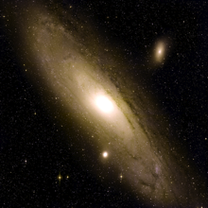
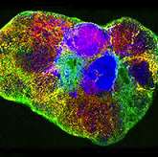
NERSC: Dedicated to DOE Science
Biology
Earth Systems
> 7000 users, 700 application codes
> 2000 annual publications; 6 Nobels
Systems architected for science
History of data-intensive science
Notes:
5 Nobels: Smoot, Perlmutter, IPCC, Karplus, SNO collaboration (MacDonald, neutrinos)

Slide 4
Myths of Genomics and HPC
(And a bit of computer science along the way)

Slide 5
Myth #1: Genomic assembly requires large shared memory machines
HPC systems can look like shared memory if you use the right algorithms and programming models

Slide 6
De Novo genome assembly problem
Input
reads
(input, typically 100-250 chars)
GCTACGGAATAAAACCAGGAACAACAGAGCCAGCAC
ATAAAACCAGGTACAACAGACCCAGCACGGATCCA
GC ACGGAATACAACCAGGAACAACAGACCCAGCAC
Multiple copies
(20x typical)
GAACAACAGACCCAGCATGGATCCA
errors
GCTACGGAATAAAACCAGGAACAACAGACCCAGCACGGATCCA
Output
The fully assembled genome (or 10s of Ks of bp fragments so we can find genes, which are typically longer than the reads)

Slide 7
HipMer genome assembly based on Meraculous
reads
K-mer Analysis
Histogram fixed-length fragments with bloom filters
1
k-mers
2) Contig Generation
Build hash table of k-mers and walk as graph
2
contigs
3
3) Alignment
Build a hash table of k-mers in contigs and map to reads (seed-and extend)
read-contig
alignments
contig-contig scaffolds
4
4) Scaffolding & Gap Closing
Build a hash table of contig pairs and merge them (local assembly)
xxx
xx
xxxx
Chapman, Jarrod A., et al. "Meraculous: de novo genome assembly with short paired-end reads." PloS ONE 6.8 (2011)
Notes:
Meta: avoiding using terminology beyond “read”, “kmer”, and “contig”.

Slide 8
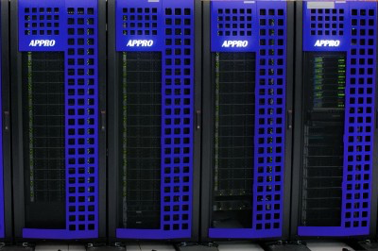
Using HPC for Large Memory Problems
 | GenePool (JGI) Large node | Cori Haswell | Cori KNL
Nodes | 1 | 1630 | 9600
cores / node | 80 cores | 32 cores | 68 cores
Memory / node | 2 TB | 128 GB | 96 GB
Total memory | 2 TB | 299 TB | 1060 TB
Storage | 300 GB (local) | 30PB (global) | 30PB (global)
Interconnect | 1 Gb/sec | 80 Gb/s | 80 Gb/s
Bisection Bandwidth |  | 6 TB/s | 45 TB/s

Slide 9
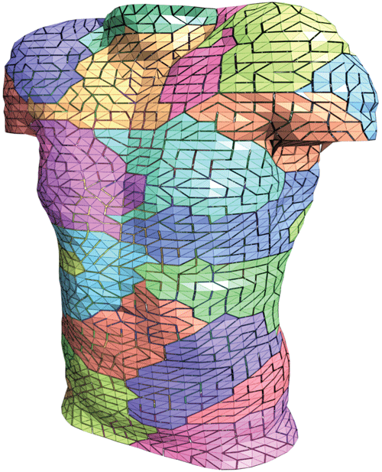
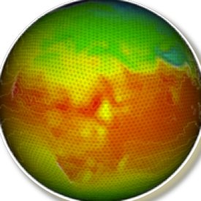
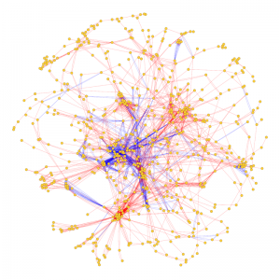
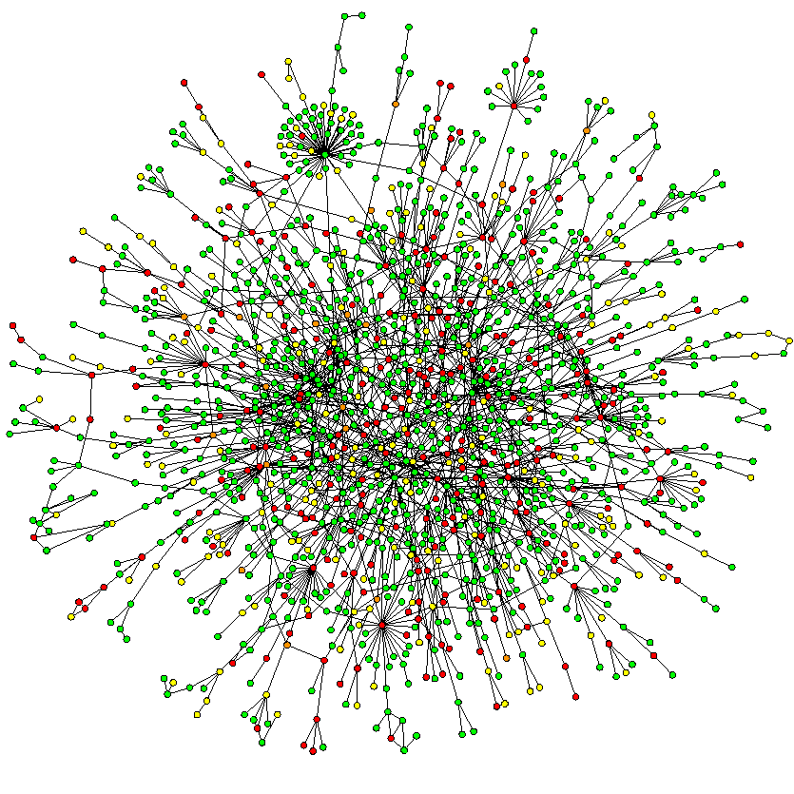
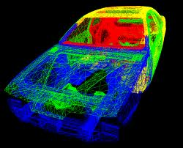
Shared Memory Thinking on Distributed Memory
Message Passing Programming
Divide up domain in pieces
Compute one piece and exchange
MPI, and many libraries
Global Address Space Programming
Each start computing
Grab whatever / whenever
UPC, UPC++, CAF, X10, Global Arrays, Chapel, and more

Slide 10
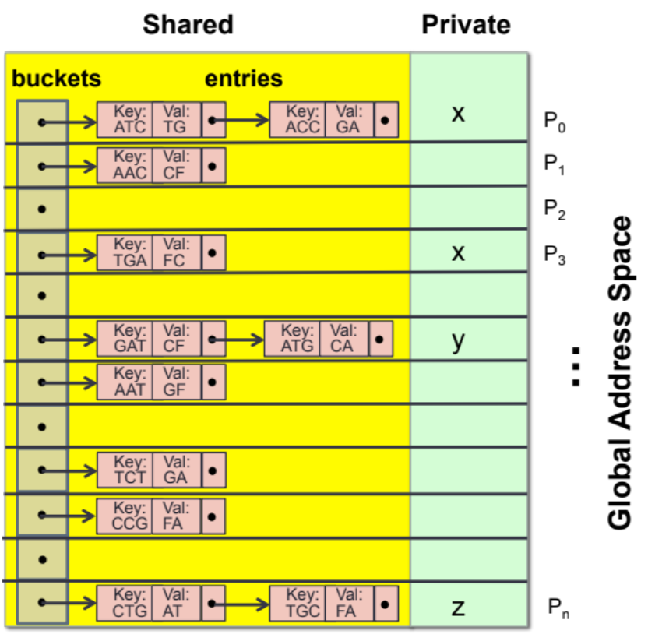
Graph algorithms (hash tables) in assembly
Graph construction, traversal, and all later stages are written in UPC to take advantage of its global address space
Input: k-mers and their high quality extensions
Read k-mers & extensions
Store k-mers & extensions
Distributed
Hash table
AAC CF
ATC TG
ACC GA
TGA FC
GAT CF
AAT GF
ATG CA
TCT GA
CCG FA
CTG AT
TGC FA
P₀
Fine-grained communication & fine-grained locking required
P₁
…
P_{n}

Slide 11
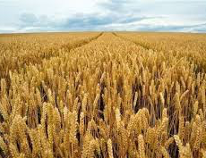
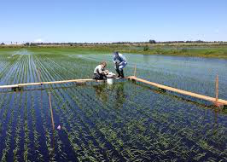
Using HipMer for first-ever science
Assembly of bread wheat genomes
Wheat genome: 17 Gbp
Assembled without chromosome sorting
Over half of contigs > 7 kb and scaffolds > 20 kb
Twitchell Wetlands (preliminary)
  MetaHipMer uses k-mer lengths and new scaffolding approaches
  21 libraries, 7.4B reads, 2.8 TB
  34% reads assembled (vs < 10%)
  First whole assembly of 21 libraries -- largest of its kind?
Chapman, Jarrod A., et al. “ Genome biology (2015)
Notes:
The Twitchell island in CA is being use for multiple studies, including improved carbon sequestration from returning island to freshwater
As far as we know, no one has done a complete assembly of the entire data set, but we need to confirm
Because we are still workign on scaffolding (see left-hand side) and there is a scaling bottleneck in the current scaffolder (see previous milestone) we did the scaffolding step separately
Most of the computation was done on 16K cores as it says above. The scafolder was run on 2 large shared memory nodes.
(Now that we have an approach to scaffolding that we’re happy with for quality, it will go into the parallel code and at the same time parallelize the bottleneck)

Slide 12
Myth #2: Genomic assembly needs large memory, but not large parallelism
Orders of magnitude speedup are possible through parallelism

Slide 13
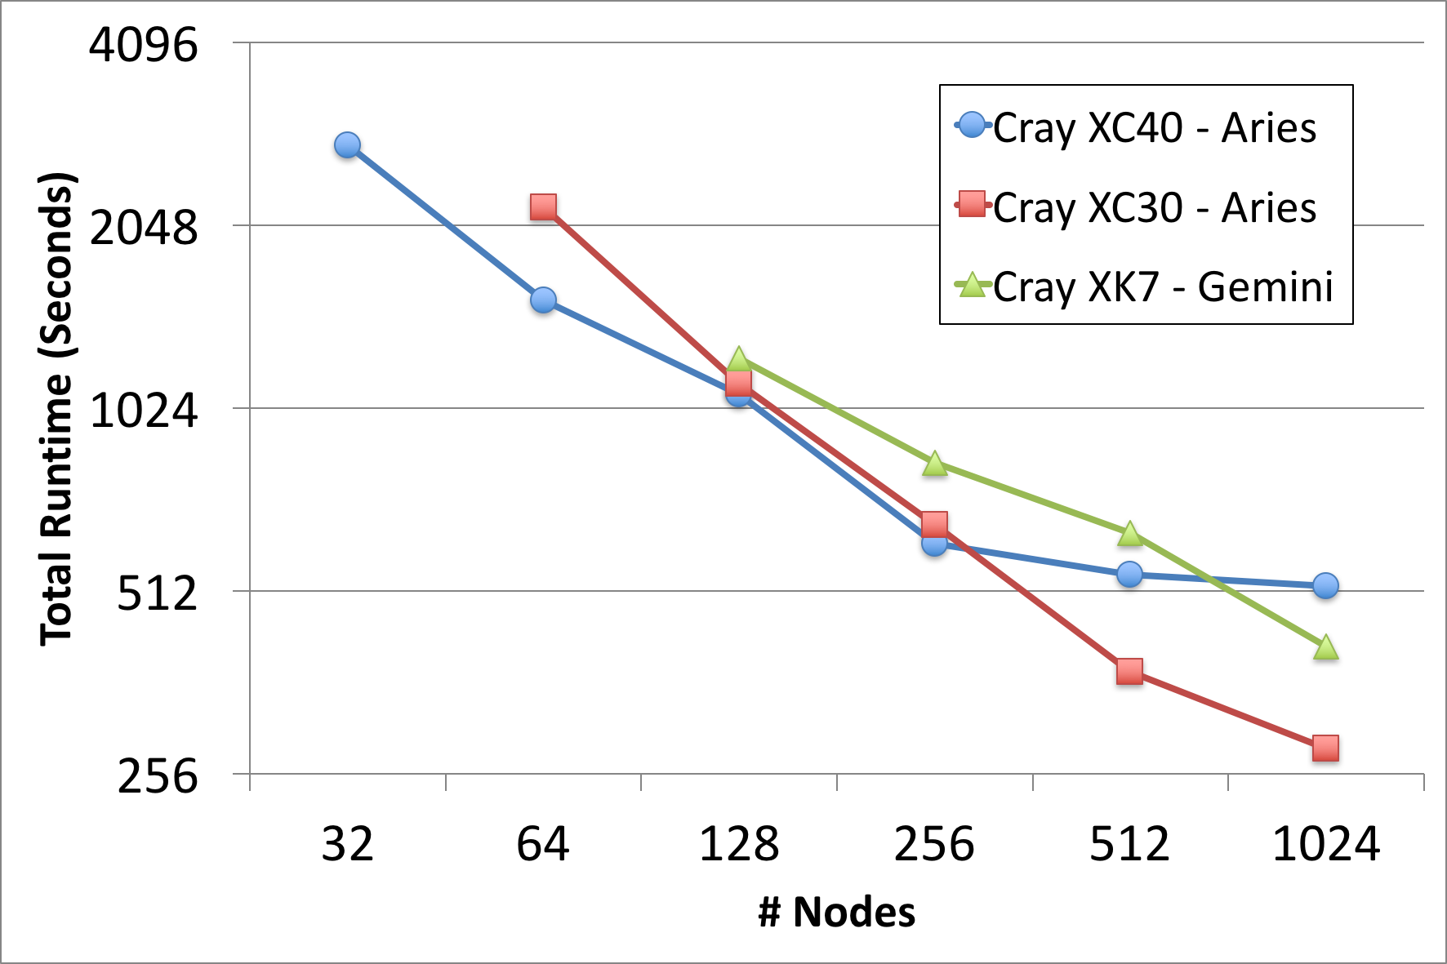
Multi-Node Strong Scaling
HipMer scales to a thousand nodes (10Ks of cores) on a fixed modest sized problem (human genome)
De Novo human assembly in 4 minutes
Uses 1K nodes (24-32K cores)
Shared HPC systems accelerate turnaround
M. Ellis, E. Georganas, R. Egan, S. Hofmeyr, A. Buluc, B. Cook, L. Oliker, K. Yelick, “Performance Characterization of De Novo Genome Assembly on Leading Parallel Systems” Euro Par 2017.

Slide 14
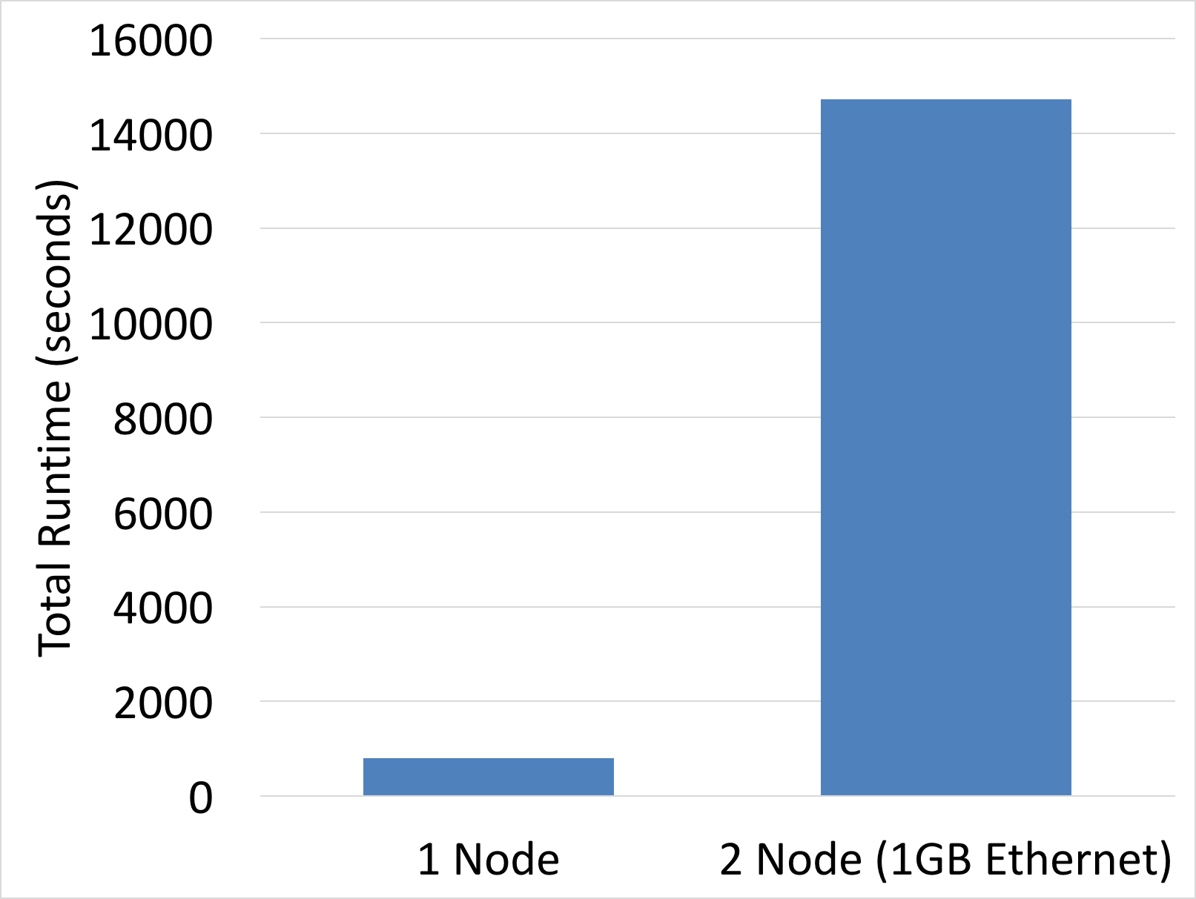
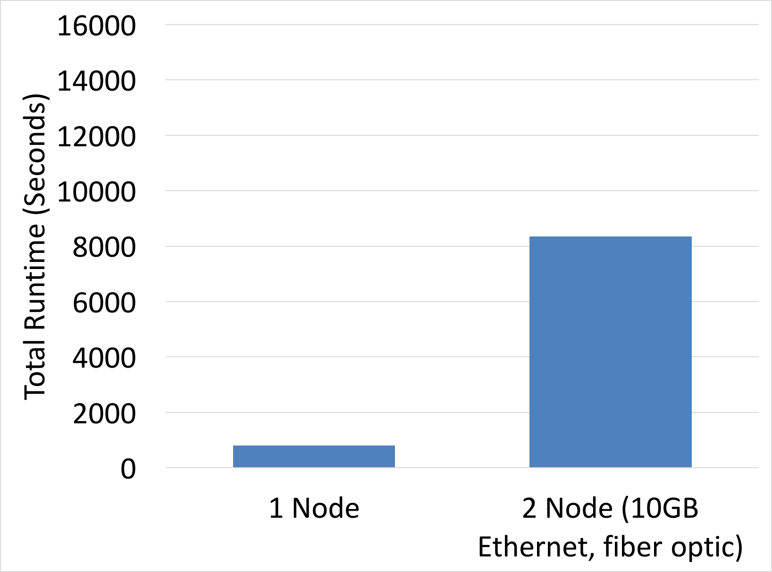
Don’t try this at home … you need an HPC network
Requires fast underlying network (e.g. NOT ethernet)
Ethernet slowdown 18x (on 1Gb switch) and 10x (on 10Gb fiber optic patch)
18x slowdown
10x slowdown
2 Node (10G Ethernet)
Reference: M. Ellis, E. Georganas, R. Egan, S. Hofmeyr, A. Buluc, B. Cook, L. Oliker, K. Yelick, “Performance Characterization of De Novo Genome Assembly on Leading Parallel Systems” Euro Par 2017.

Slide 15
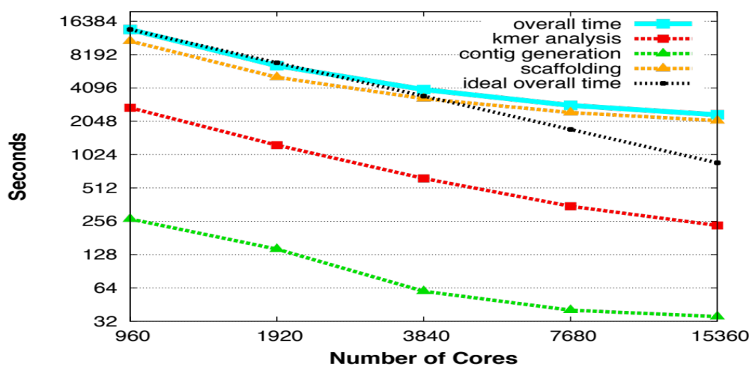
HipMer algorithms scale on and off nodes
WHEAT (on Edison)
Speedup for wheat genomes on up to 15K cores
Chapman, Jarrod A., et al. "Meraculous: de novo genome assembly with short paired-end reads." PloS ONE 6.8 (2011)

Slide 16
MetaHipMer at Scale: Amdahl’s Law Strikes
X24 cores per node
Demonstrated MetaHipMer scalability on 1-lane Wetlands (above) and multiple synthetic metagenome data sets
New connected components oNo removes above bottleneck
New HMM-based scaffolder aids ribosomal assembly

Slide 17
Myth #3: HPC is just about solving the same problems faster
The memory size and speed enables improved quality, new approaches, and new science

Slide 18
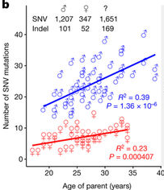
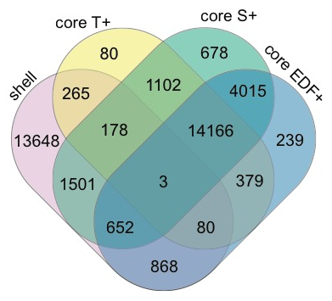
Pan-genome studies reveal intra-species diversity
150 de novo assemblies of individuals in Denmark
Many genes not in reference
91.6% of insertions ≥50 bp were novel
Reveals previous deletion bias
54 de novo assemblies of the grass Brachypodium distachyon
Nearly 2x the number of genes found in any individual genome
Many shell genes species-wide are core within a subpopulation.
L Maretty et al. Nature 1–5 (2017)
Gordon et al. Nature Communications, 2017
Notes:
91.6% of insertions ≥50 bp were novel (..). The distribution of insertion and deletion calls displayed an excess of insertions (..), in contrast to the deletion bias observed in the 1000 Genomes Project and the Genome of the Netherlands19 projects

Slide 19
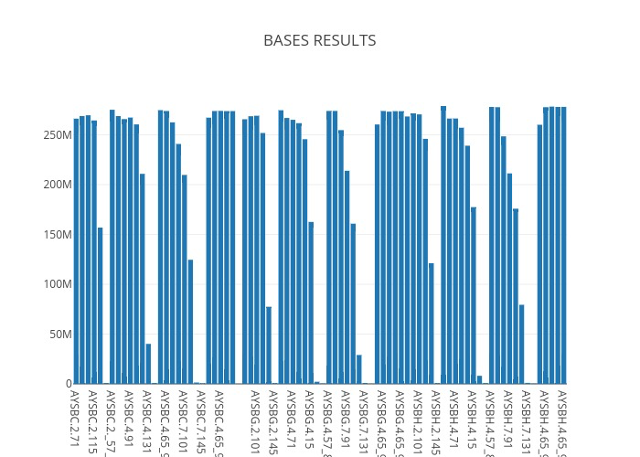
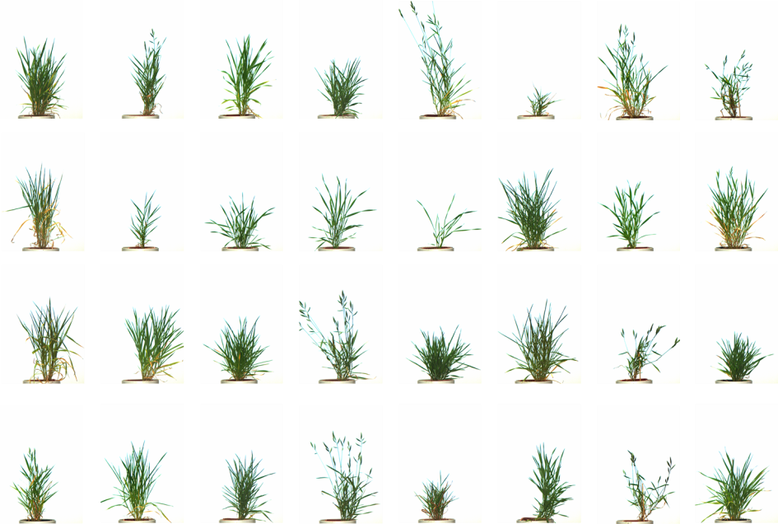
HipMer enables parameter exploration in large genomes
Assembled Genome Size
271 Mb
Brachypodium distachyon: Different populations grown under the same conditions differ in phenotype
Different parameters over 10 samples
Summary from Sean Gordon (JGI, now Zymergen)
HipMer is faster using fewer resources
Iterative kmer size and iterative scaffolding improves assembly metrics
Combining several low depth, related samples, yields good assemblies
Assembled Genome Size
Contig
size distribution
N50
271 Mb
Notes:
271 Mb is the expected size of the genome.
Assembly results for all assemblers depend greatly on input parameters.
HipMer speed allows us to explore parameter space for even large plant genomes!

Slide 20
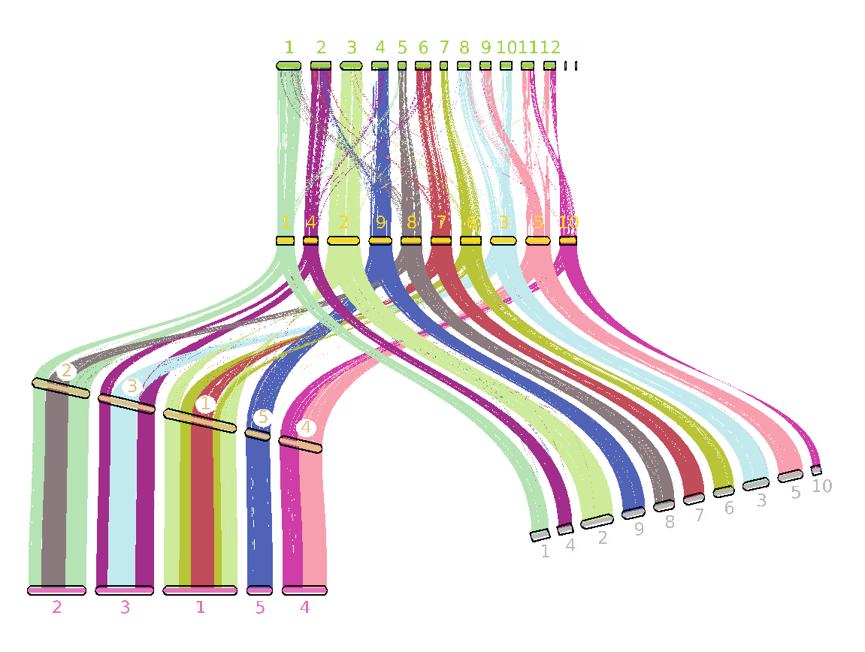
Pan-genomics needs high performance assembly
Assembling many genomes from different populations allows us to capture the majority of genes in the species
Problem: De novo assembly of hundreds of large genomes would take years to compute!
HipMer allows us to make 100s of assemblies
Rice
B. stacei
110 B. distachyon
genomes
B. hybridum
D genome
(8 genomes)
B. hybridum
S genome
(8 genomes)
S. Gordon et al: Bits of the two subgenomes are lost over time in the hybrid -- can study this evolution
Notes:
B. hybridum contains the B. distachyon genome (271 Mb), plus the genome of the closely related B. stacei (240 Mb) species.
Bits and pieces of the two subgenomes are lost over time in the hybrid.
HipMer allows us to make hundreds of assemblies of B. distachyon populations as well as many B. hybridum populations to understand what B. distachyon populations gave rise to different B. hybridum populations and also study how subgenomes have evolved in different B. hybridum populations.

Slide 21
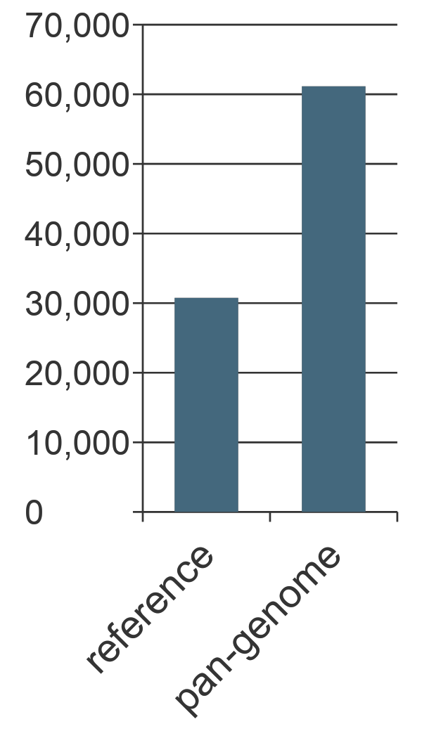
Gene-based pan-genome with clustering
CDS sequences from genes are clustered by an orthoMCL-like algorithm
61,155 pan-genome clusters
Pan-genes = representative sequence per cluster
26,125 pan-genes that are not in the reference genome
Gene clusters
Notes:
All genes from all accessions were clustered using an orthoMCL-like algorithm. The clusters were then collapsed at 90% identity.
The graph in the lower left shows that the number of genes in the pan-genome is about twice the number in the reference genome.
The graph on the right shows how many lines had genes in each cluster. We break the clusters into 4 categories:
Core genes are those that are found in every line
Soft core genes are found in almost every line (at least 53 of the 56 lines)
Shell genes are found in from 3-52 lines
Cloud genes are found in 1 or 2 lines.
We have very high confidence in the core, soft core and shell genes because they were independently found and annotated in at least 3 different genomes.
The cloud genes may contain some genes that are mis-annotated, However, many of them look like real genes, are expressed and match known genes. Nevertheless, to be conservative we excluded them from subsequent analyses.

Slide 22
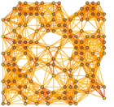
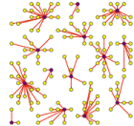
Problem: Identify gene/protein families at scale
A protein family: group of proteins with common evolutionary origin, reflected by similar functions, sequence or structure
Desired scale: 10s of billions of genes/proteins, trillions of nonzero pairwise similarities (“all metagenomes”)
Today: 47M genes took 10 days before aborting (est. 45 days)
Input: pairwise similarities
between proteins (sparse)
Output: clusters of
similar proteins
HipMCL work by Aydın Buluç (ECRP) and Ariful Azad

Slide 23

Scalable Distributed Memory, SpGEMM with Thresholding
Processor Grid
Split B into k pieces
25K
100K
20K
x
=
100K
A
C
B
Parts of the result is produced and pruned
Memory requirement can be significantly reduced by increasing k
However, A is needed to be broadcasted k times
With k=20: MCL ran on 64 nodes of Cori in about 20 minutes

Slide 24
HipMCL is highly scalable
Graph/16 on prior SMP code
Full graph 47M genes (nodes), 10B nonzeros (edges), 1.8 PB
Projected to take 47 days on previous shared memory code
1 hour with HipMCL – 1000x speedup!
Reference: A. Azad, G. Pavlopoulos, C. Ouzounis, N. Kyrpides, and A Buluç. HipMCL: A high-performance parallel implementation of the Markov clustering algorithm for large-scale networks. Nucleic Acids Research, 2018

Slide 25
Using HipMCL for first-ever science
Data | Proteins (x10⁶) | Edges (x10⁹) | Clusters (x10⁶) | time (hr) | Cori KNL nodes
Isolates | 70 | 68 | 2.9 | 2.4 | 2K
Meta-Clust50 | 282 | 37 | 41.5 | 3.2 | 2K
Science impact: HipMCL can easily cluster protein similarity networks with 100 billion edges that were impossible to cluster with prior approaches, enabling unprecedented discovery in Biology.
HPC impact: The computational need in biological clustering is reaching exascale.
Reference: A. Azad, G. Pavlopoulos, C. Ouzounis, N. Kyrpides, and A Buluç. HipMCL: A high-performance parallel implementation of the Markov clustering algorithm for large-scale networks. Nucleic Acids Research, 2018

Slide 26
Myth #4: Genome alignment should be done in a cloud or a cheap cluster
Depends on the size of the data, especially the reference

Slide 27
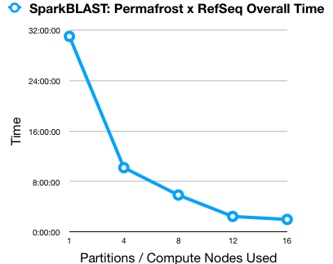
Speeding up sequence comparison across nodes
BLAST is ~41% of the JGI computing workload
BLAST is pleasingly parallel – can be broken into independent chunks
Widely-used tool for distributing compute tasks
SparkBLAST implementation by Chris Beecroft, Data Management Group, Genomic Technologies
Figure: SparkBLAST is ~15X faster on 16 nodes than on a single core enabling significantly higher throughput
Notes:
Explain pleasingly parallel… tasks distribution is relatively straightforward

Slide 28
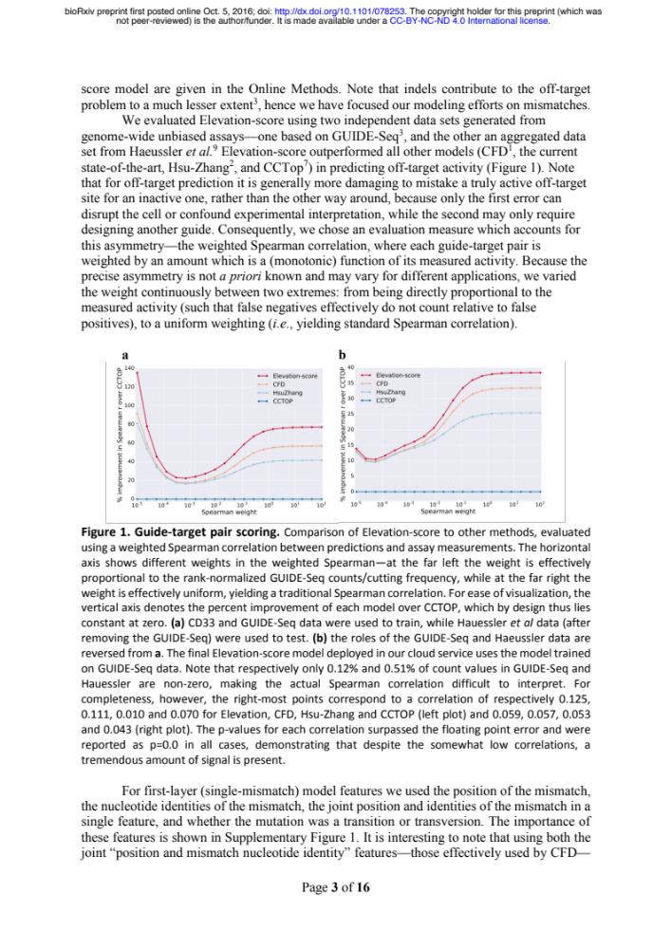
Target and Off-Target CRISPR guide analyses
Finds both desired targets and (unintentional) off-targets
Used seed-and-extend algorithm (also in HipMer)
  Build an index of them using fixed-length seeds
  Locate matches (tandem in CRISPR work)
  Extend (e.g. Smith-Waterman), which could run on GPUs
They use 3 week on 15K cores for 1 human genome and single guide!
J. Listgarten et al, Nature Biomedical Engineering (2018)

Slide 29
merAligner for large / dynamic references
Reads
(queries)
Contig
Design philosophy: merAligner used in HipMer parallelizes the end-to-end
Each processor is assigned a portion of the contigs (reference)
Processors build a global distributed seed index of the contigs in parallel
  Optimization: Aggregating stores optimization.
Each processor is assigned one portion of the reads:
  Extracts seeds and performs lookups in the distributed seed index.
  Fetches candidate contigs and locally performs alignments

Slide 30
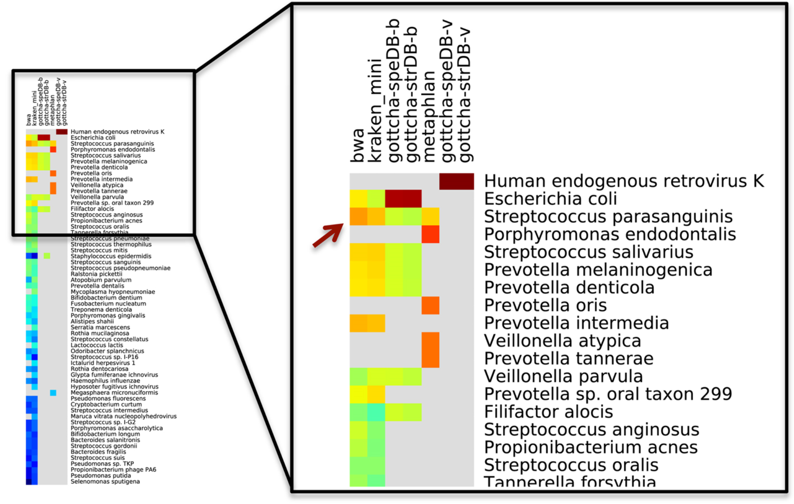
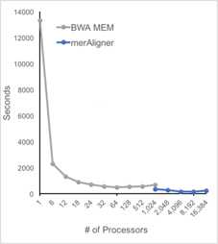
GOTTCHA Metagenome Comparison Tool
Represents metagenome by taxonomy
  Expensive all-to-all against database
  Uses MerAligner (HPC aligner in HipMer)
Patrick Chain’s group at LANL; MerAlinger integration by Migun Shakya (LANL) with Steve Hofmeyr (LBNL)

Slide 31
Myth #5: Machine Learning doesn’t need HPC
Large-scale statistical models, including both deep and traditional learning can benefit

Slide 32
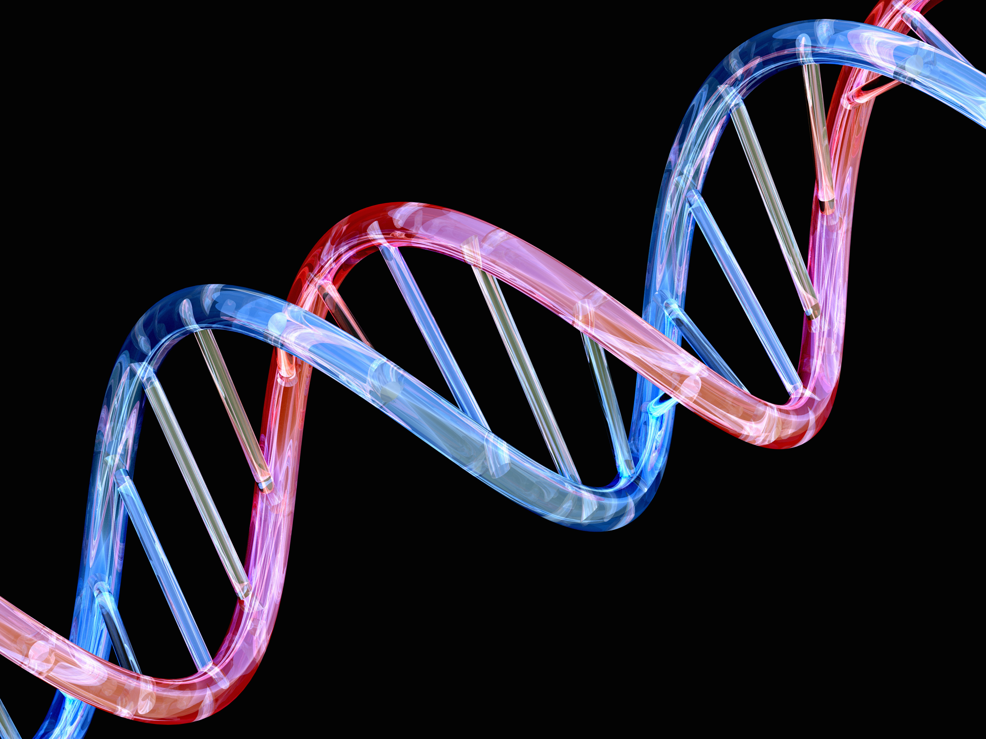

Learn the relationship between features with Graphical Model Estimator
Source: https://media4.s-nbcnews.com/i/newscms/2017_25/958456/150401-dna-strand-mn-1645_9d74198e59853eb79be3124a876ad4fd.jpg

Slide 33
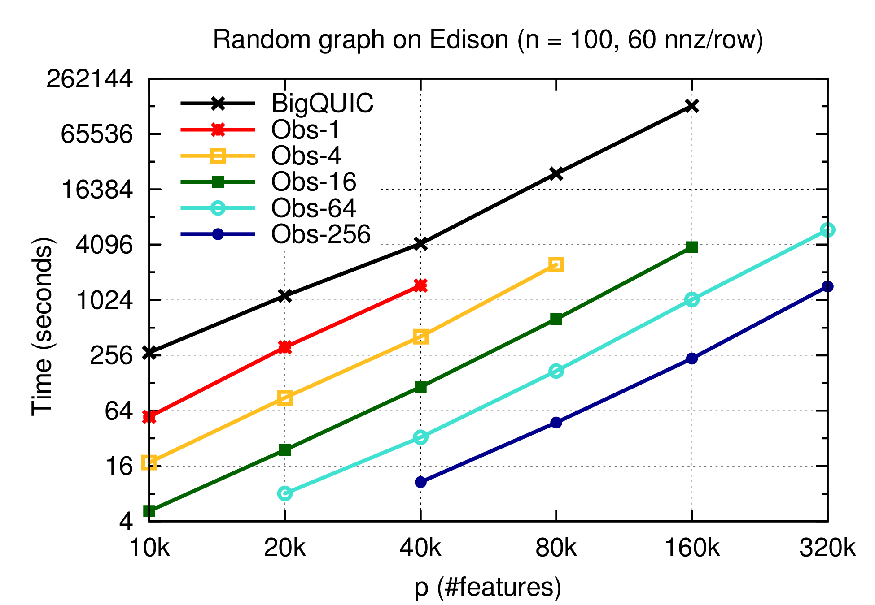
Communication Avoiding “HP-CONCORD”
BigQUIC
1 node
2 nodes
4 nodes
16 nodes
64 nodes
Best previous algorithm (1 node)
Our algorithm (HP-CONCORD)
Solve previously intractable problems using clever algorithms and HPC

Slide 34
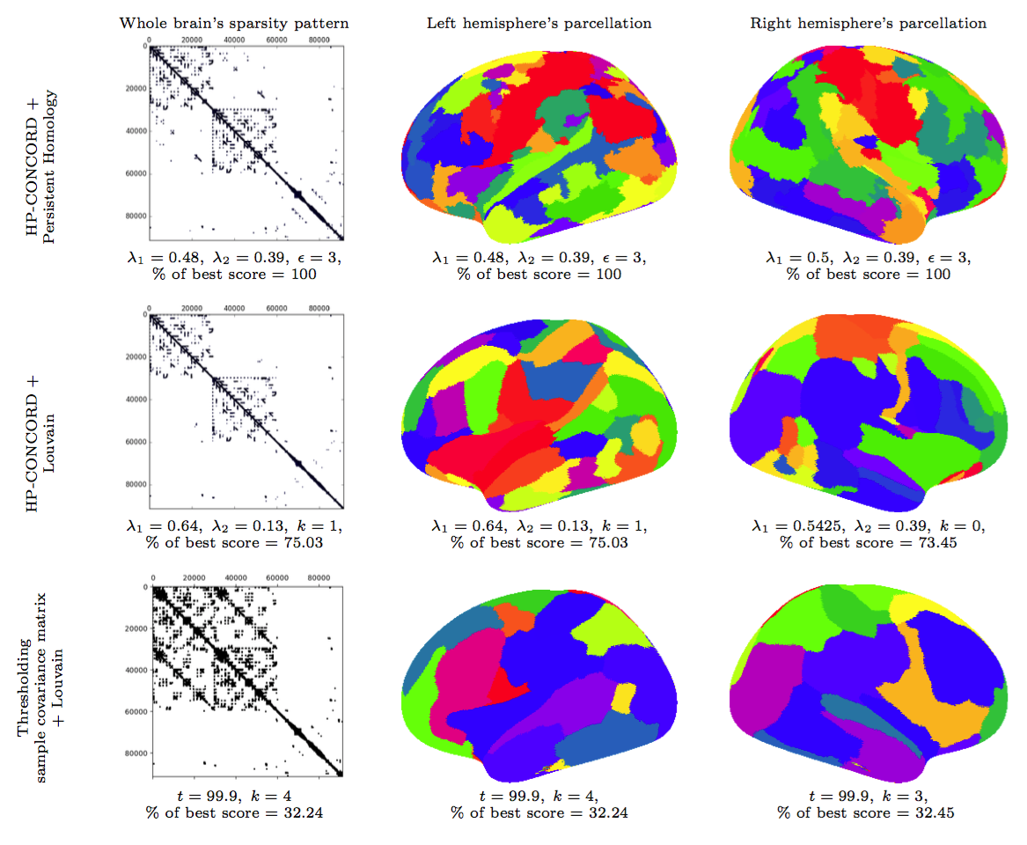
Discovering regions and co-region
Resting-state fMRI
91K x 91K Sample Covariance matrix
91K data points (2mm x 2mm x 2mm cubes)
5K time points (every 0.7 sections for 2 hour)
Averaged over 1,200 subjects
Koanantakool, et al, AISTAT 2018, to appear.

Slide 35
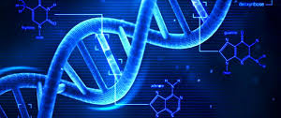
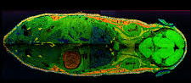
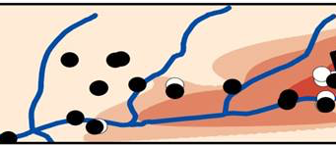
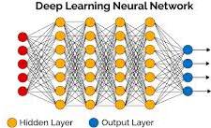
Deep Learning in Bioinformatic
Deep Learning in Bioinformati
Omics
Bioimaging
Signal processing
Protein structure prediction
Gene expression regulation
Segmentation
Brain decoding
Anomaly classification
Derived from S. Min et al, Briefings in Bioinformatics
Notes:
35

Slide 36
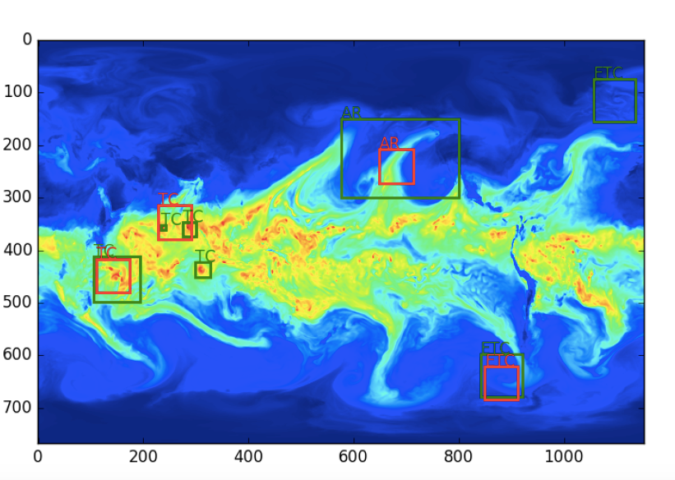
Deep Learning using HPC for Extreme Weather Events
First application of supervised and semi-supervised architectures for finding patterns in CAM5 data
DL methods are capable of extracting weather patterns with 85-99% accuracy (NIPS’17 paper)
Implementation scaled to 15PF on Cori Phase II (SC’17 paper)
Ground Truth vs Prediction
Prabhat et al

Slide 37

Breaking the curse of dimensionality
10M Genetic Variants in >40k genes
To obtain accuracy and insight, we are developing procedures to detect interactions of any form or order at the same computational cost as main effects
Explainable-AI
Genes do not work in isolation: 10¹⁷⁰ potential interactions among variants
Linking genetic variants to phenotypes requires the exploration of an enormous space
Dan Jacobson/Ben Brown
ORNL/LBNL
Notes:
Models of biological processes involve dozens to thousands of distinct molecular species, with interactions of high order as common place. Forward regression approaches cannot hope to identify high-order terms in these settings.
Combinatorial complexity occurs elsewhere: solving Maxwell’s equations to target phased arrays of lasers takes far too long for field conditions – by connecting surrogate equation models to real-world outcomes through machine learning, not only can we solve the targeting problem, we can learn from our fitted machines how to design superior array architectures.
In material science, stacked or doped metamaterials can be designed through the combinatorial application of atomic monolayers. However, functional metamaterials are currently discovered through intuition and trial-and-error. Through interpretable data analysis, we can learn engineering principles enabling material scientists to start from a design goal, and leverage the enormous catalog of previously assessed materials to identify high-priority candidates for testing.
These are the folks with whom we’re working today. Similar stories exist in network security, biomanufacturing, drug discovery, supply chain management, and in virtually every sector industry where data is collected en masse. We have an opportunity to bring the design-build-test-learn cycle to industries that still rely on trial and error.

Slide 38
Myth #6: Exascale computing is only about building big machines
The Exascale Computing Project is developing novel applications and features, software, and hardware R&D

Slide 39
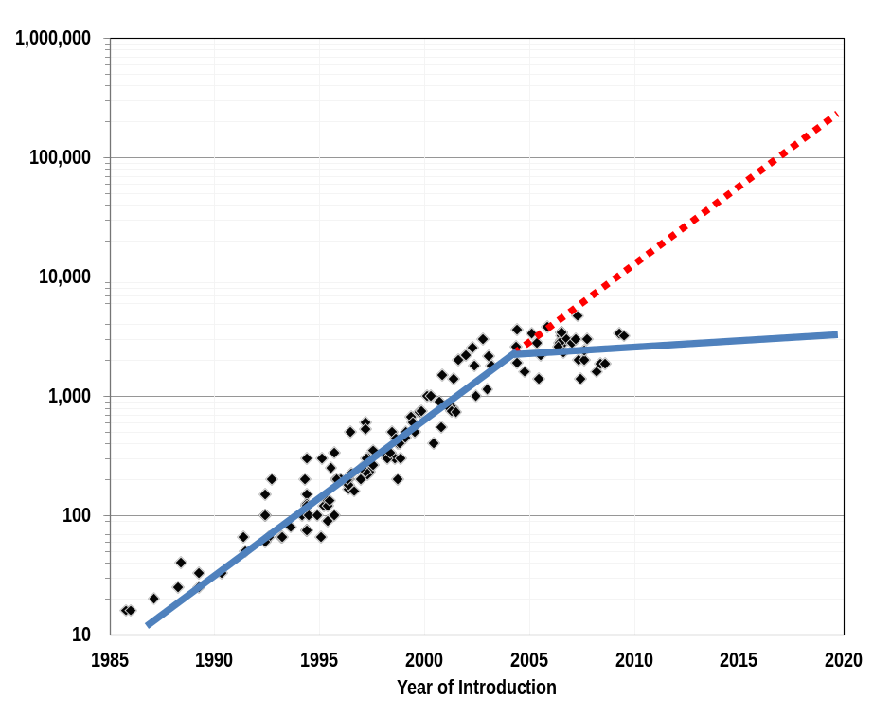
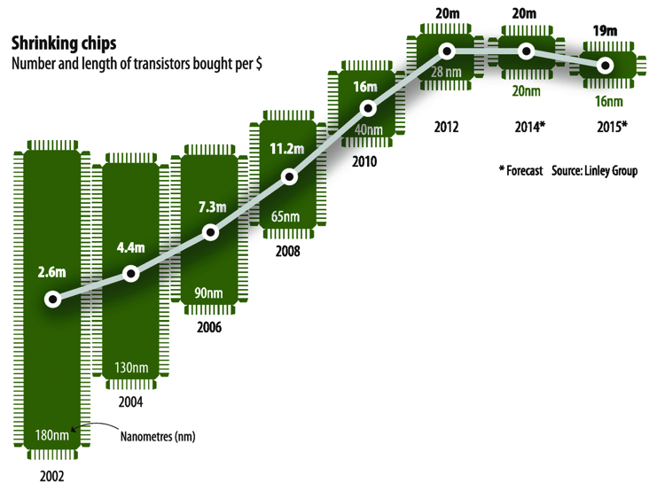
“Moore’s Law” is Running Out
Expectation Gap
Clock speed increases have ended
Transistor density is reaching its limit
Power and cost of computing are no longer dropping at historic rates
Notes:
The issue is that companies can shrink the die size, but the cost of the technology development and upgrading the facilities is high enough that the M of transistors / dollar is getting worse. (It might get better if the volume of sales gets high enough, but it's not clear that will happen as there are diminishing returns as amount of shrinkage per generation is less than it used to be, i.e., getting to the end of Moore's Law.) This slide is fine, you might just want this comment in the notes section for future reference.

Slide 40
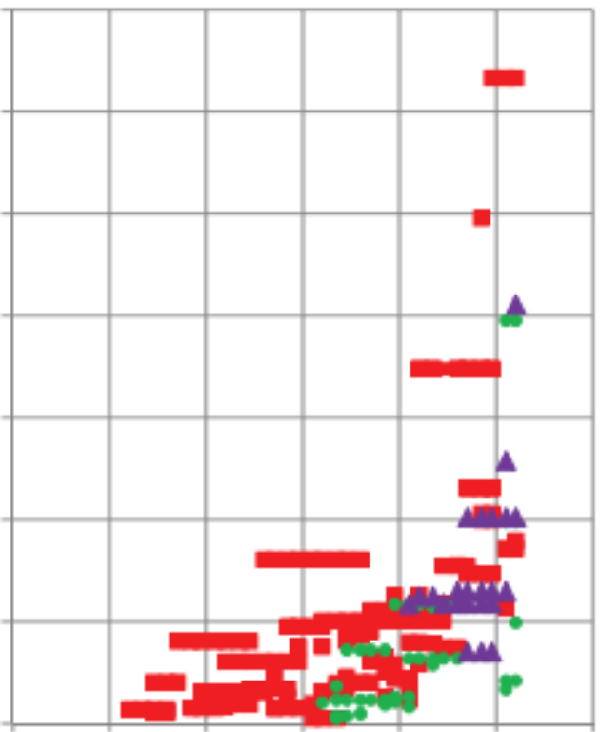
Computing is energy-constrained
At ~$1M per MW, energy costs are substantial
1 petaflop in 2008 used 3 MW
1 exaflop in 2018 at 200 MW “usual chip scaling”
Missing TaihueLight at 15MW
and Tihanhe-2 at 18MW
12
10
8
6
4
2
Megawatts per machine
(Kogge/Shalf)
Goal: 1 Exaflop in 20 MW
= 20 pJ / operation
Note: The 20 pJ / operation is
Independent of machine size
Independent of # cores used per application
But “operations” need to be useful ones
’92 ’96 ’00 ‘04 ‘08 ‘12 ‘16
Notes:
Tianhe-2 is not on here: 17.5MW for the system, 24MW including cooling and power loss

Slide 41
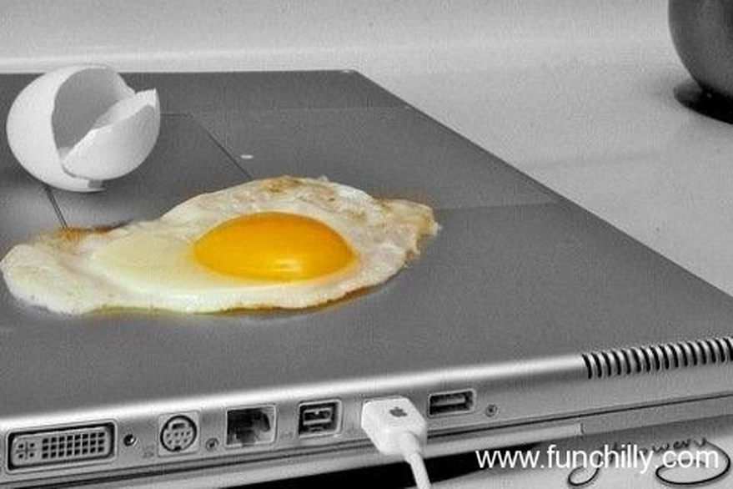
Energy Limits Computer Performance?

Slide 42


Use of manycore processors and accelerators
KNL manycore architecture for hmmsearch at JGI
3-way similarity analysis
Weak scaling (fixed size problem per node) on Titan w/ GPUs
Bill Arndt, NERSC
Joubert, Nance, Weighill, Jacobson, ORNL
Mapping alignment, similarity calculations, etc., to energy efficient manycore and accelerator architectures
Notes:
* Strong scaling

Slide 43
Data Movement is Expensive
Hierarchical energy costs.
6 pJ
Cost to move data 1 mm on-chip
Typical cost of a single floating point operation
100 pJ
Cost to move data 20 mm on-chip
120 pJ
Cost to move data off-chip,
but stay within the package (SMP)
250 pJ
2000 pJ
Cost to move data off-chip
into DRAM
~2500 pJ
Cost to move data off-chip
to a neighboring node
Source: http://slideplayer.com/slide/7541288/
Notes:
From: OpenSoC Fabric slides. Farzad Fatollahi-Fard

Slide 44














Breakthrough Science Challenges for Exascale
multimodal multiscale
complexity data size
resolution multiphysics
Cosmology
Simulation and Data
Accelerators
Cancer
Astrophysics
Data
Simulation
Combustion
Microbiome
Carbon Capture
Photon Science
Chemistry
Urban
Materials
Power grid
Earthquakes
Subsurface
Notes:
DOE should have a facility dedicated to …

Slide 45



ExaBiome: Exascale Solutions to Microbiome Analysis
Use HPC algorithms and systems for orders of magnitude speedup and to solve previously intractable problems
Problem Domain | Metagenome Assembly | Protein Clustering | Comparative Analysis
Exascale goal | Assemble millions of metagenomes from whole data | Cluster billions of proteins | Use fast alignment and annotation for time-sensitive analyses
Computing techniques | Graph algorithms, Hash Tables, alignment (Smith-Waterman) | Machine learning (clustering), sparse linear algebra / graphs | Alignment, Machine learning (dimensionality reduction), linear algebra

Slide 46
Superfacility: A vision for DOE Science Facilities and leveraging Expertise

Slide 47











Superfacility for Major Experimental Facilities
Expertise
User Community
Experimental Facilities
Computing and Data Facilities
Light Sources
Sequencers
A single interconnected “facility” where data is acquired, stored, analyzed and served
Telescopes
Particle Detectors
Methods, models, analytics, and software
Microscopes
Execution plan: one science area at a time
Notes:
The Superfacility Concept Enabling new discoveries by coupling experimental science with large scale data analysis and simulations.
Massive data sets move easily over ESnet
Science DMZ model and an ecosystem of Data Transfer Nodes now reach user facilities at 100Gb/s
Scalable seamless workflows let scientists focus on science, not data movement.
The User community around the country has access to the data and the best models, analytics, and software.
LBNL is ideally suited to develop and demonstrate an array of inter-operable science capabilities.

Slide 48








NERSC / Joint Genome Institute partnership
Bioenergy
Carbon Cycling
Biogeochemistry
DNA
Sequencing
Advanced
Genomic
Technologies
Computational
Analysis
DNA Synthesis
NERSC staff run JGI computing
HPC:
Alignment, Assembly
Annotation, Search
Clustering Phylogeny
Archave, Metadata
Notes:
Note the 4 different programs here and that JGI calls out it’s computing infrastructure as being part of the foundation for supporting their mission

Slide 49
JGI-NERSC Microbiome Data Science FICUS
JGI’s metagenomic data and NERSC’s Cori supercomputing
6 projects underway
  Patricia Babbitt UCSF
  David Baker UW, Seattle
  Phillip Brooks UC Davis
  Ed DeLong UH Manoa
  Steve Hallam UBC Vancouver
  Kostas Konstantinidis Georgia Tech
A sequence similarity network of a family of enzymes from the nitroreductase superfamily (some nitroreductases can reduce TNT, a significant soil contaminant). Source: Patsy Babbitt
Notes:
For the image: They’re mining the IMG data resources for enzyme superfamilies .
Patricia (Patsy) Babbitt of the University of California (UC), San Francisco aims to develop tools to mine the IMG/M database for enzyme superfamilies—functionally diverse collections of enzymes that share a common ancestor and fold, as well as active site architectures and reaction mechanism or other chemical capability

Slide 50



From Systems Biology to 3D Structural Interactions
Structures:
28 million compounds
Dan Jacobson, ORNL

Slide 51








Kbase: interface to collaborative, reproducible science
In KBase, you can create shareable, reproducible workflows called “Narratives” that include data, analysis steps, results, visualizations and commentary.
Data
Commentary
Visualizations
Analysis steps
Custom scripts
Version control and provenance
Sharing
Notes:
Additional talking points:
Narratives let others repeat your computational experiments, and alter parameters or input data to achieve different or improved results.
Can be kept private, shared with collaborators of your choosing, or made public
Provenance: KBase tracks the use and transformation of data, allowing credit to be given to data contributors, analysts, and tool developers as well as methods to be shared and recorded

Slide 52
HPC Transformative for Genomics
Genome analysis is an HPC problem
  De novo assembly for single genomes, metagenomes, and pan genomes
  Protein clustering
  Alignment
  All-to-all comparisons
  Statistical machine learning (traditional)
  Deep learning
Enables new approaches, new facility models, and new science

