Slide 1
More Data, More Science… and Moore’s Law?
Kathy Yelick
Associate Laboratory Director for Computing Sciences
Lawrence Berkeley National Laboratory
Professor of Electrical Engineering and Computer Sciences
University of California at Berkeley

Slide 2
Science is poised for transformation

Slide 3
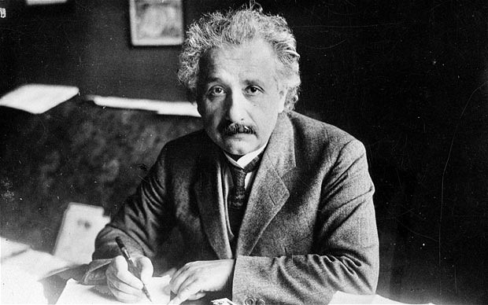
Old School Scientists: The Lone Scientist

Slide 4
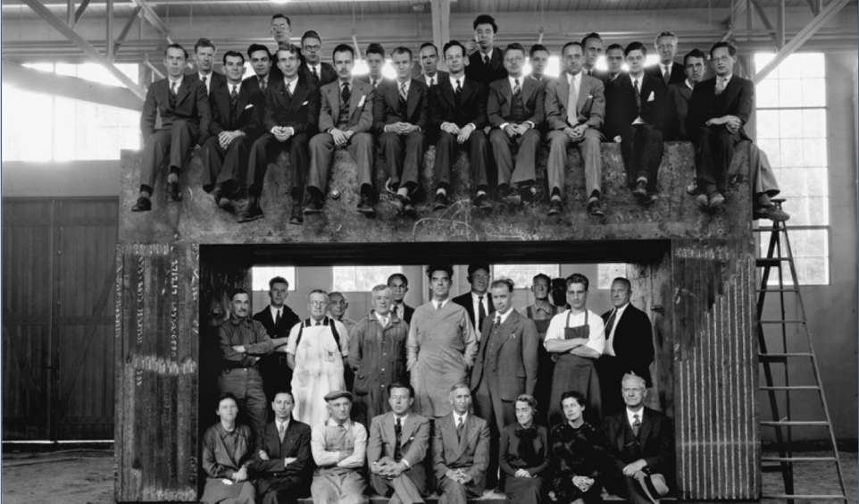
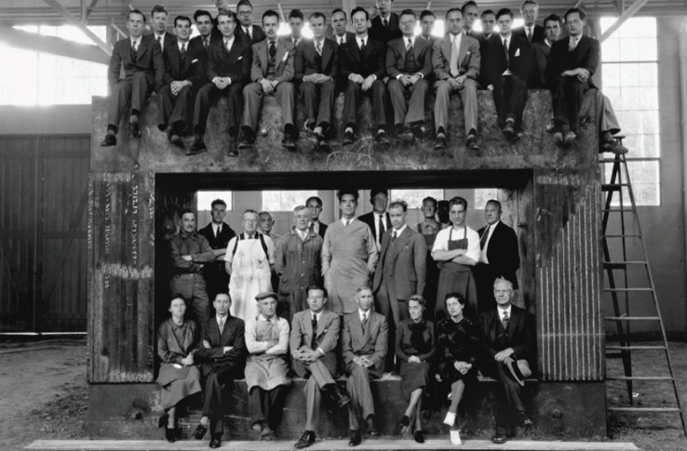
The Legacy of Team Science
Radiation Lab staff on the magnet yoke for the 60-in cyclotron, 1939, including:
E. O. Lawrence
Edwin McMillan
Luis Alvarez
J. Robert Oppenheimer
Robert R. Wilson

Slide 5
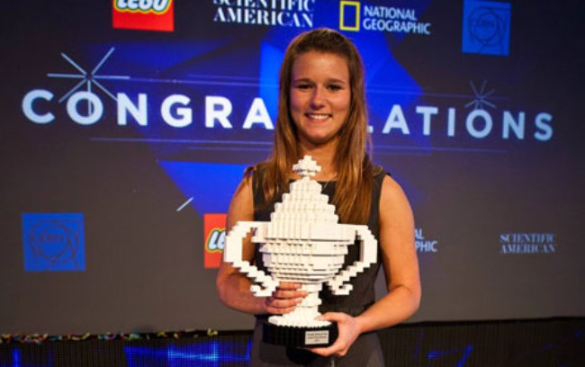
New Scientists
17-year-old Brittany Wegner creates breast cancer detection tool that is 99% accurate on a minimally invasive, previously inaccurate test.
Machine Learning + Online Data + Cloud Computing
Notes:
17-year-old Brittany Wegner creates breast cancer detection tool that is 99% accurate on a minimally invasive, previously inaccurate test.

Slide 6

Experimental Science is Changing
sdf
Notes:
I’m going to start with a story that is not about computing, because it changed my views on science and how it is going to be done in the future

Slide 7
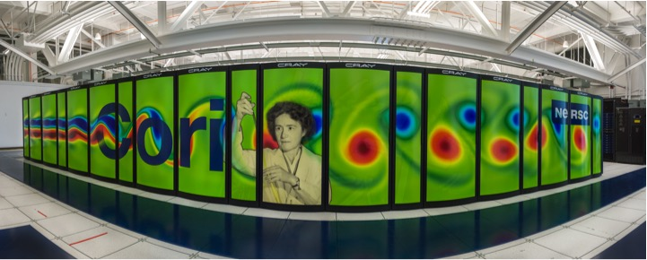
Computing Sciences at Berkeley Lab
NERSC: State-of-the art supercomputing for the broad science community – over 7000 users, 700 applications mostly in simulation

Slide 8
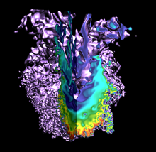
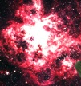
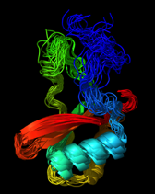
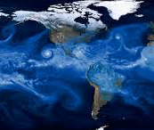
High Performance Computing in Science
Computers are used to understand things that are
for experiments alone, so simulations are used
Too Big
Too fast
Too Small
Too slow

Slide 9


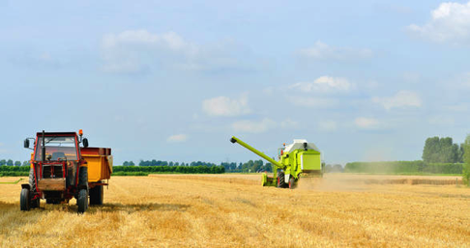
“Big Data” Changes Everything…What about Science?
Notes:
Big Data has changed our lives. It changes the products that we buy, how our sports teams are coached, and how our food is grown
But my career has been about languages and tools for modeling and simulation, right? Why am I talking about Big Data?

Slide 10
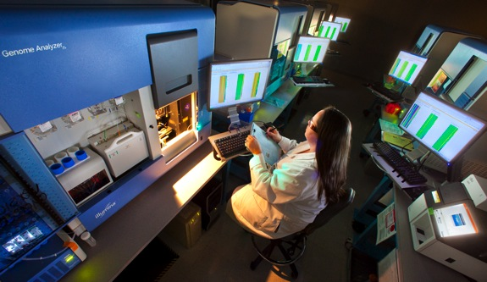
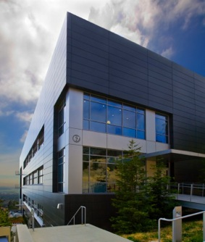
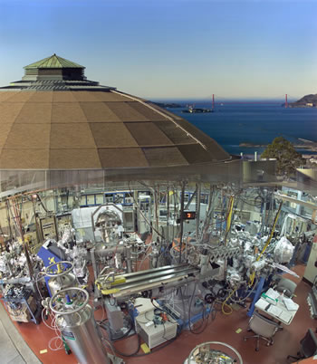
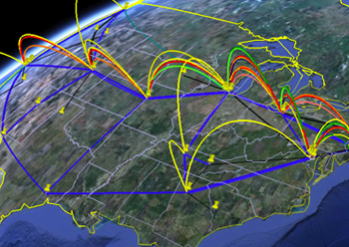
Berkeley Lab’s Advanced Facilities Enable World-Leading Science
Joint Genome Institute
Molecular Foundry
Advanced Light Source
Energy Sciences Network
National Energy Research Scientific Computing Center
About 10,000 visiting scientists (~2/3 from universities) use Berkeley Lab research facilities each year, which provide some of the world’s most advanced capabilities in materials science, biological research, computation and networking

Slide 11
Data Growth is Outpacing Computing Growth
Graph based on average growth
Projected Data Rates Relative to 2010

Slide 12
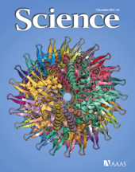
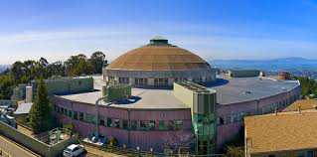

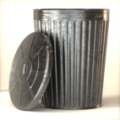



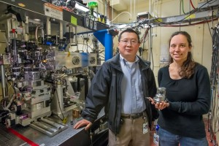
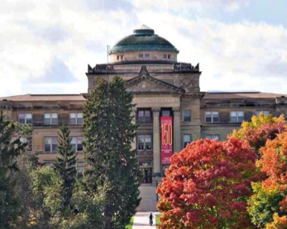
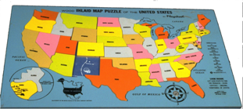
Old School Scientific Workflow

Slide 13
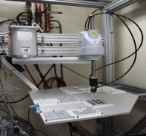

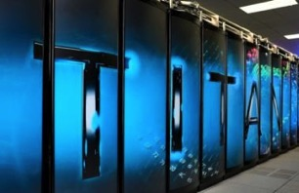

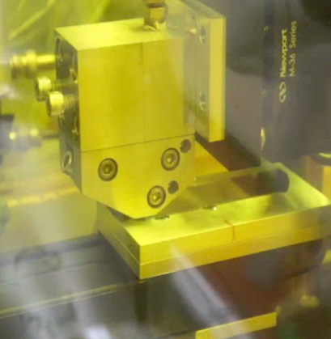
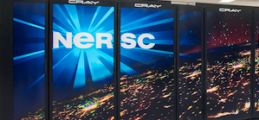
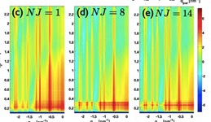
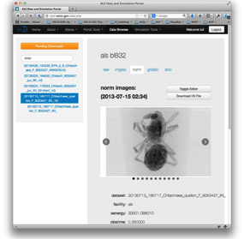

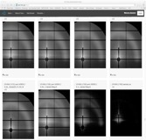

Computing, experiments, networking and expertise in a “Superfacility” for Science
GISAXS
Slot-die printing of
Organic photovoltaics
HipGISAXS & RMC
Liu et al, “Fast printing and in situ morphology …”. Adv Mater. 2015
Notes:
Grazing Incidence Small Angle X-Rays Scattering
Plastic solar cells that can be printed on flexible sheets with an ink-like solution show a lot of potential as a source of lightweight, inexpensive renewable energy. However, much of the power-conversion efficiency of such cells gets lost in the translation from small-scale lab studies to large-scale manufacturing processes.
Fabricating organic photovoltaics (OPV) that could enable large-scale manufacture of these devices.
A more flexible material than traditional photovoltaics, OPVs hold promise for reducing energy costs and increasing conversion efficiency. But mass-producing OPVs has proven to be a challenge; most efforts to fabricate them have focused on spin-coating, a process often used in laboratory testing that does not lend itself to large-scale fabrication and significantly reduces the power conversion efficiencies (PCE) of the devices.
Real-time analysis of ‘slot-die’ technique for printing organic photovoltaics
Using ALS + NERSC (SPOT Suite for reduction, remeshing, analysis)
OLCF (HipGISAXS running on Titan w/ 8000 GPUs).
Results presented at March 2015 meeting of American Physical Society by Alex Hexemer.
Additional DOE contributions: GLOBUS (ANL), CAMERA (Berkeley Lab)
•Advanced mathematical algorithms for data analysis and large-scale simulations coupled to data analysis are becoming critical to scientific understanding of BES lightsource data.
– Many Reverse Monte Carlo (RMC) and simulation codes are HPC-scale, even Exa-scale, and heavily optimized for (eg. GPU) architectures.
– We want to eliminate boundaries between the Scientist and the world’s best Algorithms running on the best architecture for that code.
• Typical ALS chain + dpdak + HipRMC on NERSC reserva1on
– a state of the art materials science questions (OPV or Nafion)
• Co-schedule ALS beam1me & Titan reserva1on
– state the art X-ray detectors and instrumentation
• Typical ALS chain + dpdak => Spade + Globus Online => ORNL (FW)
– advanced mathematical algorithms and software
• Sentry launches HipGISAXS – 8000 nodes and feeds results back IRT
– fast data movement and visualization
• HipGISAXS runs live during beam1me (see next)
– run on some of the fastest computer in the world
• Integrated Super-Facility Dashboard – not produc1on quality

Slide 14
Science at the boundary of theory and experiment … simulation and data analytics

Slide 15
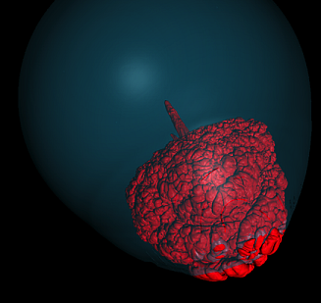
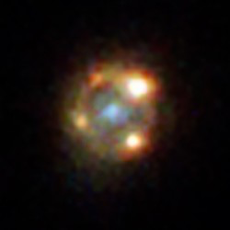
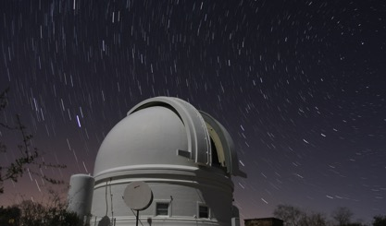
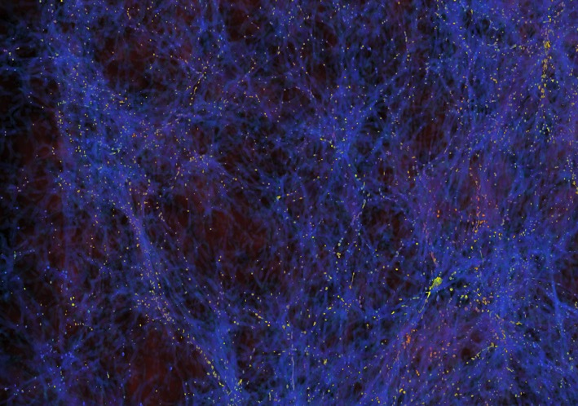
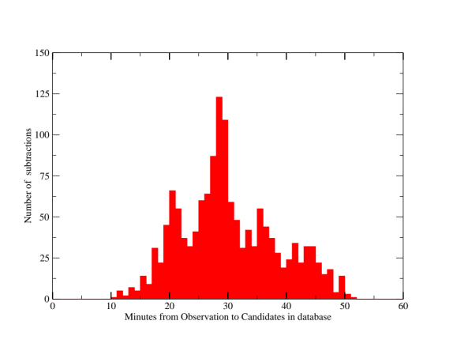
Integration of Simulation and Observational Science
Intermediate Palomar Transient Factory with DESI, CMB-S4 and LSST coming
A. Goobar, P. Nugent, et al (2017) Science
Simulations aid in interpreting data
Image subtraction, machine learning in minutes

Slide 16
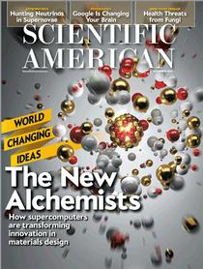

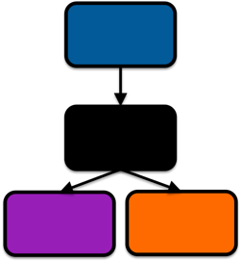
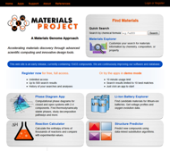
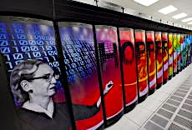
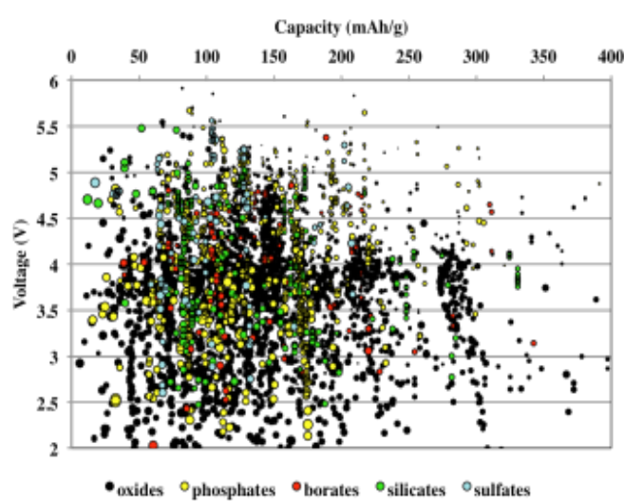
Re-Use and Re-Analyze Previously Collected Data
Materials Genome Initiative
  Materials Project: Over 10,000 users!
  “World-Changing Idea of 2013”
Voltage limit
Computers programs run by “bots”
Materials
Data
Today’s batteries
Interesting materials
Notes:
4500 users in 18 months

Slide 17
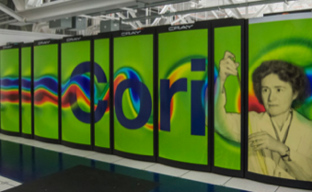
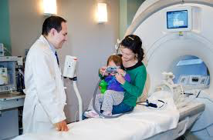
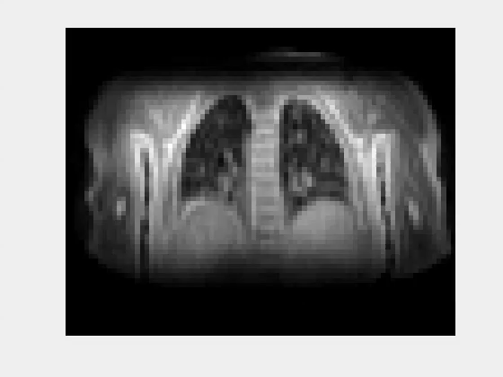
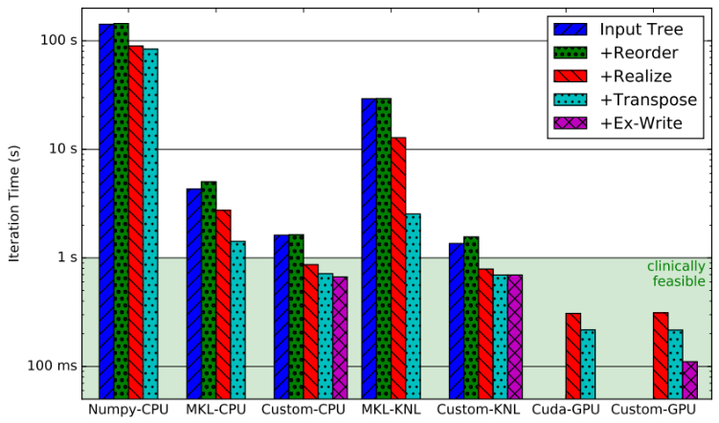
Real-Time Analytics in Health
3 min goal (1 sec/iteration)
Compressed Sensing Approach by Mike Lustig et al
MRI results Wenwen Jiang
Michael Driscoll HPC optimization

Slide 18
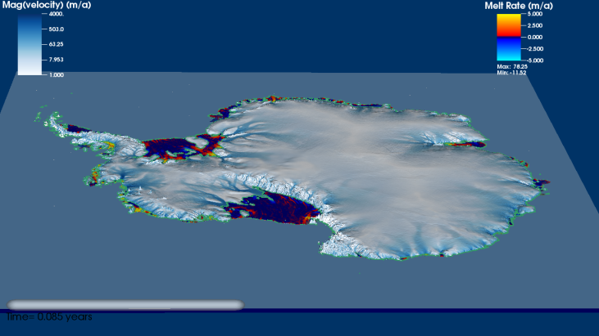

Data and Simulation in the environment
New climate modeling methods, including AMR “Dycore” produce new understanding of ice
Genomes to watersheds Scientific Focus Area
Understand interactions between environmental microbiomes and climate change with kilometer resolution models that track dynamic 3D features (with AMR) and genome-enabled analysis of environmental sensors.

Slide 19
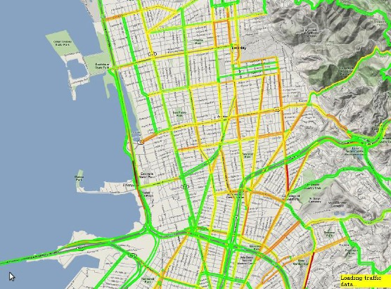
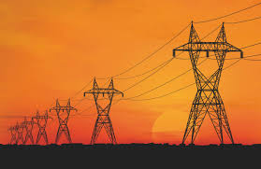
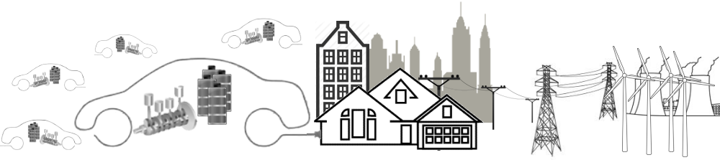
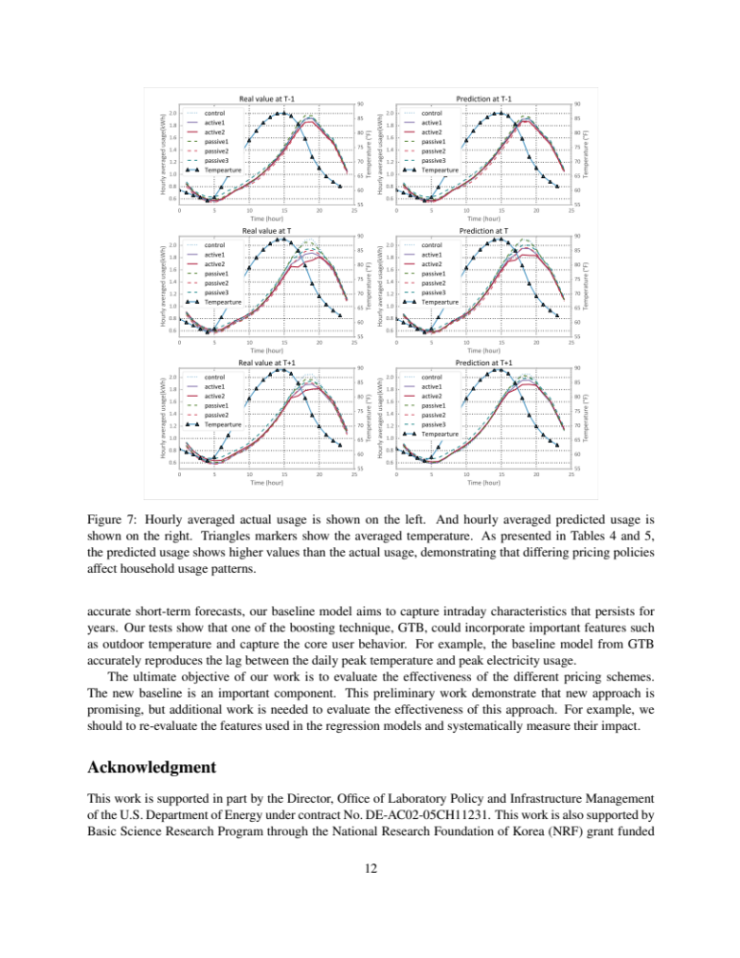
Science in embedded sensors
Transportation Modeling
Power Grid Modeling
Scenario Prediction, Planning
Decision Science

Slide 20
Computing and network facilities need to adapt

Slide 21
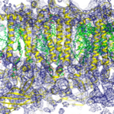




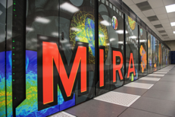
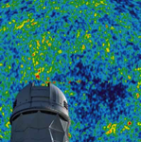

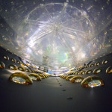



Superfacility: Integrated network of experimental and computational facilities and expertise
Expertise
User Community
Experimental Facilities
Computing and Data Facilities
Light Sources
Sequencers
A single interconnected “facility” where data is acquired, stored, analyzed and served
Telescopes
Particle Detectors
Methods, models, analytics, and software
Microscopes
Execution plan: one science area at a time
Notes:
The Superfacility Concept Enabling new discoveries by coupling experimental science with large scale data analysis and simulations.
Massive data sets move easily over ESnet
Science DMZ model and an ecosystem of Data Transfer Nodes now reach user facilities at 100Gb/s
Scalable seamless workflows let scientists focus on science, not data movement.
The User community around the country has access to the data and the best models, analytics, and software.
LBNL is ideally suited to develop and demonstrate an array of inter-operable science capabilities.

Slide 22


ESnet: Data driven science drives network capacity
Traditional IP
Transatlantic
Big science data
Science DMZ
Science DMZ to deliver bandwidth to the end users
OSCARS for bandwidth reservation
100 Exabytes/year by 2024!
Notes:
ESnet: Discovery at Scale, Unconstrained by Geography
Constant innovation allows network to keep up with explosion of data: 1 Exabyte per year now, 100 EB per year by 2024.
LCLS/NERSC/ESNET working together to analyze data at unprecedented rate.
Science requires innovative network performance, but continuity of operations must be maintained.

Slide 23

Systems configured for data-intensive science
NERSC Cori has data partition (Haswell) and pre-exascale (KNL)
NVRAM file system with close to 2 PB at 2 TB/sec
WAN-to-Cori optimized for streaming data: 100x faster from LCLS to Cori and Globus to CERN

Slide 24



Real-time queue prototyped at NERSC
In 1998 dedicated hardware; now prototype queue on Cori
<1% of NERSC allocation
Cryo-Em, Mass spec, Telescopes, Accelerator, Light sources
Cryo-EM: Image classification
Nogales Lab
PTF: Image subtraction pipeline
ALS: 3D Reconstruction, rendered on SPOT web portal

Slide 25


Interactive Analytics using Jupyter
Science notebooks through Jupyter (iPython)
Widely used in science
Interactive HPC LDRD
Deployed at NERSC:
>100 users pre-production
Fernando Perez et al

Slide 26




Containers for HPC Systems
Data analysis pipelines are often large, complex software stacks
NERSC Shifter (with Cray), supports containers for HPC systems
Used in HEP and NP projects (ATLAS, ALICE, STAR, LSST, DESI)
Startup Time
Notes:
Future work:
Need to work closely with ESnet to schedule network bandwidth to experimental facilities for some use cases
Will allow users to submit requests for realtime access during the year with an online form
Added a question to ERCAP about real-time needs to assess demand and size real-time resources.
Reviewed with program managers and gathered feedback

Slide 27

Old School Scientific Data Search

Slide 28

Automated Search, Meta-Data Analysis, and On-Demand Simulation
Automated metadata extraction using machine learning

Slide 29
Computational research challenges are substantial

Slide 30











Software implementations at scale in pipeline
MicroCT imaging
Segmentation
Topological
Analysis
Analysis
Simulation
Visualization
Notes:
Compute topological structure of pore network augmented with geometric information
Derive quantities describing flow through rock, etc.

Slide 31

CAMERA: Mathematics for Facilities
PHaSE
JCAP
JCESR
Probabilistic Graphical Models
BES Functional Electronic Materials
BES Nanoporous Materials
Constrained optimization
EFRC Gas Separation
Fluctuation/Single Particle
CLS (Canada)
Fast PDE solvers: (Level Set, DG,…)
NSLS-2
Molecular Foundry
GISAXS
ALS
Model-based reconstruction
NCEM
APS
SSRL
Iterative Phasing
Ptychography (SHARP)
LCLS
DIAMOND (UK)
Spectral analysis
ESRF (Grenoble)
Image Analysis/Tomography (QuantCT,F3D)
PETRA III (Germany)
LBNL
Machine learning, feature detection, persistent homology
LLNL/LANL
ORNL
New mathematical modeling
Electronic Structure (PEXSI)
BNL
ANL
Discrete mathematics/
Computational geometry
NERSC
OLCF
Materials Design (Zeo++)
ALCF
Linear Algebra (Selected inversion,
fast pseudoinverse approximation,...)
SIESTA, CP2K, ImageJ, Fiji
(Bosch, Samsung, Intel,GE,…)
=BES Centers/Internat.
Universities: e.g.: Berkeley, Northwestern, Georgia Tech, Rice, UCSD, U.I.C, McMaster, Austin, Stanford,…
=ASCR Facilities
=BES (and other) Facilities
=LABS
=3Rd Party Codes
=Industry
=Universities

Slide 32









Machine Learning for Science
Images in cosmology, light sources, etc.
Biology
Climate
Accelerators
Seismology
  Cosmology simulation
Chemistry
Brain
Data Complexity
Interpretability
Performance and Scale

Slide 33
Analytics vs. Simulation Kernels:
7 Giants of Data | 7 Dwarfs of Simulation
Basic statistics | Monte Carlo methods
Generalized N-Body | Particle methods
Graph-theory | Unstructured meshes
Linear algebra | Dense Linear Algebra
Optimizations | Sparse Linear Algebra
Integrations | Spectral methods
Alignment | Structured Meshes

Slide 34
Machine Learning Mapping to Linear Algebra
Logistic Regression, Support Vector Machines
Dimensionality Reduction (e.g., NMF, CX/CUR, PCA)
Clustering (e.g., MCL, Spectral Clustering)
Graphical Model Structure Learning (e.g., CONCORD)
Deep Learning (Convolutional Neural Nets)
Sparse Matrix-Sparse Vector (SpMSpV)
Sparse Matrix-Dense Vector (SpMV)
Sparse Matrix Times Multiple Dense Vectors
(SpMM)
Sparse - Sparse Matrix Product
(SpGEMM)
Dense Matrix Vector
(BLAS2)
Sparse - Dense Matrix Product
(SpDM³)
Dense Matrix Matrix (BLAS3)
Aydin Buluc
Increasing arithmetic intensity

Slide 35

Random Access Analytics
Genome assembly “needs shared memory”
Low overhead communication
Remote atomics
Partitions for any structure
Global Address Space
Scales to 15K+ cores
Under 10 minutes for human
First ever solution
E. Georganas, A. Buluc, J. Chapman, S. Hofmeyr, C. Aluru, R. Egan, L. Oliker, D. Rokhsar, K. Yelick

Slide 36


Productive Programming
Speed
Run programs up to 100x faster than Hadoop MapReduce in memory, or 10x faster on disk.
High failure rate
Slow network
Fast (local) disk
And Spark is still 10x+ slower than MPI

Slide 37

SPARK Analytics on HPC
Weak scaling (fixed problem size per node): Power Iteration Benchmark
Perfect scaling
Cluster
Cluster with RDMA
HPC
SPARK on HPC vs. clusters
Network, I/O, and virtualization all key to performance
Increased scale from O(100) to O(10,000) cores
Chaimov, Malony, Iancu, Ibrahim, Canon, Srinivasan
Notes:
Cori better scaling behavior than Comet (even with RDMA)
RDMA harms performance at low node numbers
Helps performance at higher node numbers
Reduces time spent in compute

Slide 38





Filtering, De-Noise and Compressing Data
AmeriFlux & FLUXNET: 750 users access carbon sensor data from 960 carbon flux data years
Arno Penzias and Robert Wilson discover Cosmic Microwave Background in 1965

Slide 39
How will we get enough computing for these problems?

Slide 40
Architectures for Data vs. Simulation
Separate Jobs
Compute Intensive
All-to-All
Random Access
Nearest Neighbor
Different architectures for simulation? Can simulation use data architectures?

Slide 41










More Parallelism at Lower Levels
Specialization
  Application Performance Growth
  (Gordon Bell Prizes)
“Killer cellphones”
Manycore Parallelism
Rest of the world gets parallelism
Vector parallelism
“Killer micros”

Slide 42

End of Transistor Density Scaling
ITRS now sets the end of transistor shrinking to the year 2021

Slide 43

Device alternatives require lower clock → more parallelism
Today’s CMOS
Technology
Tunneling FET advantage only at low clock rates
Notes:
T-FETs improve energy, but increase latency
Can scientific calculations increase parallelism to benefit?
- How much and what kind of parallelism?
Bottom plot says that we can gain big time in energy delay with tfets by sacrificing performance. How to take maximum advantage of such technologies (that sacrifice single core performance).
Many of them push energy delay to slower delay. So more parallelism. How general can we make the advantage? Use John’s diagram for higher delay. Assess this diagram for algorithms that are of scientific importance.
Metrics are: How much does it localize bandwidth density, force you towards higher parallelism. We could use extreme parallelizable algorithms as limit. Very parallel architectures.

Slide 44





Specialization: End Game for Moore’s Law
FPGAs
NVIDIA builds deep learning appliance with P100 Tesla’s
Intel buys deep learning startup, Nervana
Google designs its own Tensor Processing Unit (TPU)

Slide 45


Data processing with special purpose hardware
General trend towards specialization for performance
Data processing (on raw data) will be first in DOE
Particle Tracking with Neuromorphic chips
Deep learning processors for image analysis
Computing in Detectors
FPGAS for genome analysis

Slide 46

KATHY YELICK’S
2031:
a science odyssey
Notes:
Or send you Avitar

Slide 47
Life of a Scientist in 2031
No personal/departmental computers
Users don’t login to HPC Facilities
Travel replaced by telepresence
Lecturers teach millions of students
Theorems proven by online communities
Laboratory work is outsourced
Experimental facilities are used remotely
All scientific data is (eventually) open
Big science and team science democratized

Slide 48
Extreme Data Science
The scientific process is poised to undergo a radical transformation based on the ability to access, analyze, simulate and combine large and complex data sets.

