Slide 1
A Superfacility Model for Science
Kathy Yelick
Associate Laboratory Director for Computing Sciences
Lawrence Berkeley National Laboratory
Professor of Electrical Engineering and Computer Sciences
University of California at Berkeley

Slide 2
Part 1
Science is poised for transformation

Slide 3
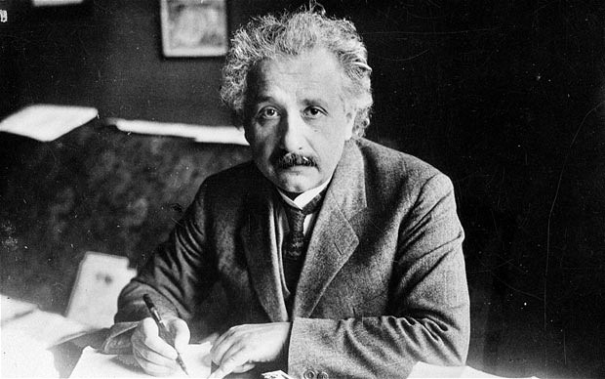
Old School Scientists: The Lone Scientist

Slide 4
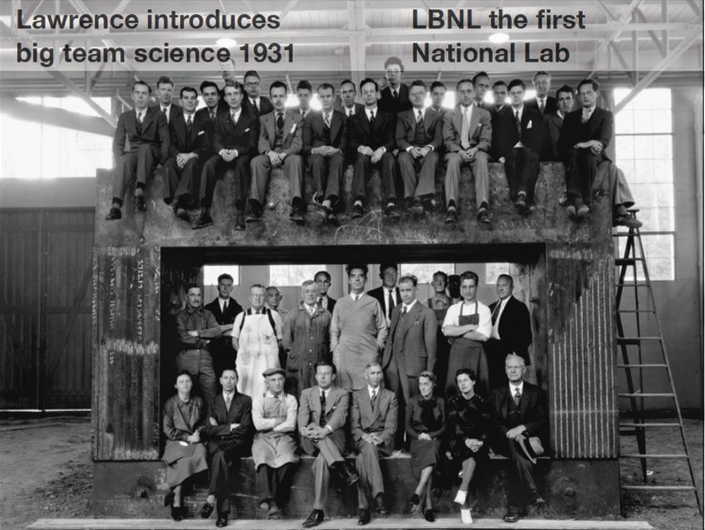
Team Science

Slide 5
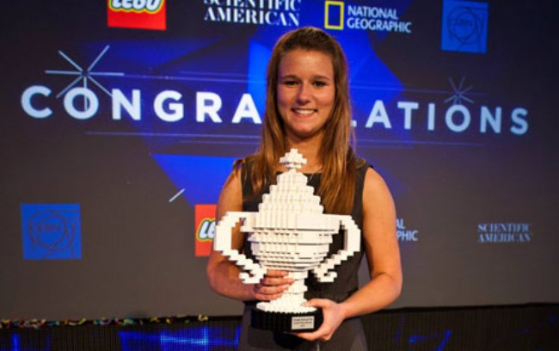
New Scientists
17-year-old Brittany Wegner creates breast cancer detection tool that is 99% accurate on a minimally invasive, previously inaccurate test.
Machine Learning + Online Data + Cloud Computing
Notes:
17-year-old Brittany Wegner creates breast cancer detection tool that is 99% accurate on a minimally invasive, previously inaccurate test.

Slide 6
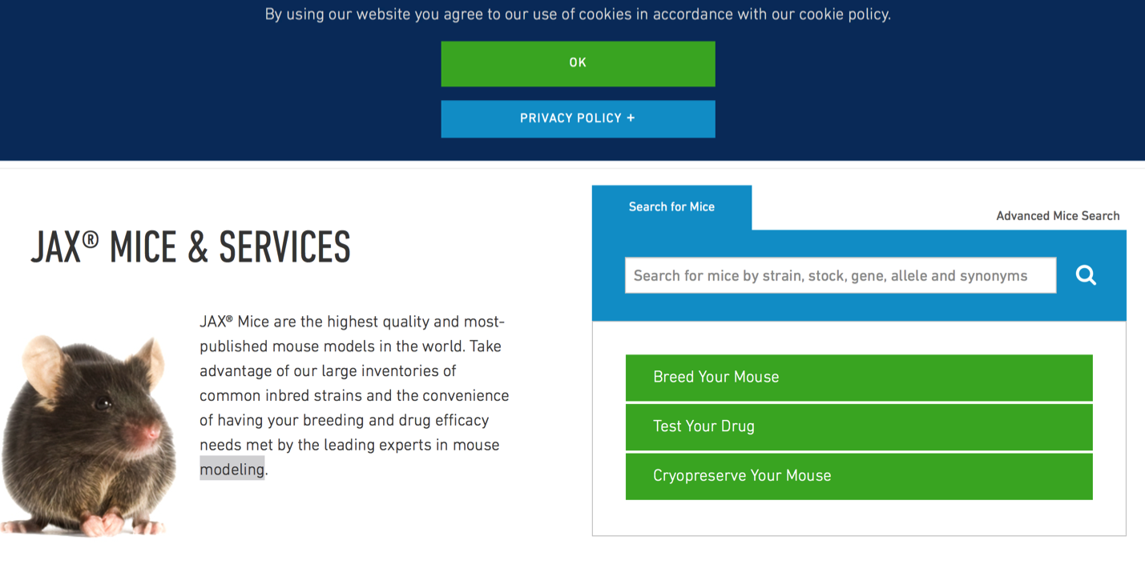
Experimental Science is Changing
sdf
Notes:
I’m going to start with a story that is not about computing, because it changed my views on science and how it is going to be done in the future

Slide 7
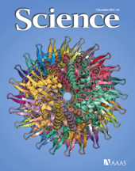
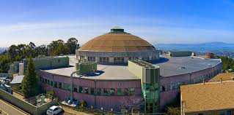

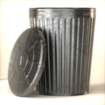



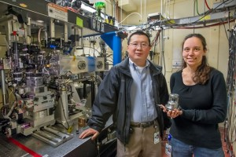
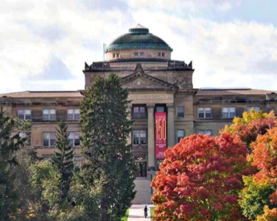
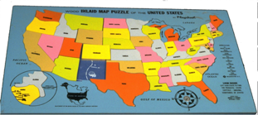
Old School Scientific Workflow

Slide 8
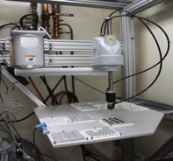

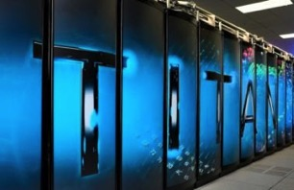

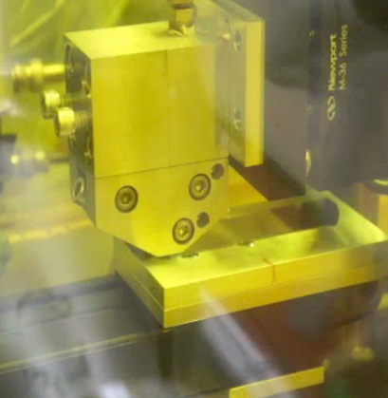
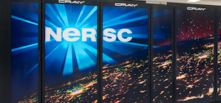
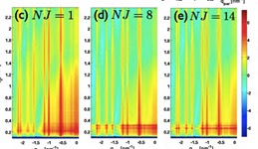
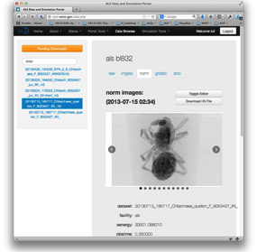

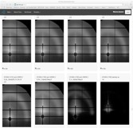

Computing, experiments, networking and expertise in a “Superfacility” for Science
GISAXS
Slot-die printing of
Organic photovoltaics
HipGISAXS & RMC
Liu et al, “Fast printing and in situ morphology …”. Adv Mater. 2015
Notes:
Grazing Incidence Small Angle X-Rays Scattering
Plastic solar cells that can be printed on flexible sheets with an ink-like solution show a lot of potential as a source of lightweight, inexpensive renewable energy. However, much of the power-conversion efficiency of such cells gets lost in the translation from small-scale lab studies to large-scale manufacturing processes.
Fabricating organic photovoltaics (OPV) that could enable large-scale manufacture of these devices.
A more flexible material than traditional photovoltaics, OPVs hold promise for reducing energy costs and increasing conversion efficiency. But mass-producing OPVs has proven to be a challenge; most efforts to fabricate them have focused on spin-coating, a process often used in laboratory testing that does not lend itself to large-scale fabrication and significantly reduces the power conversion efficiencies (PCE) of the devices.
Real-time analysis of ‘slot-die’ technique for printing organic photovoltaics
Using ALS + NERSC (SPOT Suite for reduction, remeshing, analysis)
OLCF (HipGISAXS running on Titan w/ 8000 GPUs).
Results presented at March 2015 meeting of American Physical Society by Alex Hexemer.
Additional DOE contributions: GLOBUS (ANL), CAMERA (Berkeley Lab)
•Advanced mathematical algorithms for data analysis and large-scale simulations coupled to data analysis are becoming critical to scientific understanding of BES lightsource data.
– Many Reverse Monte Carlo (RMC) and simulation codes are HPC-scale, even Exa-scale, and heavily optimized for (eg. GPU) architectures.
– We want to eliminate boundaries between the Scientist and the world’s best Algorithms running on the best architecture for that code.
• Typical ALS chain + dpdak + HipRMC on NERSC reserva1on
– a state of the art materials science questions (OPV or Nafion)
• Co-schedule ALS beam1me & Titan reserva1on
– state the art X-ray detectors and instrumentation
• Typical ALS chain + dpdak => Spade + Globus Online => ORNL (FW)
– advanced mathematical algorithms and software
• Sentry launches HipGISAXS – 8000 nodes and feeds results back IRT
– fast data movement and visualization
• HipGISAXS runs live during beam1me (see next)
– run on some of the fastest computer in the world
• Integrated Super-Facility Dashboard – not produc1on quality

Slide 9
Data Growth is Outpacing Computing Growth
Graph based on average growth
Projected Data Rates Relative to 2010

Slide 10
HPC: It’s not just for simulation
Experimentation
Data Analysis
Theory
Simulation
Computing

Slide 11
HPC: It’s not just for simulation
Experimentation
Data Analysis
Simulation
Theory
Growth in Sequencers, CCDs, sensors, etc.
Computing

Slide 12
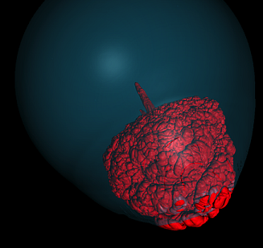
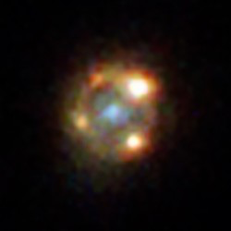
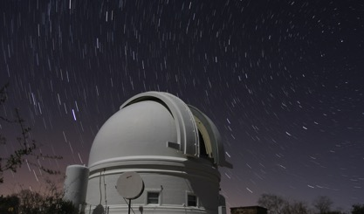
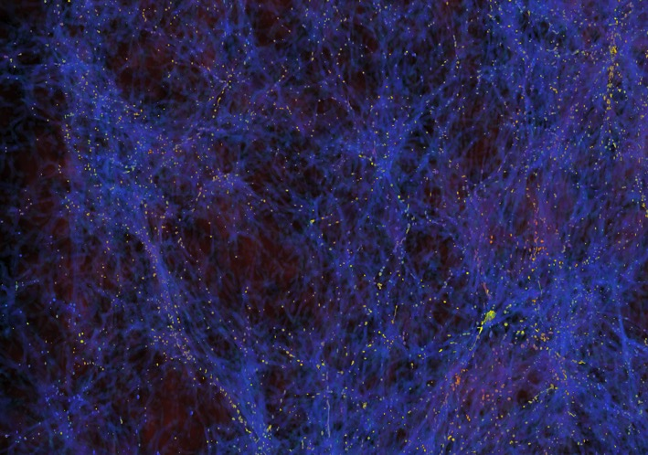
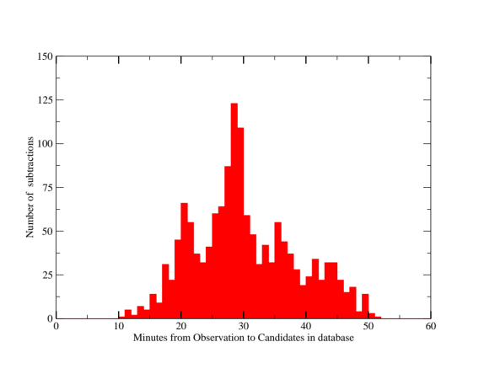
Integration of Simulation and Observational Science
Intermediate Palomar Transient Factory with DESI, CMB-S4 and LSST coming
A. Goobar, P. Nugent, et al (2017) Science
Simulations aid in interpreting data
Image subtraction, machine learning in minutes

Slide 13
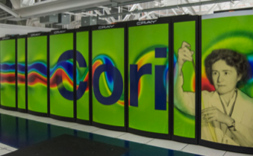
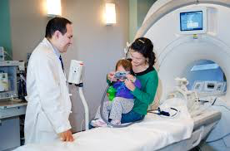
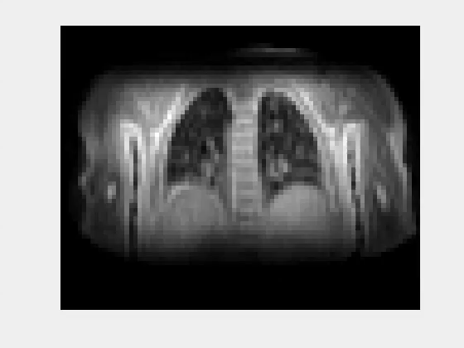
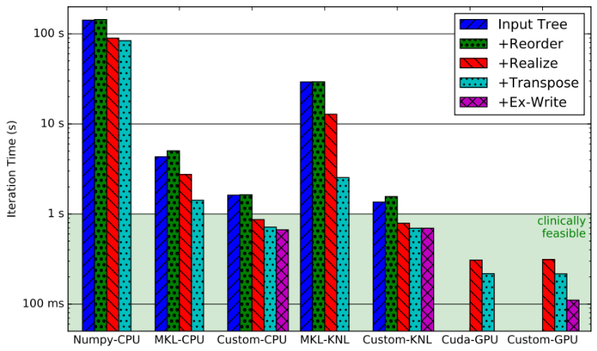
Real-Time MRI Challenge
3 min goal (1 sec/iteration)
Compressed Sensing Approach by Mike Lustig et al
MRI results Wenwen Jiang
Michael Driscoll HPC optimization

Slide 14
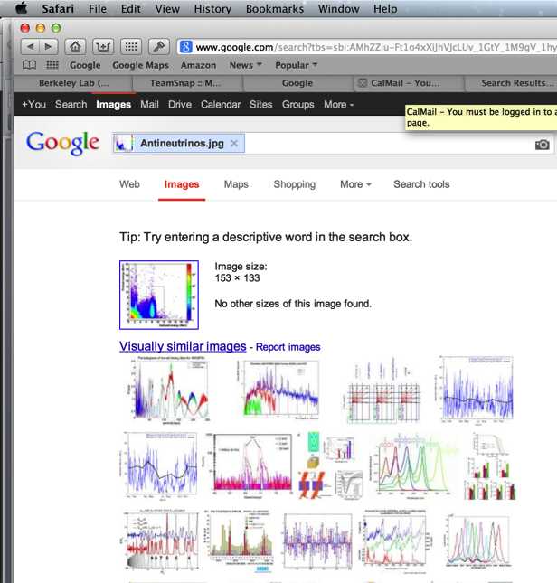
Old School Scientific Data Search

Slide 15
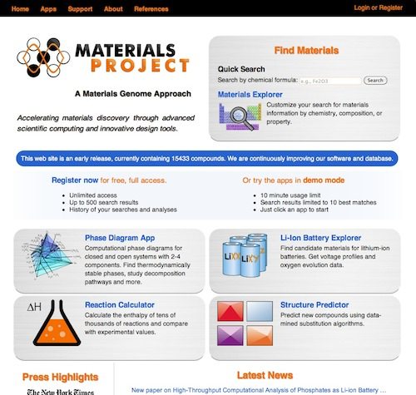
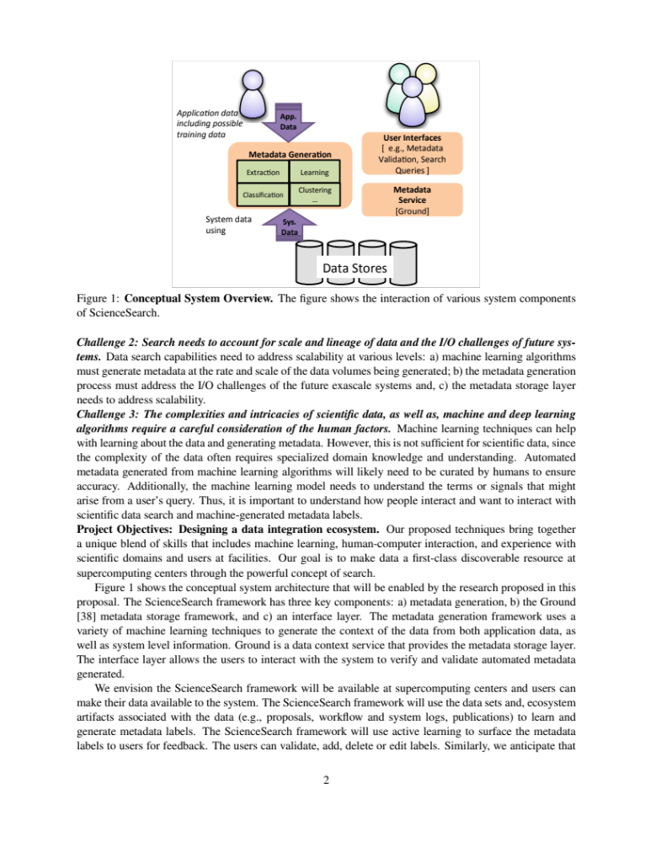
Automated Search, Meta-Data Analysis, and On-Demand Simulation
Automated metadata extraction using machine learning
Jobs submitted by “bots” based on queries; algorithms extract informatics for design

Slide 16
Part 2
Computing and Networking
Facilities need to adapt

Slide 17
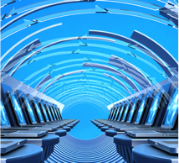

ESnet: Exponential data growth drives capacity
Traditional IP
Transatlantic
Big science data
Science DMZ
Science DMZ to deliver bandwidth to the end users
OSCARS for bandwidth reservation
100 Exabytes/year by 2024!
Notes:
ESnet: Discovery at Scale, Unconstrained by Geography
Constant innovation allows network to keep up with explosion of data: 1 Exabyte per year now, 100 EB per year by 2024.
LCLS/NERSC/ESNET working together to analyze data at unprecedented rate.
Science requires innovative network performance, but continuity of operations must be maintained.

Slide 18
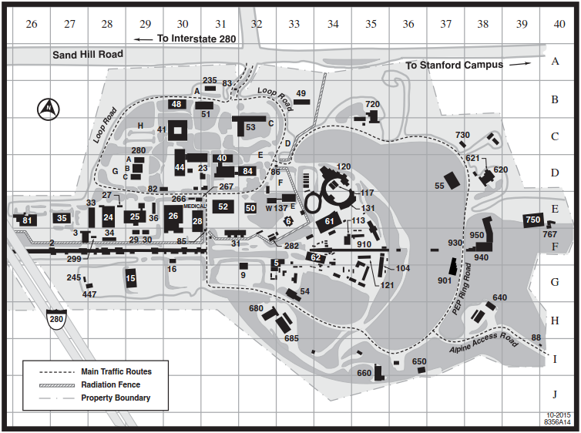
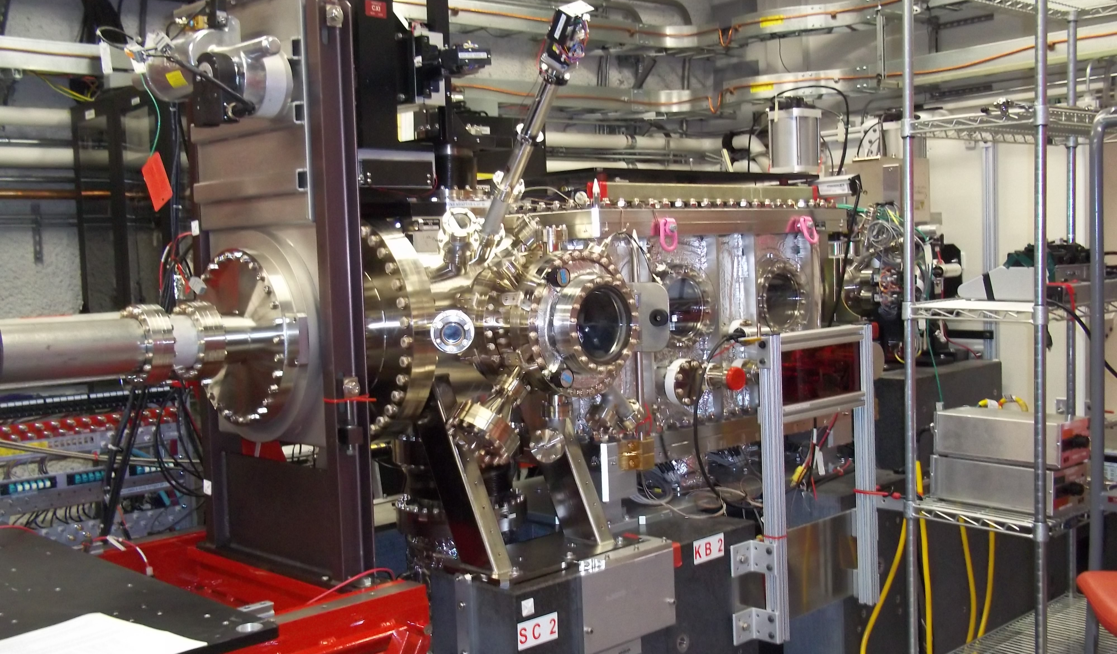
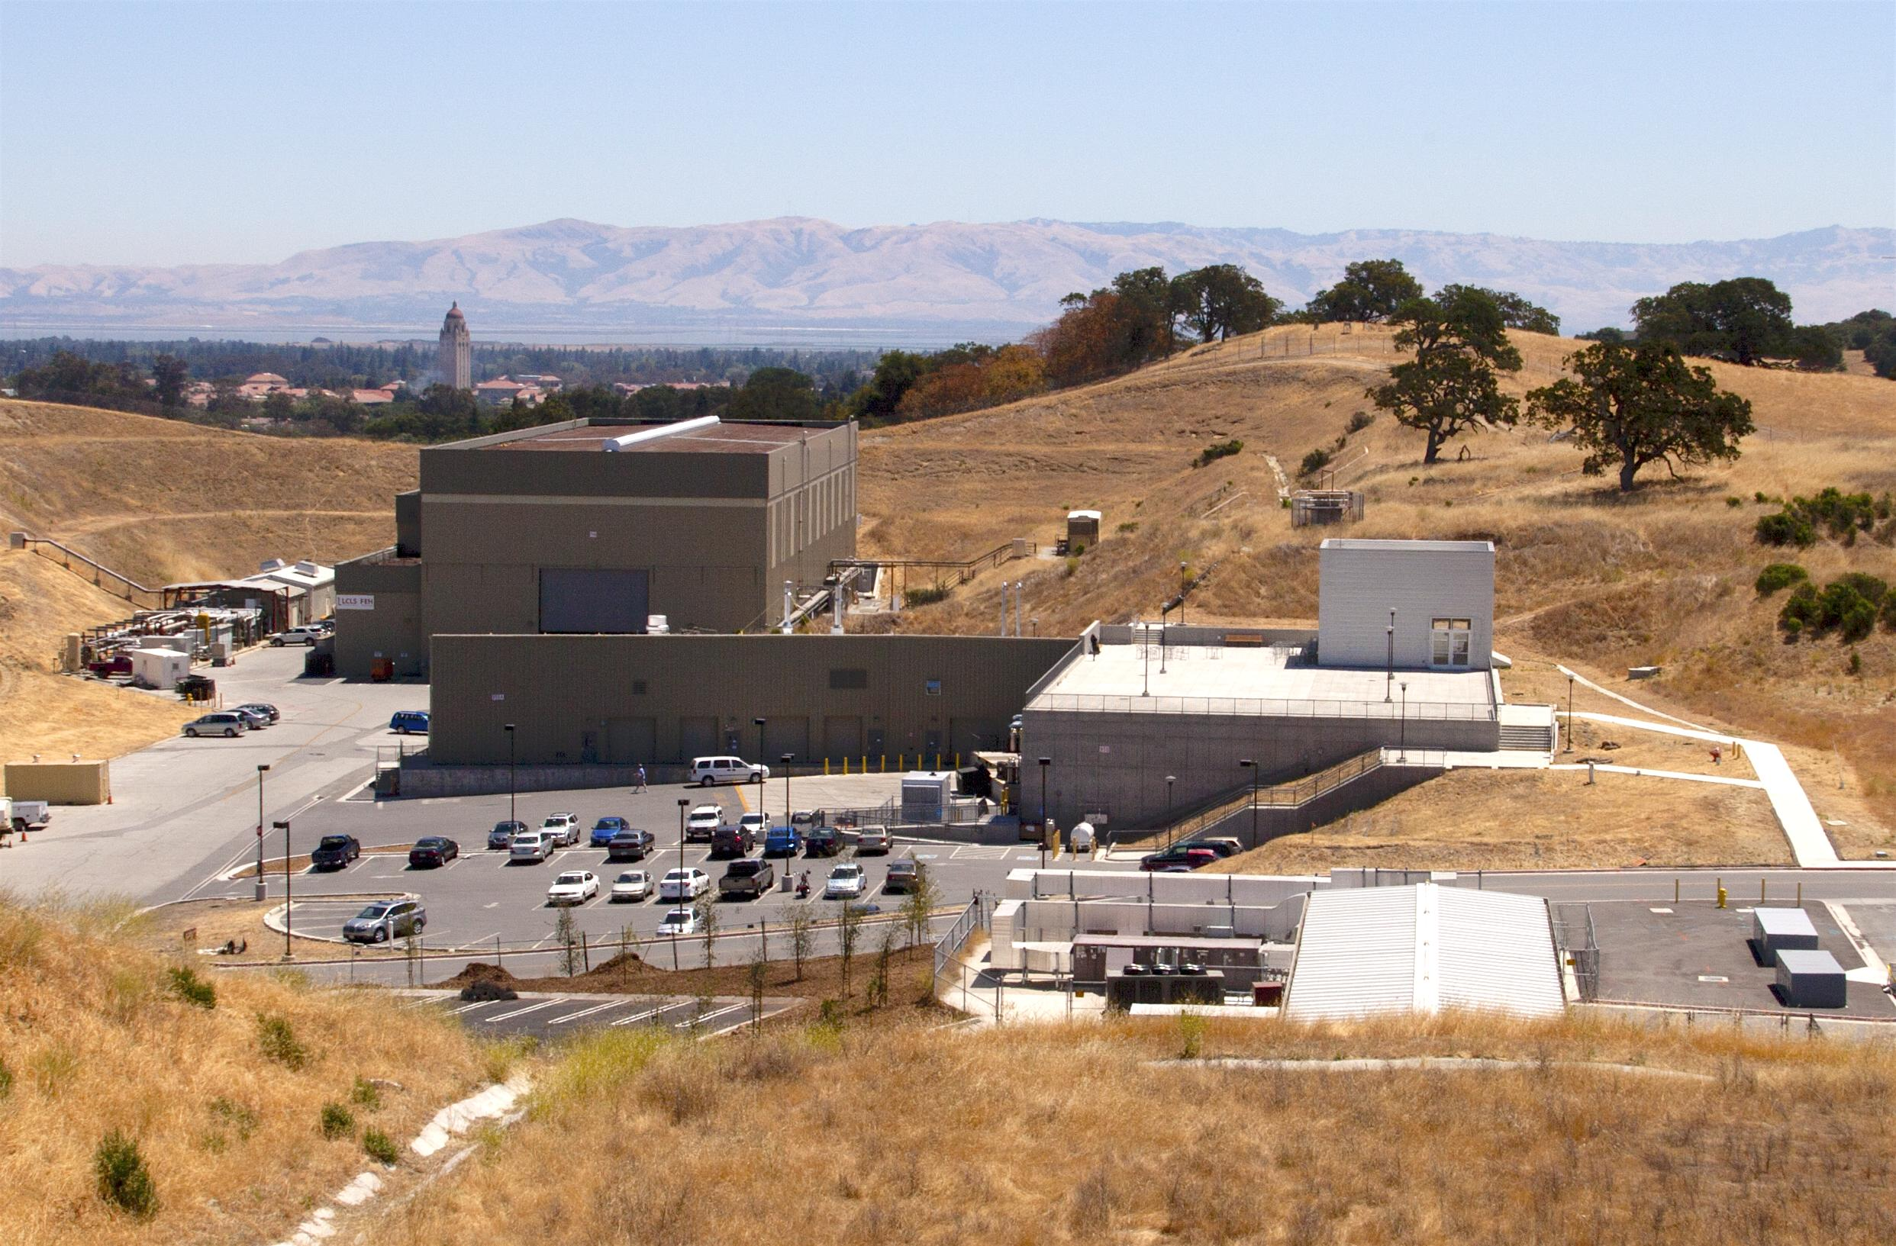
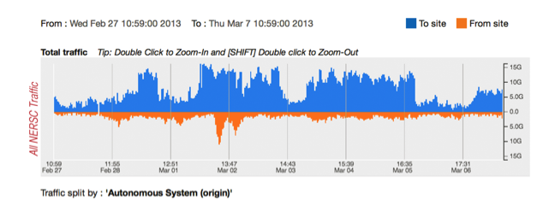
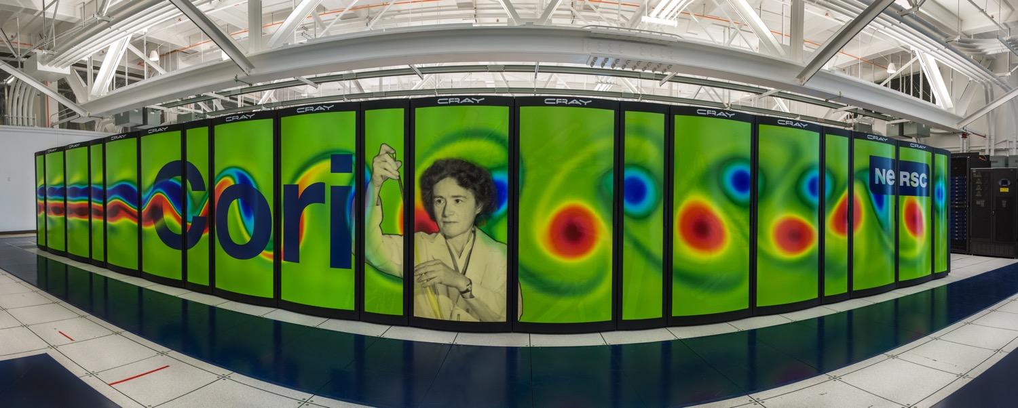
Bringing the Computer to the Experiment
LCLS/NERSC/Esnet Superfacility demo for Photosystem II
Science DMZ
3x increase in ESnet load
Notes:
SLAC LCLS example
Despite the availability of high-capacity connections at the edge of the campus, researchers struggle with inadequate cyberinfrastructure at their lab or experiment that cripples data transfer performance, before it is able to leave the campus.
Science DMZ needs to extend into the campus to the Lab or Facility
Today, HPC Centers are optimized but experimental labs/facilities where the data originates needs investments to resolve the true end to end performance issues

Slide 19
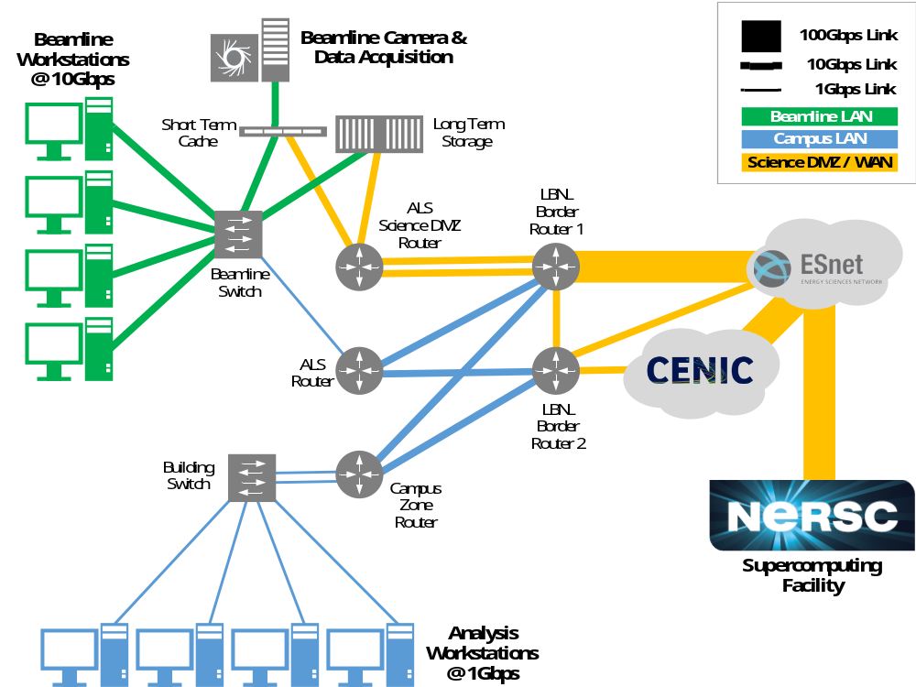
Instruments and facilities require high-speed data network architectures like ScienceDMZ
Campus
Beamline Workstations @ 10Gbps
Beamline Camera and Data Aquisition
Short Term Cache
Long Term Storage
LBNL Border Router 1
Beamline Switch
ALS Router
LBNL Border Router 2
Building Switch
Campus Zone Router
Analysis Workstations @ 1 Gbps
Notes:
ALS has implemented science DMZ
Point out:
Private network between detector and SPOT system
Dedicated data transfer “Science DMZ” links from SPOT and BL832DATA
Normal campus network for beamline user workstations, normal network connectivity, office access

Slide 20
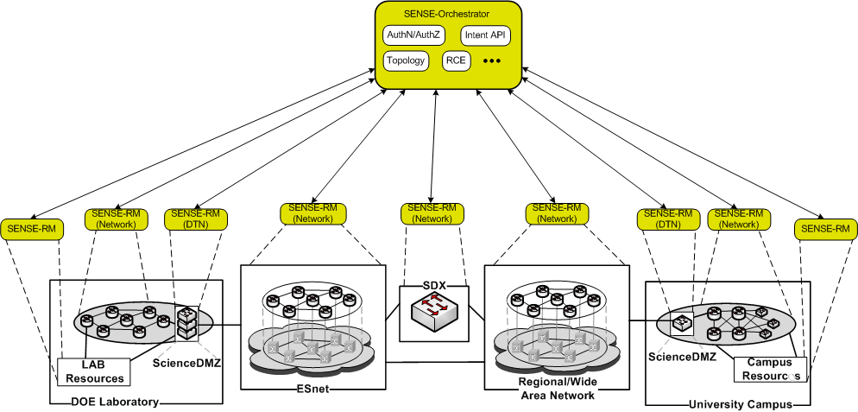
End-to-end, multi-domain network orchestration
Orchestrator Role
Network is a ‘first class’ resource for a Superfacility workflow
Authentication and identity management across domains
Resource Manager Role
SENSE-RM
(Network)
SENSE-RM
(DTN)
SENSE-RM
(Network)
SENSE-RM
(Network)
SENSE-RM
(Network)
SENSE-RM
(DTN)
SENSE-RM
(Network)
SENSE-RM
(Other)
SENSE-RM
(Other)
Defines Service Perimeter/Boundary
SDN for end-to-end Network @ Exascale (SENSE) project led by Monga @ESnet with ANL, Caltech, FNAL, NERSC, MAX/UMD
Notes:
Network is a ‘first class’ resource when building the end-to-end superfacility workflow
End-to-end, and multi-domain problems need to be solved in user-friendly (usable) manner, also needing to put in place authentication/identity management across the domains

Slide 21

ESnet6 plans for superfacility support
ESnet6 (“Hollow-Core”) Conceptual Architecture Overview
Services Edge
Programmable, Flexible, Dynamic
“Hollow” Core
Programmable, Scalable, Resilient
Data plane Programmable Switch
Compute Cluster
Core Switch Router
Optical Services Transponder
Platform
Open Line System
Network Appliance
Edge Switch Router
“Hollow” Core optimized for performance
Programmable to allocate bandwidth and monitor status
Scalable –Leverage latest technology (e.g. FlexGrid spectral partitioning, tunable wave modulation)
Resilient – Protection and restoration functions using next generation Traffic Engineering (TE) protocols
Services Edge optimized for flexibility
Programmable to manage edge router/switch and retrieve telemetry information
Flexible programmable switches (e.g. FPGA, NPU)
Dynamic instantiation of services driven by SDN paradigms (e.g., virtualization, service chaining).

Slide 22
Systems configured for data-intensive science
NERSC Cori has data partition (Haswell) and pre-exascale (KNL)
NVRAM file system with close to 2 PB at 2 TB/sec
WAN-to-Cori optimized for streaming data: 100x faster from LCLS to Cori and Globus to CERN

Slide 23


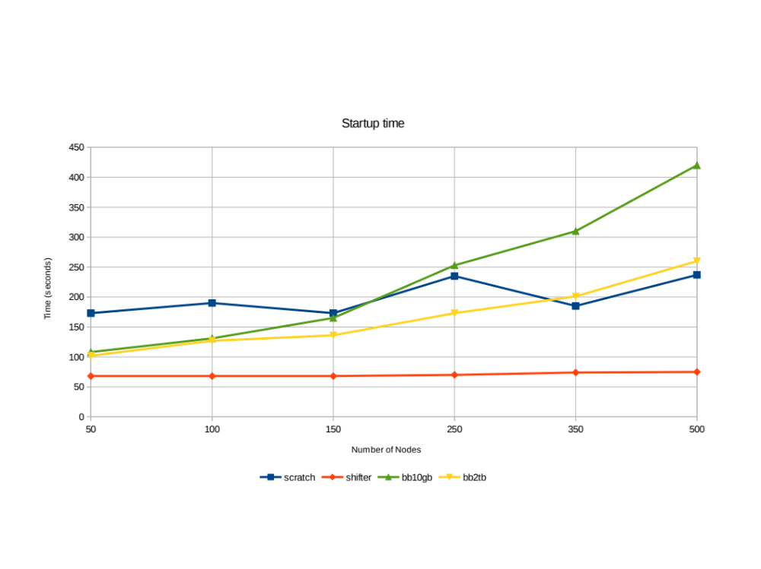
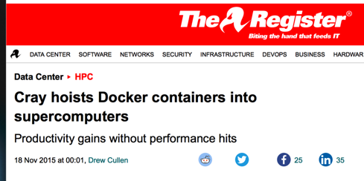
Containers for HPC Systems
Data analysis pipelines are often large, complex software stacks
NERSC Shifter (with Cray), supports containers for HPC systems
Used in HEP and NP projects (ATLAS, ALICE, STAR, LSST, DESI)
Startup Time
Notes:
Future work:
Need to work closely with ESnet to schedule network bandwidth to experimental facilities for some use cases
Will allow users to submit requests for realtime access during the year with an online form
Added a question to ERCAP about real-time needs to assess demand and size real-time resources.
Reviewed with program managers and gathered feedback

Slide 24
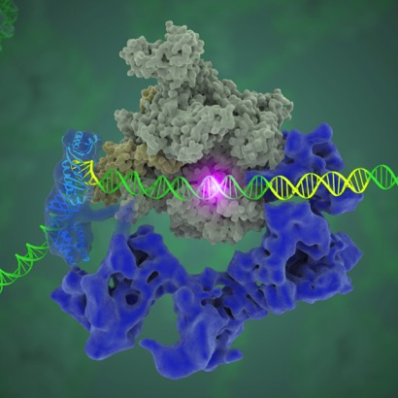
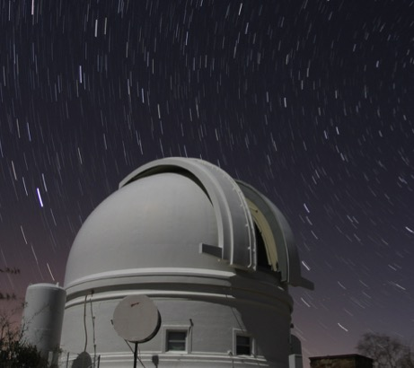
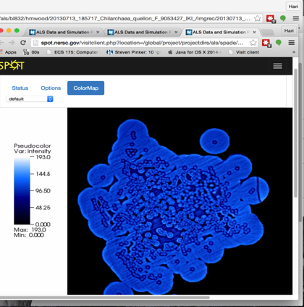
Real-time queue prototyped at NERSC
In 1998 dedicated hardware; now prototype queue on Cori
<1% of NERSC allocation
Cryo-Em, Mass spec, Telescopes, Accelerator, Light sources
Cryo-EM: Image classification
Nogales Lab
PTF: Image subtraction pipeline
ALS: 3D Reconstruction, rendered on SPOT web portal

Slide 25
Part 3
Research challenges are substantial

Slide 26
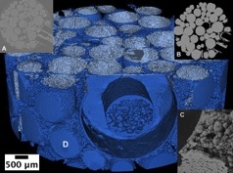
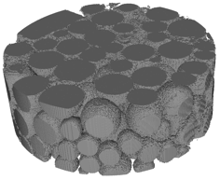
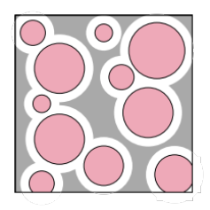
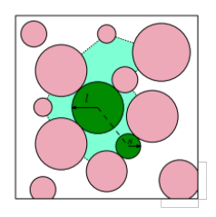
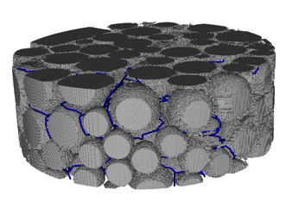
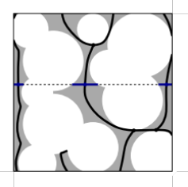
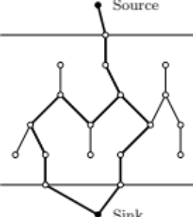
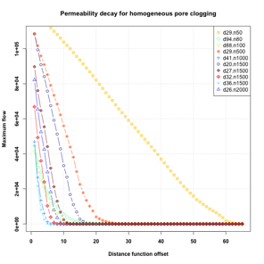



Software implementations at scale in pipeline
MicroCT imaging
Segmentation
Topological
Analysis
Analysis
Simulation
Visualization
Notes:
Compute topological structure of pore network augmented with geometric information
Derive quantities describing flow through rock, etc.

Slide 27


Interactive Analytics using Jupyter
Science notebooks through Jupyter (iPython)
Widely used in science
Interactive HPC LDRD
Deployed at NERSC:
>100 users pre-production
Fernando Perez et al

Slide 28


Productive Programming
Speed
Run programs up to 100x faster than Hadoop MapReduce in memory, or 10x faster on disk.
High failure rate
Slow network
Fast (local) disk
And Spark is still 10x+ slower than MPI

Slide 29

SPARK Analytics on HPC
Weak scaling (fixed problem size per node): Power Iteration Benchmark
Perfect scaling
Cluster
Cluster with RDMA
HPC
SPARK on HPC vs. clusters
Network, I/O, and virtualization all key to performance
Increased scale from O(100) to O(10,000) cores
Chaimov, Malony, Iancu, Ibrahim, Canon, Srinivasan
Notes:
Cori better scaling behavior than Comet (even with RDMA)
RDMA harms performance at low node numbers
Helps performance at higher node numbers
Reduces time spent in compute

Slide 30








CAMERA: Math for the Facilities
Real-time streaming ptychography—ALS, delivered to NSLS2, LANL, BESSY,
Designing mathematical algorithms to allow real-time analysis next to the equipment
Inventing new math and models to match new acquisition technologies
Robust and reliable codes and data flow: workflow environments
Cultural and Sociological Challenges
Multi-modal: Building the math that fuses information from multiple experiments
Compare and integrate multiple analysis tools
New algorithms to transform manual into automatic analysis
SFM/TEM + GISAXS
Automatic image processing for the ALS/GE
CAMERA workshop on Tomography: Joint with APS, ESRF, DIAMOND, LNLS, LLNL, SSRL,….,
Fluctuation scattering and single particle imaging for the LCLS
Workflow and access to remote supercomputers:
XiCAM for ALS, SSRL, APS, NSLS2

Slide 31
CAMERA: Mathematics for Facilities
PHaSE
JCAP
JCESR
Probabilistic Graphical Models
BES Functional Electronic Materials
BES Nanoporous Materials
Constrained optimization
EFRC Gas Separation
Fluctuation/Single Particle
CLS (Canada)
Fast PDE solvers: (Level Set, DG,…)
NSLS-2
Molecular Foundry
GISAXS
ALS
Model-based reconstruction
NCEM
APS
SSRL
Iterative Phasing
Ptychography (SHARP)
LCLS
DIAMOND (UK)
Spectral analysis
ESRF (Grenoble)
Image Analysis/Tomography (QuantCT,F3D)
PETRA III (Germany)
LBNL
Machine learning, feature detection, persistent homology
LLNL/LANL
ORNL
New mathematical modeling
Electronic Structure (PEXSI)
BNL
ANL
Discrete mathematics/
Computational geometry
NERSC
OLCF
Materials Design (Zeo++)
ALCF
Linear Algebra (Selected inversion,
fast pseudoinverse approximation,...)
SIESTA, CP2K, ImageJ, Fiji
(Bosch, Samsung, Intel,GE,…)
=BES Centers/Internat.
Universities: e.g.: Berkeley, Northwestern, Georgia Tech, Rice, UCSD, U.I.C, McMaster, Austin, Stanford,…
=ASCR Facilities
=BES (and other) Facilities
=LABS
=3Rd Party Codes
=Industry
=Universities

Slide 32









Machine Learning for Science
Images in cosmology, light sources, etc.
Biology
Climate
Accelerators
Seismology
  Cosmology simulation
Chemistry
Brain
Data Complexity
Interpretability
Performance and Scale

Slide 33
Architectures for Data vs. Simulation
Separate Jobs
Compute Intensive
All-to-All
Random Access
Nearest Neighbor
Different architectures for simulation? Can simulation use data architectures?

Slide 34
Analytics vs. Simulation Kernels:
7 Giants of Data | 7 Dwarfs of Simulation
Basic statistics | Monte Carlo methods
Generalized N-Body | Particle methods
Graph-theory | Unstructured meshes
Linear algebra | Dense Linear Algebra
Optimizations | Sparse Linear Algebra
Integrations | Spectral methods
Alignment | Structured Meshes

Slide 35
Machine Learning Mapping to Linear Algebra
Logistic Regression, Support Vector Machines
Dimensionality Reduction (e.g., NMF, CX/CUR, PCA)
Clustering (e.g., MCL, Spectral Clustering)
Graphical Model Structure Learning (e.g., CONCORD)
Deep Learning (Convolutional Neural Nets)
Sparse Matrix-Sparse Vector (SpMSpV)
Sparse Matrix-Dense Vector (SpMV)
Sparse Matrix Times Multiple Dense Vectors
(SpMM)
Sparse - Sparse Matrix Product
(SpGEMM)
Dense Matrix Vector
(BLAS2)
Sparse - Dense Matrix Product
(SpDM³)
Dense Matrix Matrix (BLAS3)
Aydin Buluc
Increasing arithmetic intensity

Slide 36

Random Access Analytics
Genome assembly “needs shared memory”
Low overhead communication
Remote atomics
Partitions for any structure
Global Address Space
Scales to 15K+ cores
Under 10 minutes for human
First ever solution
E. Georganas, A. Buluc, J. Chapman, S. Hofmeyr, C. Aluru, R. Egan, L. Oliker, D. Rokhsar, K. Yelick

Slide 37





Specialization: End Game for Moore’s Law
FPGAs
NVIDIA builds deep learning appliance with P100 Tesla’s
Intel buys deep learning startup, Nervana
Google designs its own Tensor Processing Unit (TPU)

Slide 38


Data processing with special purpose hardware
General trend towards specialization for performance
Data processing (on raw data) will be first in DOE
Particle Tracking with Neuromorphic chips
Deep learning processors for image analysis
Computing in Detectors
FPGAS for genome analysis

Slide 39





Filtering, De-Noise and Compressing Data
AmeriFlux & FLUXNET: 750 users access carbon sensor data from 960 carbon flux data years
Arno Penzias and Robert Wilson discover Cosmic Microwave Background in 1965

Slide 40

Superfacility Vision
Terabit detectors
Programmable Networks
Detectors send terabit data streams.
Distributed facility provides resilience, accessibility
In situ analysis
Advanced algorithms and specialized hardware near detectors
Data platforms
High performance memory and storage systems
Automation and control
Real-time feedback to adjust telescopes or shot setup for experiments
Archive, sharing, and reuse
Data is archived and retrieval through automated metadata
Offline analysis
Combine with simulation to interpret data, improve models
Notes:
Trends in the worlds of light sources that are motivating

Slide 41
Extreme Data Science
The scientific process is poised to undergo a radical transformation based on the ability to access, analyze, simulate and combine large and complex data sets.

Slide 42












Superfacility: Integrated network of experimental and computational facilities and expertise
Expertise
User Community
Experimental Facilities
Computing and Data Facilities
Light Sources
Sequencers
A single interconnected “facility” where data is acquired, stored, analyzed and served
Telescopes
Particle Detectors
Methods, models, analytics, and software
Microscopes
Execution plan: one science area at a time
Notes:
The Superfacility Concept Enabling new discoveries by coupling experimental science with large scale data analysis and simulations.
Massive data sets move easily over ESnet
Science DMZ model and an ecosystem of Data Transfer Nodes now reach user facilities at 100Gb/s
Scalable seamless workflows let scientists focus on science, not data movement.
The User community around the country has access to the data and the best models, analytics, and software.
LBNL is ideally suited to develop and demonstrate an array of inter-operable science capabilities.

