Slide 1
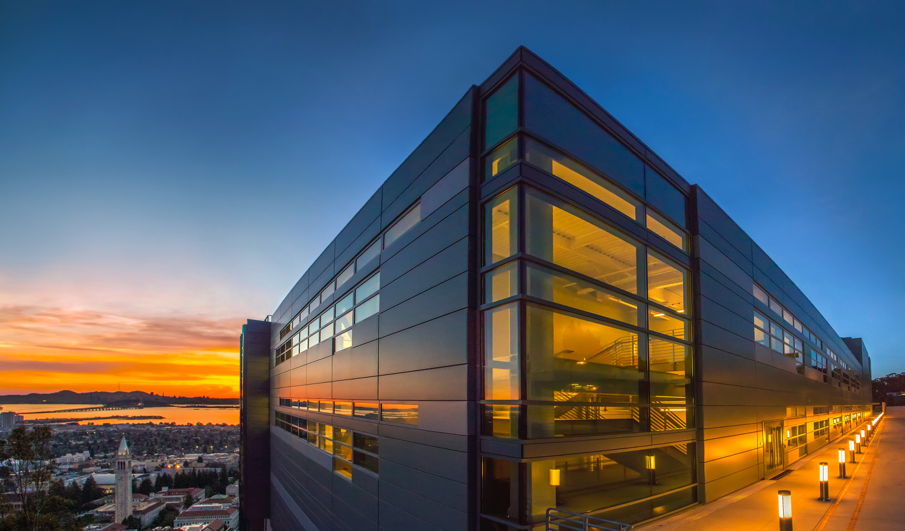


  Antisocial Parallelism:
  Avoiding, Hiding and Managing Communication
Kathy Yelick
Professor of Electrical Engineering and Computer Sciences
U.C. Berkeley
Associate Laboratory Director
Computing Sciences
Lawrence Berkeley National Laboratory

Slide 2
Breakthrough science conjecture
Exascale computing, combined with state-of-the-art mathematical models, algorithms, software techniques and data will enable breakthrough science
Notes:
Exascale success can be measured many ways (peak, HPL, GB)
but the rest of the science community will care about science breakthroughs

Slide 3
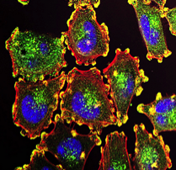
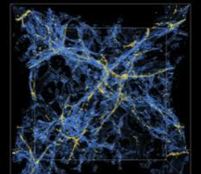

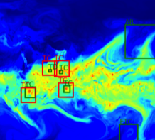
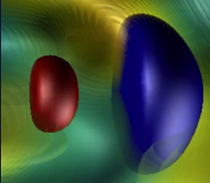

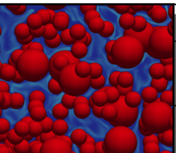
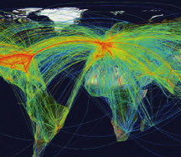
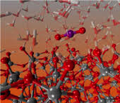
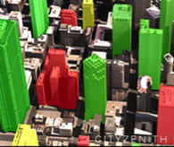
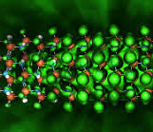
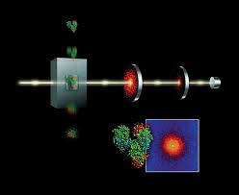
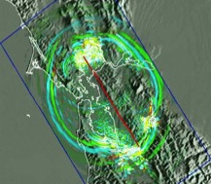
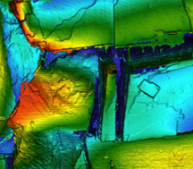
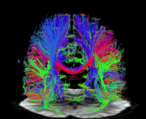
The Science Challenges at Exascale
multimodal multiscale
complexity data size
resolution multiphysics
Cancer
Simulation and Data
Cosmology
Astrophysics
Climate
Accelerators
Genomics
Data
Simulation
Carbon Capture
Transportation
Chemistry
Urban
Brain
Materials
Photon Science
Earthquakes
Subsurface
Notes:
DOE should have a facility dedicated to …

Slide 4



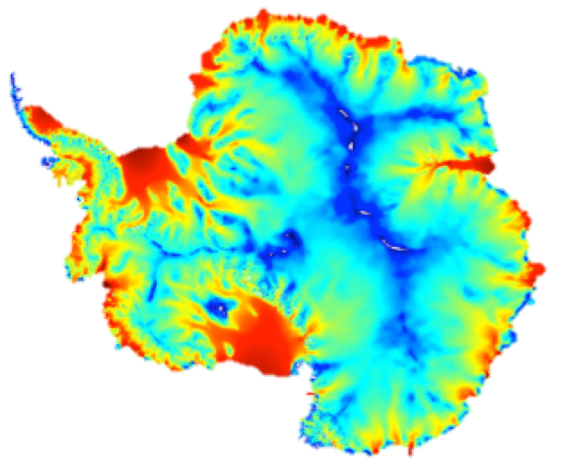


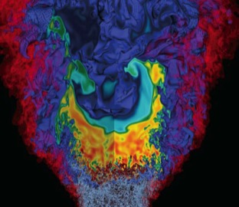

Berkeley Lab Priorities in Exascale Science
Accelerators
Subsurface
Astrophysics
Climate
Cosmology
Carbon Capture
Combustion
Earthquakes
Chemistry
Urban
Genomics
Photon Science,,,

Slide 5
Berkeley Lab Priorities in Exascale Science
Accelerators
Subsurface
Astrophysics
Climate
Cosmology
Carbon Capture
Combustion
Earthquakes
All the above will use Adaptive Mesh Refinement (AMR) mathematics and software,
a method pioneered at Berkeley Lab

Slide 6
Breakthrough science conjecture
Computing challenges at the exascale
Notes:
Exascale success can be measured many ways (peak, HPL, GB)
but the rest of the science community will care about science breakthroughs

Slide 7
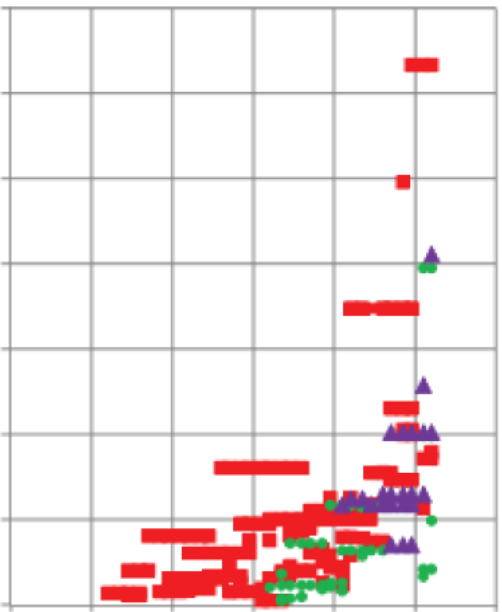
Computing is energy-constrained
At ~$1M per MW, energy costs are substantial
1 petaflop in 2008 used 3 MW
1 exaflop in 2018 at 200 MW “usual chip scaling”
Missing Tihanhe-2 at 18MW
TaihuLight at 15 MW
12
10
8
6
4
2
Goal: 1 Exaflop in 20 MW
= 20 pJ / operation
Note: The 20 pJ / operation is
Independent of machine size
Independent of # cores used per application
But “operations” need to be useful ones
Megawatts per machine
(Kogge/Shalf)
’92 ’96 ’00 ‘04 ‘08 ‘12 ‘16
Notes:
Tianhe-2 is not on here: 17.5MW for the system, 24MW including cooling and power loss

Slide 8
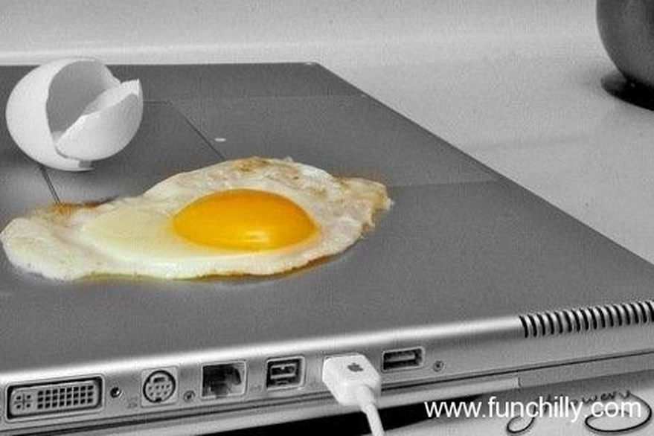
What Limits Computer Performance?

Slide 9
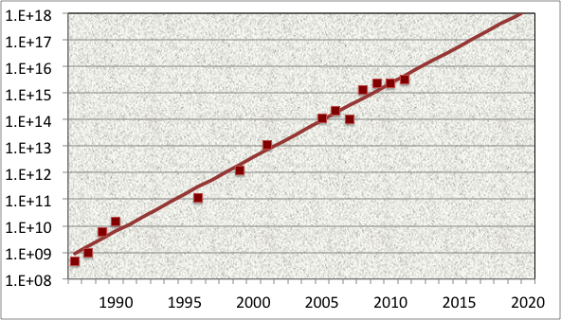
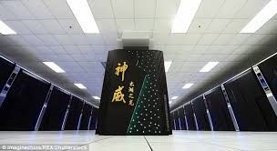






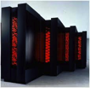



Computational Science has Moved through Difficult Technology Transitions
  Application Performance Growth
  (Gordon Bell Prizes)
Specialization at end of transistor scaling
Flop/s
Attack of the
“killer cellphones”?
The rest of the computing world gets parallelism
Attack of the “killer micros”

Slide 10
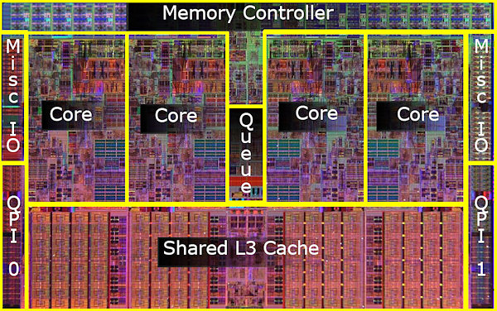
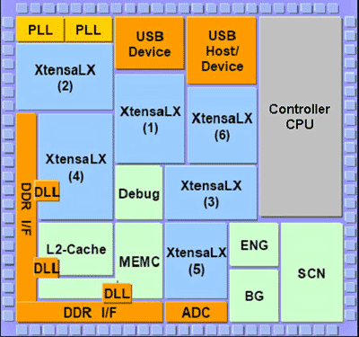
Lightweight Cores are the Future
Cell phone processor (0.1 Watt, 4 Gflop/s)
Server processor (100 Watts, 50 Gflop/s)
Small, simple cores are energy and area efficient
  10-100x more energy efficient
Encourage “parallel thinking” in algorithms and software

Slide 11
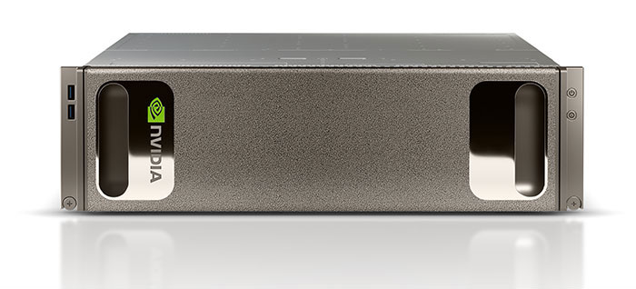
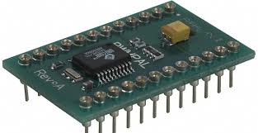
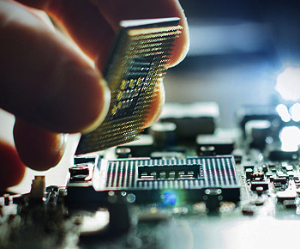
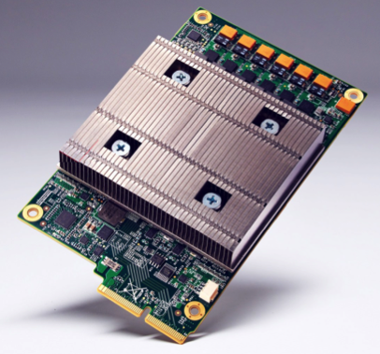
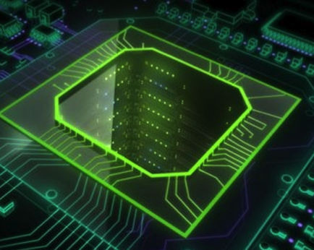
Specialization: End Game for Moore’s Law
FPGAs
NVIDIA builds deep learning appliance with P100 Tesla’s
Intel buys deep learning startup, Nervana
Google designs its own Tensor Processing Unit (TPU)

Slide 12

What’s the most expensive operation on a computer?
The memory wall (or swamp)

Slide 13
Data Movement is Expensive
CPU cycle time vs memory access time
Disk
SSD
DRAM
SRAM
CPU
Source: http://csapp.cs.cmu.edu/2e/figures.html, http://csapp.cs.cmu.edu/3e/figures.html

Slide 14
Data Movement is Expensive
Hierarchical energy costs.
6 pJ
Cost to move data 1 mm on-chip
100 pJ
Typical cost of a single floating point operation
120 pJ
Cost to move data 20 mm on chip
250 pJ
Cost to move off-chip,
but stay within the package (SMP)
2000 pJ
Cost to move data off chip
into DRAM
~2500 pJ
Cost to move data off chip
to a neighboring node
Image: http://slideplayer.com/slide/7541288/
Notes:
From: OpenSoC Fabric slides. Farzad Fatollahi-Fard

Slide 15
Synchronization is Expensive
Machines will have Frequent Faults and “Performance Instability”
Do all applications become “irregular”?
Locality-Load balance trade-off
  Most work on dynamic scheduling is inside a shared memory node
  Largest variability will be between nodes
Brian van Straalen, DOE Exascale Research
Conference, April 16-18, 2012. Impact of persistent
ECC memory faults.

Slide 16
Breakthrough science conjecture
Programming languages and compilers for exascale
Notes:
Exascale success can be measured many ways (peak, HPL, GB)
but the rest of the science community will care about science breakthroughs

Slide 17
Breakthrough science conjecture
The biggest concern for Exascale application developers is the need to write and maintain multiple versions of their software and the uncertainty over what the architectures will be.
Notes:
Exascale success can be measured many ways (peak, HPL, GB)
but the rest of the science community will care about science breakthroughs

Slide 18
Why develop new languages?
Productivity: higher level syntax
  We need a language
Correctness: static analysis can eliminate errors
  We need a compiler (front-end)
Performance: optimizations
  We need a compiler (back-end)
But you need to “know your audience”
  Need to rewrite installed base of code (anti-productivity)
  Risk of compiler disappearing (maintainability)
  Syntax matters (familiarity)
Language adoption is often about its libraries
Language design enforces clarity in concepts

Slide 19
Programming for diverse (specialized) architectures
Two “hard” compiler problems:
  dependence analysis and
  accurate performance models
Autotuners are code generators plus search
Domain-Specific Languages help with this
Autotuning avoids this problem
Xeon X5550 (Nehalem)
NVIDIA C2050 (Fermi)
1024
1024
single-precision peak
512
512
double-precision peak
256
single-precision peak
256
DGEMM
DP add-only
128
double-precision peak
128
RTM/wave eqn.
Gflop/s
Gflop/s
64
DP add-only
DGEMM
64
Device bandwidth
32
STREAM bandwidth
RTM/wave eqn.
32
27pt Stencil
16
7pt Stencil
27pt Stencil
16
7pt Stencil
GTC/pushi
SpMV
GTC/pushi
8
SpMV
8
4
GTC/chargei
4
GTC/chargei
2
2
¹/₃₂
¹/₁₆
¹/₈
¹/₄
¹/₂
1
2
4
8
16
32
¹/₃₂
¹/₁₆
¹/₈
¹/₄
¹/₂
1
2
4
8
16
32
Algorithmic intensity: Flops/Word
Algorithmic intensity: Flops/Word
Work by Williams, Oliker, Shalf, Madduri, Kamil, Im, Ethier,…

Slide 20
Libraries vs. DSLs (domain-specific languages)
NERSC survey: what motifs do they use?
What code generators do we have?
Dense Linear Algebra | Atlas
Spectral Algorithms | FFTW, Spiral
Sparse Linear Algebra | OSKI
Structured Grids | TBD
Unstructured Grids
Particle Methods
Monte Carlo
Unstructured
Stencils are both the most important motifs and a gap in our tools

Slide 21
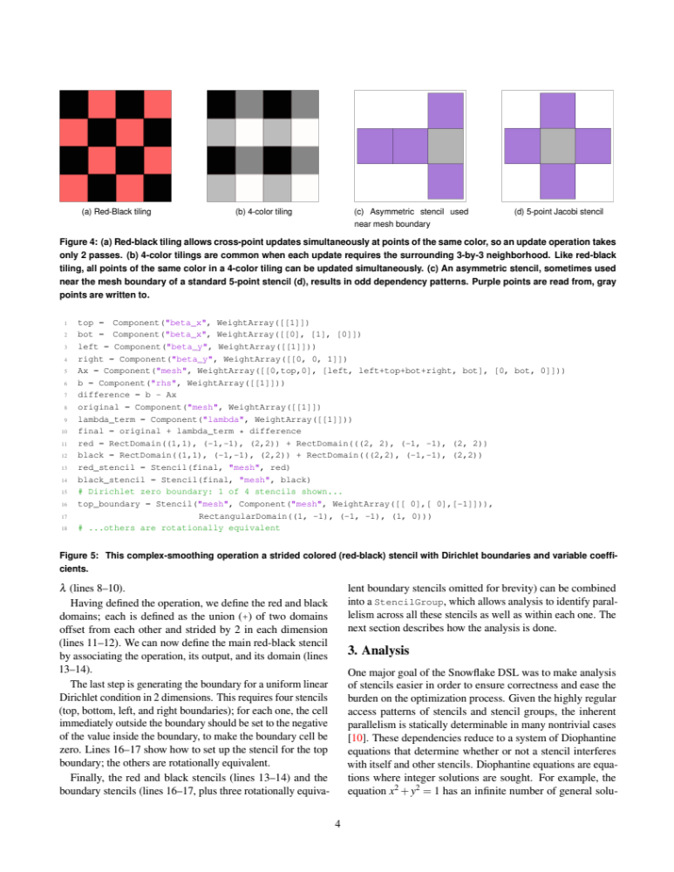
Approach: Small Compiler for Small Language
Snowflake: A DSL for Science Stencils
  Domain calculus inspired by Titanium, UPC++, and AMR in general
Complex stencils: red/black, asymmetric
Update-in-place while preserving provable parallelism
Complex boundary conditions: key to Adaptive Meshes

Slide 22
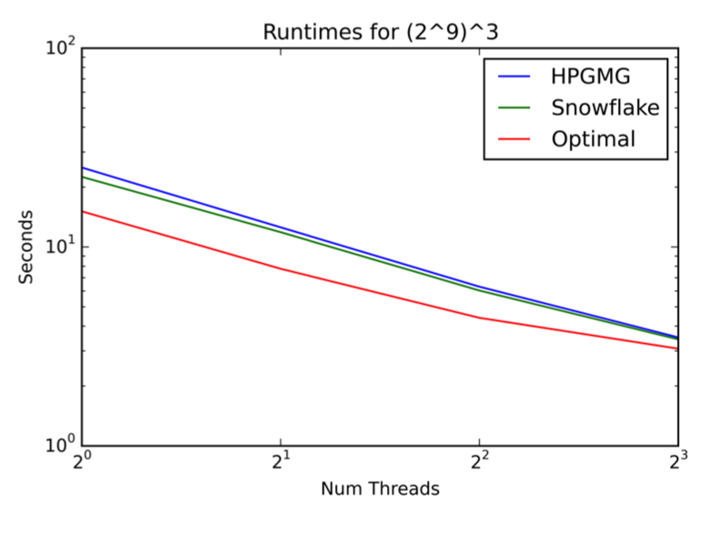
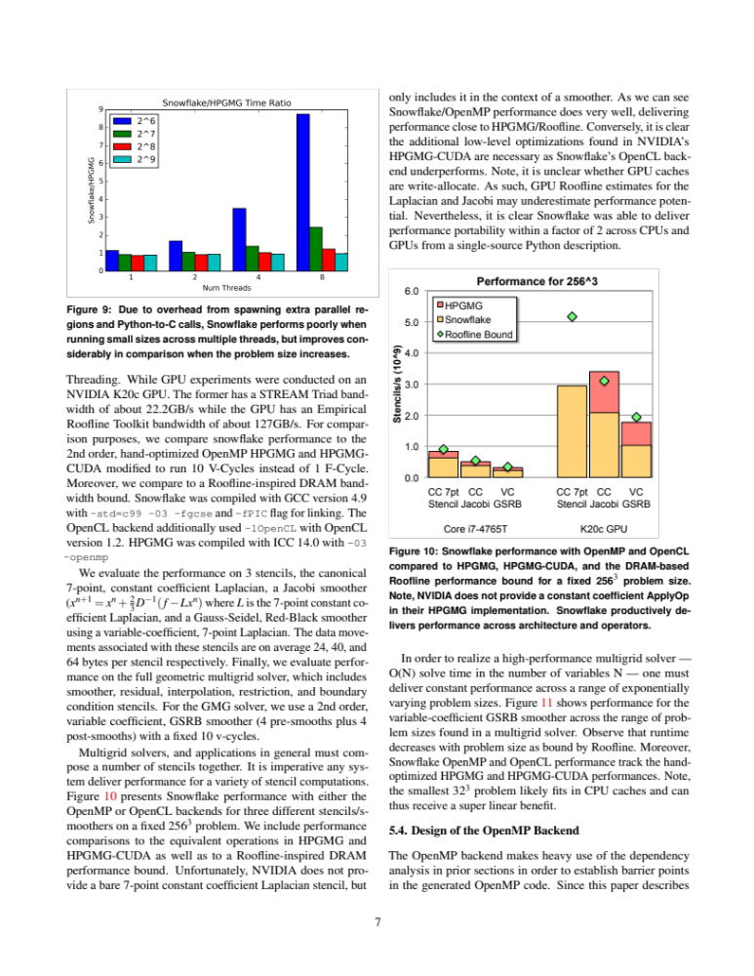
Snowflake performance
Performance on the HPGMG application benchmark using all the features of Snowflake
Competitive with hand-optimized performance
Within 2x of optimal roofline
Nathan Zhang, C. Markley, S. Williams, A. Fox

Slide 23
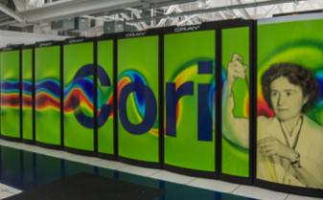
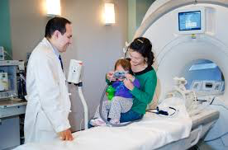
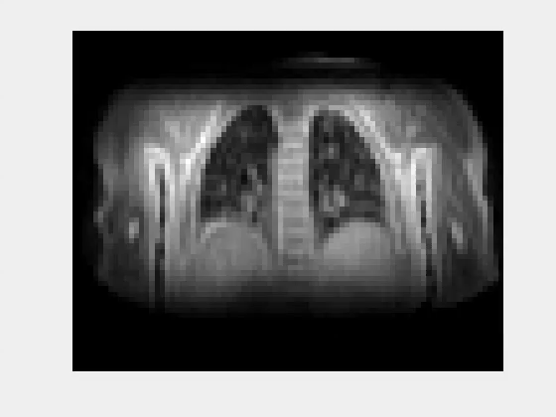
Real-Time MRI Challenge
Time (min) | Architecture
6.15 | KNL
5.42 | Ivy Bridge
4.47 | Broadwell
4.31 | Kepler
4.12 | Haswell
3.71 | Broadwell
3.16 | Kepler
0.94 | Pascal
3 min goal
Compressed Sensing Approach by Mike Lustig et al
MRI results Wenwen Jiang
Michael Driscoll HPC optimization

Slide 24


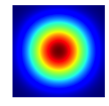
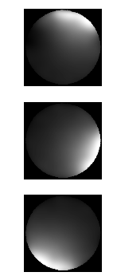

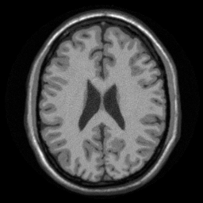
Matrix-free (loop optimization) vs. Matrix-full
coil data sample KB kernel FFT preapodize sens. maps image
Loops | Structured matrices | Matrices
Operators as loop nests | Operators as matrices with structure that compiler can optimize | Operators as arbitrary sparse matrices

Slide 25
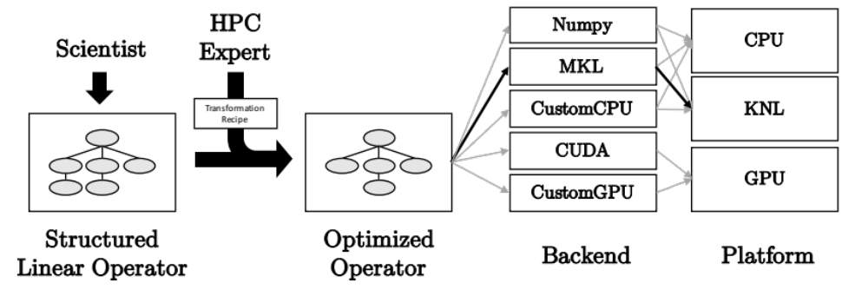
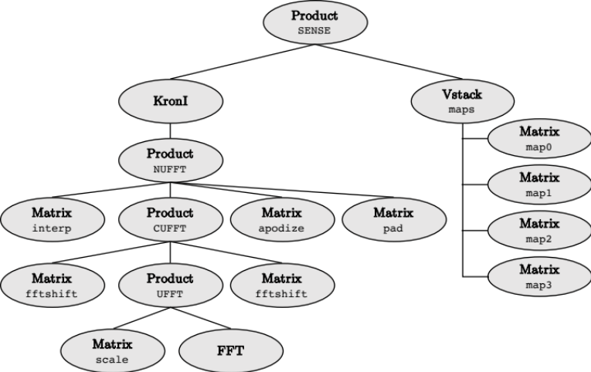
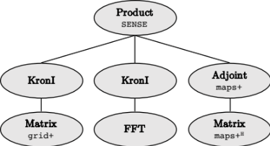
Domain-specific library with runtime optimizations
Tree transformation with matrix pattern knowledge

Slide 26
Python-Based Domain-Specific Language (EDSL)
Haswell Xeon Phi (KNL) GPU (Pascal)
Original Numpy code on Haswell: 87 sec/iteration
Runtime optimization reorganize tree of operators (matrices + FFTs) cognizant of matrix structure
Library or custom matrix kernels

Slide 27
Compiler challenges
Auto-SIMDization
Auto-parallelism for attached accelerators
Auto-vectorization for vector processors
Auto-parallelization for SMPs
Auto-parallelization for HPC
Architecture difficulty
(related to granularity of parallelism)
Autotuner code generation
General purpose strongly typed
General purpose loosely typed
Domain specific (in degrees of specificity)
Language difficulty

Slide 28
Avoiding Communication in Iterative Solvers
Consider Sparse Iterative Methods for Ax=b
  Krylov Subspace Methods: GMRES, CG,…
Solve time dominated by:
  Sparse matrix-vector multiple (SPMV)
    Which even on one processor is dominated by “communication” time to read the matrix
  Global collectives (reductions)
    Global latency-limited
Can we lower the communication costs?
  Latency: reduce # messages by computing multiple reductions at once
  Bandwidth to memory, i.e., compute Ax, A²x, … A^{k}x with one read of A
Joint work with Jim Demmel, Mark Hoemman, Marghoob Mohiyuddin

Slide 29
Communication Avoiding Kernels
The Matrix Powers Kernel : [Ax, A²x, …, A^{k}x]
Replace k iterations of y = A⋅x with [Ax, A²x, …, A^{k}x]
Idea: pick up part of A and x that fit in fast memory, compute each of k products
Example: A tridiagonal matrix (a 1D “grid”), n=32, k=3
General idea works for any “well-partitioned” A
A³·x
A²·x
A·x
x
1 2 3 4 …
… 32
Notes:
C. J. Pfeifer, Data flow and storage allocation for the PDQ-5 program
on the Philco-2000, Comm. ACM 6, No. 7 (1963), 365366.
Referred to in paper by Leiserson/Rao/Toledo/ in 1993 paper on blocking covers

Slide 30
Communication Avoiding Kernels (Sequential case)
The Matrix Powers Kernel : [Ax, A²x, …, A^{k}x]
Replace k iterations of y = A⋅x with [Ax, A²x, …, A^{k}x]
Sequential Algorithm
Example: A tridiagonal, n=32, k=3
Saves bandwidth (one read of A&x for k steps)
Saves latency (number of independent read events)
Step 1
Step 2
Step 3
Step 4
A³·x
A²·x
A·x
x
1 2 3 4 …
… 32

Slide 31
Communication Avoiding Kernels:
(Parallel case)
The Matrix Powers Kernel : [Ax, A²x, …, A^{k}x]
Replace k iterations of y = A⋅x with [Ax, A²x, …, A^{k}x]
Parallel Algorithm
Example: A tridiagonal, n=32, k=3
Each processor works on (overlapping) trapezoid
Saves latency (# of messages); Not bandwidth
But adds redundant computation
Proc 1
Proc 2
Proc 3
Proc 4
A³·x
A²·x
A·x
x
1 2 3 4 …
… 32

Slide 32
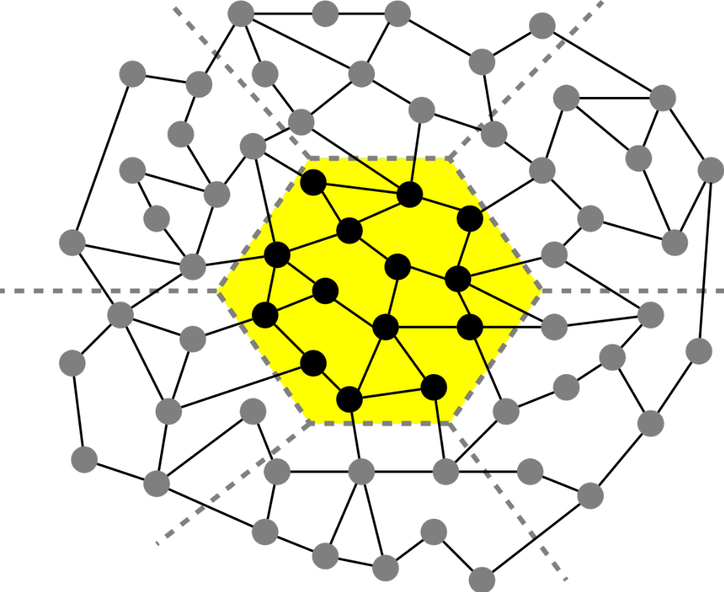
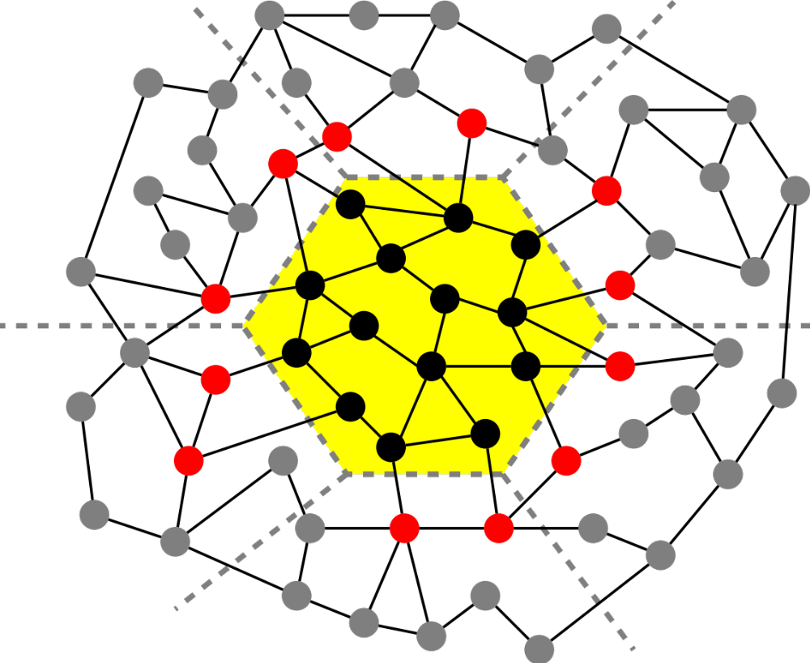
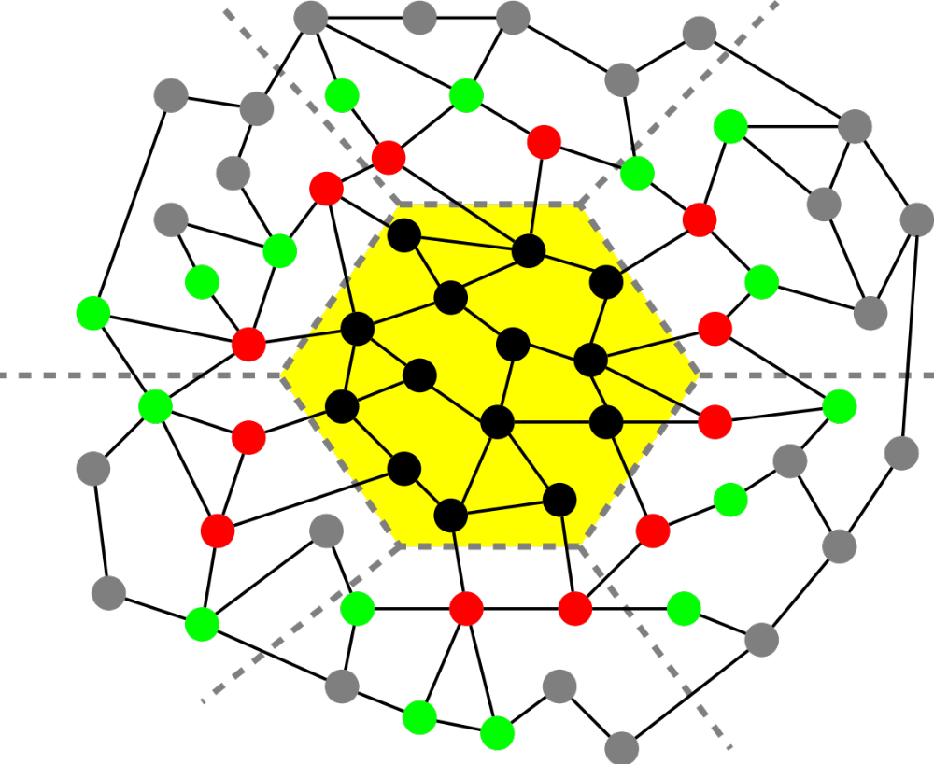
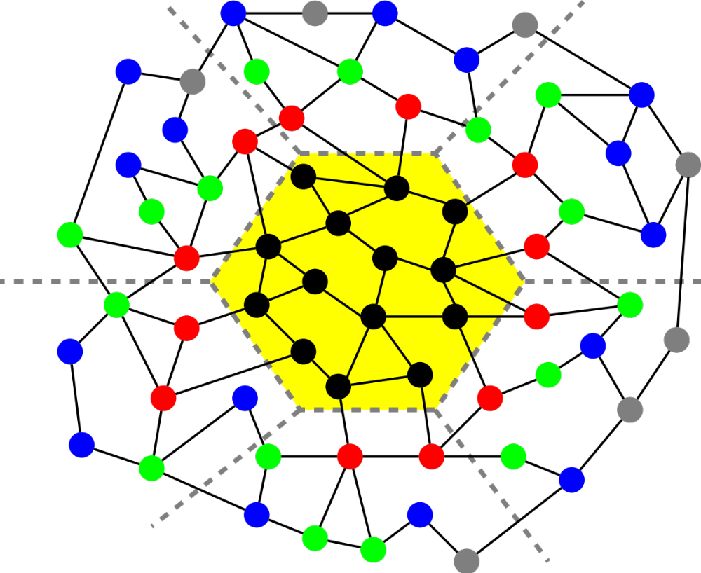
Matrix Powers Kernel on a General Matrix
For implicit memory management (caches) uses a TSP algorithm for layout
Joint work with Jim Demmel, Mark Hoemman, Marghoob Mohiyuddin
Saves communication for “well partitioned” matrices
    Serial: O(1) moves of data moves vs. O(k)
    Parallel: O(log p) messages vs. O(k log p)

Slide 33
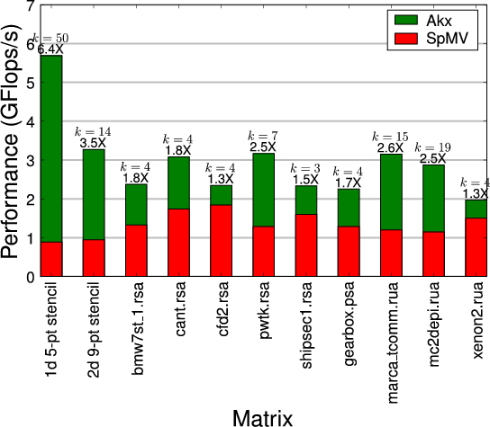
A^{k}x has higher performance than Ax
Speedups on Intel Clovertown (8 core)
Jim Demmel, Mark Hoemmen, Marghoob Mohiyuddin, Kathy Yelick

Slide 34
Minimizing Communication of GMRES to solve Ax=b
GMRES: find x in span{b,Ab,…,A^{k}b} minimizing || Ax-b ||₂
Standard GMRES
for i=1 to k
w = A · v(i-1) … SpMV
MGS(w, v(0),…,v(i-1))
update v(i), H
endfor
solve LSQ problem with H
Communication-avoiding GMRES
W = [ v, Av, A²v, … , A^{k}v ]
[Q,R] = TSQR(W)
… “Tall Skinny QR”
build H from R
solve LSQ problem with H
Sequential case: #words moved decreases by a factor of k
Parallel case: #messages decreases by a factor of k
Oops – W from power method, precision lost!
Notes:
34

Slide 35
TSQR: An Architecture-Dependent Algorithm
W₀
W₁
W₂
W₃
R₀₀
R₁₀
R₂₀
R₃₀
R₀₁
Parallel:
W =
R₀₂
R₁₁
W₀
W₁
W₂
W₃
R₀₀
Sequential:
R₀₁
W =
R₀₂
R₀₃
Work by Laura Grigori, Jim Demmel, Mark Hoemmen, Julien Langou
W₀
W₁
W₂
W₃
R₀₀
R₀₁
Dual Core:
R₀₁
W =
R₀₂
R₁₁
R₀₃
R₁₁
Multicore / Multisocket / Multirack / Multisite / Out-of-core: ?
Can choose reduction tree dynamically
Notes:
Oldest reference for idea of tree: Golub/Plemmons/Sameh 1988,
But didn’t avoid communication

Slide 36
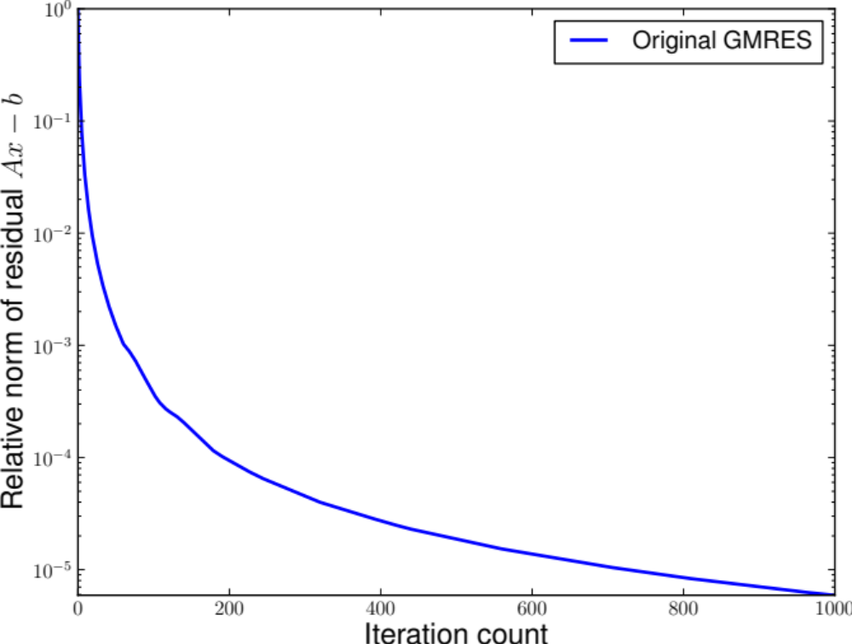
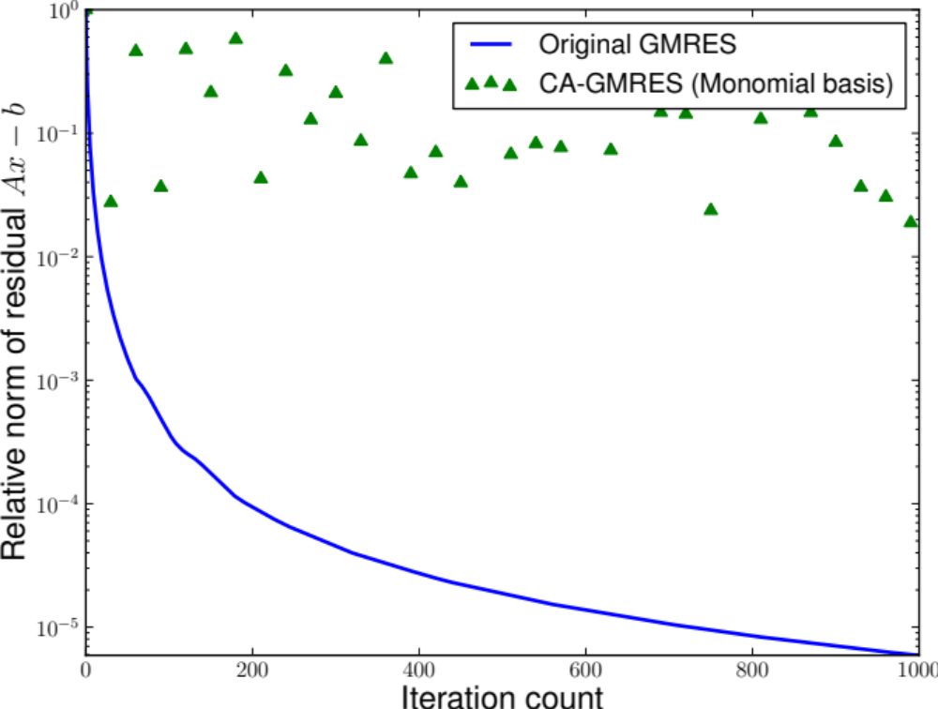
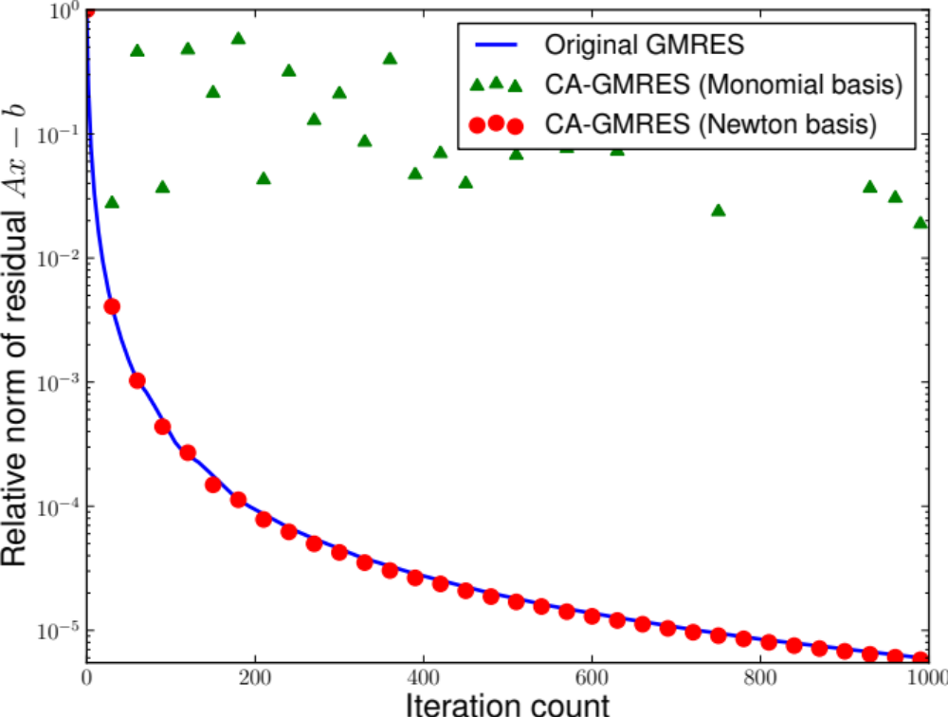
Matrix Powers Kernel (and TSQR) in GMRES
Jim Demmel, Mark Hoemmen, Marghoob Mohiyuddin, Kathy Yelick

Slide 37
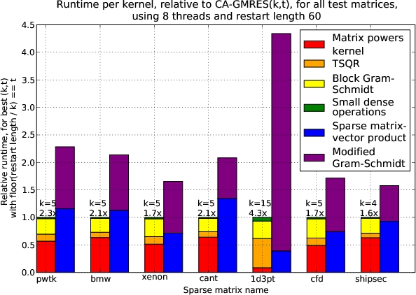
Communication-Avoiding Krylov Method (GMRES)
Performance on 8 core Clovertown

Slide 38



  DSLs popular outside scientific computing
Developed for Image Processing
  10+ FTEs developing Halide
  50+ FTEs use it; > 20 kLOC
HPGMG (Multigrid on Halide)
Halide Algorithm by domain expert
Halide Schedule either
  Auto-generated by autotuning with opentuner
  Or hand created by an optimization expert
Halide performance
Autogenerated schedule for CPU
Hand created schedule for GPU
No change to the algorithm
g+
Image
Auto
Enhance
Func Ax_n("Ax_n"), lambda("lambda"), chebyshev("chebyshev");
Var i("i"),j("j"),k("k");
Ax_n(i,j,k) = a*alpha(i,j,k)*x_n(i,j,k) - b*h2inv*(
beta_i(i,j,k) *(valid(i-1,j,k)*(x_n(i,j,k) + x_n(i-1,j,k)) - 2.0f*x_n(i,j,k))
+ beta_j(i,j,k) *(valid(i,j-1,k)*(x_n(i,j,k) + x_n(i,j-1,k)) - 2.0f*x_n(i,j,k))
+ beta_k(i,j,k) *(valid(i,j,k-1)*(x_n(i,j,k) + x_n(i,j,k-1)) - 2.0f*x_n(i,j,k))
+ beta_i(i+1,j,k)*(valid(i+1,j,k)*(x_n(i,j,k) + x_n(i+1,j,k)) - 2.0f*x_n(i,j,k))
+ beta_j(i,j+1,k)*(valid(i,j+1,k)*(x_n(i,j,k) + x_n(i,j+1,k)) - 2.0f*x_n(i,j,k))
+ beta_k(i,j,k+1)*(valid(i,j,k+1)*(x_n(i,j,k) + x_n(i,j,k+1)) - 2.0f*x_n(i,j,k)));
lambda(i,j,k) = 1.0f / (a*alpha(i,j,k) - b*h2inv*(
beta_i(i,j,k) *(valid(i-1,j,k) - 2.0f)
+ beta_j(i,j,k) *(valid(i,j-1,k) - 2.0f)
+ beta_k(i,j,k) *(valid(i,j,k-1) - 2.0f)
+ beta_i(i+1,j,k)*(valid(i+1,j,k) - 2.0f)
+ beta_j(i,j+1,k)*(valid(i,j+1,k) - 2.0f)
+ beta_k(i,j,k+1)*(valid(i,j,k+1) - 2.0f)));
chebyshev(i,j,k) = x_n(i,j,k) + c1*(x_n(i,j,k)-x_nm1(i,j,k))+
c2*lambda(i,j,k)*(rhs(i,j,k)-Ax_n(i,j,k));

Slide 39
Breakthrough science conjecture
Open Problem: Compiling for communication optimality…
... with irregular loop nests and sparsity
Notes:
Exascale success can be measured many ways (peak, HPL, GB)
but the rest of the science community will care about science breakthroughs

Slide 40
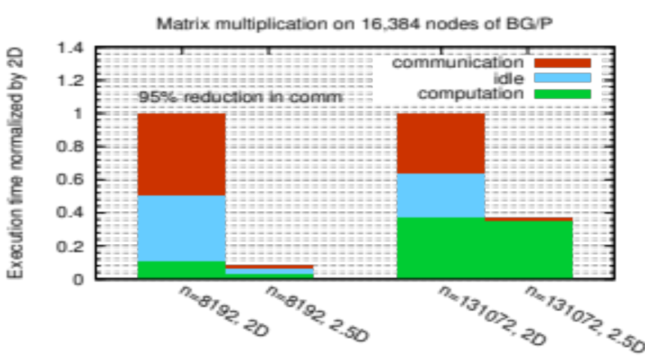
Beyond Domain Decomposition
2.5D Matrix Multiply on BG/P, 16K nodes / 64K cores
c = 16 copies
Surprises:
Even Matrix Multiply had room for improvement
Idea: make copies of C matrix (as in prior 3D algorithm, but not as many)
Result is provably optimal in communication
Lesson: Never waste fast memory
And don’t get hung up on the owner computes rule
Can we generalize for compiler writers?
EuroPar’11 (Solomonik, Demmel)
SC’11 paper (Solomonik, Bhatele, Demmel)
Notes:
SC’11 paper about need to fully utilize 3D torus network on BG/P to get this to work

Slide 41
Deconstructing 2.5D Matrix Multiply
Solomonick & Demmel
x
k
y
Tiling the iteration space
2D algorithm: never chop k dim
2.5 or 3D: Assume + is associative; chop k, which is → replication of C matrix
z
y
z
j
x
i
Matrix Multiplication code has a 3D iteration space
Each point in the space is a constant computation (*/+)
for i
for j
for k
C[i,j] …
A[i,k] …
B[k,j] …

Slide 42
Beyond Domain Decomposition
Much of the work on compilers is based on owner-computes (domain decomposition)
  For MM: Divide C into chunks, schedule movement of A/B
  Data-driven domain decomposition partitions data; but we can partition work instead
Ways to compute C “pencil”
  Serially
  Parallel reduction
  Parallel asynchronous (atomic) updates
  Or any hybrid of these
For what types / operators does this work?
  “+” is associative for 1,2 rest of RHS is “simple”
  and commutative for 3
x += …
x += …
x += …
x += …
Standard vectorization trick
Using x for C[i,j] here

Slide 43
Lower Bound: What is the minimum amount of communication required?
Load
Load
Segment 1
Load
FLOP
Matrix Multiply Proof from Irony/Toledo/Tiskin (2004)
Assume fast memory of size M
How much work (F) can we do with O(M) data?
For matrix multiplication, this uses a result from Loomis an Whitney (1949)
  # cubes in 3D set = Volume of 3D set
  ≤ (area(A shadow) * area(B shadow) *
  area(C shadow)) ^{1/2}
Store
FLOP
Segment 2
Load
Load
Load
Time
FLOP
FLOP
Segment 3
FLOP
Store
Store
FLOP
Store
Load
FLOP
...

Slide 44
Generalizing Communication Lower Bounds and Optimal Algorithms
For serial matmul, we know #words_moved = Ω (n³/M^{1/2}), attained by tile sizes M^{1/2} x M^{1/2}
Thm (Christ,Demmel,Knight,Scanlon,Yelick): For any program that “smells like” nested loops, accessing arrays with subscripts that are linear functions of the loop indices
#words_moved = Ω (#iterations/Me)
for some e we can determine
Thm (C/D/K/S/Y): Under some assumptions, we can determine the optimal tiles sizes
  E.g., index expressions are just subsets of indices
Long term goal: All compilers should generate communication optimal code from nested loops
Notes:
Linear functions of the loop indices means subscripts can be j, j+3*k, 7*i-2*j+4*k, etc.
“Smells like” nested loops means sparse accesses, pointer references, etc are ok.
For example, this includes not just linear algebra, but direct n-body, database join, etc.
The theory to determine e requires some recent deep mathematical results using functional analysis
and group theory, due to a team of pure mathematicians including Mike Christ @ Berkeley, Terry Tao @UCLA, others.
The original characterization of e was not necessarily even decidable (Hilbert’s 10th problem over rationals), but
We think it is now decidable (still writing it up).
The assumptions in the second theorem are that
Dependencies permit us to reorder loop iterations as needed (matmul being an example)
Array subscripts are just subset of the loop indices (again like matmul, where loop indices are i,j,k, and
Subscripts are A(i,k), B(k,j), C(i,j)
We are still working on generalizing these assumptions.

Slide 45
Using .5D ideas on N-body
n particles, k-way interaction.
  Molecules, stars in galaxies, etc.
Most common: 2-way N-body
Best algorithm is to divide n particles into p groups??
for t timesteps
forall i₁, …, i_{k}
force[i₁] += interact(particle[i₁], …, particle[i_{k}])
forall i
move(particle[i], force[i])
O(n^{k}).
.......................................................................................
No!

Slide 46
Communication Avoiding 2-way N-body
(using a “1.5D” decomposition)
p/c
............
............
............
............
............
............
............
............
............
............
............
............
............
............
............
............
............
............
............
............
............
............
............
............
............
............
c
............
............
............
............
............
............
............
............
............
............
............
............
............
............
............
............
............
............
............
............
............
............
............
............
............
............
Divide p into c groups
Replicate particles across groups
Repeat: shift copy of n/(p*c) particles to the left within a group
Reduce across c to produce final value for each particle
  Total Communication: O(log(p/c) + log c) messages,
  O(n*(c/p+1/c)) words
Driscoll, Georganas, Koanantakool, Solomonik, Yelick

Slide 47

Less Communication..
Cray XE6; n=24K particles, p=6K cores
Down is good
96% reduction in shift time (red)
Notes:
= 78.38

Slide 48

Strong Scaling of 1.5D N-body
Up is good
4.4x

Slide 49


Challenge: Symmetry & Load Balance
Force symmetry (f_{ij} = -f_{ji}) saves computation
2-body force matrix vs 3-body force cube
How to divide work equally?
6x save
of O(n³)!
2x save
of O(n²)

Slide 50


Communication-Avoiding 3-body
p=5 (in colors)
6 particles per processor
5x5 subcubes
Equivalent triplets in the big tetrahedron
Communication optimal.
Replication by c decreases
#messages by c³ and #words by c²
Actual triplets
    [Koanantakool and Yelick

Slide 51

3-Way N-Body Speedup
Cray XC30, 24k cores, 24k particles
Down is good
22.1x
Koanantakool & Yelick
Notes:
C=64
22.13x speedup
99.95% reduction in communication time

Slide 52

Perfect Strong Scaling
BlueGene/Q 16k particles, Strong Scaling
Up is good
42x
Koanantakool & Yelick

Slide 53

Sparse-Dense Matrix Multiply Too!
Variety of algorithms that divide in or 2 dimensions
Koanantakool et al

Slide 54

100x Improvement
A^{66k x 172k}, B^{172k x 66k}, 0.0038% nnz, Cray XC30
Up is good
100x
Koanantakool & Yelick
Notes:
Stochastic linear programming problem

Slide 55
Linear Algebra is important to Machine Learning too!
Logistic Regression, Support Vector Machines
Dimensionality Reduction (e.g., NMF, CX/CUR, PCA)
Clustering (e.g., MCL, Spectral Clustering)
Graphical Model Structure Learning (e.g., CONCORD)
Deep Learning (Convolutional Neural Nets)
Sparse Matrix-Sparse Vector (SpMSpV)
Sparse Matrix-Dense Vector (SpMV)
Sparse Matrix Times Multiple Dense Vectors
(SpMM)
Sparse - Sparse Matrix Product
(SpGEMM)
Dense Matrix Vector
(BLAS2)
Sparse - Dense Matrix Product
(SpDM³)
Dense Matrix Matrix (BLAS3)
Increasing arithmetic intensity
Aydin Buluc, Sang Oh, John Gilbert, Kathy Yelick

Slide 56

Inverse Covariance Matrix Estimation (CONCORD)

Slide 57

HP-CONCORD on Brain fMRI data

Slide 58
Breakthrough science conjecture
Problem 3: Runtimes
Notes:
Exascale success can be measured many ways (peak, HPL, GB)
but the rest of the science community will care about science breakthroughs

Slide 59
PGAS: A programming model for exascale
Global address space: thread may directly read/write remote data using an address (pointers and arrays)
  … = *gp; ga[i] = …
Partitioned: data is designated as local or global
shared int [ ] ga; and upc_malloc (…)
x: 1
y:
x: 5
y:
x: 7
y: 0
Examples:
UPC
UPC++
Global address space
l:
l:
l:
g:
g:
g:
p0
p1
pn
A programming model can influence how programmers think

Slide 60
One-Sided Communication is Closer to Hardware
host
CPU
one-sided message
address
data payload
network
interface
two-sided put message
message ID
data payload
memory
Hardware does 1-sided communication
Overhead for send/receive messaging is worse at exascale
2.9 GHz x86
1 GHz x86 (model)
1 GHz 3-SIMT (model)
Nanoseconds
Software Overhead

Slide 61

What we love about Partitioned Global Address Space Programming (PGAS)
Key: Never cache remote data (trivially coherent)
Convenience
  Build large shared structures
  Read and write data “anywhere” (global), “anytime”
  (asynchronous) and without the other thread (one-sided)
Performance control
  Explicit control over data layout, direct use of RDMA hardware

Slide 62
HipMer is all about the runtime and data structures
reads
K-mer Analysis
(synchronous) irregular all-to-all
1
k-mers
2) Contig Generation
asynchronous remote insert (aggregate and overlap) and get
2
contigs
3
3) Alignment
asynchronous remote insert and lookup (software caching)
read-contig
alignments
4) Scaffolding & Gap Closing
asynchronous remote insert and lookup (software caching)
contig-contig scaffolds
4
xxx
xx
xxxx
Notes:
Meta: avoiding using terminology beyond “read”, “kmer”, and “contig”.

Slide 63

Graph algorithms (hash tables) in genome assembly
Graph construction, traversal, and all later stages are written in UPC to take advantage of its global address space
Input: k-mers and their high quality extensions
Read k-mers & extensions
Store k-mers & extensions
Distributed
Hash table
AAC CF
ATC TG
ACC GA
TGA FC
GAT CF
AAT GF
ATG CA
TCT GA
CCG FA
CTG AT
TGC FA
P₀
Fine-grained communication & fine-grained locking required
P₁
…
P_{n}

Slide 64
Lessons in Antisocial Parallelism
Compress Data Structures
Target Higher Level Loops
Understand theory / numerics
Replicate data
Understand theory / lower bounds
Aggregate communication
Overlap communication
Use one-sided communication
Synchronization strength reduction
Combine the techniques

Slide 65

Communication Hurts!

