Slide 1
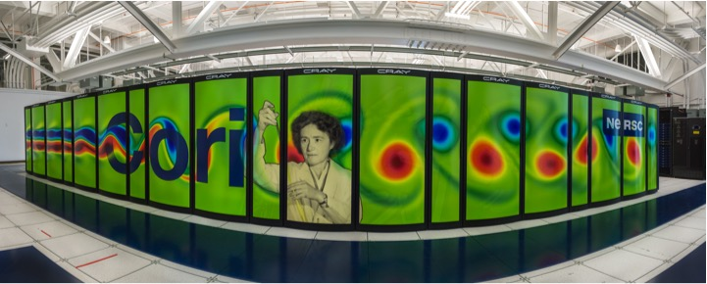
  Avoiding, Hiding and Managing Communication at the Exasacle
Kathy Yelick
Associate Laboratory Director
Computing Sciences
Lawrence Berkeley National Lab
Professor of Electrical Engineering
and Computer Sciences
UC Berkeley

Slide 2
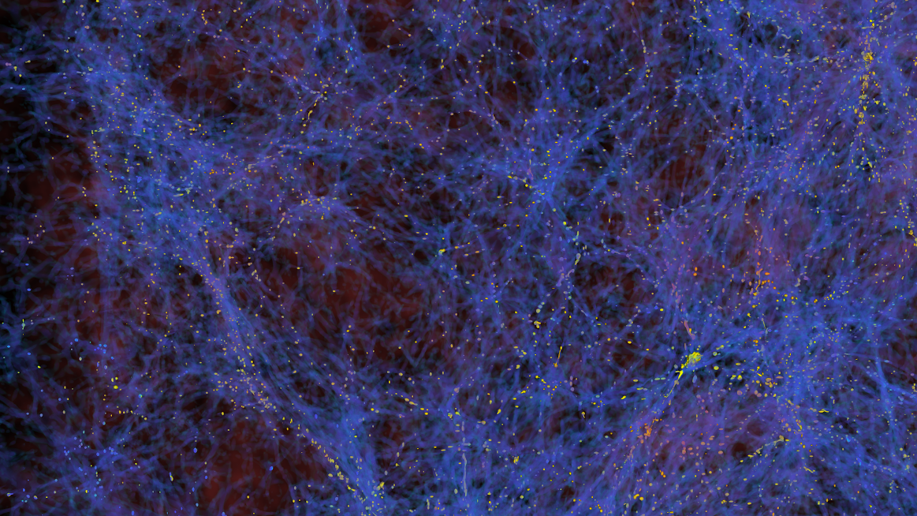
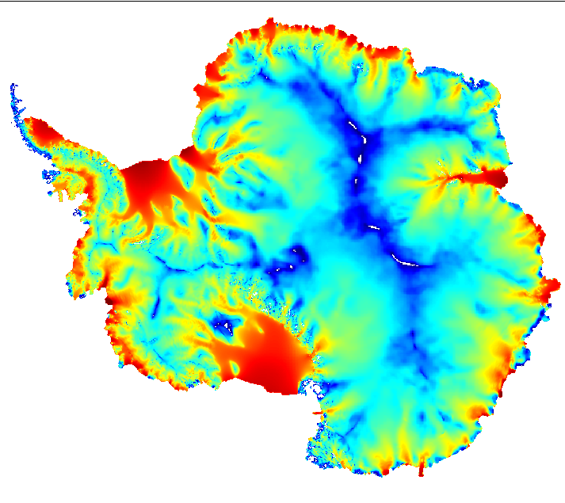

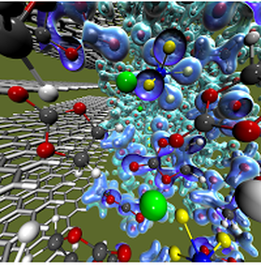
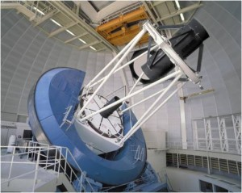
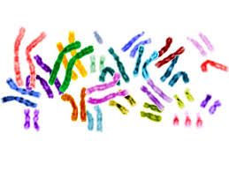
Science at the Boundary of Simulation and Observation
Cosmology
Environment
Materials
In many areas, there are opportunities to combine simulation and observation for new discoveries.
These will require increased computing capabilities.

Slide 3










Hardware Trend: More Parallelism at Lower Levels
More, slower devices; new levels of parallelism
  Application Performance Growth
  (Gordon Bell Prizes)
More, slower cores
Manycore Parallelism
Multicore parallelism
Vector parallelism
ILP,
TLP

Slide 4
Data Movement is Expensive
CPU cycle time vs memory access time
Disk
SSD
DRAM
SRAM
CPU
Sources:
http://csapp.cs.cmu.edu/2e/figures.html, http://csapp.cs.cmu.edu/3e/figures.html

Slide 5
Data Movement is Expensive
Hierarchical energy costs.
6 pJ
Cost to move data 1 mm on-chip
100 pJ
Typical cost of a single floating point operation
120 pJ
Cost to move data 20 mm on chip
250 pJ
Cost to move off-chip,
but stay within the package (SMP)
2000 pJ
Cost to move data off chip
into DRAM
~2500 pJ
Cost to move data off chip
to a neighboring node
Source: http://slideplayer.com/slide/7541288/
Notes:
From: OpenSoC Fabric slides. Farzad Fatollahi-Fard

Slide 6
Summary
More parallelism
Diversity of processors / accelerators
Communication (data movement) is expensive

Slide 7
Compilers and Autotuning

Slide 8
Autotuning: Write Code Generators
Two “unsolved” compiler problems:
  dependence analysis and
  accurate performance models
Autotuners are code generators plus search
Domain-Specific Languages help with this
✔
Autotuning avoids this problem
Xeon X5550 (Nehalem)
NVIDIA C2050 (Fermi)
1024
1024
single-precision peak
512
512
double-precision peak
256
single-precision peak
256
DGEMM
DP add-only
128
double-precision peak
128
RTM/wave eqn.
Gflop/s
Gflop/s
64
DP add-only
DGEMM
64
Device bandwidth
32
STREAM bandwidth
RTM/wave eqn.
32
27pt Stencil
16
7pt Stencil
27pt Stencil
16
7pt Stencil
GTC/pushi
SpMV
GTC/pushi
8
SpMV
8
4
GTC/chargei
4
GTC/chargei
2
2
¹/₃₂
¹/₁₆
¹/₈
¹/₄
¹/₂
1
2
4
8
16
32
¹/₃₂
¹/₁₆
¹/₈
¹/₄
¹/₂
1
2
4
8
16
32
Algorithmic intensity: Flops/Word
Algorithmic intensity: Flops/Word
Work by Williams, Oliker, Shalf, Madduri, Kamil, Im, Ethier,…

Slide 9
Libraries vs. DSLs (domain-specific languages)
NERSC survey: what motifs do they use?
What code generators do we have?
Dense Linear Algebra | Atlas
Spectral Algorithms | FFTW, Spiral
Sparse Linear Algebra | OSKI
Structured Grids | TBD
Unstructured Grids
Particle Methods
Monte Carlo
Unstructured
Stencils are both the most important motifs and a gap in our tools

Slide 10
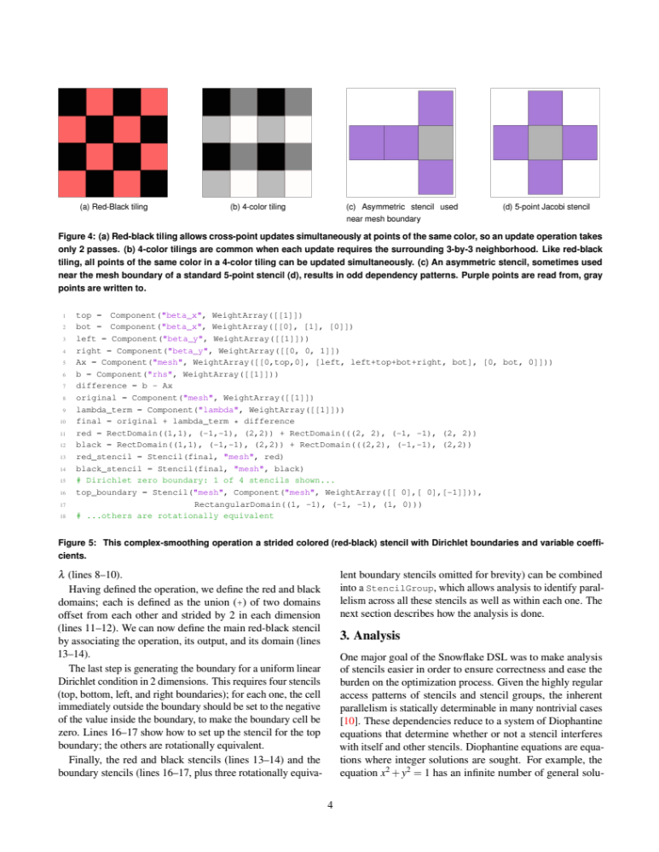
Approach: Small Compiler for Small Language
Snowflake: A DSL for Science Stencils
  Domain calculus inspired by Titanium, UPC++, and AMR in general
Complex stencils: red/black, asymmetric
Update-in-place while preserving provable parallelism
Complex boundary conditions

Slide 11
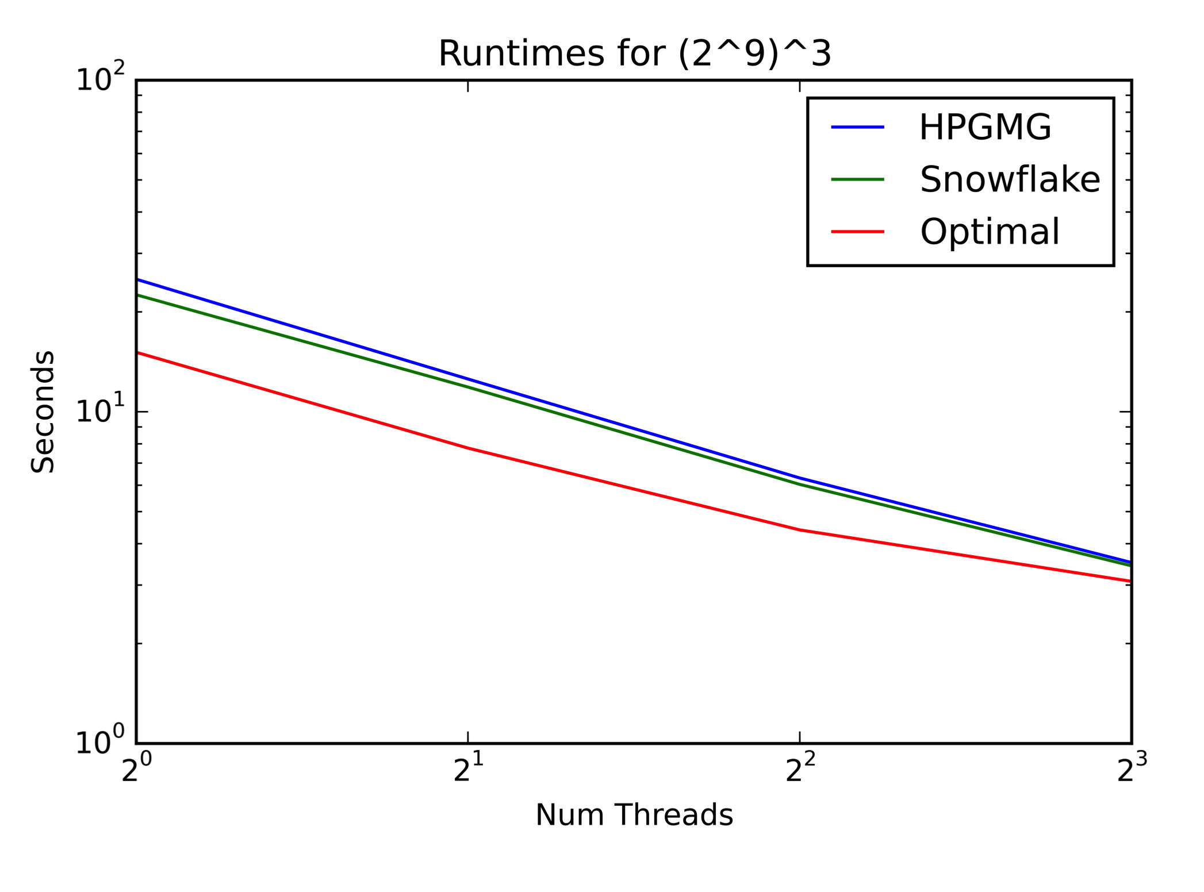
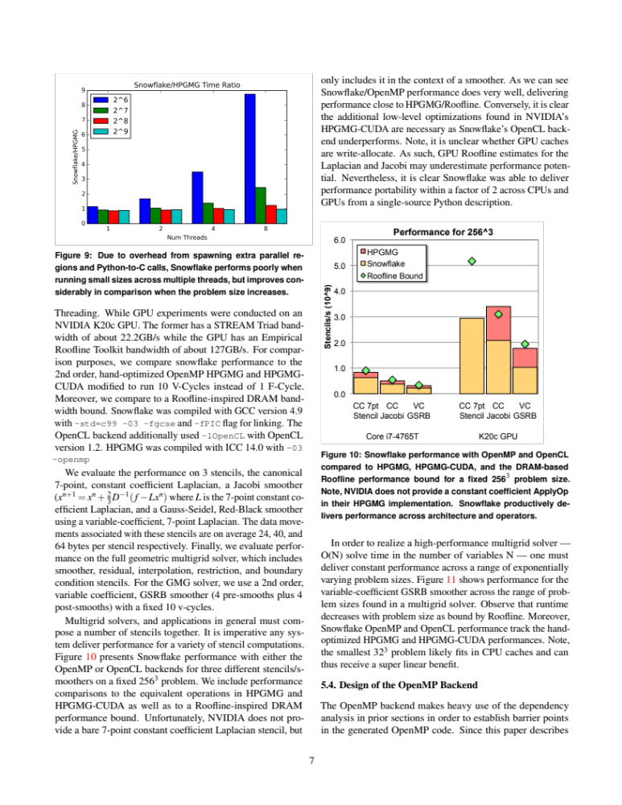
Snowflake Performance
Performance on the HPGMG application benchmark using all the features of Snowflake
Competitive with hand-optimized performance
Within 2x of optimal roofline
Nathan Zhang, C. Markley, S. Williams, A. Fox, K. Yelick

Slide 12




  DSLs popular outside scientific computing
Developed for Image Processing
  10+ FTEs developing Halide
  50+ FTEs use it; > 20 kLOC
HPGMG (Multigrid on Halide)
Halide Algorithm by domain expert
Halide Schedule either
  Auto-generated by autotuning with opentuner
  Or hand created by an optimization expert
Halide performance
Autogenerated schedule for CPU
Hand created schedule for GPU
No change to the algorithm
g+
Image
Auto
Enhance
Func Ax_n("Ax_n"), lambda("lambda"), chebyshev("chebyshev");
Var i("i"),j("j"),k("k");
Ax_n(i,j,k) = a*alpha(i,j,k)*x_n(i,j,k) - b*h2inv*(
beta_i(i,j,k) *(valid(i-1,j,k)*(x_n(i,j,k) + x_n(i-1,j,k)) - 2.0f*x_n(i,j,k))
+ beta_j(i,j,k) *(valid(i,j-1,k)*(x_n(i,j,k) + x_n(i,j-1,k)) - 2.0f*x_n(i,j,k))
+ beta_k(i,j,k) *(valid(i,j,k-1)*(x_n(i,j,k) + x_n(i,j,k-1)) - 2.0f*x_n(i,j,k))
+ beta_i(i+1,j,k)*(valid(i+1,j,k)*(x_n(i,j,k) + x_n(i+1,j,k)) - 2.0f*x_n(i,j,k))
+ beta_j(i,j+1,k)*(valid(i,j+1,k)*(x_n(i,j,k) + x_n(i,j+1,k)) - 2.0f*x_n(i,j,k))
+ beta_k(i,j,k+1)*(valid(i,j,k+1)*(x_n(i,j,k) + x_n(i,j,k+1)) - 2.0f*x_n(i,j,k)));
lambda(i,j,k) = 1.0f / (a*alpha(i,j,k) - b*h2inv*(
beta_i(i,j,k) *(valid(i-1,j,k) - 2.0f)
+ beta_j(i,j,k) *(valid(i,j-1,k) - 2.0f)
+ beta_k(i,j,k) *(valid(i,j,k-1) - 2.0f)
+ beta_i(i+1,j,k)*(valid(i+1,j,k) - 2.0f)
+ beta_j(i,j+1,k)*(valid(i,j+1,k) - 2.0f)
+ beta_k(i,j,k+1)*(valid(i,j,k+1) - 2.0f)));
chebyshev(i,j,k) = x_n(i,j,k) + c1*(x_n(i,j,k)-x_nm1(i,j,k))+
c2*lambda(i,j,k)*(rhs(i,j,k)-Ax_n(i,j,k));

Slide 13
Algorithms for the Hardware

Slide 14
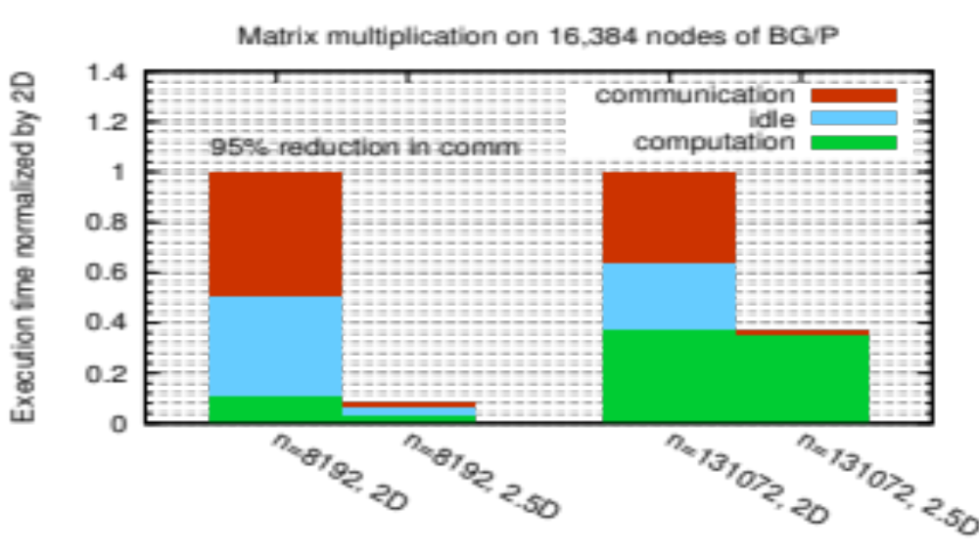
Beyond Domain Decomposition
2.5D Matrix Multiply on BG/P, 16K nodes / 64K cores
c = 16 copies
Surprises:
Even Matrix Multiply had room for improvement
Idea: make copies of C matrix (as in prior 3D algorithm, but not as many)
Result is provably optimal in communication
Lesson: Never waste fast memory
And don’t get hung up on the owner computes rule
Can we generalize for compiler writers?
EuroPar’11 (Solomonik, Demmel)
SC’11 paper (Solomonik, Bhatele, Demmel)
Notes:
SC’11 paper about need to fully utilize 3D torus network on BG/P to get this to work

Slide 15
Deconstructing 2.5D Matrix Multiply
Solomonick & Demmel
x
k
y
Tiling the iteration space
2D algorithm: never chop k dim
2.5 or 3D: Assume + is associative; chop k, which is → replication of C matrix
z
y
z
j
x
i
Matrix Multiplication code has a 3D iteration space
Each point in the space is a constant computation (*/+)
for i
for j
for k
C[i,j] …
A[i,k] …
B[k,j] …

Slide 16
Using .5D ideas on N-body
n particles, k-way interaction.
  Molecules, stars in galaxies, etc.
Most common: 2-way N-body
Best algorithm is to divide n particles into p groups??
for t timesteps
forall i₁, …, i_{k}
force[i₁] += interact(particle[i₁], …, particle[i_{k}])
forall i
move(particle[i], force[i])
O(n^{k}).
.......................................................................................
No!

Slide 17
Communication Avoiding 2-way N-body
(using a “1.5D” decomposition)
p/c
............
............
............
............
............
............
............
............
............
............
............
............
............
............
............
............
............
............
............
............
............
............
............
............
............
............
c
............
............
............
............
............
............
............
............
............
............
............
............
............
............
............
............
............
............
............
............
............
............
............
............
............
............
Divide p into c groups
Replicate particles across groups
Repeat: shift copy of n/(p*c) particles to the left within a group
Reduce across c to produce final value for each particle
  Total Communication: O(log(p/c) + log c) messages,
  O(n*(c/p+1/c)) words
Driscoll, Georganas, Koanantakool, Solomonik, Yelick

Slide 18
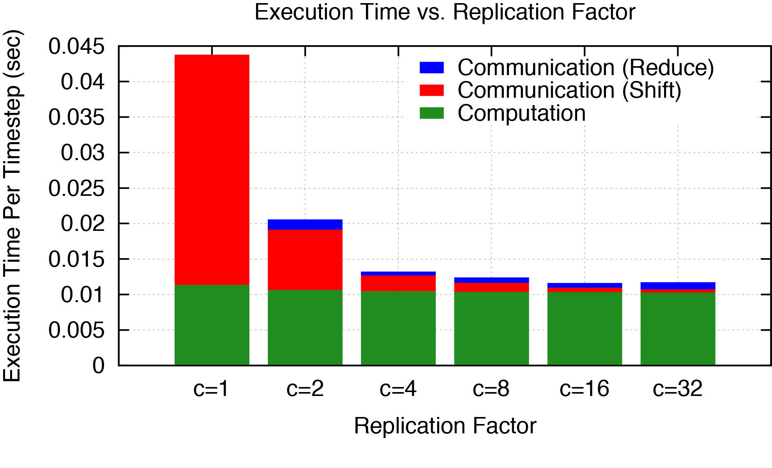
Less Communication..
Cray XE-6; n=24K particles, p=6K cores
Down is good
96% reduction in shift time (red)
Notes:
= 78.38

Slide 19
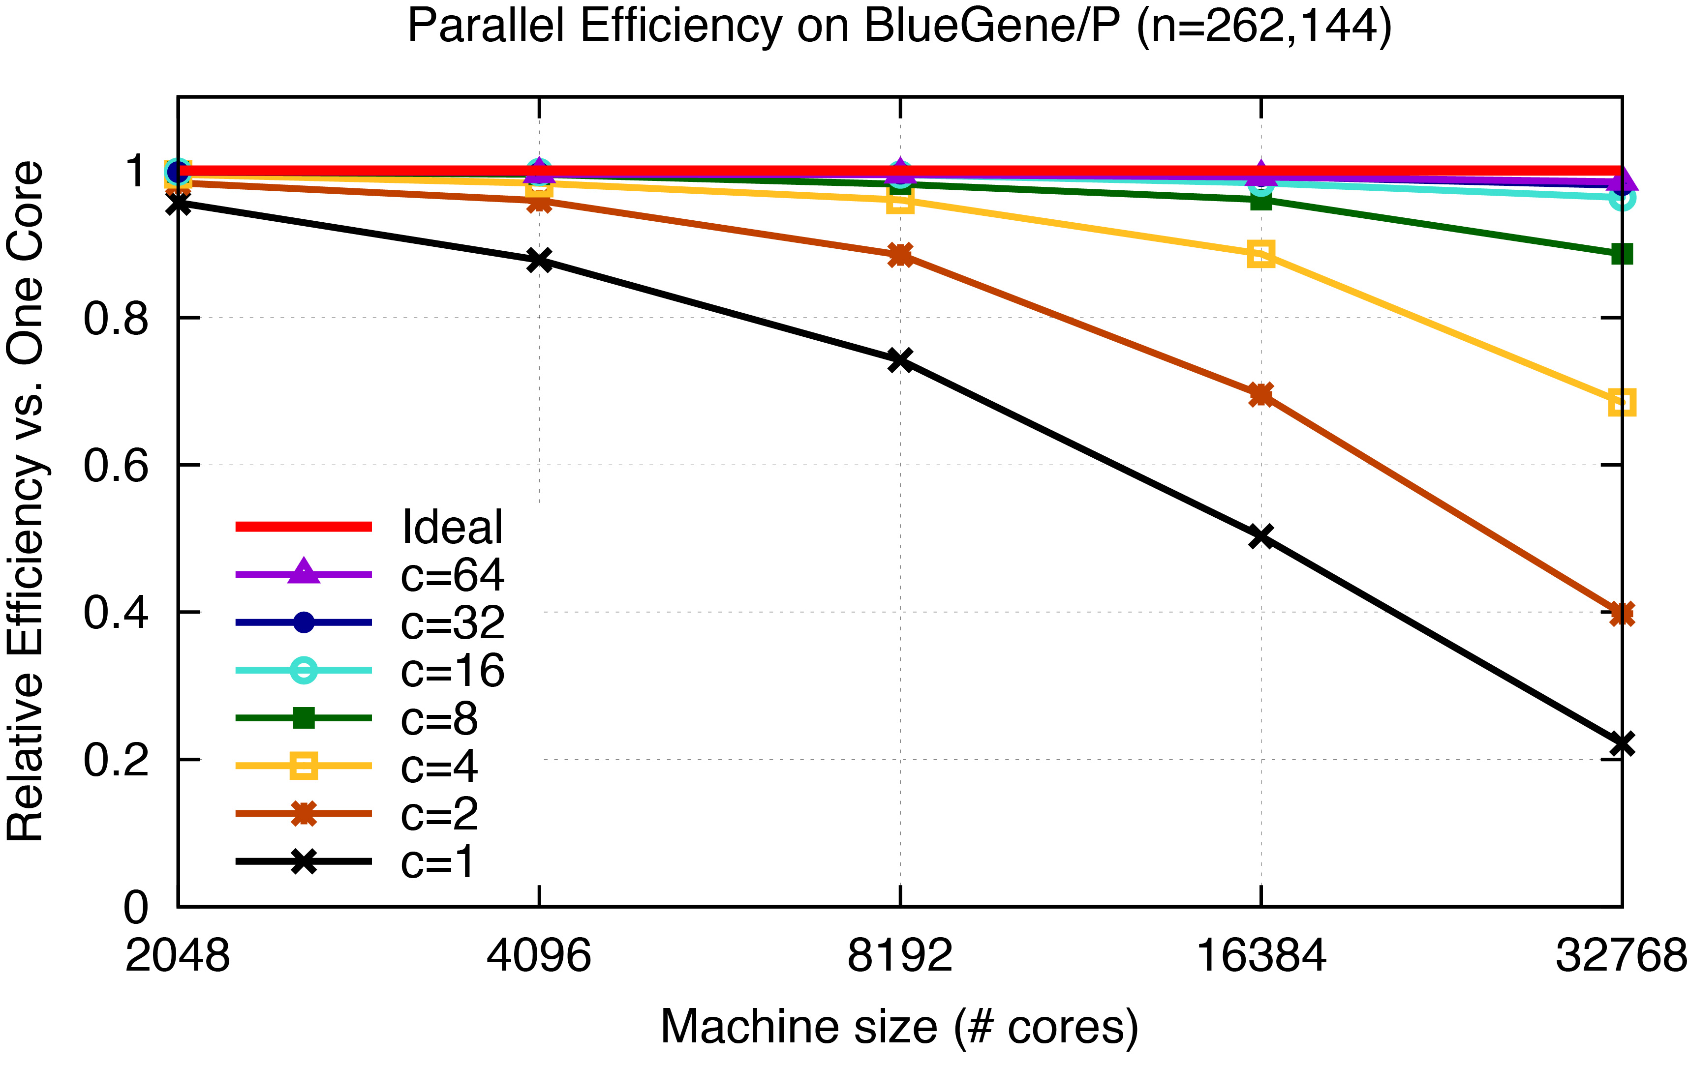
Strong Scaling
Up is good
4.4x

Slide 20
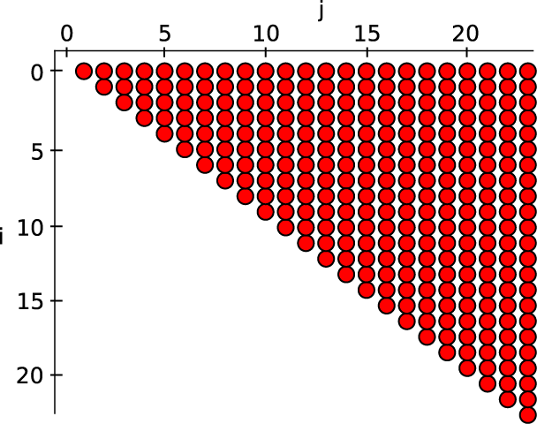
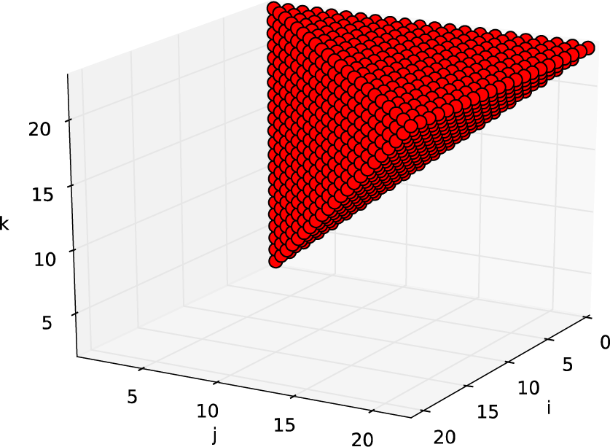
Challenge: Symmetry & Load Balance
Force symmetry (f_{ij} = -f_{ji}) saves computation
2-body force matrix vs 3-body force cube
How to divide work equally?
6x save
of O(n³)!
2x save
of O(n²)

Slide 21
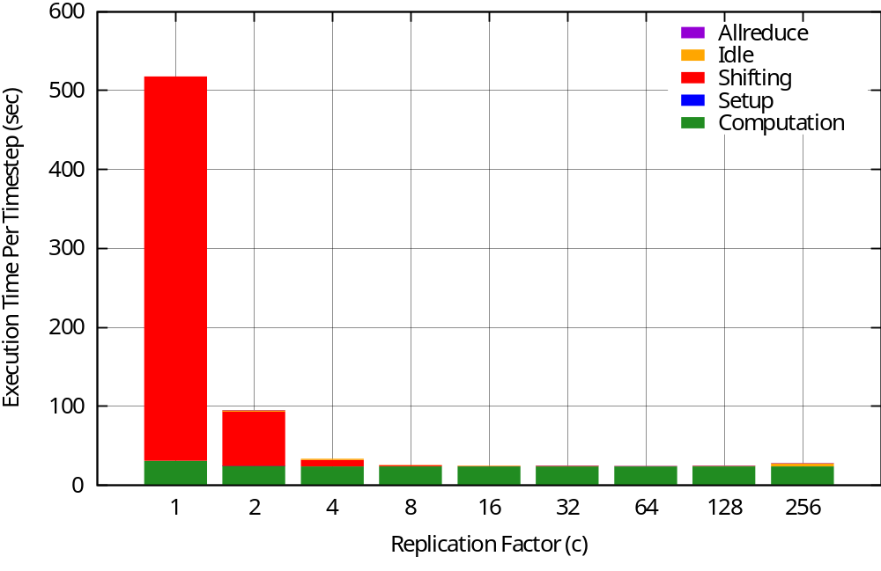
3-Way N-Body Speedup
Cray XC30, 24k cores, 24k particles
Down is good
22.1x
Koanantakool & Yelick
Notes:
C=64
22.13x speedup
99.95% reduction in communication time

Slide 22
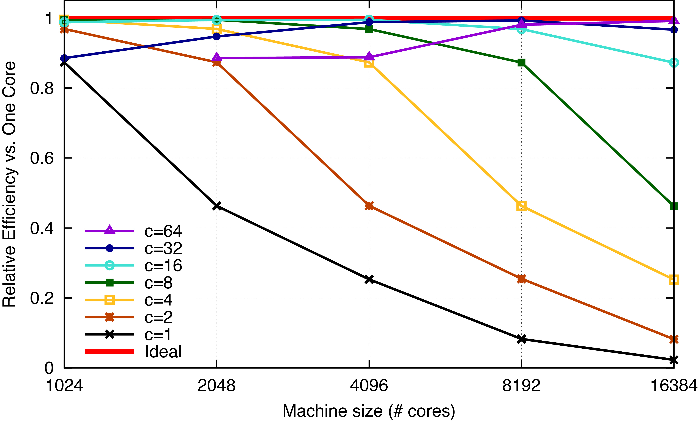
Perfect Strong Scaling
BlueGene/Q 16k particles, Strong Scaling
Up is good
42x
Koanantakool & Yelick

Slide 23
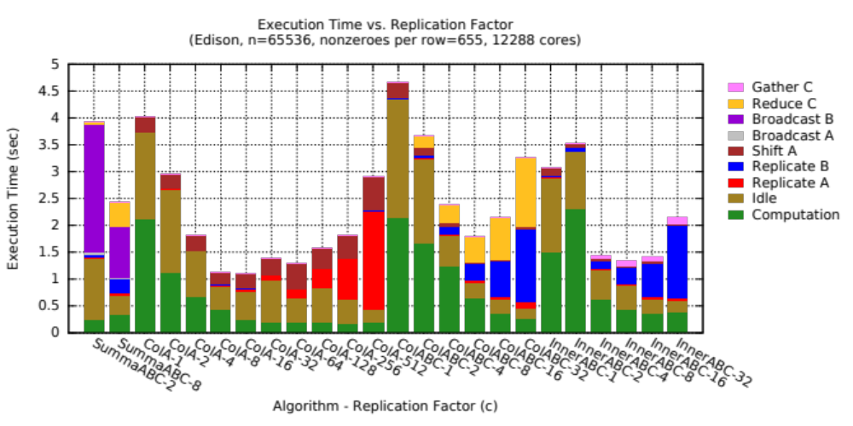
Sparse-Dense Matrix Multiply Too!
Variety of algorithms that divide in or 2 dimensions
Koanantakool & Yelick

Slide 24
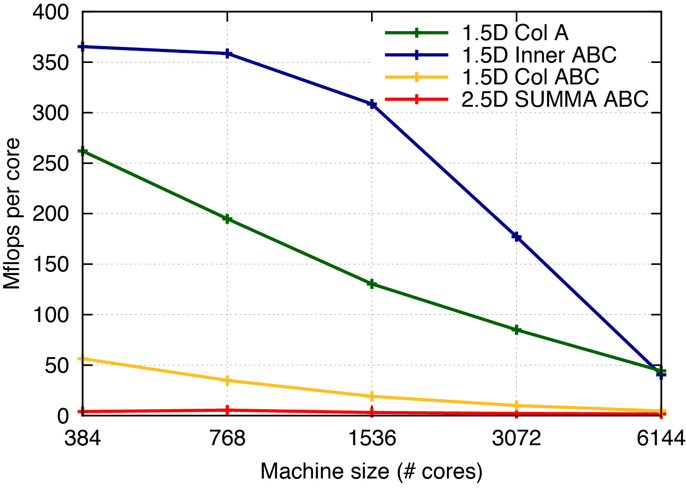
100x Improvement
A^{66k x 172k}, B^{172k x 66k}, 0.0038% nnz, Cray XC30
Up is good
100x
Koanantakool & Yelick
Notes:
Stochastic linear programming problem

Slide 25
Linear Algebra is important to Machine Learning too!
Logistic Regression, Support Vector Machines
Dimensionality Reduction (e.g., NMF, CX/CUR, PCA)
Clustering (e.g., MCL, Spectral Clustering)
Graphical Model Structure Learning (e.g., CONCORD)
Deep Learning (Convolutional Neural Nets)
Sparse Matrix-Sparse Vector (SpMSpV)
Sparse Matrix-Dense Vector (SpMV)
Sparse Matrix Times Multiple Dense Vectors
(SpMM)
Sparse - Sparse Matrix Product
(SpGEMM)
Dense Matrix Vector
(BLAS2)
Sparse - Dense Matrix Product
(SpDM³)
Dense Matrix Matrix (BLAS3)
Increasing arithmetic intensity
Aydin Buluc, Sang Oh, John Gilbert, Kathy Yelick

Slide 26
Overhead Can’t be Tolerated

Slide 27
PGAS: A programming model for exascale
Global address space: thread may directly read/write remote data using an address (pointers and arrays)
  … = *gp; ga[i] = …
Partitioned: data is designated as local or global
shared int [ ] ga; and upc_malloc (…)
x: 1
y:
x: 5
y:
x: 7
y: 0
Examples:
UPC
UPC++
Global address space
l:
l:
l:
g:
g:
g:
p0
p1
pn
A programming model can influence how programmers think

Slide 28
One-Sided Communication is Closer to Hardware
host
CPU
one-sided message
address
data payload
network
interface
two-sided put message
message ID
data payload
memory
Hardware does 1-sided communication
Overhead for send/receive messaging is worse at exascale
2.9 GHz x86
1 GHz x86 (model)
1 GHz 3-SIMT (model)
Nanoseconds
Software Overhead

Slide 29
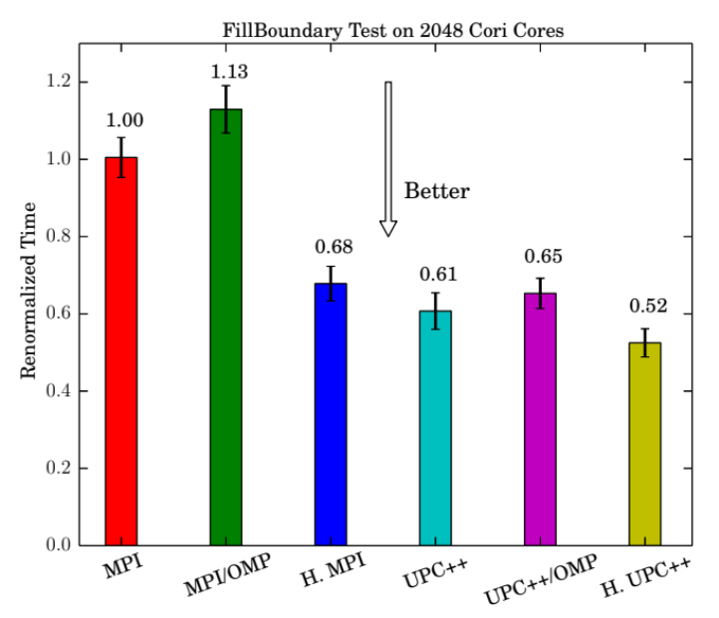
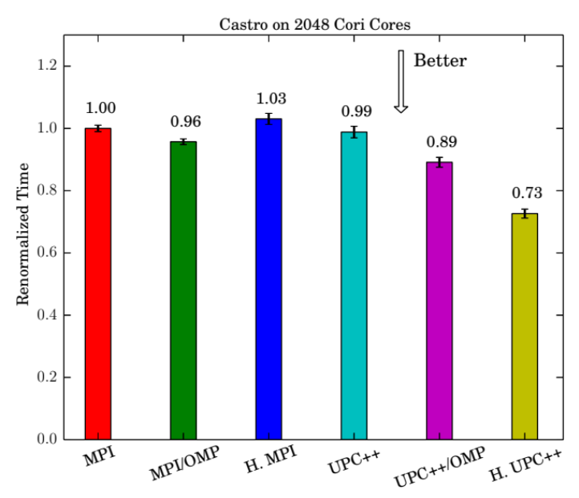
One-sided PGAS (UPC++) in AMR
Adaptive Mesh Refinement (AMR) using UPC++
  Metadata costs make flat MPI impractical
  Replaced communication (retained most code)
  Hierarchical algorithms (UPC++/UPC++ or MPI/MPI best)
Weiquin Zhang, Y. Zheng

Slide 30
Avoid Unnecessary Synchronization

Slide 31
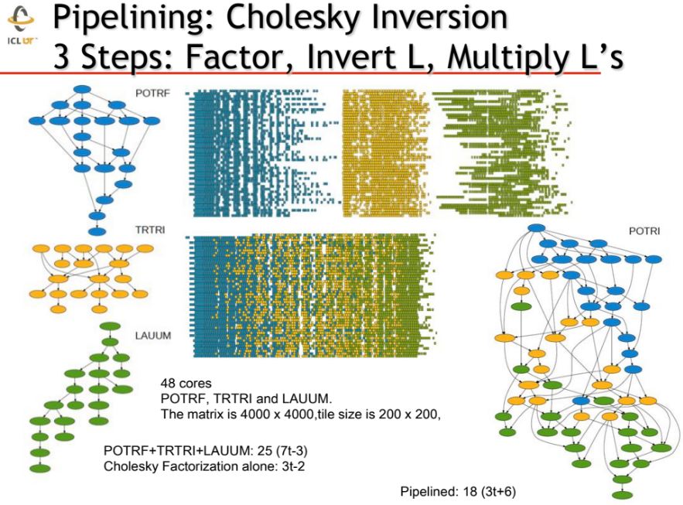
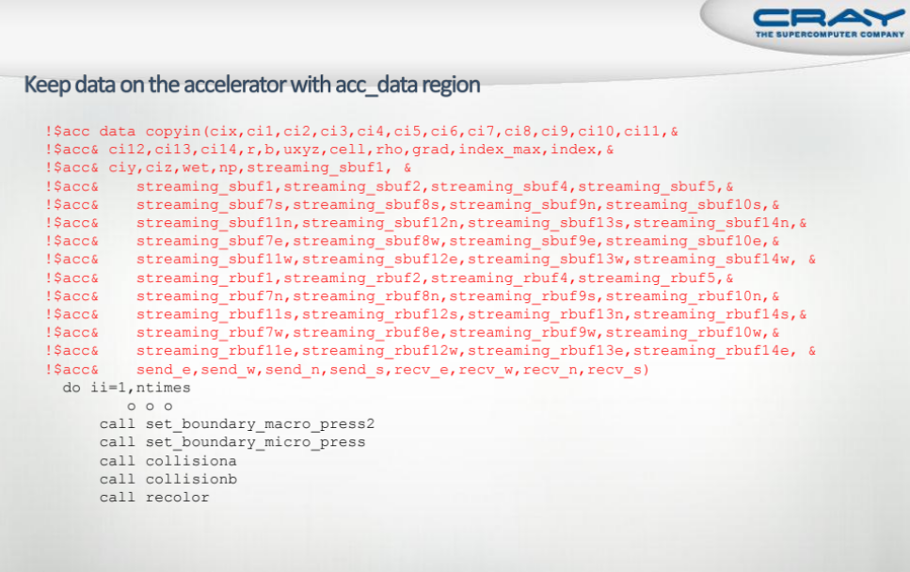
Sources of Unnecessary Synchronization
Libraries
Abstraction
Loop Parallelism
Accelerator Offload
!$OMP PARALLEL DO
DO I=2,N
B(I) = (A(I) + A(I-1)) / 2.0
ENDDO
!$OMP END PARALLEL DO
Bulk Synchronous
Less Synchronous
“Simple” OpenMP parallelism implicitly synchronized between loops
LAPACK: removing barriers ~2x faster (PLASMA)
Analysis | % barriers | Speedup
Auto | 42% | 13%
Guided | 63% | 14%
NWChem: most of barriers are unnecessary (Corvette)
The transfer between host and GPU can be slow and cumbersome, and may (if not careful) get synchronized

Slide 32
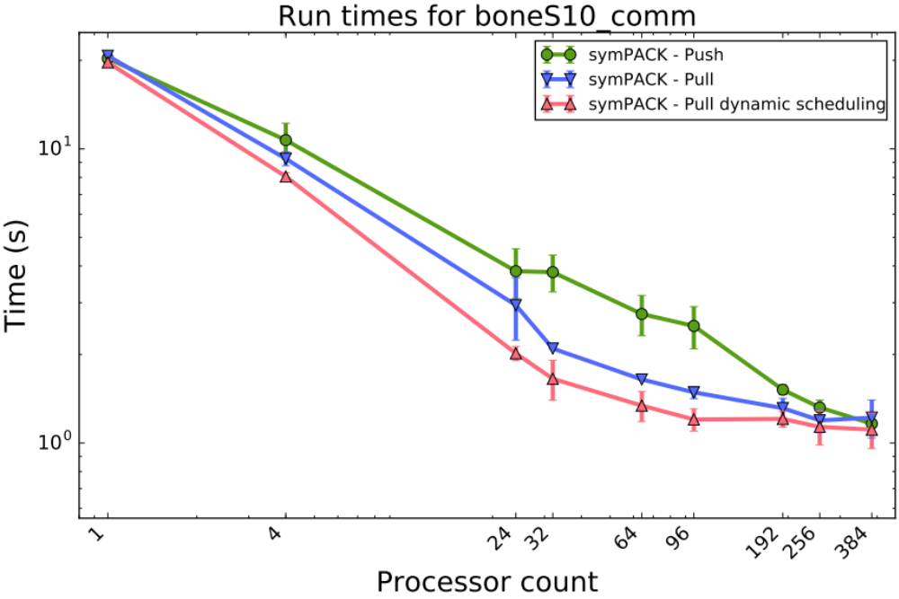
Asynchronous Sparse Cholesky in UPC++
Fan-both algorithm by Jacquelin & Ng, in UPC++

Slide 33
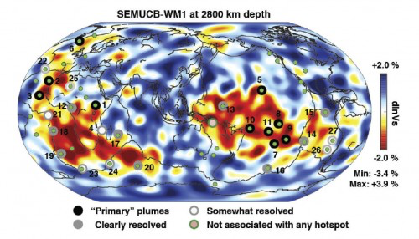
Whole-Mantle Seismic Model Using UPC++
First-ever whole-mantle seismic model from numerical waveform tomography
Finding: Most volcanic hotspots are linked to two spots on the boundary between the metal core and rocky mantle 1,800 miles below Earth's surface.
Makss unsolvable problems solvable!
Scott French, Barbara Romanowicz, "Broad plumes rooted at the base of the Earth’s mantle beneath major hotspots", Nature, 2015
Notes:
Additional paper: Scott French, Barbara Romanowicz, "Whole-mantle radially anisotropic shear velocity structure from spectral-element waveform tomography", Geophysical Journal International, 2014, 199, doi: 10.1093/gji/ggu334

Slide 34
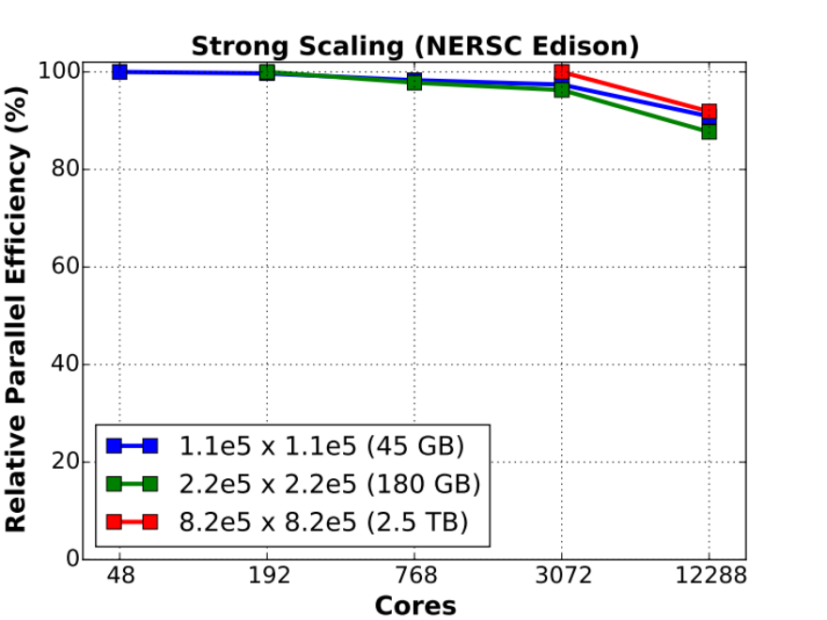
Data Fusion for Observation with Simulation
Unaligned data from observation
One-sided strided updates
Could MPI-3.0 one-sided do this? Yes, but not well so far
Scott French, Y. Zheng, B. Romanowicz, K. Yelick

Slide 35

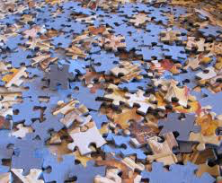
Unstructured, Graph-based, Data analytics problem:
De novo Genome Assembly
DNA sequence consists of 4 bases: A/C/G/T
Read: short fragment of DNA sequence that can be read by a DNA sequencing technology – can’t read whole DNA at once.
De novo genome assembly: Reconstruct an unknown genome from a collection of short reads.
  Constructing a jigsaw puzzle without having the picture on the box
Notes:
First I’ll present some definitions relevant to the problem

Slide 36
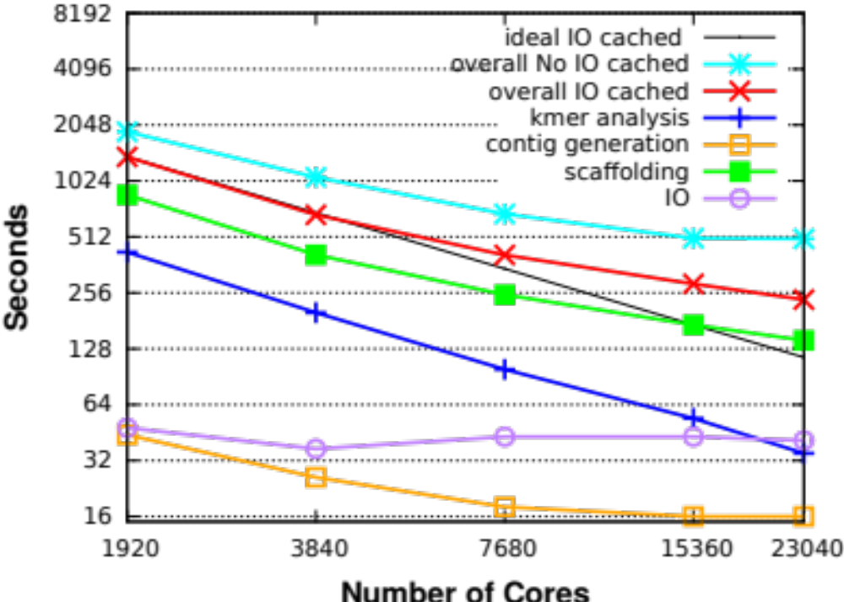
Strong scaling (human genome) on Cray XC30
Makes unsolvable problems solvable!
Complete assembly of human genome in 4 minutes using 23K cores.
700x speedup over original Meraculous (took 2,880 minutes on large shared memory with some Perl code); Some problems (wheat, squid, only run on HipMer version)

Slide 37
Summary
Communication is the most expensive thing computers do
  Memory
  Network
Compilers
  Domain specific languages simplify program analysis
  Autotuning helps identify optimizations
PGAS and one-sided communication can help lower costs
  Better match to RDMA hardware
  Also supports applications with irregular accesses
Algorithms can avoid communication
  Both data volume (bandwidth) and number of messages (latency)
  Probably optimal and faster (more scalable) in practice

Slide 38
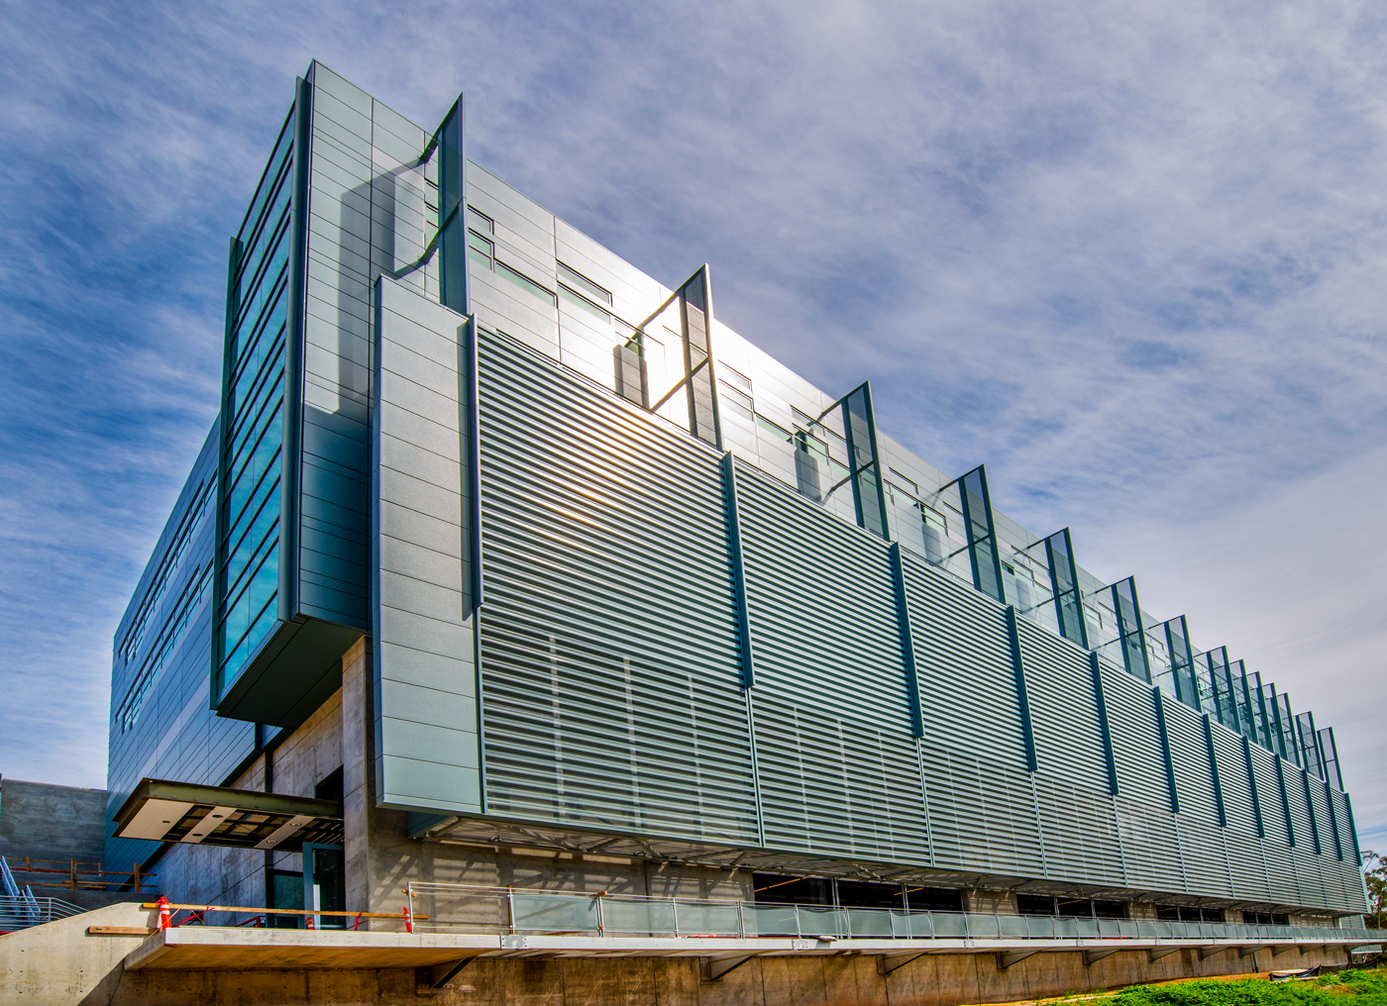


  Thank you!
Notes:
I will be discussing our Exascale Science strategy, and then introduce the talks for the rest of the exascale section.

