Slide 1
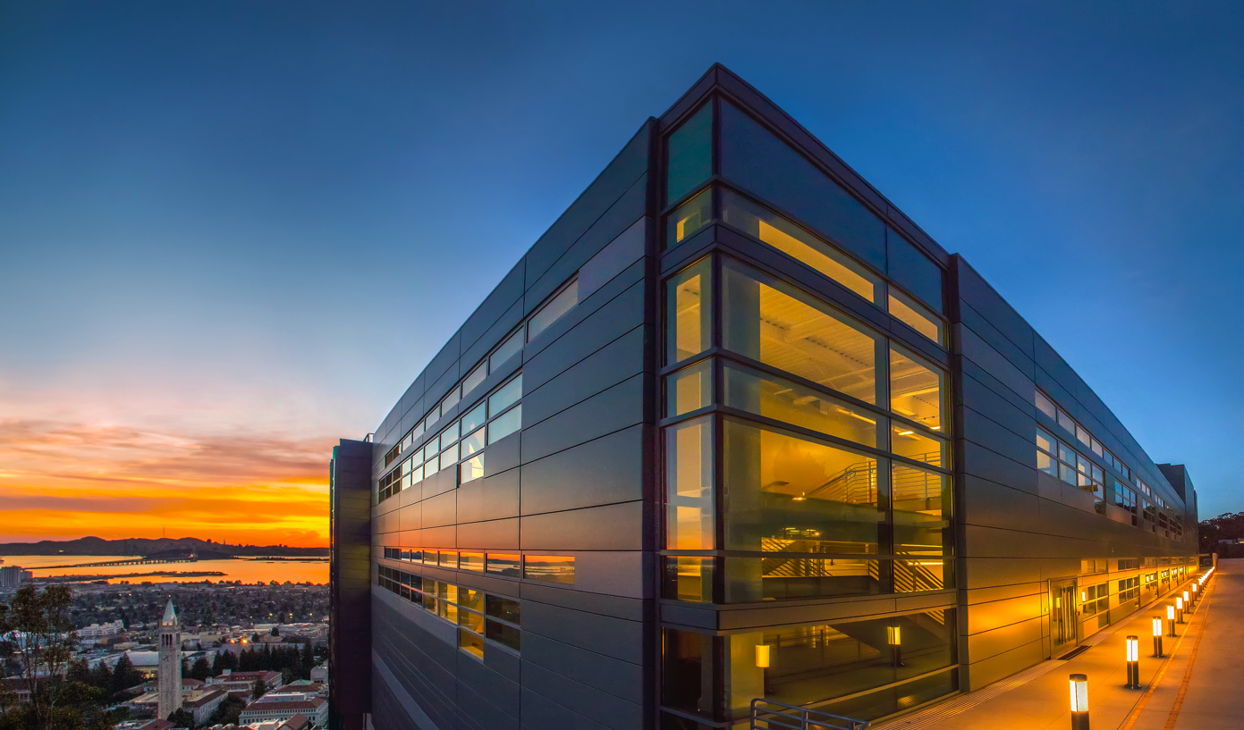


  Languages and Compilers for Exascale Science
Kathy Yelick
Professor of Electrical Engineering and Computer Sciences
U.C. Berkeley
Associate Laboratory Director
Computing Sciences
Lawrence Berkeley National Laboratory

Slide 2
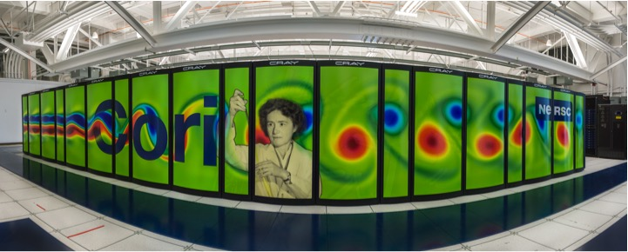
NERSC Supercomputing for Science and Energy
State-of-the art computing for the broad science community – over 7000 users, 700 applications

Slide 3
Breakthrough science conjecture
Exascale computing, combined with state-of-the-art mathematical models, algorithms, software techniques and data will enable breakthrough science
Notes:
Exascale success can be measured many ways (peak, HPL, GB)
but the rest of the science community will care about science breakthroughs

Slide 4
Exascale Computing Project (US DOE ECP) to Impact Broad HPC landscape
Vendor exploration of technology for novel architectures
Apps developed and ported to higher roadmap
Software to use the new architectures
Integration through co-design
10X
ECP enables all future HPC systems to be on this roadmap
Capability
ECP benefits will also flow down to commodity computing
ECP
Today’s HPC roadmap achieves capable exascale 2027
Year
2017
2021
2022
2023
2024
2025
2026
2027
Notes:
NERSC Role
2020 / 2021 system

Slide 5
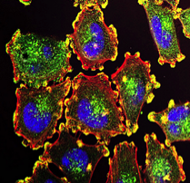
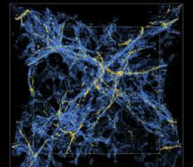
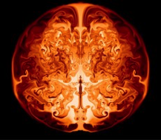
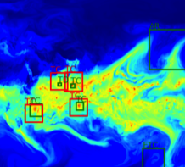
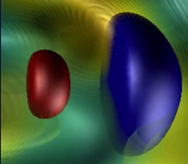
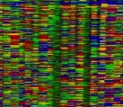
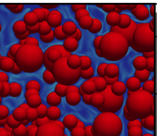
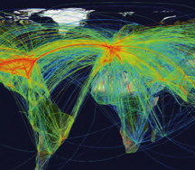
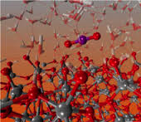
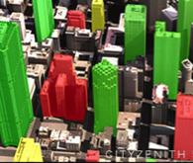
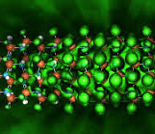
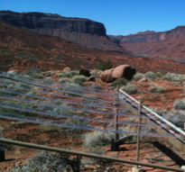
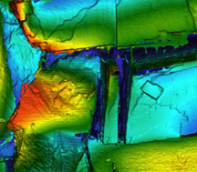
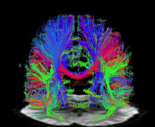
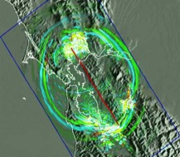
The Science Challenges at Exascale
multimodal multiscale
complexity data size
resolution multiphysics
Cancer
Cosmology
Astrophysics
Climate
Accelerators
Genomics
Data
Simulation
Carbon Capture
Transportation
Chemistry
Urban
Brain
Materials
Environment
Earthquakes
Subsurface
Notes:
DOE should have a facility dedicated to …

Slide 6
Data Growth is Outpacing Computing Growth
Graph based on average growth
Projected Data Rates Relative to 2010

Slide 7
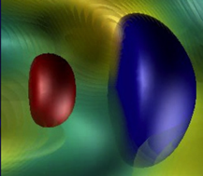

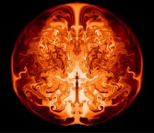


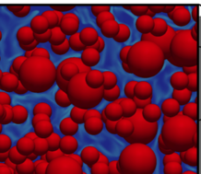

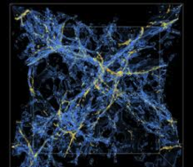

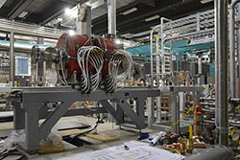
Mathematics will provide Exasacle Science Capabilities
Adaptive Mesh Refinement
Scalable (Sparse) Solvers
Accelerators
Subsurface
Astrophysics
Genomics
Materials
A 1 TeV electron-positron collider
Geo-mechanical chemical evolution of fracking
Source of heaviest elements
Gene clusters for biomanufacturing
Defects, interfaces and disorder in functional materials
Carbon Capture
Earthquakes
Cosmology
Chemistry
Nuclei
1MWe chemical looping reactor
Regional-scale model to simulate structures
Dark energy equation of state
Catalytic conversion of biomass-derived intermediates
Large neutron-rich nuclei and nuclear binding
  Berkeley Lab has demonstrated unsurpassed ability to harness the power of advanced mathematics and computer science for high-impact science.
Notes:
Using Advanced Mathematics and Computer Science to maximize the science impact at Exascale.
AMR codes are transforming simulations in accelerators, subsurface, astrophysics, carbon capture, earthquakes, and cosmology.
Scalable solvers are having major impact on genomics, materials, chemistry, and nuclei
Berkeley Lab has demonstrated unsurpassed ability to harness the power of advanced mathematics and computer science for high-impact science.

Slide 8
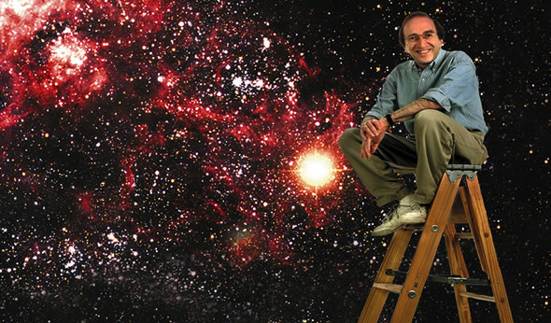
Former cosmology breakthrough (Nobel prize)
Notes:
Type 1A Supernova as standard candles (1 is white dwarf with known intensity as it explodes – will be part of twin star and attract mass from companion until it’s 40% more than our sun). Reaction happens the same way and at the same mass, so the brightness is the same.

Slide 9
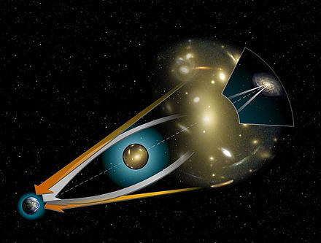
More accurate way to measure
Image: wikipedia

Slide 10
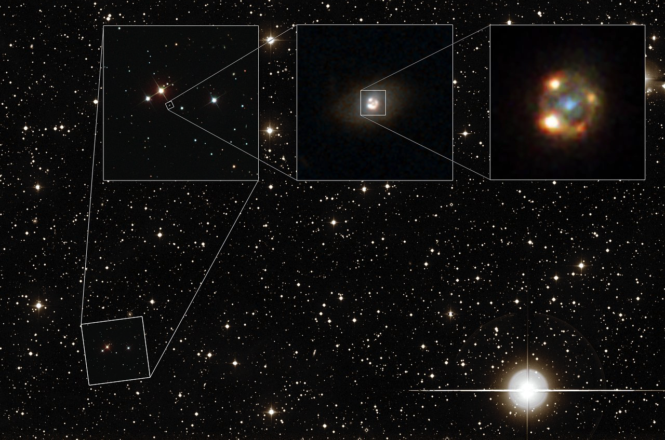

Recent cosmology breakthrough in observation
This composite image shows the gravitationally lensed type Ia supernova iPTF16geu, about 4 billion light years away as seen with different telescopes. Image credit: Joel Johansson, Stockholm University
A.Goobar, et al, Science. 2017
Notes:
Tying to understand dark energy and dark matter
Search for supernova to use as measurement points – multiple images of same Type 1A Supernova will give better accuracy
A data collection and analysis pipeline that begins at Palomar Observatory in Southern California and ends at NERSC was used to discover the first instance of a galaxy acting as a gravitational lens to produce four magnified images of a background Type 1a supernova. As soon as observations are taken, the data travel more than 400 miles to NERSC, where machine learning algorithms running on NERSC’s supercomputers sift through the data in real time and identify candidates. Type 1a supernova serve as “standard candles” that allow astronomers to measure the rate of the expansion of the universe, which allowed for the Nobel-prize winning discovery of an accelerating universe in the late 1990s. Having a Type 1a gravitationally lensed allows astronomers to see more distant supernova due to the magnification effect and being able to observe light from the supernova arriving at different times because of the different path length traveled by the different lensed images provides further information about the history of the supernova. More about the pipeline can be found at http://www.ptf.caltech.edu/page/data_processing. The discovery was published in the journal Science in April 2017.

Slide 11
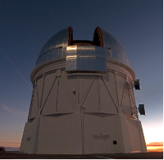
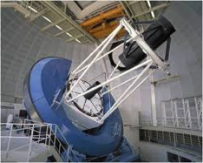
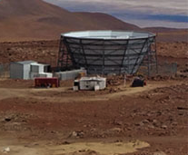
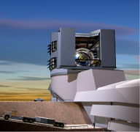
Cosmology observations drive simulations
  Science: Dark Energy, Dark Matter, Gravitational Waves, Neutrino Mass
  Computation: factor of X100 increase in science reach, order of magnitude improvement in modeling accuracy and predictability
DES
DESI
CMB-S4
LSST
Sky Survey
CMB-S3
CMB-S4
 | DES |  | DESI |  |  |  | LSST
2016 | 2017 | 2018 | 2019 | 2020 | 2021 | 2022 | 2023 | 2024 | 2025 | 2026
Simulation Requirements
Large-scale N-body, Medium Hydro
Initial sub-grid models
Large-scale N-body & Hydro
Improved sub-grid models
Extreme scale N-body, Hydro
Complex sub-grid models
Required Performance
200 Pflops Exaflops
US DOE ECP PI: Salman Habib (ANL)
Notes:
Don’t forget to point out the key role of data!

Slide 12

Precision Cosmology: Simulation Frontiers
Petascale
Exascale
Next-generation surveys
End-to-end, multi-probe survey-scale simulations
Multiple cross-calibrated probes
UQ-enabled cosmic calibration frameworks
2nd-generation surveys
Multi-probe simulations
Few precision probes
Intermediate accuracy parameter estimation
Terascale
Fidelity/Complexity
1st-generation surveys
Singzle-probe simulations
Simulation Volume
US DOE ECP PI: Salman Habib (ANL)
Notes:
Don’t forget to point out the key role of data!

Slide 13
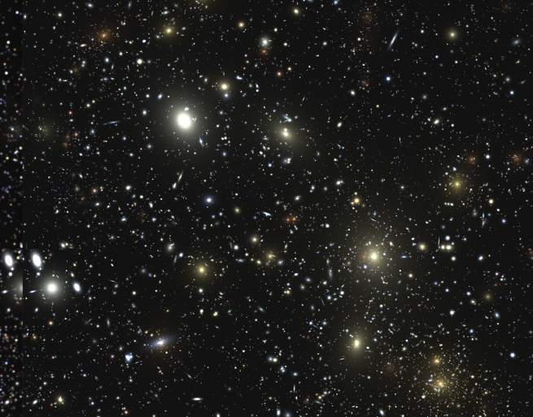
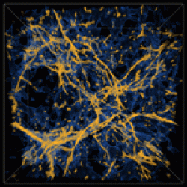
Cosmology at the Exascale
Simulation of Lyman-Alpha Forest with Nyx, used to estimate neutrino mass and as a standard ruler.
Synthetic galaxy catalog for LSST generated with HACC and Galacticus codes
Exascale is needed to model and interpret the latest observations
Improve understanding of Dark Energy, Dark Matter, Primordial Gravitational Waves, Neutrino Mass, and parametrics such as the Hubble Constant
US DOE ECP PI: Salman Habib (ANL)

Slide 14
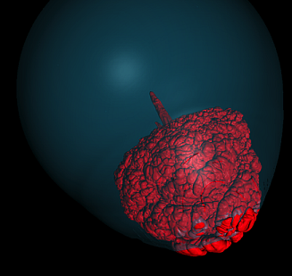
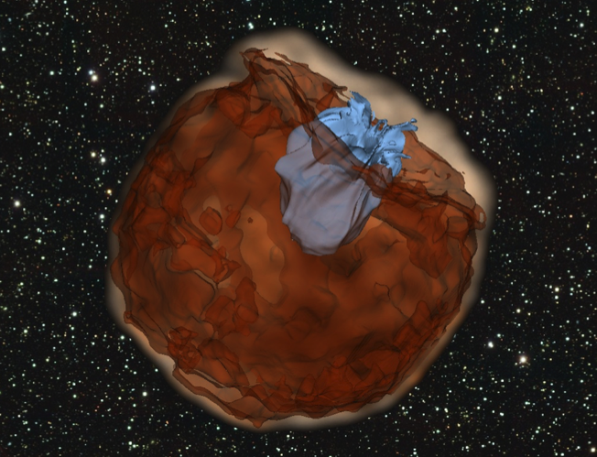
Astrophysics at the Exascale
Less than a second after ignition, the flame breaks through the surface of an expanded white dwarf (using AMR)
Expanding debris from a supernova explosion (red) running over and shredding a nearby star (blue)
Exascale is needed to identify the source of the heaviest elements
Understand rapid neutron capture process (r-process) by simulating scenarios: core-collapse supernovae, neutron star mergers, and accreting black holes
US DOE ECP PI: Dan Kasen (LBNL)

Slide 15
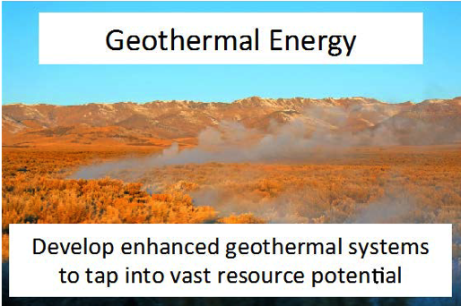
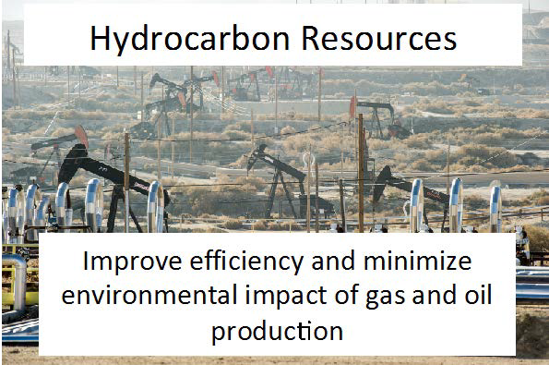

Subsurface Science at the Exascale
Exascale is needed for impacts of energy extraction and waste storage on subsurface integrity
Simulate an entire field of well bores and their interaction through the reservoir over 100 year timescales. Simulate the evolution of a fracture system in caprock subject to geomechanical and geochemical stresses over scales from pore (micron) to 100 meters
US DOE ECP PI: Carl Steefel (LBNL)

Slide 16
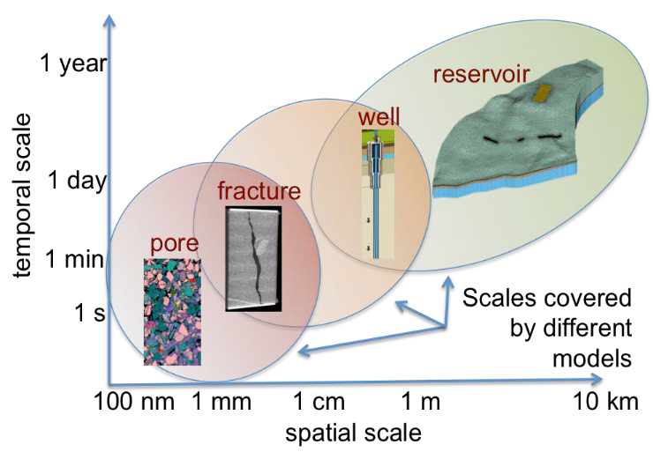
Subsurface science requires modeling across scales

Slide 17

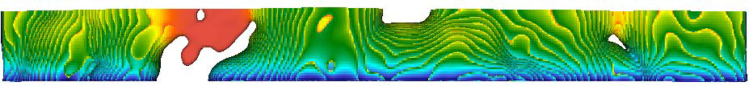
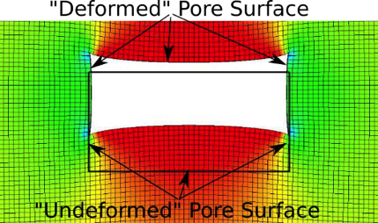
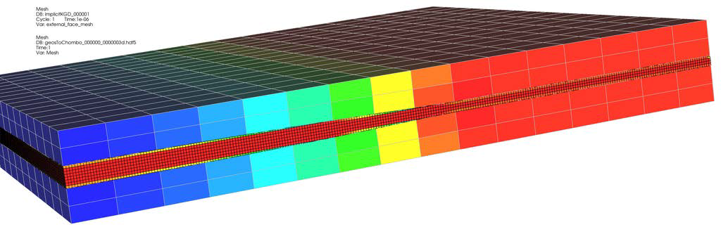
Combining codes to deliver new science capability
Flow driven chemical erosion of a fracture in CaMg(CO₃)₂ (Chombo-Crunch)
Pore deformation resulting from change in stress loading in a Lagrangian mechanics treatment (GEOS)
Combined model

Slide 18
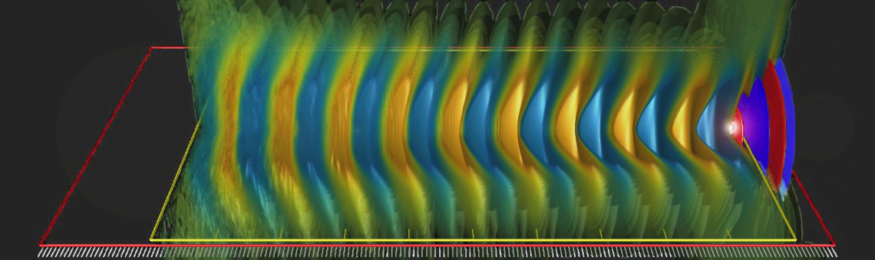
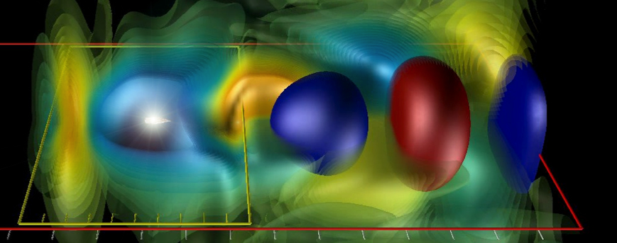
Accelerator Science at the Exascale
Simulation of laser-plasma acceleration with wavefronts of laser light (red and blue); the wake fields are accelerating (pale blue) or decelerating (orange). Right shows wake in “boosted” frame of reference.
Exascale is needed to simulate future accelerators
Goal: Model a chain of up to a hundred plasma acceleration stages in a few days, for the design of a 1 TeV electron-positron high-energy collider
US DOE ECP PI: Jean Luc Vay (LBNL)

Slide 19
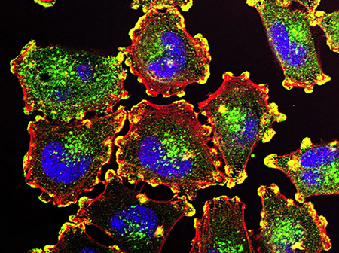
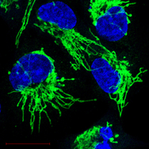
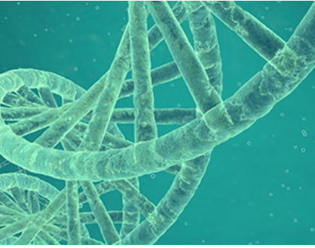
Cancer Analytics at the Exascale
Image: NCI
Image: Kashatus/NCI/UVA
Metastatic cancer classification and genetics improve treatment [Cell 2015]
One third of all cancers caused by mutations in RAS genes
Combinatorial explosion with number of genomic features considered
Exascale is needed to develop cell-specific interventions
Mapping genetic susceptibility to cancer and its outcomes; intracellular molecular signaling in complex mutational backgrounds; combine genetic, genomic, and clinical data
US DOE ECP PI: Rick Stevens (ANL)

Slide 20
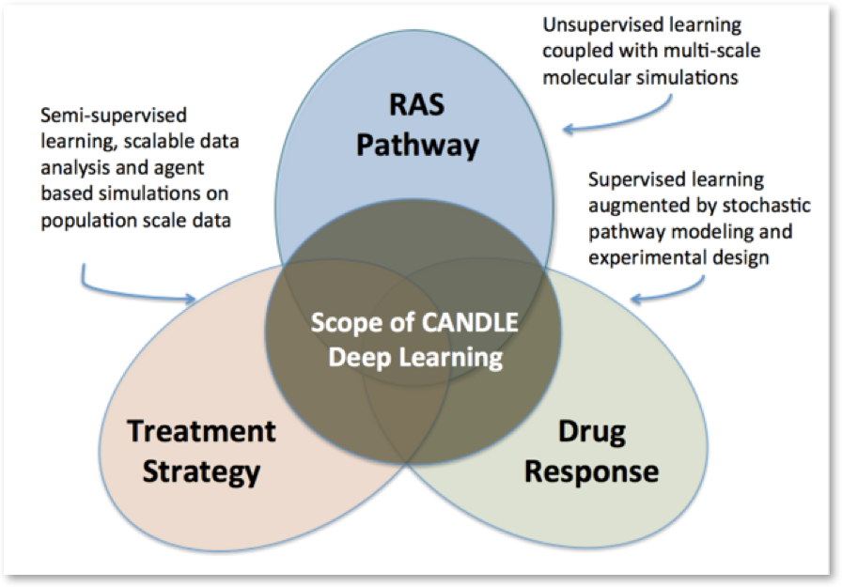
Cancer Analytics at the Exascale
US DOE ECP PI: Rick Stevens (ANL)

Slide 21
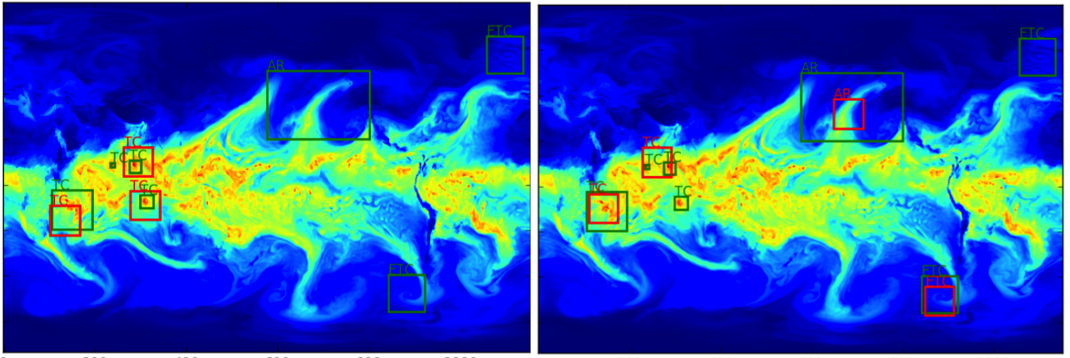
Deep-Learning at Scale on HPC systems
Identified extreme climate events using supervise (left) and semisupervised (right) deep learning. Green = ground truth, Red = predictions (confidence > 0.8). [NIPS 2017]
Deep Learning at 15 PF on NERSC Cori (Cray + Intel KNL)
Trained in 10s of minutes on 10 terabyte datasets, millions of Images 9600 nodes, optimized on KNL with IntelCaffe and MKL (NERSC / Intel collaboration) Synch + Asynch parameter update strategy for multi-node scaling (NERSC / Stanford)
Evan Racah, Christopher Beckham, Tegan Maharaj, Samira Ebrahimi Kahou, Prabhat, Christopher Pal, Evan Racah (LBNL, Ecole Poly. Montreal, Microsoft)
Notes:
Finally I want to close with another non-traditional example in HPC but something, as we heard about this morning, that we expect to grow in importance - and thats Deep learning on science. Whats exciting about these runs is that they scaled the training of single model (as opposed to farming out multiple models) to the entire Cori system. They applied this to a couple really interesting science case. The first (pictured) is classifying extreme whether events in climate data - don’t require a poor grad student to go through years of simulated data to identify events. :) The other is identifying new and interesting signatures in LHC (large hadron collider at CERN) events to indentify new physics. The team did a lot of work getting the ML stack on up on running on Cori and implementing asynchronous parameters updates across the nodes to enable full system scaling.

Slide 22
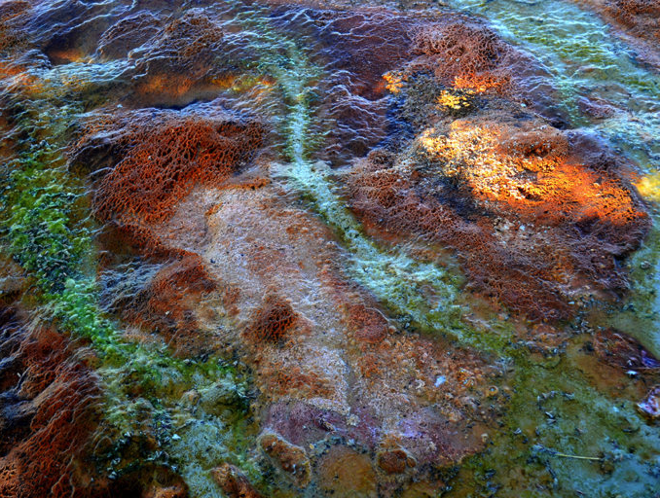
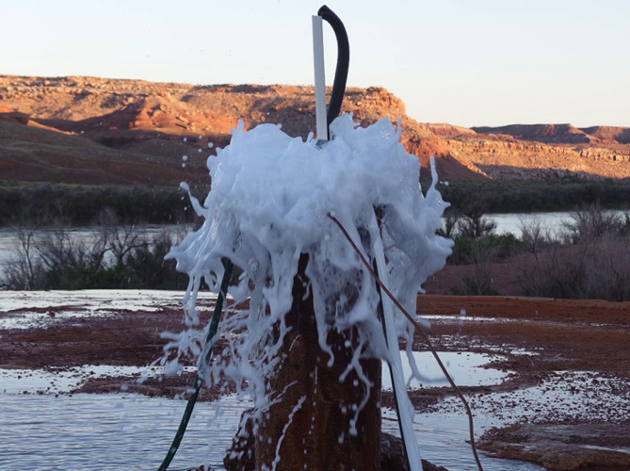
Genome Science at the Exascale
Marissa Fessenden, LBNL
Jill Banfield, UCB/ LBNL
Thermophilic microbial mat in West Thumb Geyser Basin, Yellowstone National Park
Compact CRISPR systems found in deep underground Crystal Geyser bacteria (Banfield)
Exascale is needed to characterize microbial communities
Metagenome analysis with high performance assembly and machine learning; identify gene clusters for energy, environment, biomanufacturing and health
US DOE ECP PI: Kathy Yelick (LBNL)
Notes:
Detailed turbulent structures are visible throughout the Southern Ocean, where the Antarctic circumpolar current flows eastward around the globe. Large eddies are particularly visible in the Agulhas current at the southern tip of Africa. These ocean simulations are validated against satellite and shipboard observations.
Even though individual eddies occur on scales of 10-150 km, their cumulative effects have large and long-ranging consequences on the earth's climate. In the Southern Ocean, eddies transport heat poleward. The strength of large-scale circulations in the northern hemisphere is sensitive to the turbulence in the Southern Ocean. Ocean models are used to test how these interactions may be altered in a changing climate.
This high-resolution simulation includes 90 million grid cells, ranging from 10 to 30 km in horizontal width. It is run on a super computer using eight thousand processors.
The MPAS-Ocean model is developed at Los Alamos National Laboratory by the Climate, Ocean, and Sea Ice Model team (COSIM). Core MPAS-Ocean developers include Mark Petersen (CCS-2), Todd Ringler, and Douglas Jacobsen (T-3). MPAS-Ocean is a component of the Accelerated Climate Model for Energy, a new climate model by the Department of Energy. The image was created using Paraview software with the assistance of Phillip Wolfram (T-3).

Slide 23
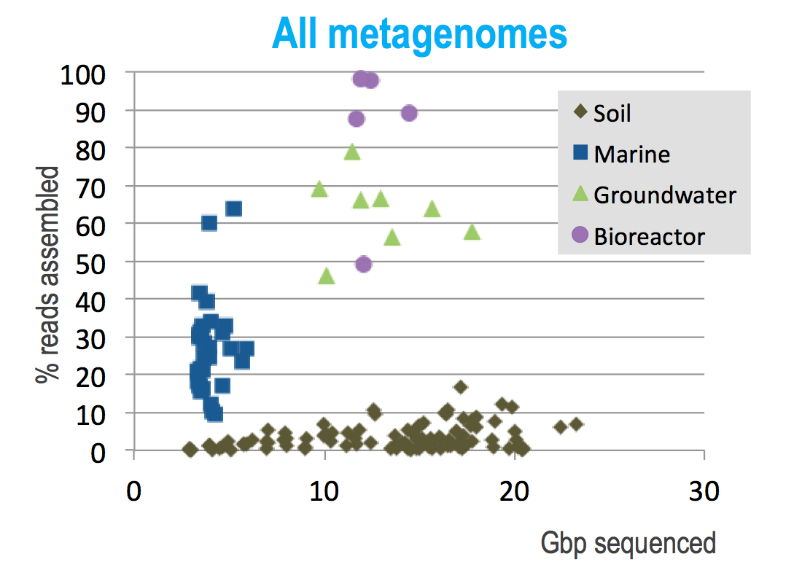
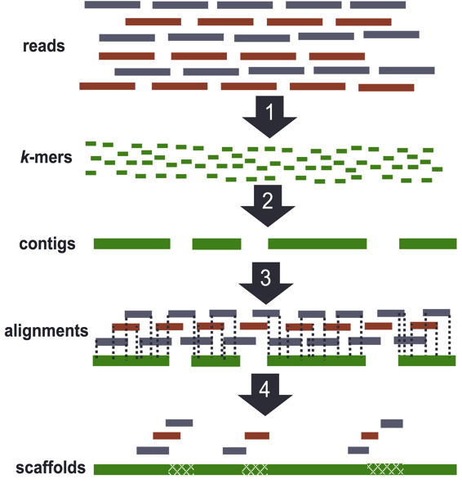
Environment: orders of magnitude harder than humans
De novo genome assembly
Read multiple times. Chop reads into k-mers | Histogram k-mers (eliminate errors) | DFS walk k-mer graph (stored as hash table) | Various graph operations (more hash tables)

Slide 24

Multi-Node Strong Scaling
HipMer scales efficiently to 100’s and 1000’s of nodes
Human Genome Results (small problem)
Minimum aggregate memory required
Scales linearly on node, KNL (68 cores)
Requires high injection rate, low latency
Would benefit from remote hardware atomics
Ellis, Georganas, Egan, Hofmeyr, Buluc, Cook, Oliker, Yelick [Europar ‘17]

Slide 25




Exascale Science in analytics from embedded sensors
Transportation
Power grid
Urban systems
Earthquakes
Exascale simulation and combined analytics
Infrastructure planning | Scenario analysis, e.g., emergency response | Behavioral analysis, human in the loop | Policy and ecnomics

Slide 26

Whole-Mantle Seismic Model Using
First-ever whole-mantle seismic model from numerical waveform tomography
Finding: Most volcanic hotspots are linked to two spots on the boundary between the metal core and rocky mantle 1,800 miles below Earth's surface.
Makes unsolvable problems solvable!
Scott French, Barbara Romanowicz, Nature, 2015
Notes:
Additional paper: Scott French, Barbara Romanowicz, "Whole-mantle radially anisotropic shear velocity structure from spectral-element waveform tomography", Geophysical Journal International, 2014, 199, doi: 10.1093/gji/ggu334

Slide 27

Data Fusion for Observation with Simulation
Unaligned data from observation
One-sided strided updates
Scott French, Y. Zheng, B. Romanowicz, K. Yelick

Slide 28
Computer Science breakthroughs at the Exascale
challenges

Slide 29

End of Transistor Density Scaling
ITRS now sets the end of transistor shrinking to the year 2021

Slide 30


Technology Scaling Trends
The many ends of “Moore’s” Law
Transistors
Thread Performance
Clock Frequency
Performance
Power (watts)
# Cores
Year
Source: John Shalf and Kunle Olukotun, Lance Hammond, Herb Sutter, and Burton Smith
Notes:
Shalf’s s
Well at least we’ve got Moore’s Law (lithography scaling)
But in 2025 we won’t have that any more, and our current play of doubling processor cores that gets us to exascale is no longer going to be available as a source of technology scaling.
Could extend this if you build out in 3D! But energy density is already at the limits, so you cant.
And data movement goes lower if you have photonics or if you have lower voltages….

Slide 31

Device alternatives require lower clock → more parallelism
Today’s CMOS
Technology
Tunneling FET advantage only at low clock rates
Notes:
T-FETs improve energy, but increase latency
Can scientific calculations increase parallelism to benefit?
- How much and what kind of parallelism?
Bottom plot says that we can gain big time in energy delay with tfets by sacrificing performance. How to take maximum advantage of such technologies (that sacrifice single core performance).
Many of them push energy delay to slower delay. So more parallelism. How general can we make the advantage? Use John’s diagram for higher delay. Assess this diagram for algorithms that are of scientific importance.
Metrics are: How much does it localize bandwidth density, force you towards higher parallelism. We could use extreme parallelizable algorithms as limit. Very parallel architectures.

Slide 32






Specialization: End Game for Moore’s Law
NVIDIA builds deep learning appliance with P100 Tesla’s
Intel buys deep learning startup, Nervana
Google designs its own Tensor Processing Unit (TPU)

Slide 33
Breakthrough science conjecture
The biggest concern for Exascale application developers is the need to write and maintain multiple versions of their software and the uncertainty over what the architectures will be.
Notes:
Exascale success can be measured many ways (peak, HPL, GB)
but the rest of the science community will care about science breakthroughs

Slide 34
Breakthrough science conjecture
Problem 1: Languages
Notes:
Exascale success can be measured many ways (peak, HPL, GB)
but the rest of the science community will care about science breakthroughs

Slide 35
Why develop new languages?
Productivity: higher level syntax
  We need a language
Correctness: static analysis can eliminate errors
  We need a compiler (front-end)
Performance: optimizations
  We need a compiler (back-end)
But you need to “know your audience”
  Need to rewrite installed base of code (anti-productivity)
  Risk of compiler disappearing (maintainability)
  Syntax matters (familiarity)
Language adoption is often about its libraries
Language design enforces clarity in concepts

Slide 36



Real-Time MRI Challenge
Time (min) | Architecture
6.15 | KNL
5.42 | Ivy Bridge
4.47 | Broadwell
4.31 | Kepler
4.12 | Haswell
3.71 | Broadwell
3.16 | Kepler
0.94 | Pascal
3 min goal
Compressed Sensing Approach by Mike Lustig et al
MRI results Wenwen Jiang
Michael Driscoll HPC optimization

Slide 37





Matrix-free (loop optimization) vs. Matrix-full
coil data sample KB kernel FFT preapodize sens. maps image
Loops | Structured matrices | Matrices
Operators as loop nests | Operators as matrices with structure that compiler can optimize | Operators as arbitrary sparse matrices

Slide 38
Python-Based Domain-Specific Language (EDSL)
Haswell Xeon Phi (KNL) GPU (Pascal)
Original Numpy code on Haswell: 87 sec/iteration
Runtime optimization reorganize tree of operators (matrices + FFTs) cognizant of matrix structure
Library or custom matrix kernels

Slide 39
Breakthrough science conjecture
Problem 2: Compilers
Notes:
Exascale success can be measured many ways (peak, HPL, GB)
but the rest of the science community will care about science breakthroughs

Slide 40
Reports of our death have been greatly exaggerated
Auto-SIMDization
Auto-parallelism for attached accelerators
Auto-vectorization for vector processors
Auto-parallelization for SMPs
Auto-parallelization for HPC
Architecture difficulty
(related to granularity of parallelism)
Autotuner code generation
General purpose strongly typed
General purpose loosely typed
Domain specific (in degrees of specificity)
Language difficulty

Slide 41
Programming for diverse (specialized) architectures
Two “unsolved” compiler problems:
  dependence analysis and
  accurate performance models
Autotuners are code generators plus search
Domain-Specific Languages help with this
✔
Autotuning avoids this problem
Xeon X5550 (Nehalem)
NVIDIA C2050 (Fermi)
1024
1024
single-precision peak
512
512
double-precision peak
256
single-precision peak
256
DGEMM
DP add-only
128
double-precision peak
128
RTM/wave eqn.
Gflop/s
Gflop/s
64
DP add-only
DGEMM
64
Device bandwidth
32
STREAM bandwidth
RTM/wave eqn.
32
27pt Stencil
16
7pt Stencil
27pt Stencil
16
7pt Stencil
GTC/pushi
SpMV
GTC/pushi
8
SpMV
8
4
GTC/chargei
4
GTC/chargei
2
2
¹/₃₂
¹/₁₆
¹/₈
¹/₄
¹/₂
1
2
4
8
16
32
¹/₃₂
¹/₁₆
¹/₈
¹/₄
¹/₂
1
2
4
8
16
32
Algorithmic intensity: Flops/Word
Algorithmic intensity: Flops/Word
Work by Williams, Oliker, Shalf, Madduri, Kamil, Im, Ethier,…

Slide 42
Libraries vs. DSLs (domain-specific languages)
NERSC survey: what motifs do they use?
What code generators do we have?
Dense Linear Algebra | Atlas
Spectral Algorithms | FFTW, Spiral
Sparse Linear Algebra | OSKI
Structured Grids | TBD
Unstructured Grids
Particle Methods
Monte Carlo
Unstructured
Stencils are both the most important motifs and a gap in our tools

Slide 43



  DSLs popular outside scientific computing
Developed for Image Processing
  10+ FTEs developing Halide
  50+ FTEs use it; > 20 kLOC
HPGMG (Multigrid on Halide)
Halide Algorithm by domain expert
Halide Schedule either
  Auto-generated by autotuning with opentuner
  Or hand created by an optimization expert
Halide performance
Autogenerated schedule for CPU
Hand created schedule for GPU
No change to the algorithm
g+
Image
Auto
Enhance
Func Ax_n("Ax_n"), lambda("lambda"), chebyshev("chebyshev");
Var i("i"),j("j"),k("k");
Ax_n(i,j,k) = a*alpha(i,j,k)*x_n(i,j,k) - b*h2inv*(
beta_i(i,j,k) *(valid(i-1,j,k)*(x_n(i,j,k) + x_n(i-1,j,k)) - 2.0f*x_n(i,j,k))
+ beta_j(i,j,k) *(valid(i,j-1,k)*(x_n(i,j,k) + x_n(i,j-1,k)) - 2.0f*x_n(i,j,k))
+ beta_k(i,j,k) *(valid(i,j,k-1)*(x_n(i,j,k) + x_n(i,j,k-1)) - 2.0f*x_n(i,j,k))
+ beta_i(i+1,j,k)*(valid(i+1,j,k)*(x_n(i,j,k) + x_n(i+1,j,k)) - 2.0f*x_n(i,j,k))
+ beta_j(i,j+1,k)*(valid(i,j+1,k)*(x_n(i,j,k) + x_n(i,j+1,k)) - 2.0f*x_n(i,j,k))
+ beta_k(i,j,k+1)*(valid(i,j,k+1)*(x_n(i,j,k) + x_n(i,j,k+1)) - 2.0f*x_n(i,j,k)));
lambda(i,j,k) = 1.0f / (a*alpha(i,j,k) - b*h2inv*(
beta_i(i,j,k) *(valid(i-1,j,k) - 2.0f)
+ beta_j(i,j,k) *(valid(i,j-1,k) - 2.0f)
+ beta_k(i,j,k) *(valid(i,j,k-1) - 2.0f)
+ beta_i(i+1,j,k)*(valid(i+1,j,k) - 2.0f)
+ beta_j(i,j+1,k)*(valid(i,j+1,k) - 2.0f)
+ beta_k(i,j,k+1)*(valid(i,j,k+1) - 2.0f)));
chebyshev(i,j,k) = x_n(i,j,k) + c1*(x_n(i,j,k)-x_nm1(i,j,k))+
c2*lambda(i,j,k)*(rhs(i,j,k)-Ax_n(i,j,k));

Slide 44

Approach: Small Compiler for Small Language
Snowflake: A DSL for Science Stencils
  Domain calculus inspired by Titanium, UPC++, and AMR in general
Complex stencils: red/black, asymmetric
Update-in-place while preserving provable parallelism
Complex boundary conditions: key to Adaptive Meshes

Slide 45


Snowflake performance
Performance on the HPGMG application benchmark using all the features of Snowflake
Competitive with hand-optimized performance
Within 2x of optimal roofline
Nathan Zhang, C. Markley, S. Williams, A. Fox

Slide 46
Breakthrough science conjecture
Open Problem: Compiling for communication optimality…
... with irregular loop nests and sparsity
Notes:
Exascale success can be measured many ways (peak, HPL, GB)
but the rest of the science community will care about science breakthroughs

Slide 47
Data Movement is Expensive
CPU cycle time vs memory access time
Disk
SSD
DRAM
SRAM
CPU
Source: http://csapp.cs.cmu.edu/2e/figures.html, http://csapp.cs.cmu.edu/3e/figures.html

Slide 48
Data Movement is Expensive
Hierarchical energy costs.
6 pJ
Cost to move data 1 mm on-chip
100 pJ
Typical cost of a single floating point operation
120 pJ
Cost to move data 20 mm on chip
250 pJ
Cost to move off-chip,
but stay within the package (SMP)
2000 pJ
Cost to move data off chip
into DRAM
~2500 pJ
Cost to move data off chip
to a neighboring node
Image: http://slideplayer.com/slide/7541288/
Notes:
From: OpenSoC Fabric slides. Farzad Fatollahi-Fard

Slide 49

Beyond Domain Decomposition
2.5D Matrix Multiply on BG/P, 16K nodes / 64K cores
c = 16 copies
Surprises:
Even Matrix Multiply had room for improvement
Idea: make copies of C matrix (as in prior 3D algorithm, but not as many)
Result is provably optimal in communication
Lesson: Never waste fast memory
And don’t get hung up on the owner computes rule
Can we generalize for compiler writers?
EuroPar’11 (Solomonik, Demmel)
SC’11 paper (Solomonik, Bhatele, Demmel)
Notes:
SC’11 paper about need to fully utilize 3D torus network on BG/P to get this to work

Slide 50
Deconstructing 2.5D Matrix Multiply
Solomonick & Demmel
x
k
y
Tiling the iteration space
2D algorithm: never chop k dim
2.5 or 3D: Assume + is associative; chop k, which is → replication of C matrix
z
y
z
j
x
i
Matrix Multiplication code has a 3D iteration space
Each point in the space is a constant computation (*/+)
for i
for j
for k
C[i,j] …
A[i,k] …
B[k,j] …

Slide 51
Using .5D ideas on N-body
n particles, k-way interaction.
  Molecules, stars in galaxies, etc.
Most common: 2-way N-body
Best algorithm is to divide n particles into p groups??
for t timesteps
forall i₁, …, i_{k}
force[i₁] += interact(particle[i₁], …, particle[i_{k}])
forall i
move(particle[i], force[i])
O(n^{k}).
.......................................................................................
No!

Slide 52
Communication Avoiding 2-way N-body
(using a “1.5D” decomposition)
p/c
............
............
............
............
............
............
............
............
............
............
............
............
............
............
............
............
............
............
............
............
............
............
............
............
............
............
c
............
............
............
............
............
............
............
............
............
............
............
............
............
............
............
............
............
............
............
............
............
............
............
............
............
............
Divide p into c groups
Replicate particles across groups
Repeat: shift copy of n/(p*c) particles to the left within a group
Reduce across c to produce final value for each particle
  Total Communication: O(log(p/c) + log c) messages,
  O(n*(c/p+1/c)) words
Driscoll, Georganas, Koanantakool, Solomonik, Yelick

Slide 53

Less Communication..
Cray XE6; n=24K particles, p=6K cores
Down is good
96% reduction in shift time (red)
Notes:
= 78.38

Slide 54

Strong Scaling
Up is good
4.4x

Slide 55


Challenge: Symmetry & Load Balance
Force symmetry (f_{ij} = -f_{ji}) saves computation
2-body force matrix vs 3-body force cube
How to divide work equally?
6x save
of O(n³)!
2x save
of O(n²)

Slide 56


Communication-Avoiding 3-body
p=5 (in colors)
6 particles per processor
5x5 subcubes
Equivalent triplets in the big tetrahedron
Communication optimal.
Replication by c decreases
#messages by c³ and #words by c²
Actual triplets
    [Koanantakool and Yelick

Slide 57

3-Way N-Body Speedup
Cray XC30, 24k cores, 24k particles
Down is good
22.1x
Koanantakool & Yelick
Notes:
C=64
22.13x speedup
99.95% reduction in communication time

Slide 58

Perfect Strong Scaling
BlueGene/Q 16k particles, Strong Scaling
Up is good
42x
Koanantakool & Yelick

Slide 59

Sparse-Dense Matrix Multiply Too!
Variety of algorithms that divide in or 2 dimensions
Koanantakool et al

Slide 60

100x Improvement
A^{66k x 172k}, B^{172k x 66k}, 0.0038% nnz, Cray XC30
Up is good
100x
Koanantakool & Yelick
Notes:
Stochastic linear programming problem

Slide 61
Linear Algebra is important to Machine Learning too!
Logistic Regression, Support Vector Machines
Dimensionality Reduction (e.g., NMF, CX/CUR, PCA)
Clustering (e.g., MCL, Spectral Clustering)
Graphical Model Structure Learning (e.g., CONCORD)
Deep Learning (Convolutional Neural Nets)
Sparse Matrix-Sparse Vector (SpMSpV)
Sparse Matrix-Dense Vector (SpMV)
Sparse Matrix Times Multiple Dense Vectors
(SpMM)
Sparse - Sparse Matrix Product
(SpGEMM)
Dense Matrix Vector
(BLAS2)
Sparse - Dense Matrix Product
(SpDM³)
Dense Matrix Matrix (BLAS3)
Increasing arithmetic intensity
Aydin Buluc, Sang Oh, John Gilbert, Kathy Yelick

Slide 62
Breakthrough science conjecture
Problem 3: Runtimes
Notes:
Exascale success can be measured many ways (peak, HPL, GB)
but the rest of the science community will care about science breakthroughs

Slide 63

What we love about Partitioned Global Address Space Programming (PGAS)
Key: Never cache remote data (trivially coherent)
Convenience
  Build large shared structures
  Read and write data “anywhere” (global), “anytime”
  (asynchronous) and without the other thread (one-sided)
Performance control
  Explicit control over data layout, direct use of RDMA hardware

Slide 64
HipMer is all about the runtime and data structures
reads
K-mer Analysis
(synchronous) irregular all-to-all
1
k-mers
2) Contig Generation
asynchronous remote insert (aggregate and overlap) and get
2
contigs
3
3) Alignment
asynchronous remote insert and lookup (software caching)
read-contig
alignments
4) Scaffolding & Gap Closing
asynchronous remote insert and lookup (software caching)
contig-contig scaffolds
4
xxx
xx
xxxx
Notes:
Meta: avoiding using terminology beyond “read”, “kmer”, and “contig”.

Slide 65

Graph algorithms (hash tables) in genome assembly
Graph construction, traversal, and all later stages are written in UPC to take advantage of its global address space
Input: k-mers and their high quality extensions
Read k-mers & extensions
Store k-mers & extensions
Distributed
Hash table
AAC CF
ATC TG
ACC GA
TGA FC
GAT CF
AAT GF
ATG CA
TCT GA
CCG FA
CTG AT
TGC FA
P₀
Fine-grained communication & fine-grained locking required
P₁
…
P_{n}

Slide 66
Lessons learned and open problem
Asynchronous one-sided communication model changes algorithmic intuition
Machines still require aggregation, even if it’s asynchronous
Understanding side-effects of usage is key
  Insert-only phase, lookup-only phase, marking elements but not changing table, etc.
  Caching of hash table depends on the statics (useful in some phases, not others)
This model should not be built for each application

Slide 67
Summary
Exascale computing will deliver science breakthroughs
  In simulation and data analytics
  But requires advances in models, algorithms, languages, compilers and runtime systems
Languages must be matched to user needs
  Domain specific languages and application level libraries
Compiler techniques are key to performance
  Novel delivery mechanisms (runtimes, DLS, libraries,…)
Runtime systems
  Lightweight communication still matters, but better synchronization models are needed

