Slide 1
The Endgame for Moore’s Law
Architectures, Algorithms, and Applications
Kathy Yelick
Professor of Electrical Engineering and Computer Sciences
University of California at Berkeley
Associate Laboratory Director for Computing Sciences
Lawrence Berkeley National Laboratory

Slide 2

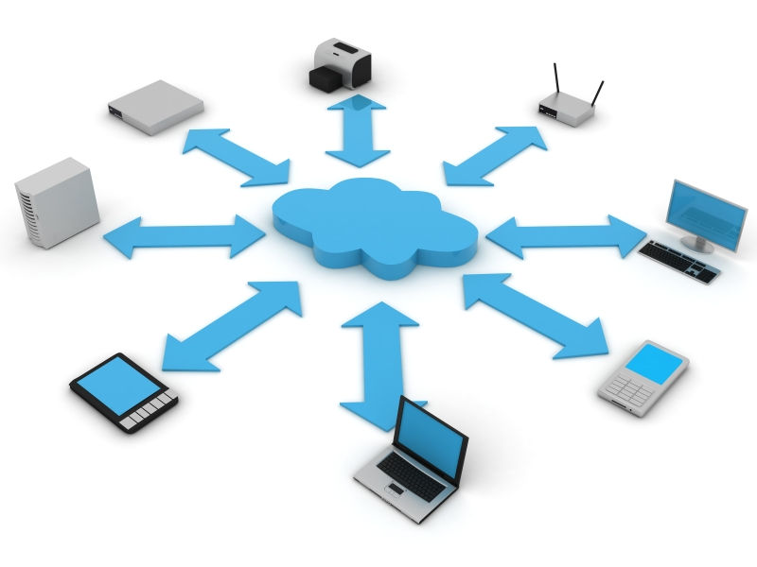

Computing for Science
Computing research driven by need to answer fundamental science questions and address societal challenges

Slide 3
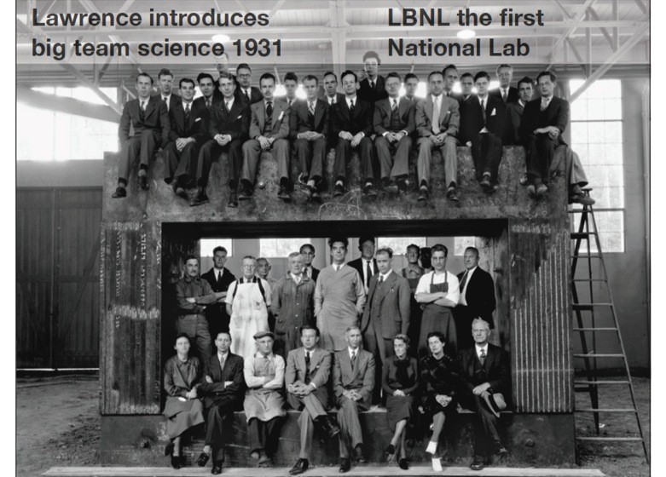
Berkeley Lab Embraces Team Science
13 Nobel Prizes
4200 employees
$800M in funding
Operated by UC
1000 student
250 faculty
Notes:
DOE is largest single agency supporter of research in physical sciences
40% of funding in the area is from DOE

Slide 4
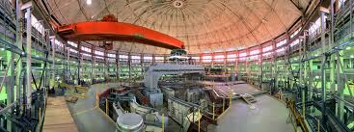
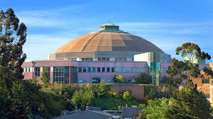
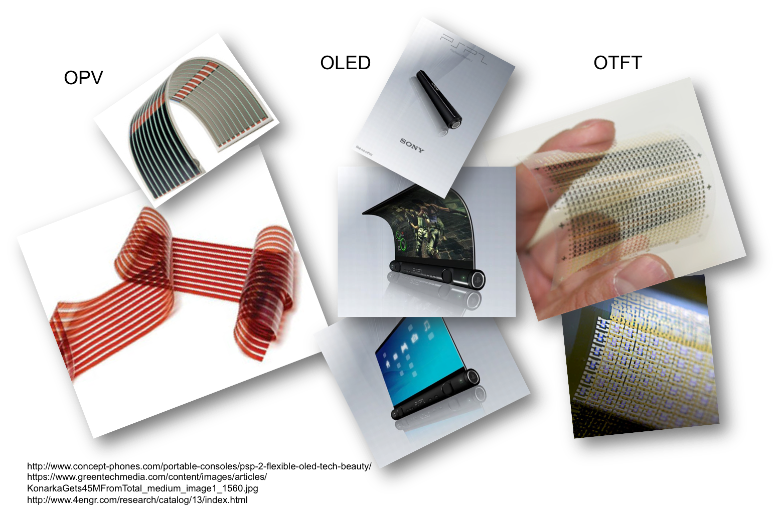
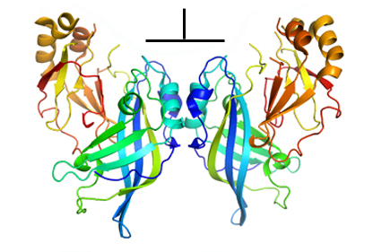
Photon Science: More Computing and Better Algorithms
MULTIPLE FUNCTIONS OF EBOLA VIRUS
3D PRINTING OF PHOTOVOLTAICS
Notes:
Printing analysis would have taken ½ year on Titan machine

Slide 5
Data Growth is Outpacing Computing Growth
Graph based on average growth
Projected Data Rates Relative to 2010

Slide 6
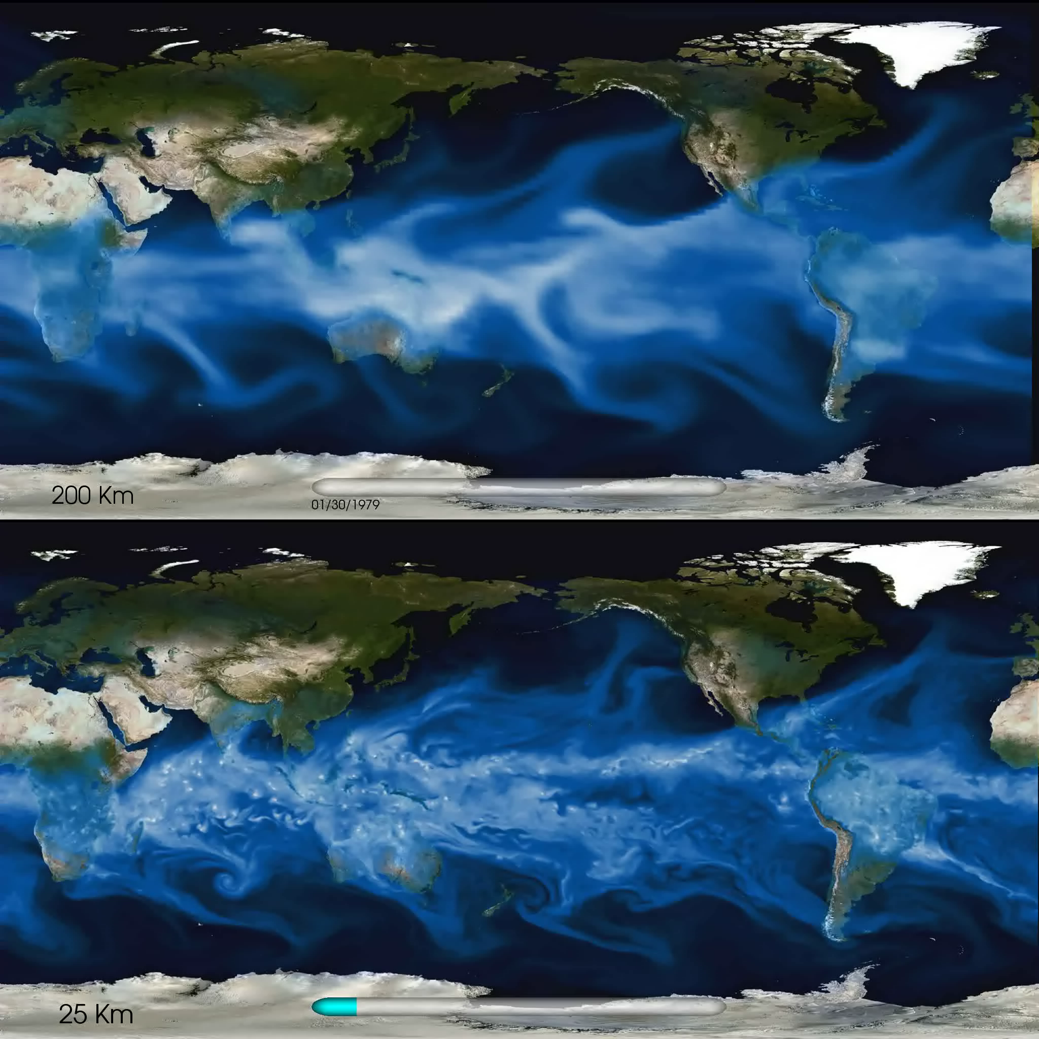

Climate Challenge: Understanding Precipitation and Extremes
Michael Wehner, Prabhat, Chris Algieri, Fuyu Li, Bill Collins, Lawrence Berkeley National Laboratory; Kevin Reed, University of Michigan; Andrew Gettelman, Julio Bacmeister, Richard Neale, National Center for Atmospheric Research

Slide 7
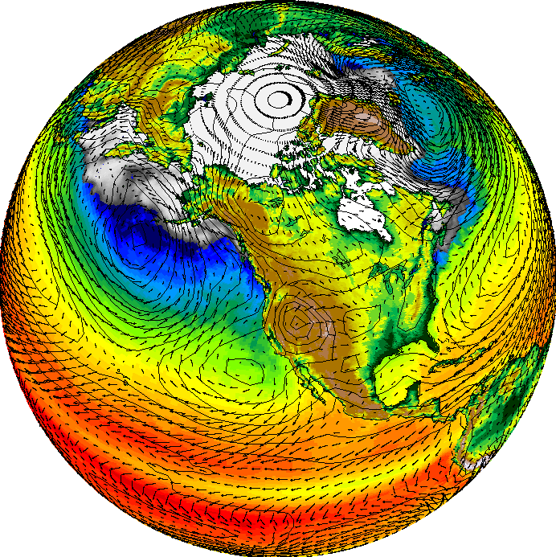
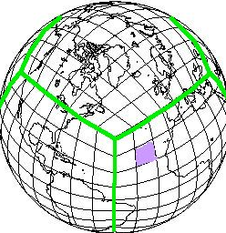
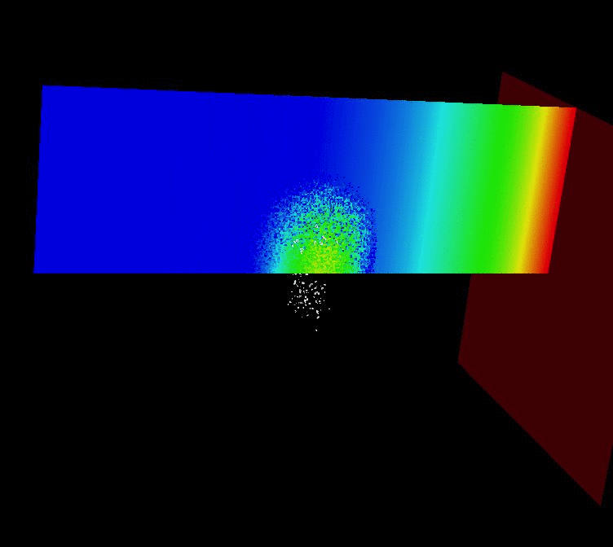
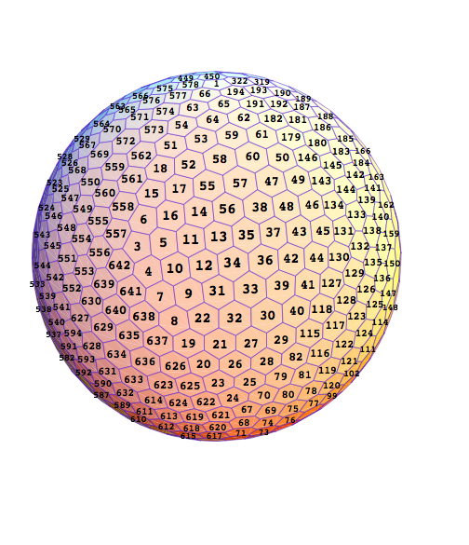
Computer Science and Math Challenges in Climate
New types of meshes to reach 1km resolution
New math of clouds
Resolution of clouds in global models requires new math, new data structures, and faster computers
Notes:
A cloud may look like just a billowing mass of air, but cloud dynamics in fact involve complicated physics. One of the most important factors in cloud dynamics, for example, is entrainment, which is when convecting clouds take environmental air and fold it into themselves as they are rising—a turbulent exchange of air between clouds and their environment. The more they do this, the less buoyant the cloud becomes and the less likely it is to rain. This process is difficult to study and build a model for because of the phase changes and complicating influence of latent heat being released.
The same cloud, without precipitation. David Romps uses these simulations to learn more about the turbulent entrainment process.
What’s worse, the entrainment rate may be the single most influential factor on climate models. “The entrainment rate is this parameter representing this really esoteric process, and it’s the parameter to which the climate is most sensitive — that’s an awful state of affairs!” Romps says. “We don’t understand entrainment.”
How would an improved understanding and model of clouds affect the global climate model? “It would rain in the right places,” Romps says. “The large-scale winds would look better because the release of latent heat drives a lot of those winds, and climate sensitivity would be better constrained because not only is the base state highly dependent on convective parameterization but the model predictions for future climate change are also very sensitive to that as well.”
Romps has also tested theories on how future climate change will affect clouds. One of the biggest predictions is that higher temperatures will result in, roughly, fewer clouds, or more precisely, a smaller convective mass flux. Why? If the earth is warmed by 1 degree Celsius, then the amount of water vapor in the atmosphere increases by 7 percent. Meanwhile climate models say that the amount of rain in the future will increase by 1 to 3 percent.

Slide 8

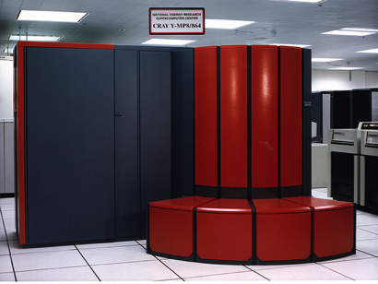
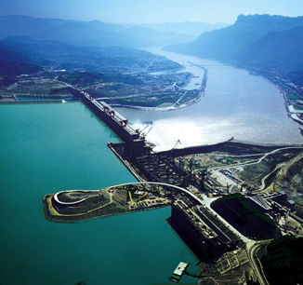

More Computing for the Black Swans
Notes:
Black Swans – the unanticipated

Slide 9
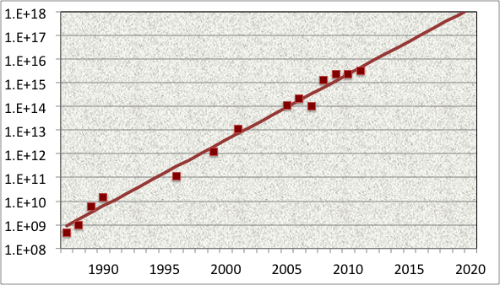






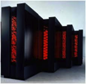



Architectures to Grow Computing Performance and their Programming Models and Algorithms
  Application Performance Growth
  (Gordon Bell Prizes)
Flop/s
Notes:
11:20 (5 minutes)

Slide 10
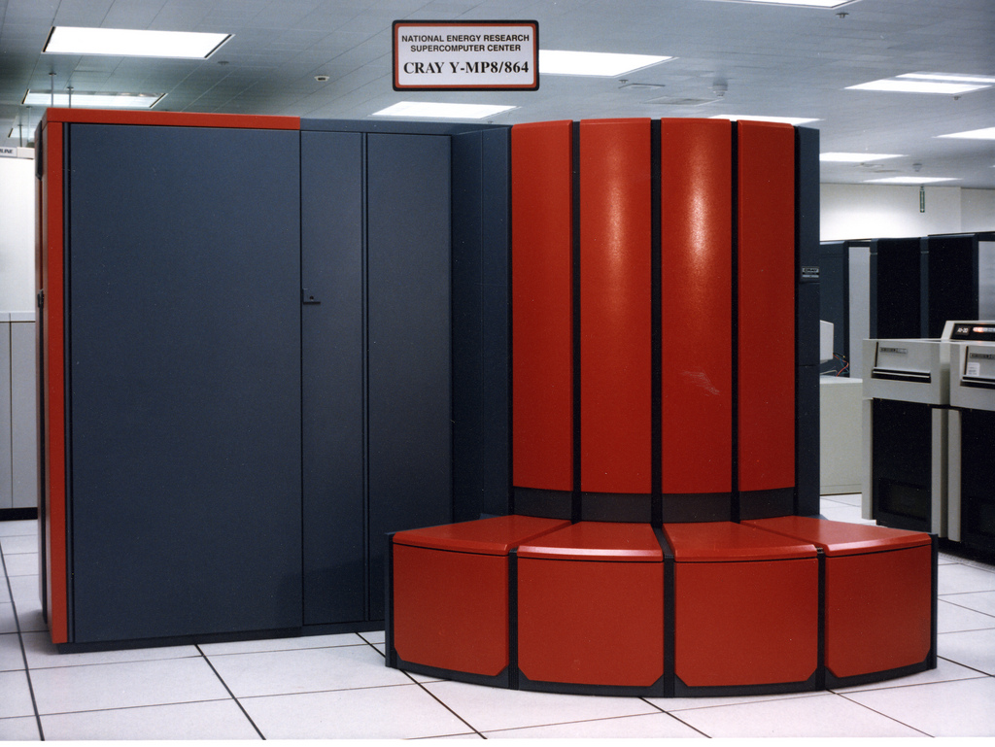
Scientific Computing: The Early Days
Programming: Vectorizing compilers
Algorithms: Array-based (with a “cartoon” of performance)
Notes:
Automatic vectorization was not entirely successful from a compiler perspective
Programmers needed to annotate loops and sometimes rewrite code to remove dependendies

Slide 11

Data Parallelism in Hardware: A Brief History
Programming: Dataparallel Languages (C*, *Lisp, CMF,..)
Algorithms: Dataparallel algorithms (scan, reduce, segmented scan)

Slide 12
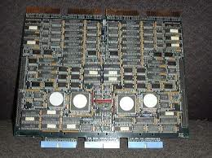
Shared Memory in Hardware
Programming: Threads with locks
Algorithms: PRAM (and cache coherence in hardware)

Slide 13
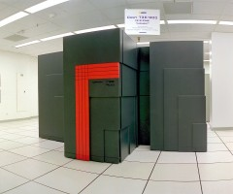
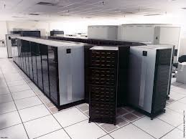
Massive Parallelism Replaces Vector Supercomputers
Programming: Message Passing
Algorithms: Domain decomposition (graph partitioning, etc.)

Slide 14
PGAS Programming Models
Global address space: thread may directly read/write remote data using an address (pointers and arrays)
  … = *gp; ga[i] = …
Partitioned: data is designated as local or global
shared int [ ] ga; and upc_malloc (…)
x: 1
y:
x: 5
y:
x: 7
y: 0
Global address space
l:
l:
l:
g:
g:
g:
p0
p1
pn
Notes:
Too much time on this slide and next 3
Don’t talk about malloc
What about clusters of SMPs
Process, processor, thread
Too much talking relative to slide

Slide 15
Important Insights in PGAS
Lightweight one-sided communication is essential
  Active Messages at Berkeley and others
Global addressing ≠ shared memory
Never cache remote data → trivial cache coherence
A little bit of compiler work makes this a language
  Split-C among others
Locality control is still important (the P in PGAS)
  Distributed memory algorithms
Never have to say “receive”
  Ability to access remote data is still convenient

Slide 16
Can We Have Sequential Consistency?
Reordering by the compiler even on sequentially consistent hardware
Reordering by hardware
  Write buffers or network may reorder
  Can be prevented using some form of fence instruction
Can get sequential consistent semantics
  Need (conservative) race analysis, concurrency analysis, cycle detection (all easier with strong typing)
T1
T2
reordering T1’s writes is legal by dependence analysis
data = 1
f = flag
flag = 1
d = data

Slide 17
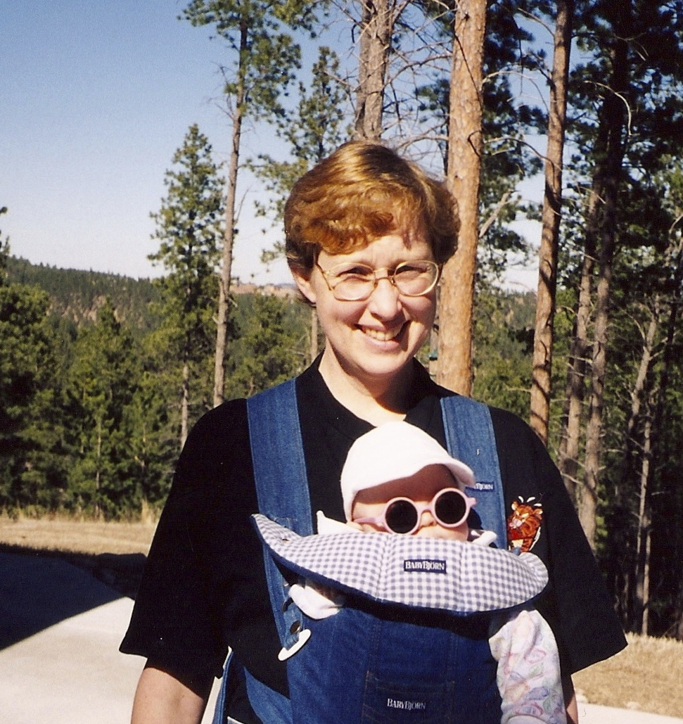
Timing is Everything → Unified Parallel C (UPC)
Bill Carlson, Jesse Draper, David Culler, Kathy Yelick, Eugene Brooks, Karen Warren
Notes:
Spring 1997

Slide 18
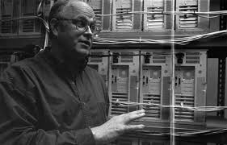
Attack of the Killer Micros
Copyright ©1996-2015 Computer History Museum
Programming: Message Passing
Algorithms: Domain decomposition (graph partitioning, etc.)

Slide 19
One-Sided Communication Is Faster than Two-Sided
Cray XE6 (Hopper at NERSC)

Slide 20
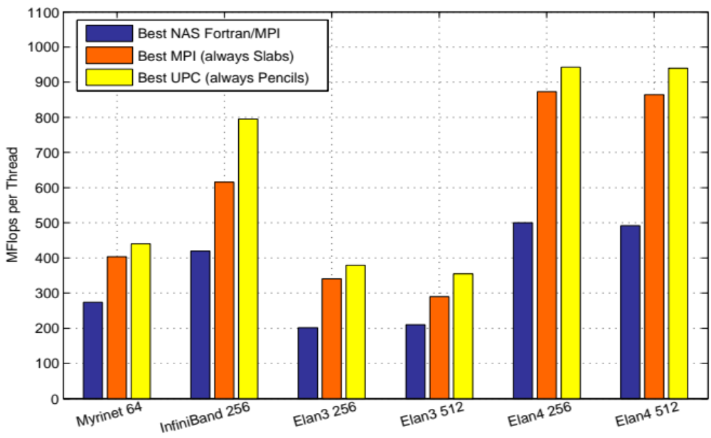
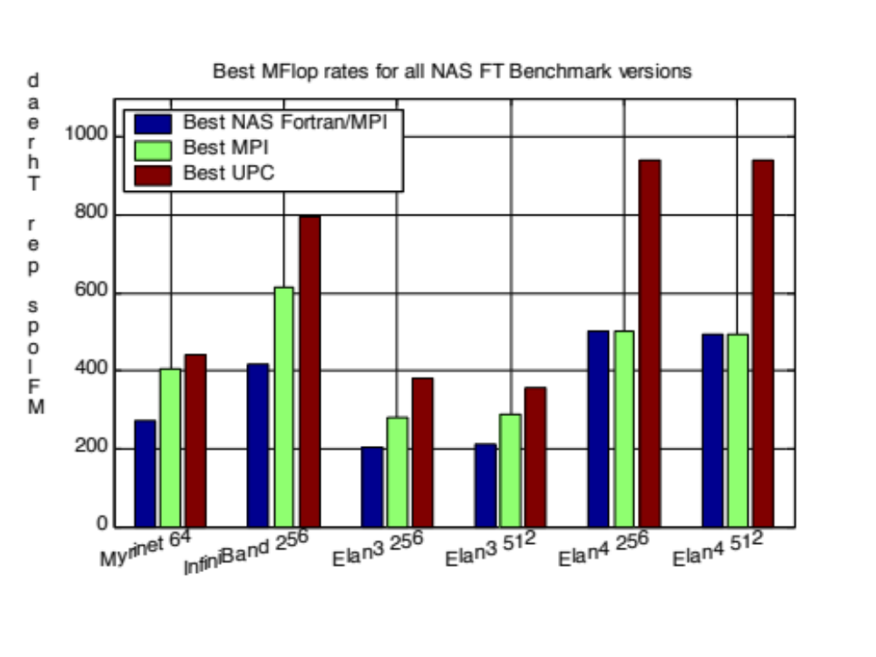
For Bisection-Bandwidth Limited Problems this Pays Off
E.g., 3D FFT with global transpose
Chunk (NAS FT with FFTW)
Best MPI (always slabs)
Best UPC (always pencils)
MFlops per Thread
Slab is always best for MPI; small message cost too high
Pencil is always best for UPC; more overlap
Myrinet Infiniband Elan3 Elan3 Elan4 Elan4
#procs 64 256 256 512 256 512
Notes:
Remote “long message matching queue depths”
MPI point less negative

Slide 21
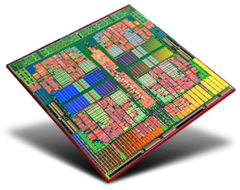
Multicore Revolution: The Rest of the World Goes Parallel
Programming: Threads with locks, restricted (fork-join CILK),…
Algorithms: PRAM, lock-free algorithms
Notes:
The rest of the world wakes up to parallel computing

Slide 22
PGAS on Shared Memory is the Easy Case… Right?
Shared memory (pthreads) backend
  Just load / store – fast!
  Local pointers in apps
  Thread pinning in runtime
Also built process + shared memory backend
  Consistently better!

Slide 23
Bringing Users Along: UPC Experience
1991
Active Msgs are fast
Other GASNet-based languages
1993
Split-C funding (DOE)
2001
gcc-upc at Intrepid
2010
Hybrid MPI/UPC
1992
First AC (accelerators + split memory)
1997
First UPC Meeting
2001
First UPC Funding
2006
UPC in NERSC procurement
1992 First Split-C (compiler class)
“best of” AC, Split-C, PCP
2002 GASNet Spec
2003 Berkeley Compiler release
Necessary ecosystem for user adoption:
  Users with a need
  The right machine (RDMA)
  Research and production implementations
  Sustained funding and visionary center directors
Influencing others (MPI 1-sided, Chapel, X10…)
Understand your users!
Users with a need

Slide 24
Lessons Learned #1
We are at the mercy of hardware designers and their constraints
Full employment for programming systems researchers and algorithms designers
Notes:
11:35 (20 minutes)

Slide 25
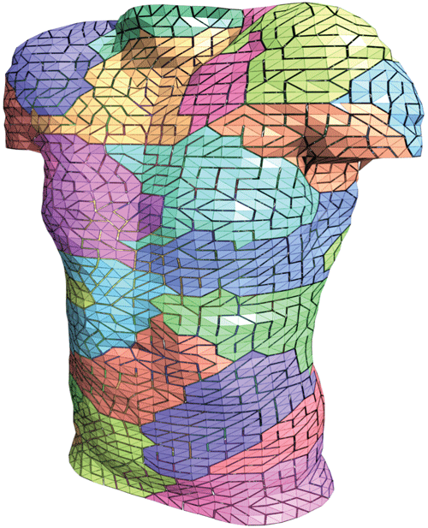
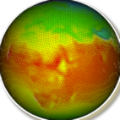
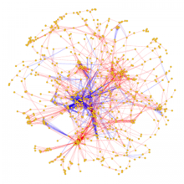
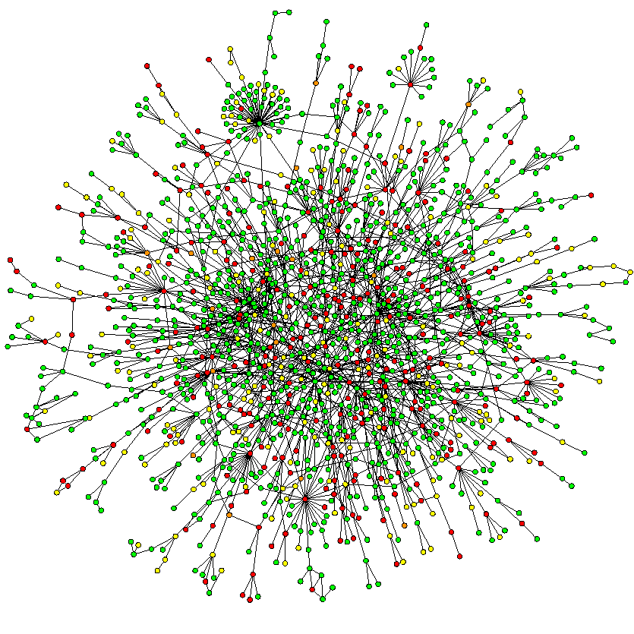
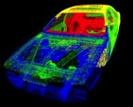
Lesson #2: Understand Applications
More Regular
Message Passing Programming
Divide up domain in pieces
Compute one piece
Send/Receive data from others
More Irregular
Global Address Space Programming
Each start computing
Grab whatever / whenever

Slide 26



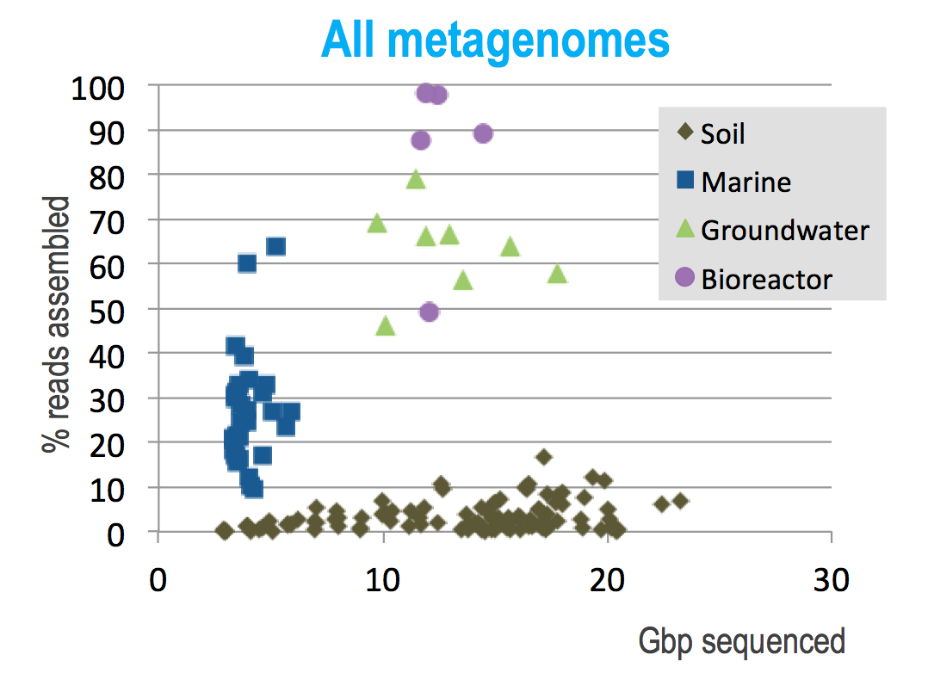
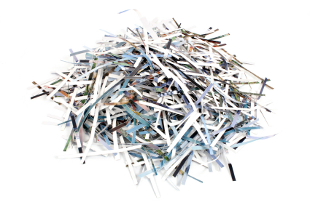
Genome Assembly: PGAS Killer App
For a
great are made so
all men tragically g
ally great
For all men tragically great are made so
Many genomes are never assembled
de Bruijn graph construction with large hash table

Slide 27
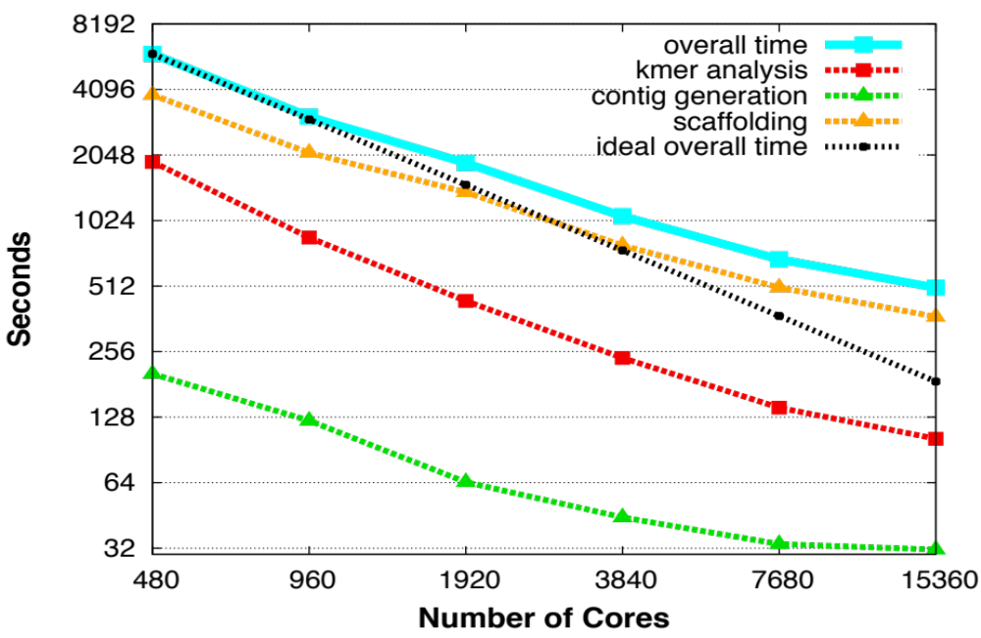
Genome Assembly: Transform Discovery Process
Perl to PGAS: Months to minutes
Remote Atomics
Dynamic Aggregation
Software Caching (sometimes)
Clever algorithms and data structures (bloom filters, locality-aware hashing)
Transforms process of discovery for de novo assembly
8 minutes for humans ($50 of NERSC time)
39 minutes for harder wheat (one of first full assemblies!)
Evangelos Georganas, Aydin Buluc, Lenny Oliker, Jarrod Chapman, Rob Egan, Dan Rokhsar, Kathy Yelick
Notes:
Wheat genome assembly is a grad challenge, only recently completely by two groups, one at JGI
The JGI code called Meraculous is used in production and is key to JGI.
Meraculous was partly parallelized before and was written in Perl, but the most challenging part of assembly (contig generation) had not been parallelized.
Contig generation is like putting together a puzzle, where you have fixed-length (K) sequences of the genome, called K-mers, and the goral is to created the longest possible chains, called contigs
The challenges to parallelization has been the need for random access into a large table that does not fit into shared memory hardware; the serial code was also very slow
The contig generation step has been entirely rewritten using DEGAS languages ideas, i.e., PGAS, with asynchronous communication and adaptive communication scheduluing to build and read a large shared hash table
Other parts of the pipline (k-mer analysis using bloom filters and better I/O) were also imlemented as part or other projects.
The work has just been accepted as an SC14 paper and a biology paper on this work was submitted to Nature Biotechnology
The biology groups have been able to do unprecedented genome assemblies using the high quality Meraculous algorithm)
The code would be much hardware to write in a traditional message passing style, i.e., it is so “unproductive” that it hadn’t been written for Meracuolous
Future work involves encapsulating the distirbuted data structures for both bloom filters and hash tables for use in other application, bioinformatics and otherwise
This is also an important workload to demonstrat that current petascale machines and future exascale ones can solve such irregular data-intensive computations

Slide 28
Cloud Computing: A Business Model, Not a Technology
53x
~
HPC:
Optimized for batch scheduling
>90% utilization
Failures assumed to be rare
Clouds:
Optimized for on-demand workload
Low utilization → elasticity
Failures assumed to be frequent
NERSC cost/core hours dropped 10x (1000%) from 2007 to 2011, while Amazon pricing dropped 15% in the same period

Slide 29
What’s ahead for Hardware?
Notes:
11:45 (30 minutes)

Slide 30
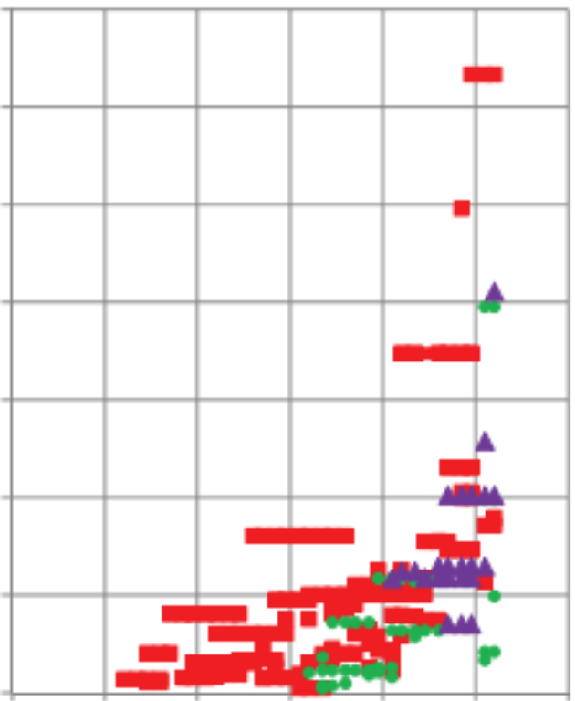
Energy is the Primary Design Constraint
At ~$1M per MW, energy costs are substantial
1 petaflop in 2008 used 3 MW
1 exaflop in 2018 at 200 MW “usual chip scaling”
Missing Tihanhe-2 at 18MW
12
10
8
6
4
2
Goal: 1 Exaflop in 20 MW
= 20 pJ / operation
Note: The 20 pJ / operation is
Independent of machine size
Independent of # cores used per application
But “operations” need to be useful ones
Megawatts per machine
(Kogge/Shalf)
’92 ’96 ’00 ‘04 ‘08 ‘12 ‘16
Notes:
Tianhe-2 is not on here: 17.5MW for the system, 24MW including cooling and power loss

Slide 31
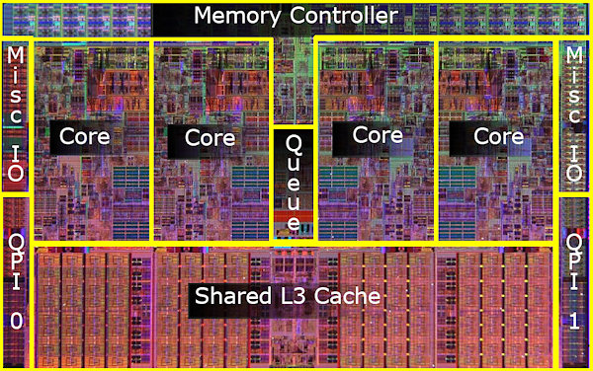
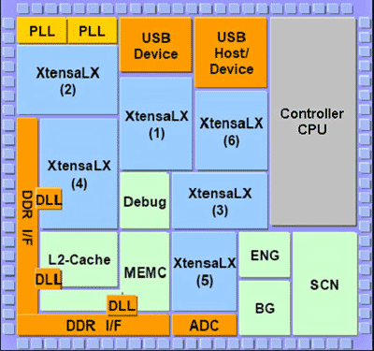
More Parallelism
Cell phone processor (0.1 Watt, 4 Gflop/s)
Server processor (100 Watts, 50 Gflop/s)
Small, simple cores are energy and area efficient
  Reflected in both GPUs and Xeon Phi (Knight’s *)
  SIMD is also efficient (if you have data parallelism in apps)
Dark silicon and heterogeneity are also likely

Slide 32
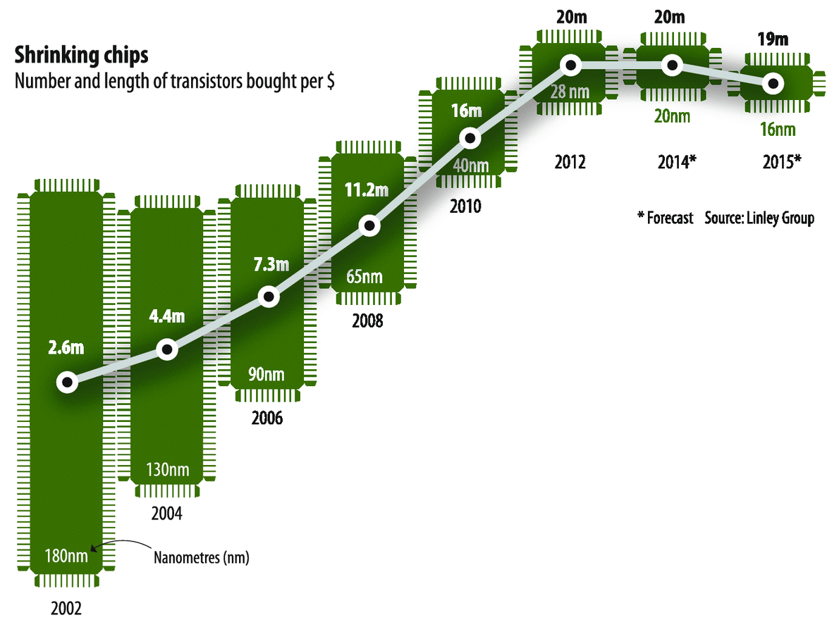
Moore’s Law is Running Out
Notes:
The issue is that companies can shrink the die size, but the cost of the technology development and upgrading the facilities is high enough that the M of transistors / dollar is getting worse. (It might get better if the volume of sales gets high enough, but it's not clear that will happen as there are diminishing returns as amount of shrinkage per generation is less than it used to be, i.e., getting to the end of Moore's Law.) This slide is fine, you might just want this comment in the notes section for future reference.

Slide 33
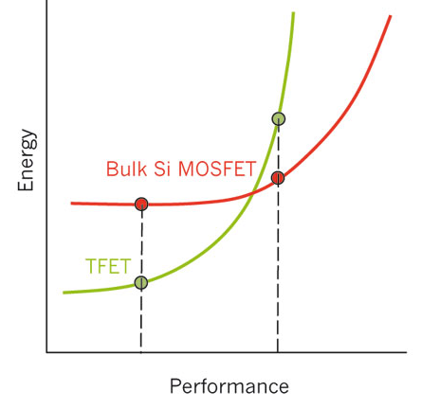
New CMOS Technologies → More Parallelism
Ionescu & Riel, Nature 2011
Notes:
Notional graph showing current (MOSFET) technology compared to a new TFET
The TFET is interesting on the left of the crossover, where it has lower energy
But in this range the absolute performance is lower than where one runs todays’ devides
Slower clock
More parallelism to get the same performance

Slide 34
Avoid Synchronization: Parallel by Default
Single Program Multiple Data (SPMD) is too restrictive
0
2
4
6
Hierarchical SPMD + PGAS is a good machine abstraction
1
0
3
5
7
1
2
3
The SPMD model encourages “all the cores all the time”
  No parallel forking startup or implicit join synchronization
  Slow things are obviously slow:
Need hierarchy to match machine (hybrid algorithms, 1 model)
barrier
if (mythread == 0) {lots of work}

Slide 35
Performance Heterogeneity?
Question: do all applications become “irregular”?
Finer-grained tasks means that variations and overhead matter more
Brian van Straalen, DOE Exascale Research
Conference, April 16-18, 2012. Impact of persistent
ECC memory faults.
Unpredictable → dynamic scheduling

Slide 36
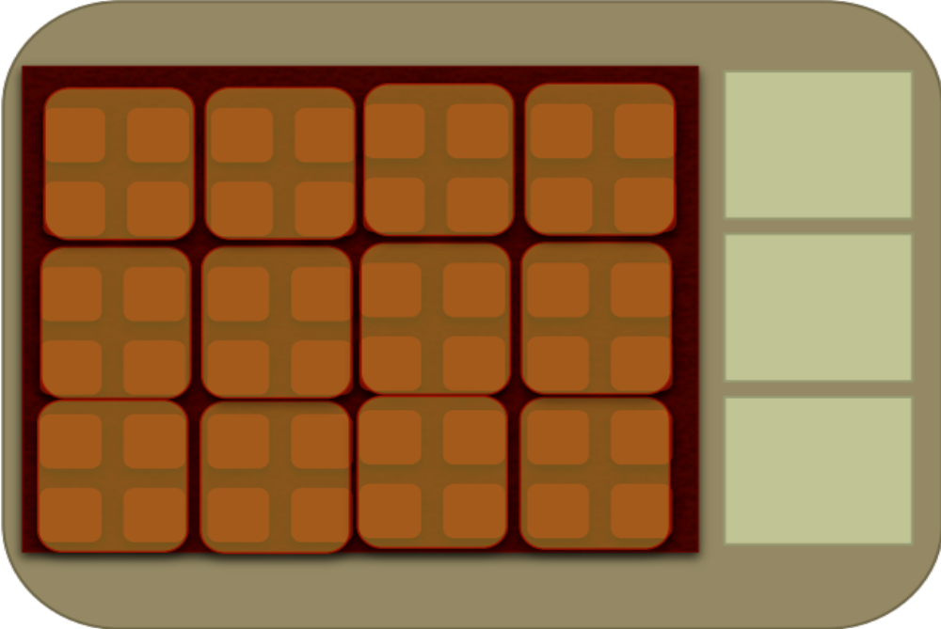
Data Movement in Future Systems
Memory Stacks on Package
Low Capacity, High Bandwidth, Software Control?
Bulky Core
Latency
Optimized
Memory
Thin Cores
(tiny, simple, massively parallel)
Throughput-Optimized
DRAM/DIMMS
High Capacity Low Bandwidth
NVRAM: Burst Buffers / rack-local storage (software control)
“NIC” on Board
Based on slide from J. Shalf

Slide 37
Memory System Optimizations
Xeon X5550 (Nehalem)
NVIDIA C2050 (Fermi)
1024
1024
single-precision peak
512
512
double-precision peak
256
256
DGEMM
DP add-only
single-precision peak
128
128
double-precision peak
RTM/wave eqn.
64
DP add-only
DGEMM
64
Device bandwidth
32
STREAM bandwidth
RTM/wave eqn.
32
27pt Stencil
16
7pt Stencil
27pt Stencil
16
7pt Stencil
8
GTC/pushi
8
SpMV
GTC/pushi
SpMV
GTC/chargei
4
4
GTC/chargei
2
2
¹/₃₂
¹/₁₆
¹/₈
¹/₄
¹/₂
1
2
4
8
16
32
¹/₃₂
¹/₁₆
¹/₈
¹/₄
¹/₂
1
2
4
8
16
32
Two big compiler problems:
Discovering parallelism
  domain-specific languages and small compilers
Generating good code
  Automatic performance tuning

Slide 38
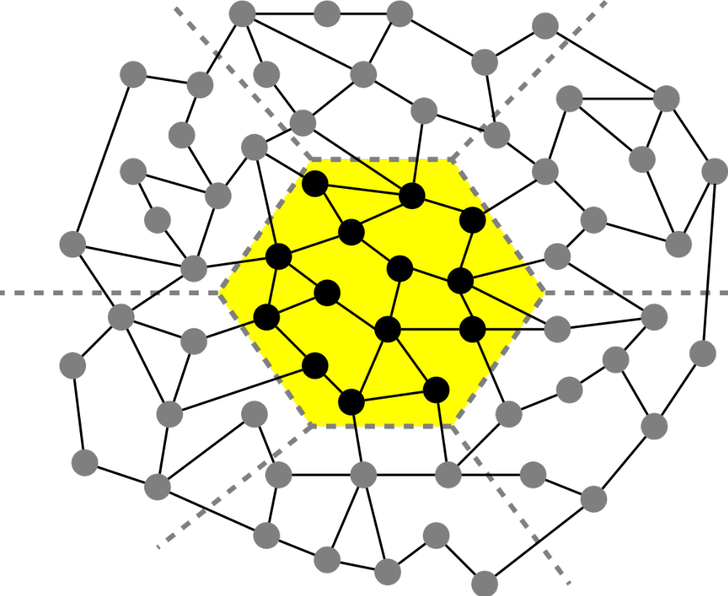
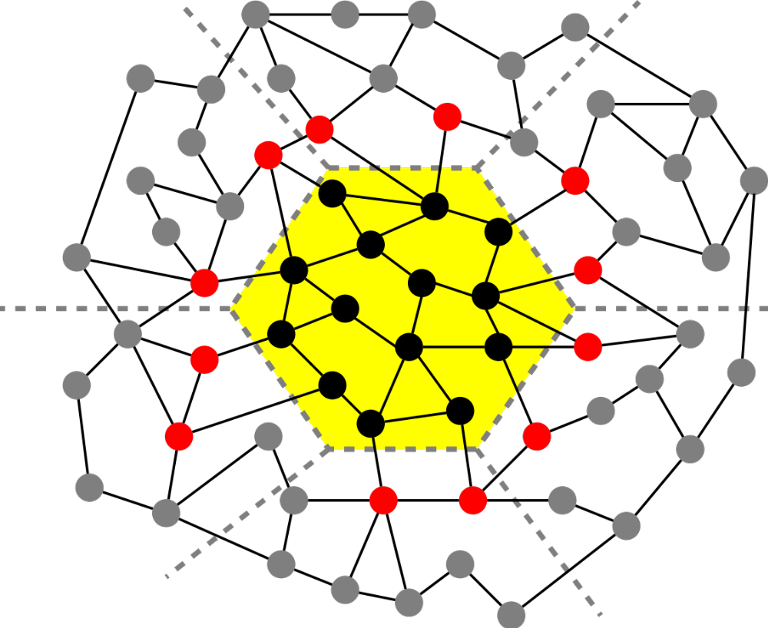
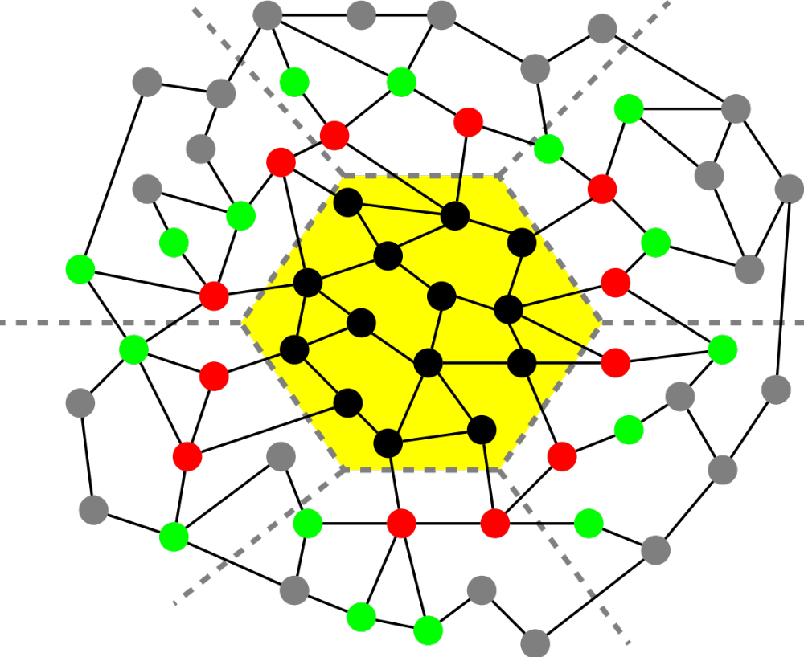
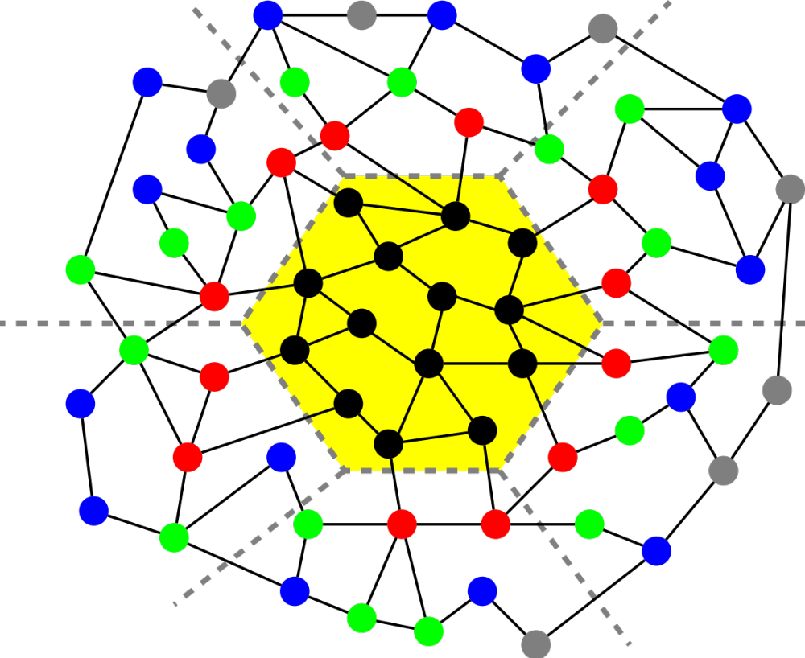
Communication Avoiding Sparse Solvers
For implicit memory management (caches) uses a TSP algorithm for layout
Joint work with Jim Demmel, Mark Hoemman, Marghoob Mohiyuddin
Saves communication for “well partitioned” matrices
    Serial: O(1) moves of data moves vs. O(k)
    Parallel: O(log p) messages vs. O(k log p)

Slide 39
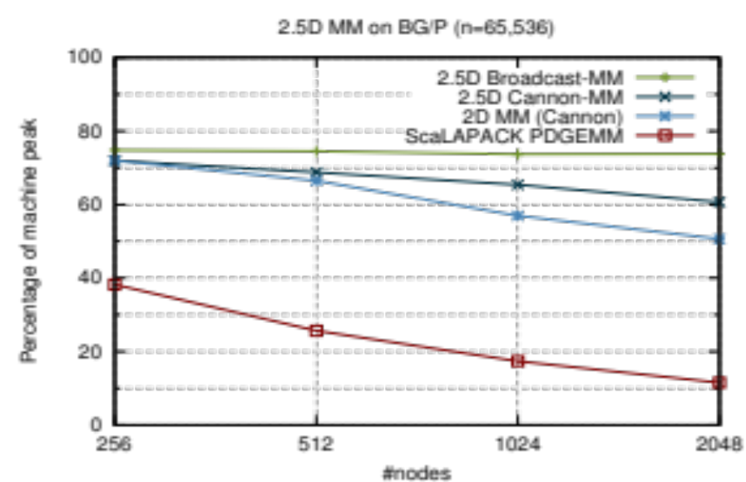
Algorithms and Software: Avoid Communication and Synchronization
“C shadow”
Perfect Strong Scaling
k
“B shadow”
i
j
Solomonik, Demmel
“A shadow”
“Rethink” algorithms to optimize for data movement
New class of communication-optimal algorithms
Most codes are not bandwidth limited, but many should be
Can they be automated and for what types of loops?

Slide 40
Generalizing Communication Lower Bounds and Optimal Algorithms
For matmul, we know #words_moved = Ω (n³/M^{1/2}), attained by tile sizes M^{1/2} x M^{1/2}
Thm (Christ,Demmel,Knight,Scanlon,Yelick): For any nested-loop-like program, accessing arrays with subscripts that are linear functions of the loop indices
#words_moved = Ω (#iterations/Me)
for some e we can determine by solving a Linear Program
Thm (C/D/K/S/Y): Under some assumptions, we can determine the optimal tiles sizes
  E.g., index expressions are just subsets of indices
Long term goal: All compilers should generate communication optimal code from nested loops
Notes:
Linear functions of the loop indices means subscripts can be j, j+3*k, 7*i-2*j+4*k, etc.
“Smells like” nested loops means sparse accesses, pointer references, etc are ok.
For example, this includes not just linear algebra, but direct n-body, database join, etc.
The theory to determine e requires some recent deep mathematical results using functional analysis
and group theory, due to a team of pure mathematicians including Mike Christ @ Berkeley, Terry Tao @UCLA, others.
The original characterization of e was not necessarily even decidable (Hilbert’s 10th problem over rationals), but
We think it is now decidable (still writing it up).
The assumptions in the second theorem are that
Dependencies permit us to reorder loop iterations as needed (matmul being an example)
Array subscripts are just subset of the loop indices (again like matmul, where loop indices are i,j,k, and
Subscripts are A(i,k), B(k,j), C(i,j)
We are still working on generalizing these assumptions.

Slide 41
Theorem Applied to Direct N-Body
Program
  for i=1:n
  for j=1:n
  F(i) += force( P(i) , P(j) )
Record array indices in matrix Δ
Solve LP for x = [x_{i},x_{j}]^{T}: max 1^{T}x s.t. Δ x ≤ 1
  Result: x = [1,1], 1^{T}x = 2 = s_{HBL}
Thm: #words_moved = Ω(n²/M^{SHBL-1})= Ω(n²/M¹)
Attained by block sizes M^{xi},M^{xj} = M¹,M¹
 | i | j
 | 1 | 0 | F
Δ = | 1 | 0 | P(i)
 | 0 | 1 | P(j)

Slide 42
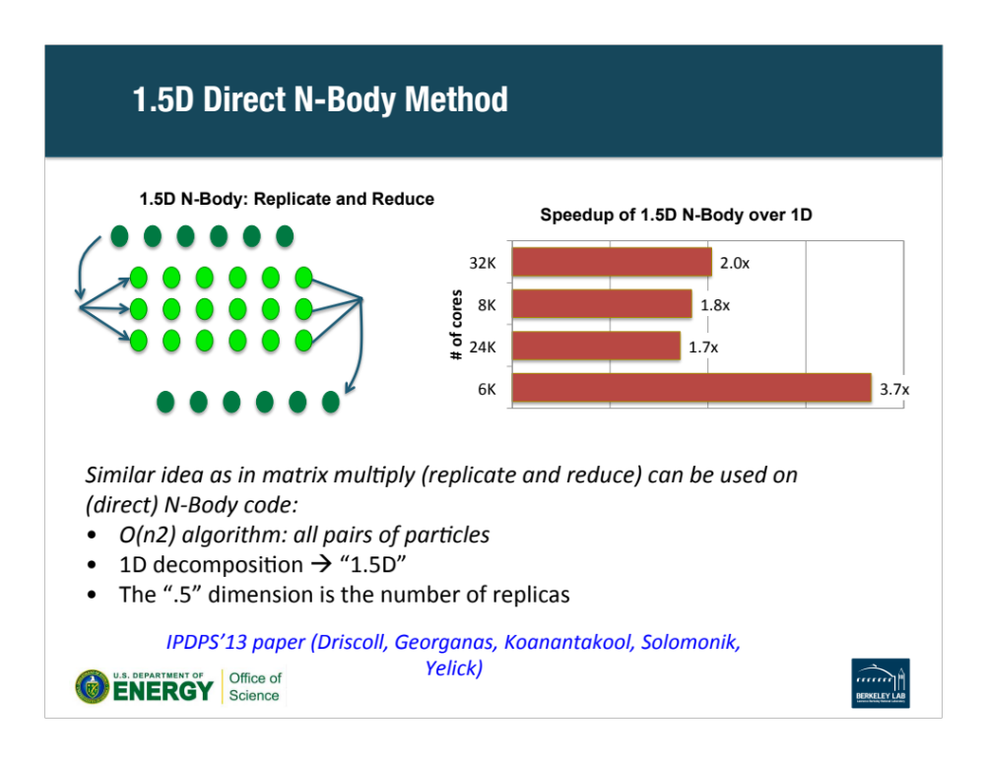
1.5D Direct N-Body Method
1.5D N-Body: Replicate and Reduce
Speedup of 1.5D N-Body over 1D
Similar idea as in matrix multiply (replicate and reduce) can be used on (direct) N-Body code:
O(n²) algorithm: all pairs of particles
1D decomposition → “1.5D”
The “.5” dimension is the number of replicas
IPDPS’13 paper (Driscoll, Georganas, Koanantakool, Solomonik, Yelick)

Slide 43
Specialization: End Game for Moore’s Law
Likely relationship
Ops/Joule
NERSC-8
Cori Ph2 (Xeon Phi)
NERSC-8 Ph1 (Haswell)
NERSC-7 Edison (Ivy Bridge)
General Purpose
Reconfigurable
Special Purpose
This is an issue for the entire computing industry.

Slide 44
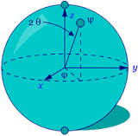
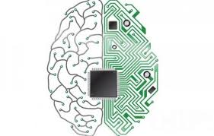
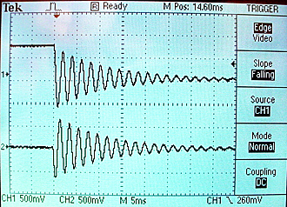
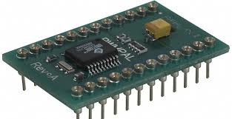
Beyond Moore’s Law
Is there a new model of computing that is useful for science?
Quantum
Neuromorphic
Are there ways of storing, transferring and computing on information that significantly reduce power?
Traditional digital
Analog

Slide 45
Science Applications of Neuromorphic Computing
Energy
Physical Sciences
Energy Sciences
Bio
sciences
Nano
Structures
Macro
Molecules
Neutrino Detectors
Energy Grid
Cosmology
Tomography
Event Identification
Image Analysis
Inverse Problems
Improved Programmability
Usable Hardware

Slide 46
QUANTUM INFORMATION SCIENCE (QIS):
AN APPLICATIONS ORIENTED VIEW
QIS
Computing (~100-100,000)
Gate Based: Shor, Grover,…
Adiabatic Quantum Computing
Quantum Annealing
Simulations (~1-100)
Chemical & Materials Science
Theoretical Physics: Cosmology,...
Communication (~1, flying)
Quantum Key Distribution
Quantum Commitment
Metrology (~1-10)
Precision measurements, squeezing
Sensors (Magnetic, Charge, Light)
Irfan Siddiqi 2015

Slide 47
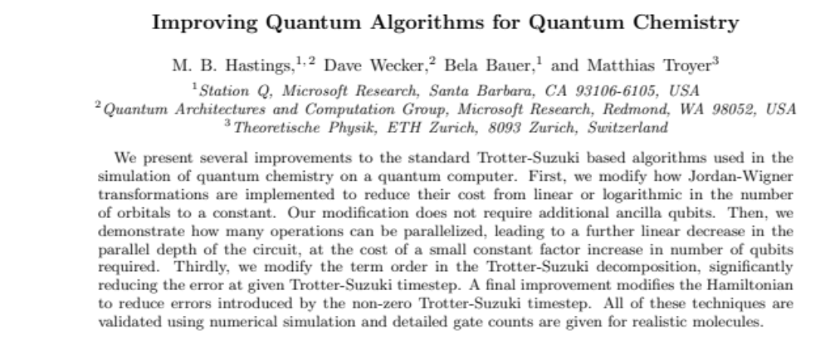
Electronic Structure Methods for Chemistry
Method | Scaling for N electrons
DFT | O(N²)-O(N³)
HF | O(N²)-O(N⁴)
MP2 | O(N⁵)
CISD, CCSD | O(N⁶)
CCSD(T) | O(N⁷)
CCSDT | O(N⁸)
FCI | O(exp(N))
Scaling for N electrons on Quantum Device
FC #1 | O(N⁹)
FC #2 | O(N⁷)
FC #3 | O(N^{5.5})
Full configuration interaction
Quantum Simulation:
“What quantum computers do in their sleep” [Scott Aaronson]
Open questions in theory and practice

Slide 48
End Game for Moore’s Law
More parallelism
More specialization
Less communication
Understand your applications!
Notes:
New kinds of parallelism
Avoid synchroonzation and overheads

