Slide 1
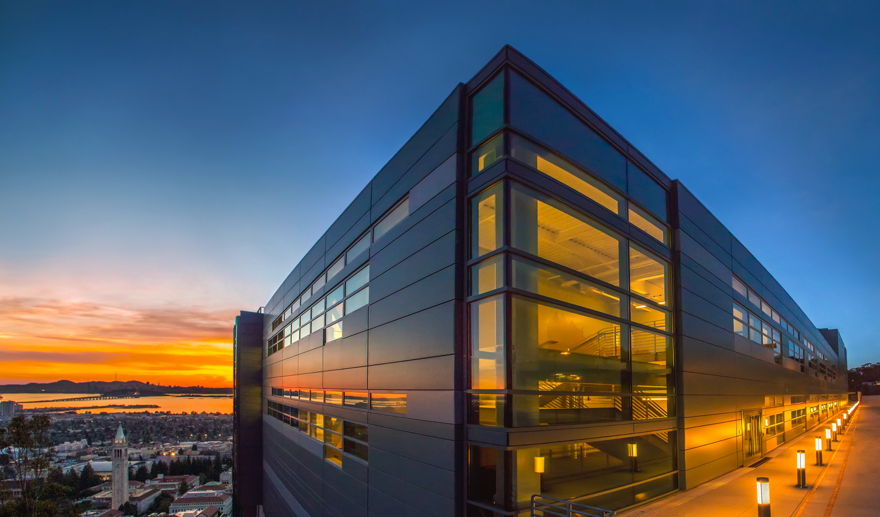
  Beyond Exascale Computing
Kathy Yelick
Vice Chancellor for Research
and Robert S. Pepper Professor of
Electrical Engineering and Computer Sciences
U.C. Berkeley
Senior Faculty Scientist
Computing Sciences
Lawrence Berkeley National Laboratory

Slide 2
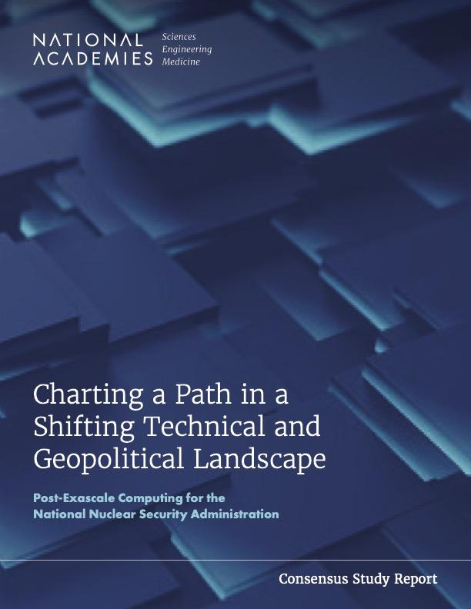
National Academies Study
Kathy Yelick (Chair)
John Bell
Bill Carlson
Fred Chong
Dona Crawford
Jack Dongarra
Mark Dean
Ian Foster
Charlie McMillan
Dan Meiron
Daniel Reed
Karen Willcox
(report at www.cstb.org)

Slide 3
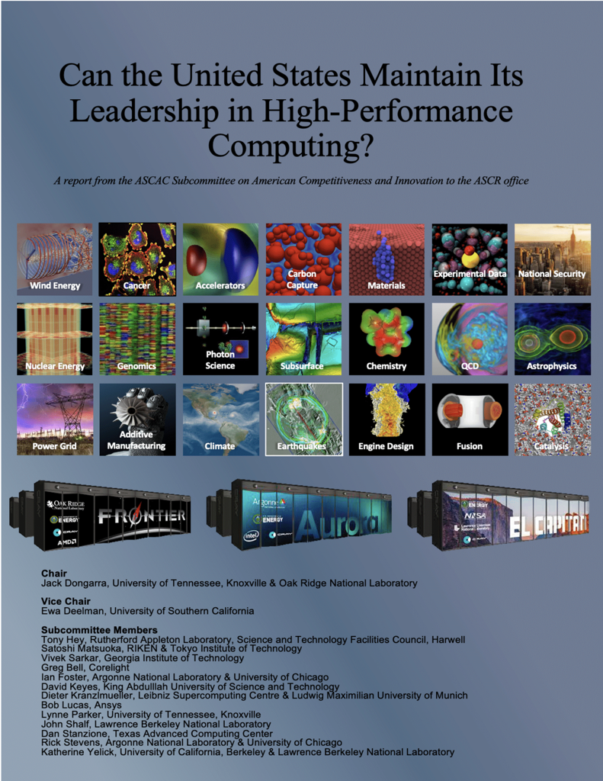
DOE ASCR Report
Jack Dongarra (Chair)
Ewa Deelman (Vice Chair)
Tony Hey
Satoshi Matsuoka
Vivek Sarkar
Greg Bell
Ian Foster
David Keyes
Dieter Kranzlmeuller
Bob Lucas
Lynne Parker
John Shalf
Dan Satanzione
Rick Stevens
Katherine Yelick
(report at www.osti.gov/)

Slide 4
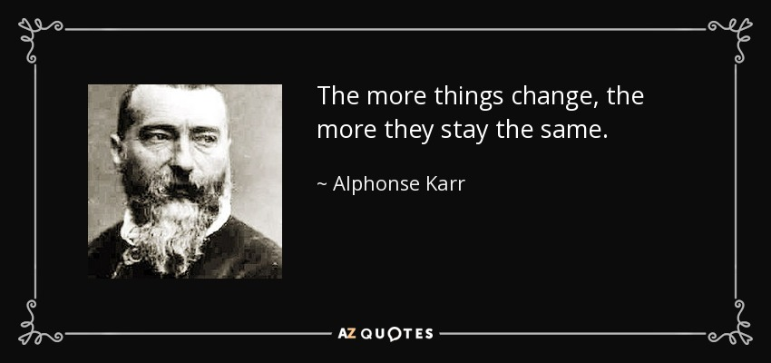
Is this Exascale all over again?

Slide 5
Post-Exascale Computing
Computing demand
Available technology
Disruptions

Slide 6

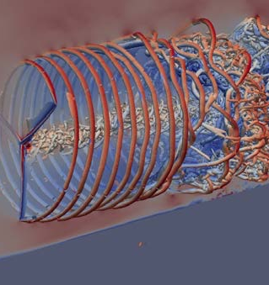
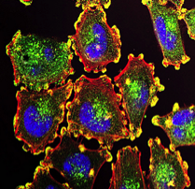
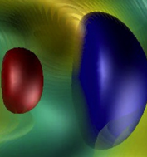
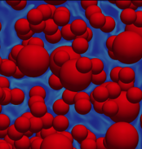
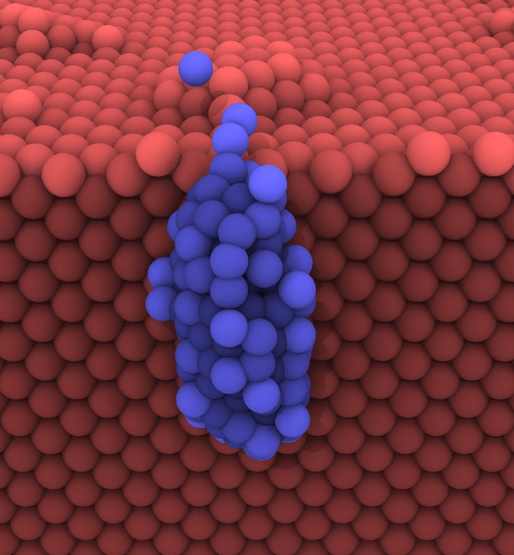
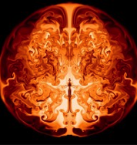
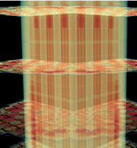

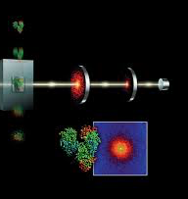
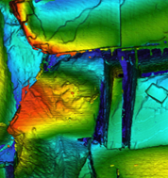
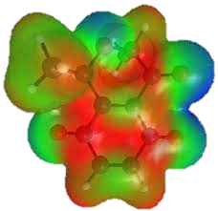
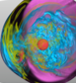
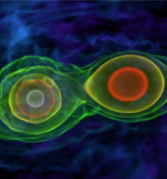
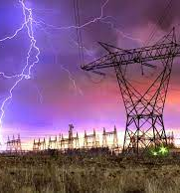
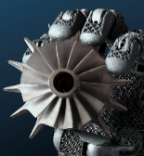
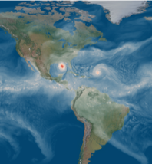
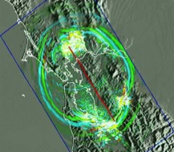
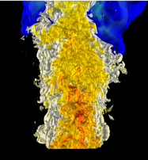
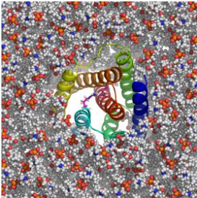
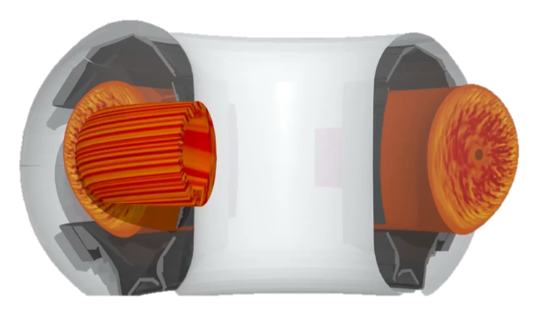
Continue to Rethink Applications
Wind Energy
Cancer
Accelerators
Carbon Capture
Materials
Fusion
Astrophysics
24 projects with about 10 people per team
Rely heavily on hardware features and software teams
Several new to HPC, all with new capabilities
We should have another 2 dozen in 10 years!!
Nuclear Energy
Genomics
Photon Science
Subsurface
Chemistry
QCD
Cosmology
xfg
Additive Manufacturing
Power Grid
Climate
Earthquakes
Combustion
Fusion
Catalysis
Notes:
DOE should have a facility dedicated to …

Slide 7

Scientific Computing Circa 2007
Exascale report from 2007 Town Halls Entirely focused on modeling and simulation
Scientific Computing is often used synonymously with Simulation and HPC
Simulation $⊂$ Scientific Computing $⊂$ HPC

Slide 8
Runtime of “hero” calculations are too long
Number of Nodes | Memory Footprint | Wall-Clock Time
2400 | ~300–400 TB | 6 months
4990 | ~600 TB | 3–4 months
288 | ~20 TB | 1 month
3250 | 104 TB | 5.8 days
512 | 32.8 TB | 2 months
Iterative design does not happen on 6 month cycles

Slide 9
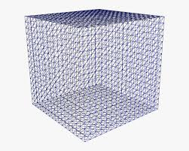
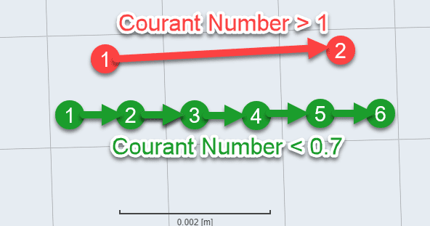
Weak Scaling has Diminishing Returns
Increase resolution by 10x in each dimension
Runtime increases ☹
Increase cores by 1000x

Slide 10
New demands for HPC in Science
Simulation
From atoms to the universe
Data
Images, text, to genomes
Learning
Interpret, infer and automate

Slide 11
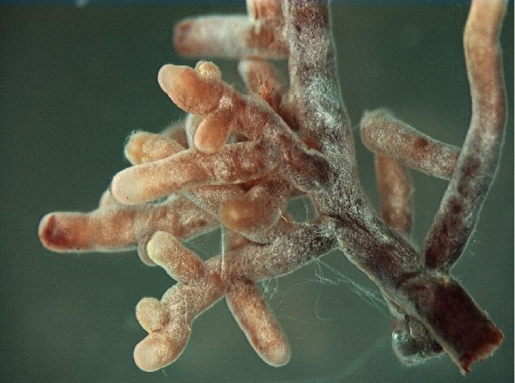
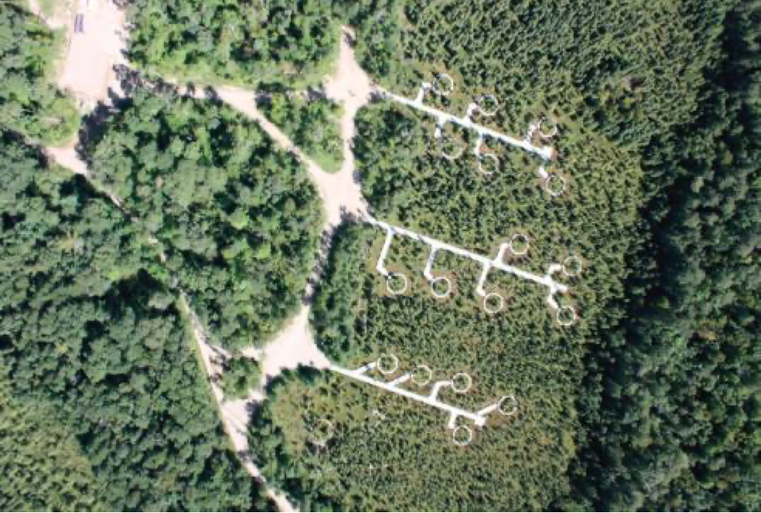
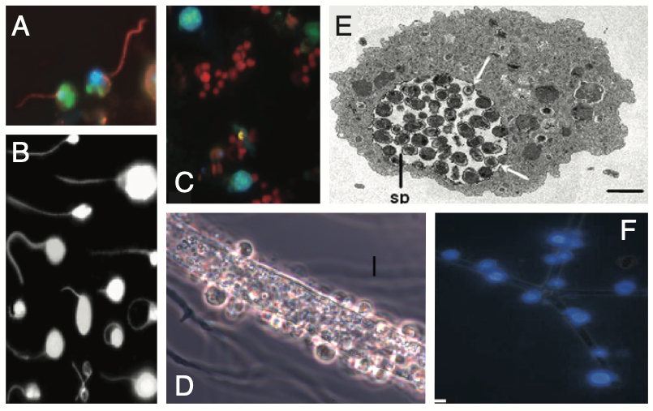
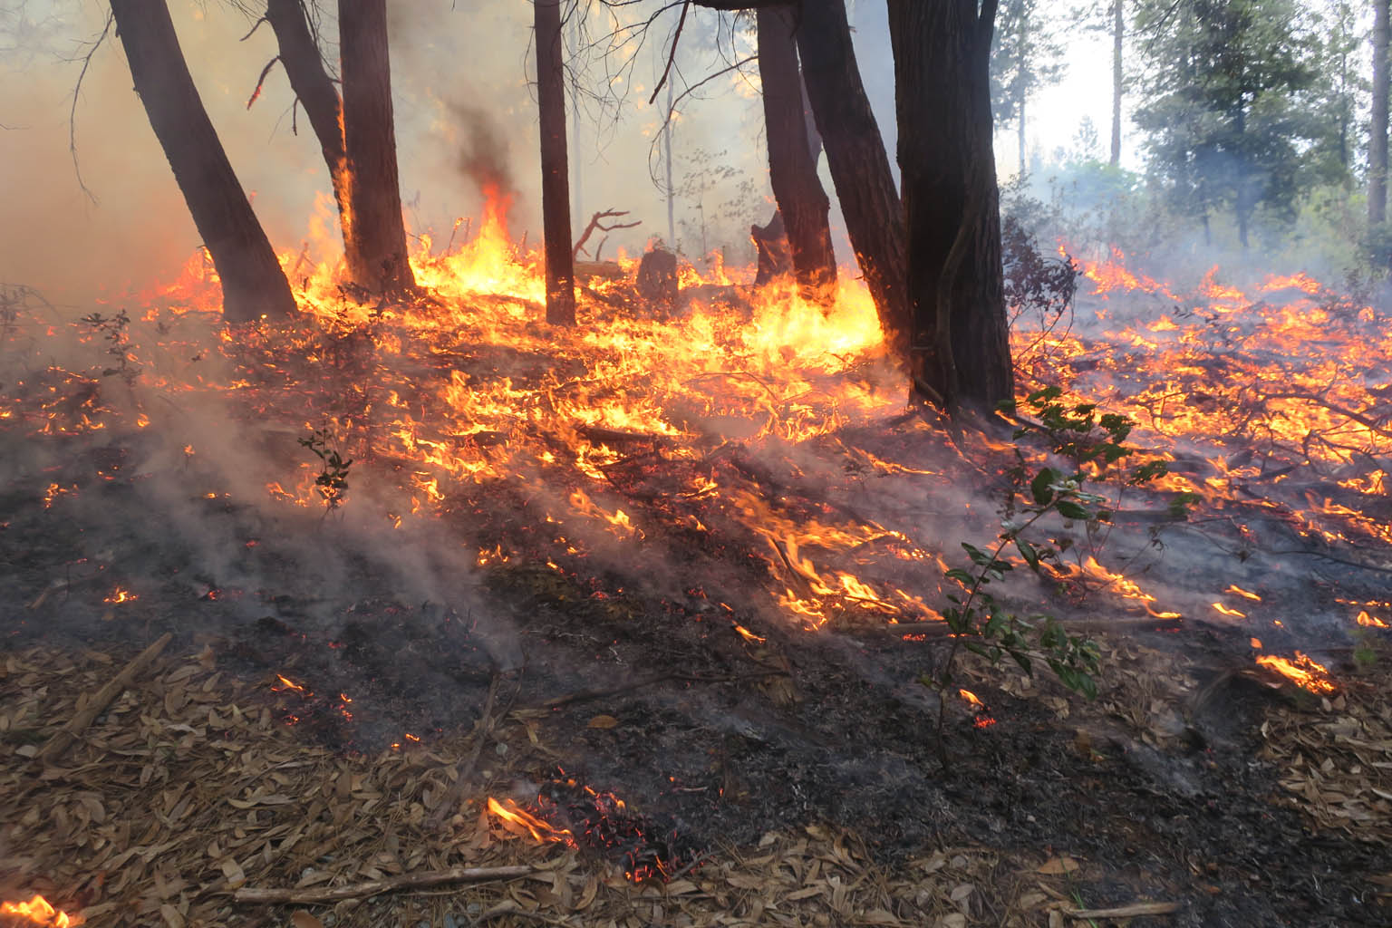
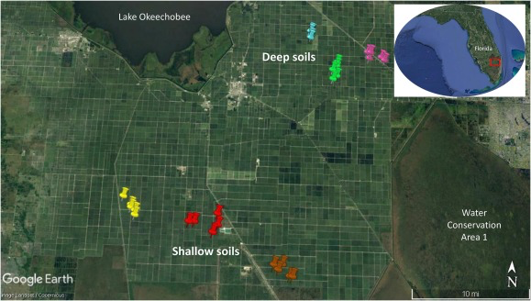
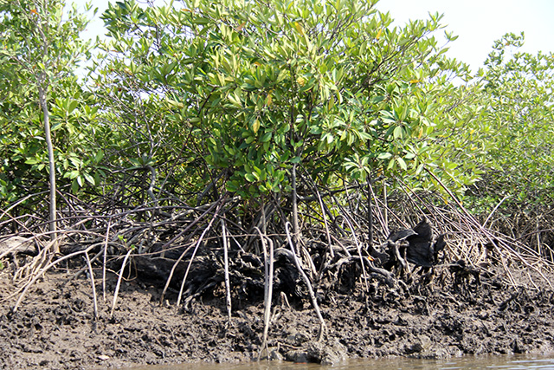
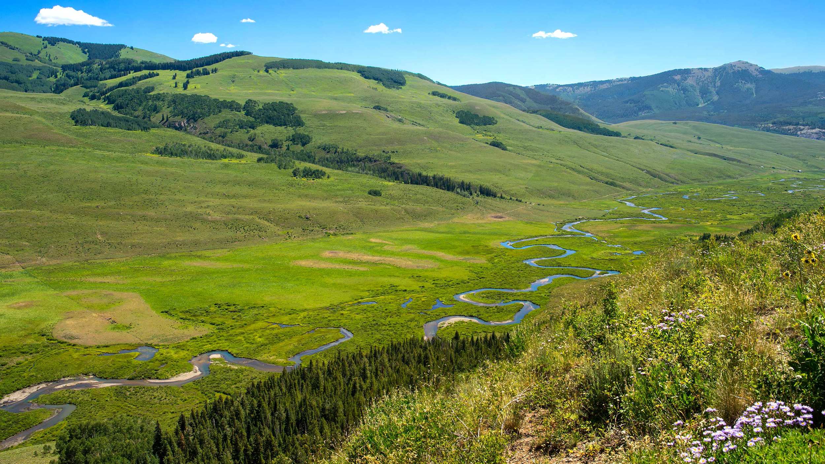
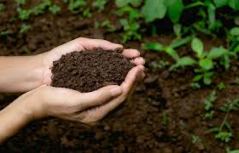

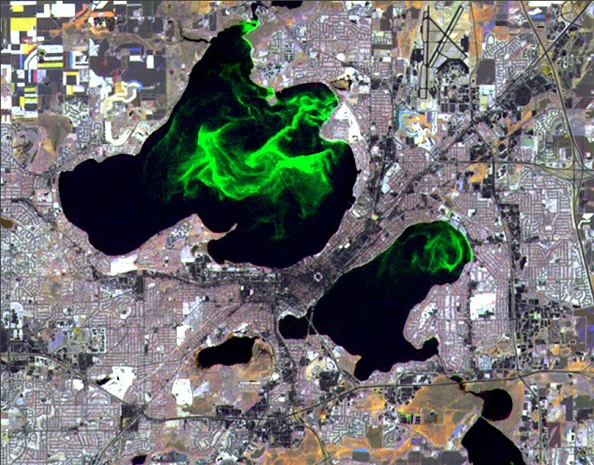
JGI User Science and ExaBiome’s MetaHipMer Assembler
Peatland bog (0.6 TB)
Mycorrhizal fungi (1.5 TB)
Prescribed fire (1.5 TB)
Subtropical soils (1.5 TB)
Dark matter fungi (1.7 TB)
Dark matter fungi (1.7 TB)
Coastal mangroves (2.1 TB)
Mountainous watershed (2.7 TB)
Soil carbon cycle (3.3 TB)
Great Redox Experiment (8TB)
Lake Mendota Time Series (25 TB)
Analyzing huge data sets with exascale tools lead to discovery of new species and protein families … new science!
Extensively used by JGI (only available terabase-scale metagenome assembler)
Notes:
Peatland: Fungal, bacterial, and archaeal communities mediating C cycling and trace gas flux in peatland ecosystems subject to climate change
Fungi: Scaling molecular mechanisms of mycorrhizal-decomposer interactions to emergent ecosystem carbon balance
Fire: Immediate effects of prescribed fire on microbial communities, decomposition, and nitrification
Soils: Biogeochemistry of carbon and nitrogen cycling in subsiding subtropical soils
Dark matter fungi: Revealing the ecological function of uncultured fungal dark matter in freshwater ecosystems using single cell genomics
Mangroves: Methane production in Texas coastal mangroves
Watershed: The synchronization of microbial and plant phenology in a mountainous watershed and its importance for nutrient retention under changing hydrologic regimes
soil carbon cycle: Microbial metabolic dependency and its impacts on the soil carbon cycle
GRE: Microbial Carbon Transformations in Wet Tropical Soils: Effects of Redox Fluctuation
Mendota: Extended temporal dynamics of microbially-mediated freshwater carbon processing as revealed through time-series metagenomes
Mention that these are just a few of the projects being done at JGI - the demand is ever-increasing, now that the community knows the potential benifits of large-scale coassembly.

Slide 12
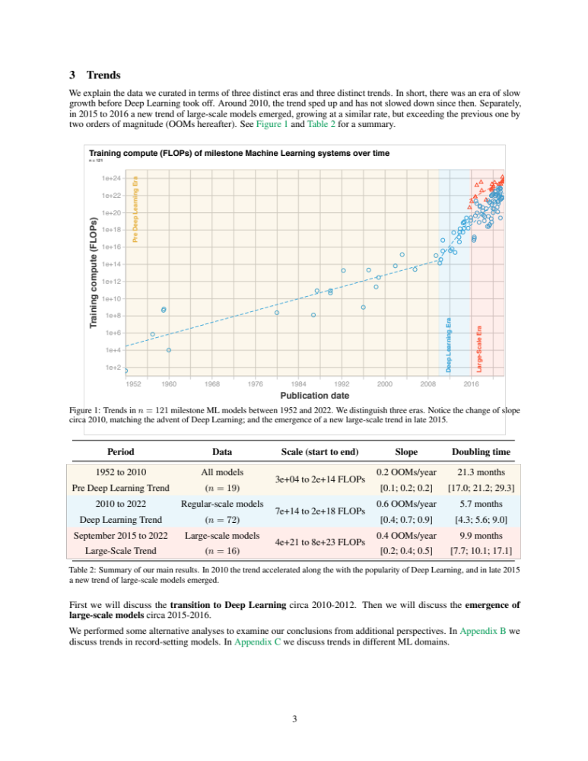
Machine Learning Drives Computational Demand

Slide 13
Computing Requirements in Machine Learning
300,000x increase from 2011 (AlexNet) to 2018 (AlphaGoZero)
From 2011-2018 the fastest Top500 machine grew < 15x
A petaflop/s-day = 10¹⁵neural net operations per second for one day, ~= 10²⁰operations
OpenAI estimates 3.4-month doubling!
https://blog.openai.com/ai-and-compute/

Slide 14
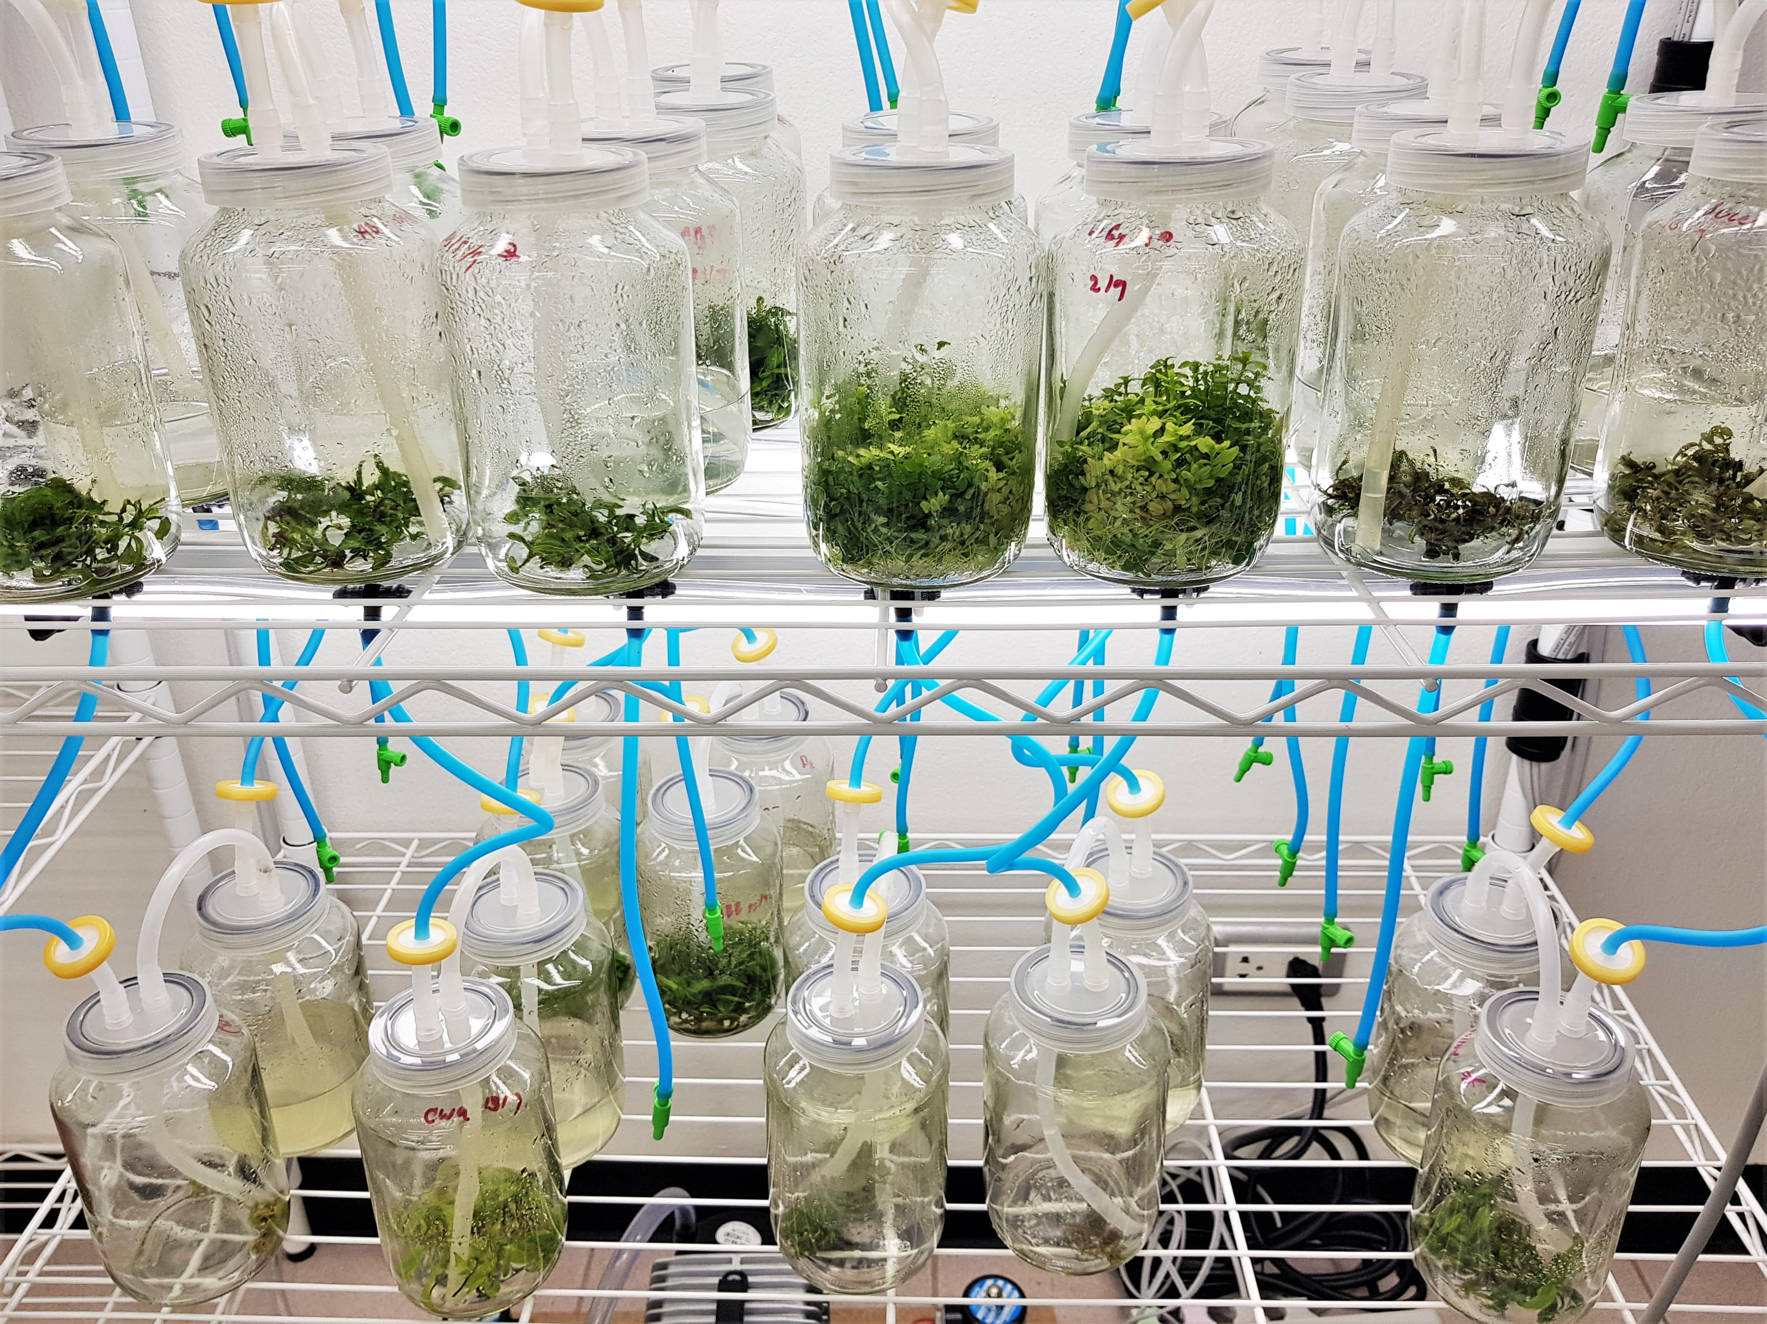
Reproducibility and Efficiency in Science through Cloud Labs
“Plugging an experiment into a browser forces researchers to translate the exact details of every step into unambiguous code”
https://www.theguardian.com/

Slide 15
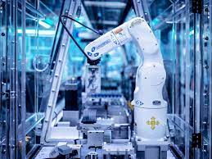
Automation in Self-Driving Laboratories
E.g., Strateos Cloud Lab
14K square feed
200+ instruments

Slide 16
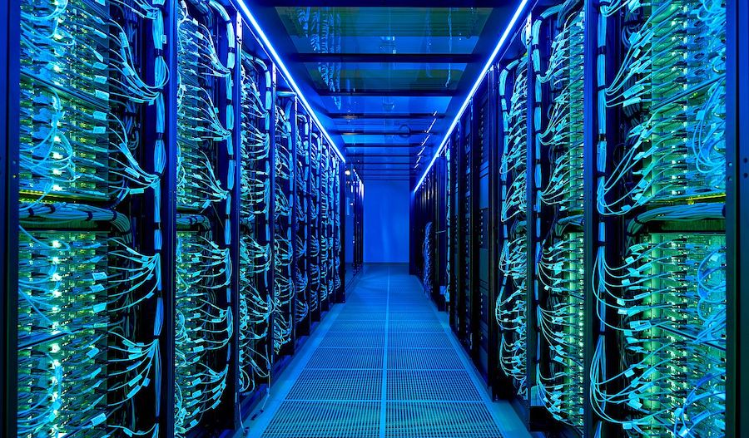
I sense an insatiable demand for computing in science.
This was true pre-exascale and will persist indefinitely.
HoreKa at Karlsruhe Institute of Technology

Slide 17
Post-Exascale Computing
Computing demand
Available technology
Disruptions

Slide 18
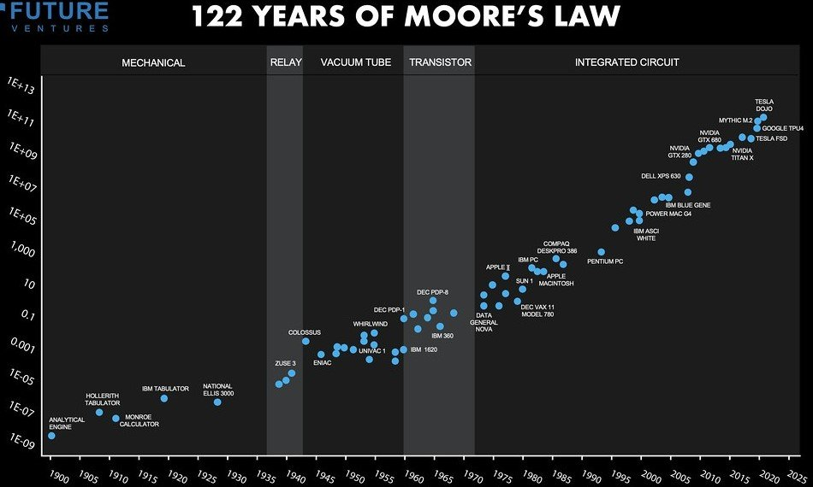
From https://www.unite.ai/moores-law/

Slide 19
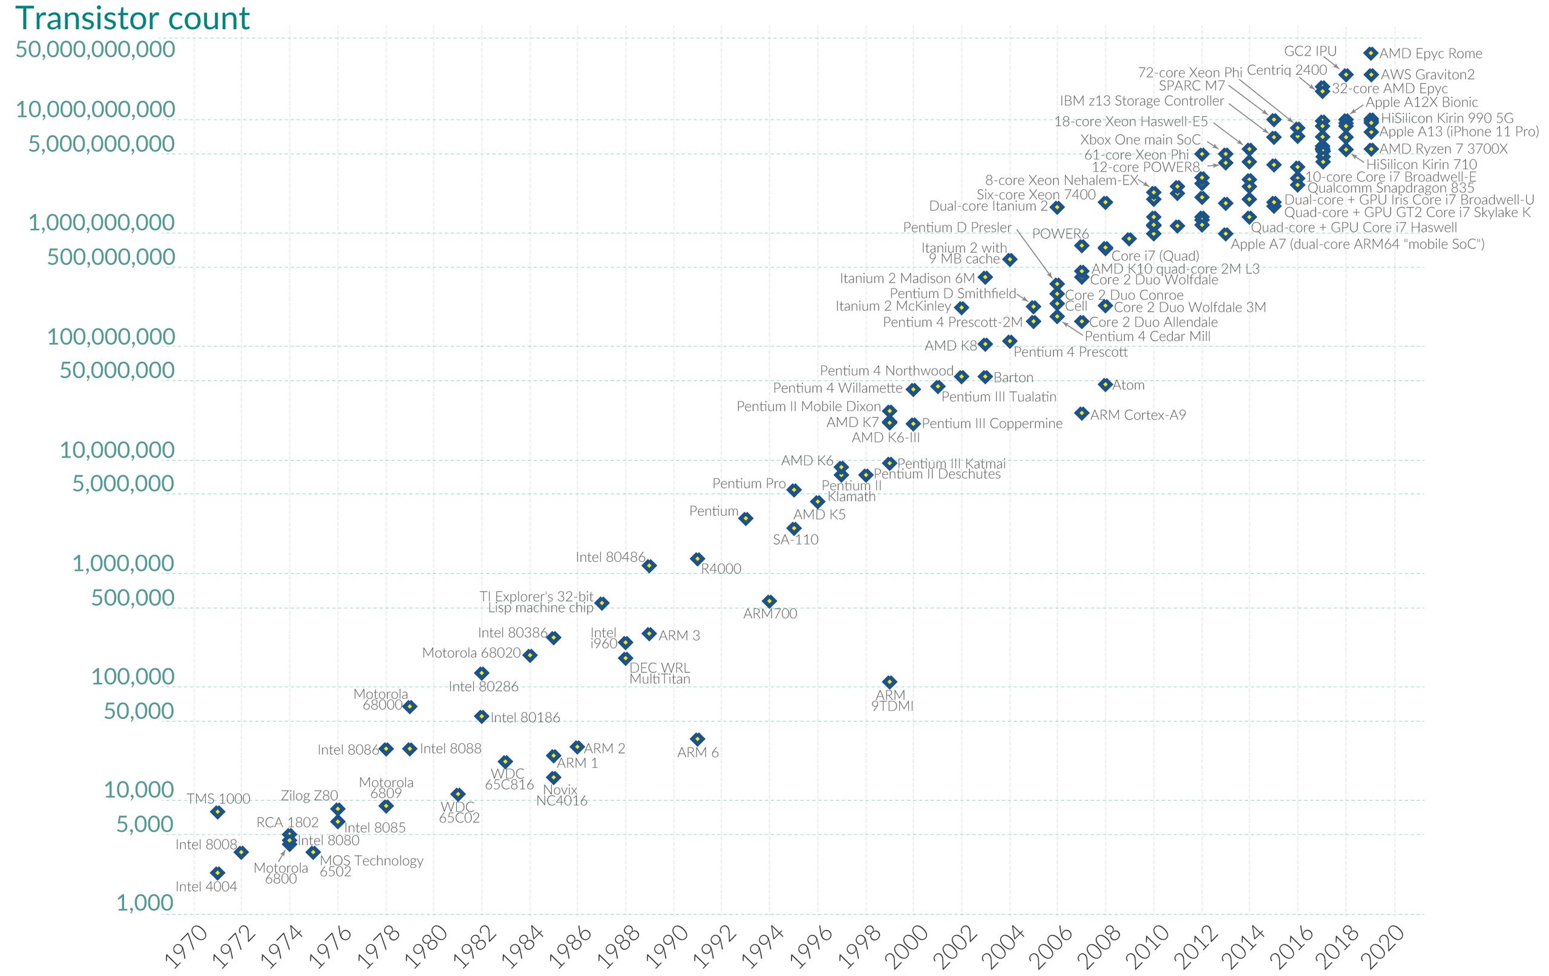
10 µm | 6 µm | 3 µm | 1.5 µm | 1 µm | 800 nm | 600 nm | 350 nm | 250 nm | 180 nm | 130 nm | 90 nm | 65 nm | 45 nm | 32 nm | 22 nm | 14 nm | 10 nm | 7 nm | 5 nm | 3 nm

Slide 20

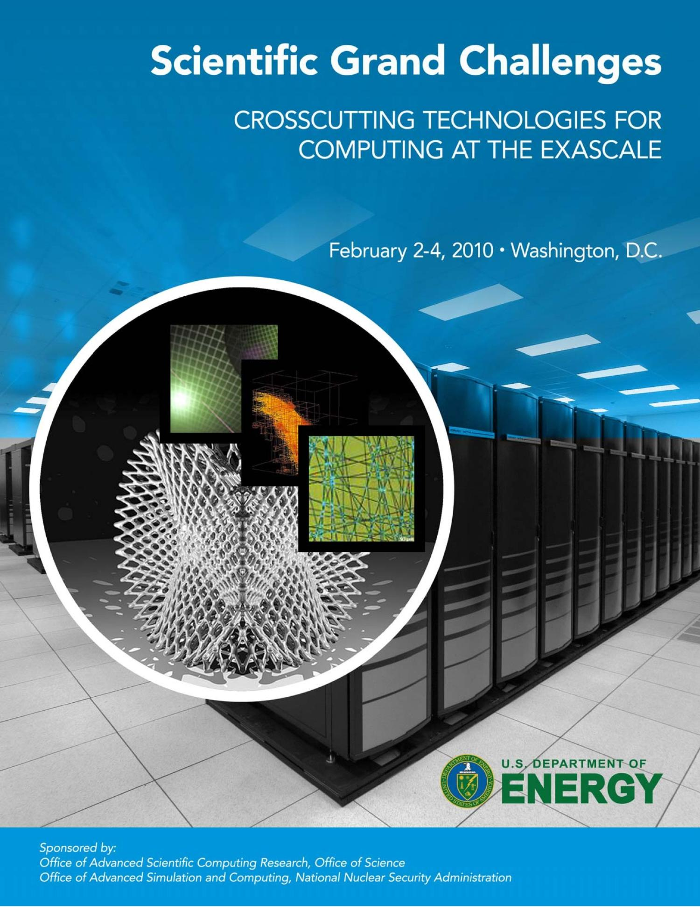
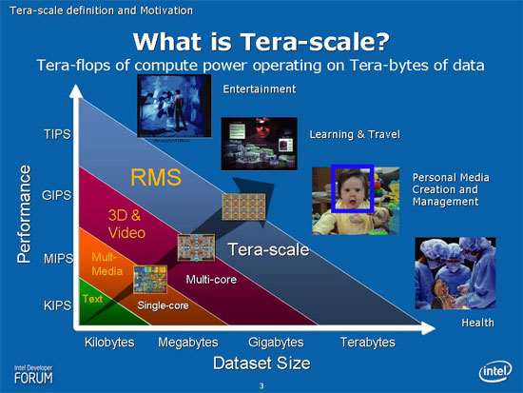
It’s hard to think exponentially

Slide 21
But it’s also hard to stop

Slide 22
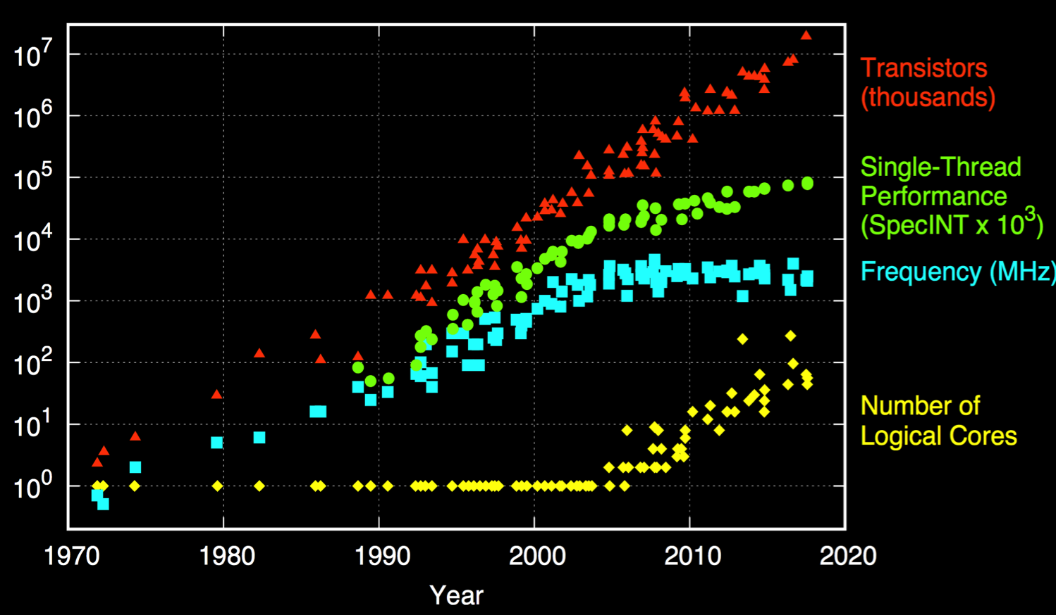
Dennard Scaling is Dead; Moore’s Law Will Follow
M. Horowitz, F. Labonte, O. Shacham, K. Olukotun, L. Hammond, C. Batten, and K. Rupp
Notes:
Single-thread performance has stagnated --- need parallelism to hit peak flops.
Image reconstruction typically memory bandwidth bound:
Need parallelism to saturate memory bandwidth.
Must design code well to leverage memory hierarchy.
Caches on multi/many-core systems
Coalescing on GPU systems.
Problem is getting worse---50-60% flop improvements, 23% bw---machines becoming more imbalanced.
Compute bound now ⇒ maybe not in future.
Takeaway: growing burden on software to deliver performance.

Slide 23
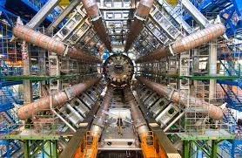
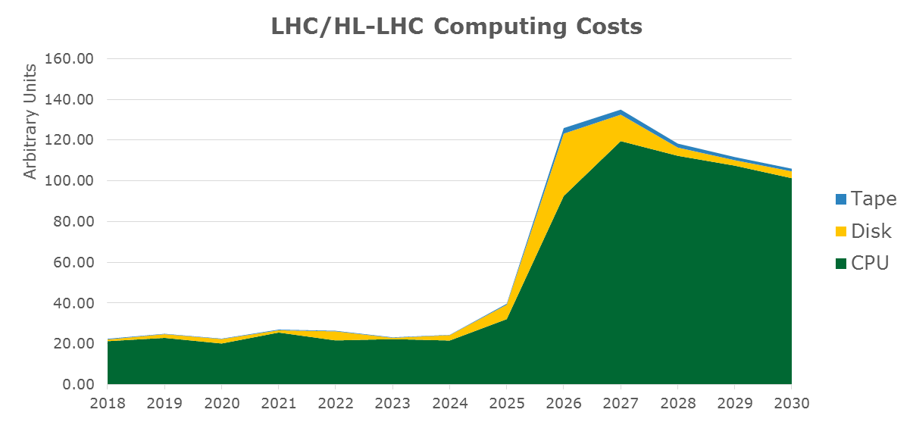
Prediction of Atlas computing +$1B

Slide 24
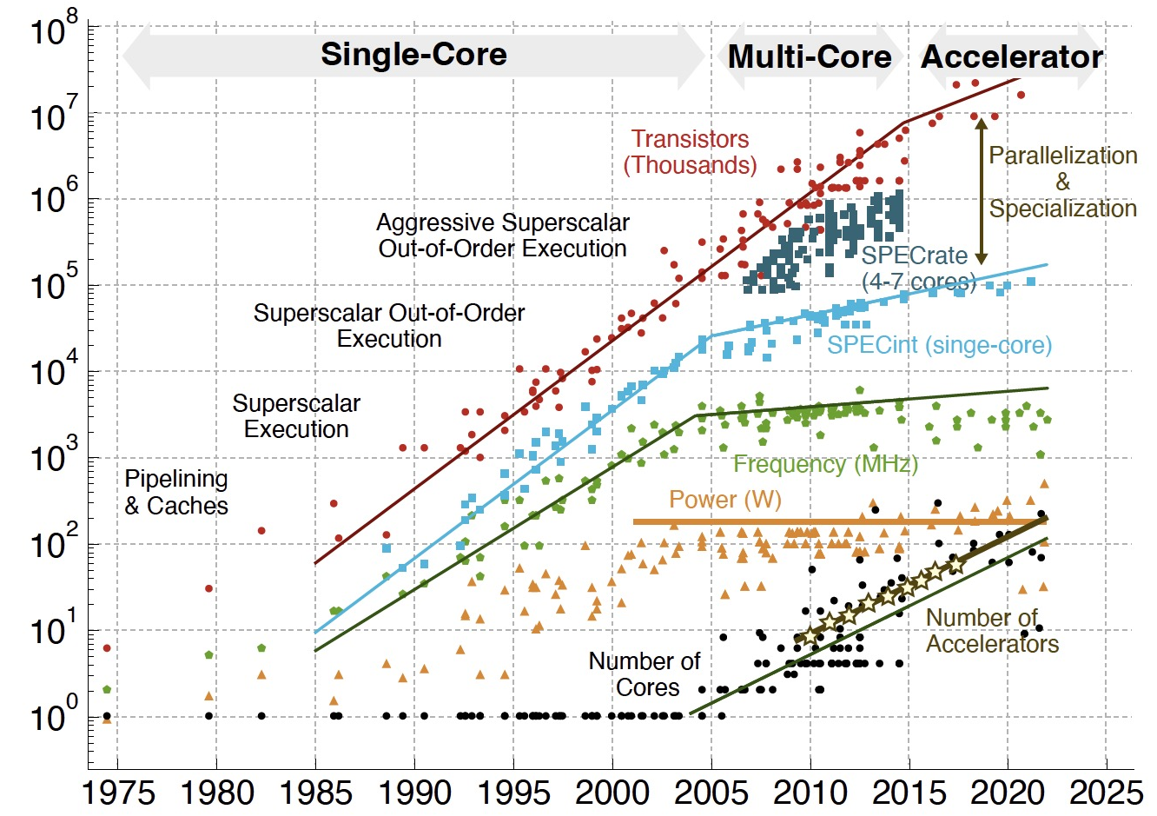
End Game for Moore’s Law: Parallelization and Specialization
From Chris Batten, Cornell ENGRI 1210 citing
C. Batten, M. Horowitz, F. Labonte, O. Shacham, K. Olukotun, L. Hammond, K. Rupp & [Y. Shao, IEEE Micro'15] & [C. Leiserson, Science'20]
Notes:
Single-thread performance has stagnated --- need parallelism to hit peak flops.
Image reconstruction typically memory bandwidth bound:
Need parallelism to saturate memory bandwidth.
Must design code well to leverage memory hierarchy.
Caches on multi/many-core systems
Coalescing on GPU systems.
Problem is getting worse---50-60% flop improvements, 23% bw---machines becoming more imbalanced.
Compute bound now ⇒ maybe not in future.
Takeaway: growing burden on software to deliver performance.

Slide 25
Exascale Architecture Plans (2008)
Petascale X 10x more energy X 100x more Performance per Joule = Exascale
Accelerators (GPUs)
100x more cores
Faster clocks + SIMD

Slide 26


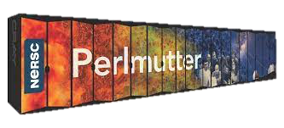
Exascale Era Architectures (US DOE Office of Science)
US DOE Office of Science Systems
Exascale
HPE AMD+AMD
Exascale
HPE Intel+Intel
Pre-exascale
HPE AMD+NVIDIA
1 Architecture (3 GPUs), 1 Integrator!

Slide 27
Growth of Accelerators in HPC

Slide 28
Notes:
https://github.com/basicmi/AI-Chip
>4B VC investment

Slide 29
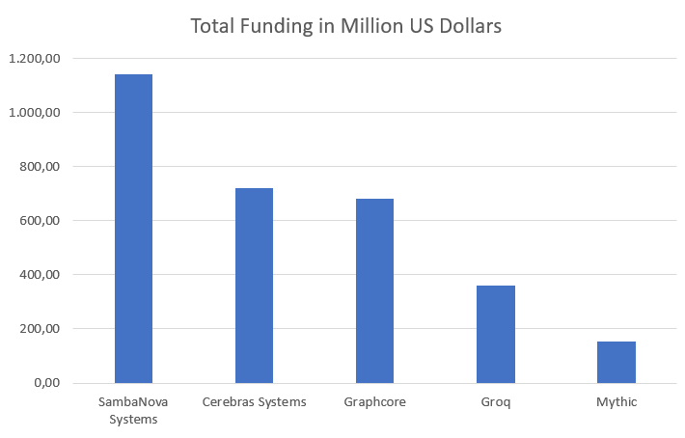
Everyone is Making AI Chips
NVIDIA
AMD
Intel
IBM
Traditional chip makers
“Software” companies
Facebook + Intel
Amazon (Echo, Oculus)
Google (TPU, Pixel)
Apple (SoCs)
Microsoft (“AI chip”)
Graphcore, Nervana Cerebras, Wave Computing, Horizon Robotics, Cambricon, DeePhi, Esperanto, SambaNova, Eyeriss, Tenstorrent, Mythic, ThinkForce, Groq, Lightmatter
Not everyone is selling those chips!

Slide 30
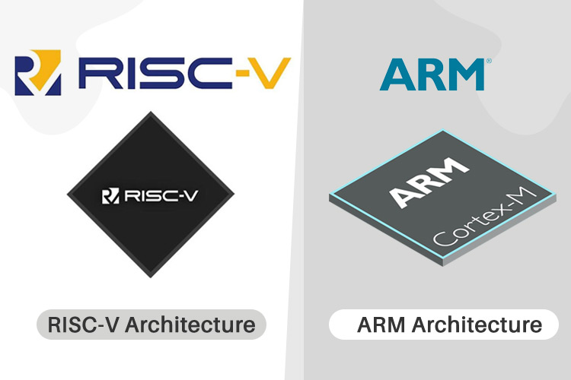
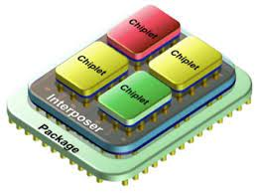
Specialization for the masses?

Slide 31
Specialization: Is deep learning the only application?
Remember when the Linpack Benchmark represented scientific computing?

Slide 32

Cloud ”Hyperscalars” dominate computing
Source: Dan Reed, U. Utah

Slide 33

Technology and Marketplace: Radically Different!
What’s a post-Exascale strategy for the science community?
Beat them
  Design processors for science
  More Co-Design and
  don’t forget the math and software
Join them
  Leverage AI Hardware
  for AI in Science
  andSimulation ?

Slide 34
Post-Exascale Computing
Computing demand
Available technology
Disruptions

Slide 35



AI for Science
Scientific discovery in the age of artificial intelligence, 2023

Slide 36

Analyze Images to Find Cats
Classification
Localization
Detection
Segmentation
Source: Prabhat

Slide 37




Analyze Simulations to Find Hurricanes
Classification
Localization
Detection
Segmentation
Extending image-based methods to complex, 3D, scientific data sets is non-trivial!
Source: Prabhat

Slide 38



Deep Learning: like adding 4,000 extra tons of detectors!
7
Based on 8/12/2016 slide by Joe Lykken at Fermilab

Slide 39


CNNs for Materials with Physical Laws
Physics-aware learning
TRAIN
TEST
A network with 3D translation- and 3D rotation-equivariance
Slides from Tess Smidt and Risi Condor; E.g., 2018 paper by Thomas, Smidt, Kearnes, Yang, Li, Kohlhoff, Riley
Notes:
Phenol group in a big molecule
Existing networks for chem only use topology / distances, not angles

Slide 40
Using NLP on scientific publications
Analyze 3.3 million abstracts from materials science papers
Word2vec’s representation of the elements, projected onto two dimensions
Vahe Tshitoyan, Leigh Weston, John Dagdelen, Anubhav Jain

Slide 41





Filtering, De-Noise and Curating Data
AmeriFlux & FLUXNET: 750 users access carbon sensor data from 960 carbon flux data years; Developing ML to denoise data.
Arno Penzias and Robert Wilson discover Cosmic Microwave Background in 1965
Gilberto Z. Pastorello, Dario Papale, Housen Chu, Carlo Trotta, Deb A. Agarwal, Eleonora Canfora, Dennis D. Baldocchi, M. S. Torn

Slide 42

Generate Videos
Caroline Chan, Shiry Ginosar, Tinghui Zhou, Alexei A. Efros, UC Berkeley
Notes:
We will see the source subject, a trained ballerina and two targets (graduate students). You’ll briefly see the two students attempting to dance with their own talent.
Then using GANs, they will appear to dance using the source’s talent.

Slide 43

Everybody Dance Now, Caroline Chan, Shiry Ginosar, Tinghui Zhou, Alexei A. Efros

Slide 44
Generate Data from Expensive Experiments
Generate convergence maps of weak gravitational lensing, to help in understanding the physical laws governing the universe.
CosmoGAN: Mustafa Mustafa, Deborah Bard, Wahid Bhimji, Zarija Lukić, Rami Al-Rfou, Jan M. Kratochvil
Notes:
Generate convergence maps of weak gravitational lensing, to help in understanding the physical laws governing the universe.
These GAN-generated maps can be computed much more efficiently than a full 3D simulation
They are physically realistic, i.e., statistically indistinguishable from those made from detailed simulations.

Slide 45

Automated experiments
Utilization and robustness
AI-based autonomous discovery
Decisions based on small datasets
Uncertainty estimates
Source: CAMERA Project, PI James Sethian
Slide input: Lavanya Ramakrishna

Slide 46


Digital Twins
Simulations
Sensors / data
Multi-level
Real-time

Slide 47
AI in Science
Fairness
Interpret-ability
Inverse Design
Learning across scales
Complex, 3D+, sparse data
Transfer learning
Federated learning on sensors
Uncertainty Quantifi-cation
Physics-aware Learning
Control of experiments
Draft NAIRR report is out

Slide 48


The economic model is key

Slide 49
Cloud vs HPC
: It’s all about the Business Model in ‘35
Cloud | HPC
Focus on storage | Focus on computing (flop/s)
Cheap(est) commodity component | High end components (some specialization)
Commodity networks | High performance networks
Pay as you go | Purchased for mission; pay in non-fungible “hours”
< 50% utilization | > 90% utilization
On-demand access | Large jobs wait in queues
Multiple jobs per node | Dedicated set of nodes
On-node disks (air cooled) | Separate storage (compute liquid cooled)
Policy and business model

Slide 50



Rethink software
Transform publishing, research, teaching!
Higher level
Different interaction
Old programming models never die, they just get buried under layers!

Slide 51
How did we get here?
Computing demands continue to grow
The benefits of more weak scaling are limited
Computing technology has hit several “walls”
The computing industry has changed dramatically
AI methods are having huge impacts elsewhere
Quantum computing potential for science still unknown
Cloud computing is dominating the computing industry
Global supply chain issues present uncertainties
We need a new strategy for post-exascale computing

