Slide 1
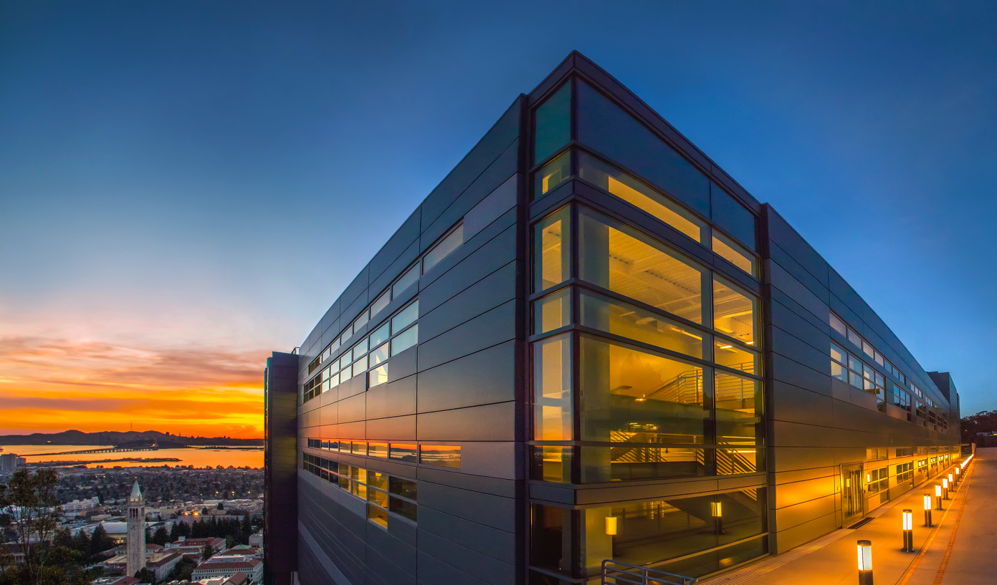
  Beyond Exascale Computing
Kathy Yelick
Vice Chancellor for Research
and Robert S. Pepper Professor of
Electrical Engineering and Computer Sciences
U.C. Berkeley
Senior Faculty Scientist
Computing Sciences
Lawrence Berkeley National Laboratory

Slide 2

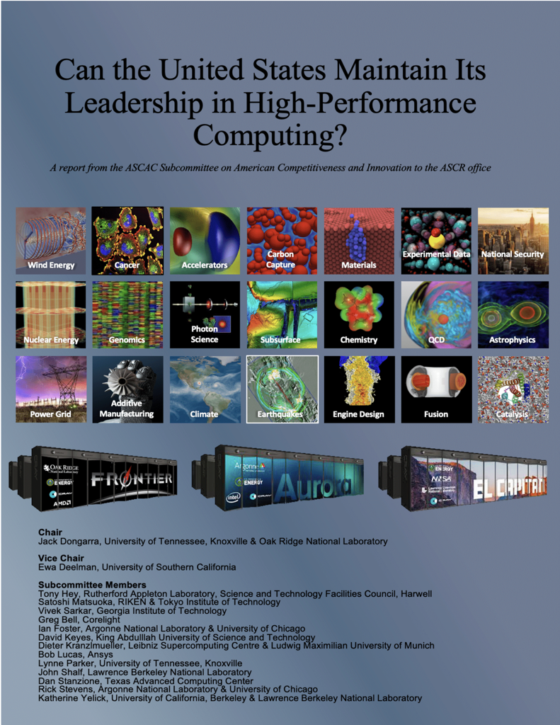
Notes:
Thanks for invitation and for many reports and co-authors

Slide 3
Post-Exascale Computing
Computing demand
Disruptions
Technology

Slide 4

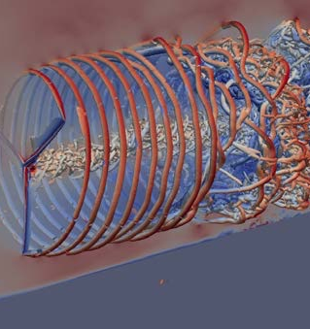
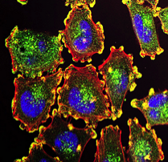
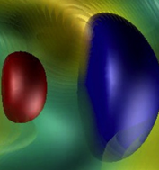
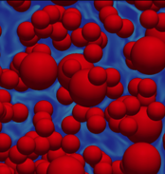
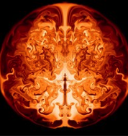
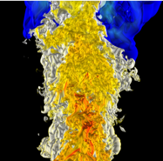
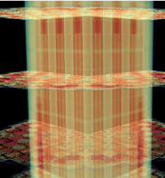

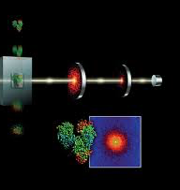
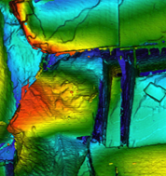
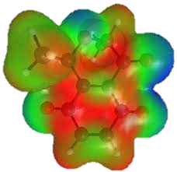
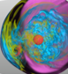
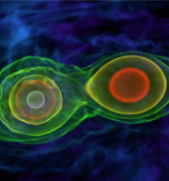
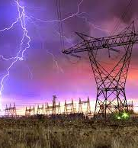
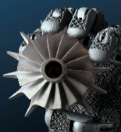
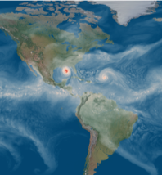
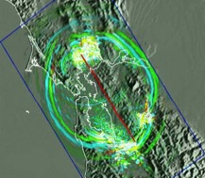
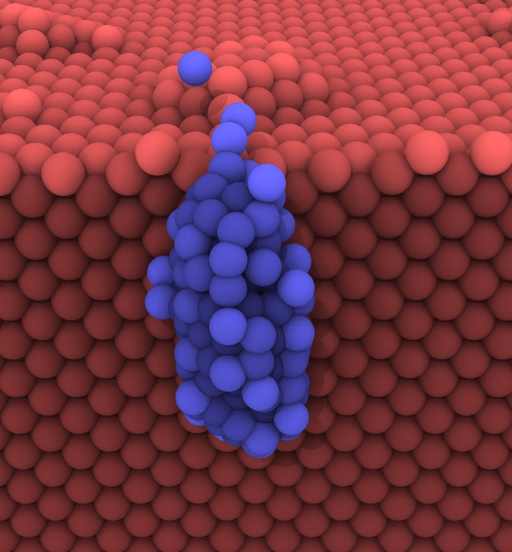
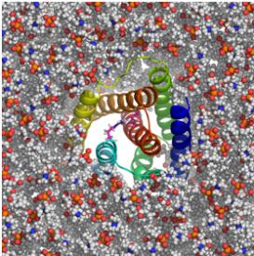
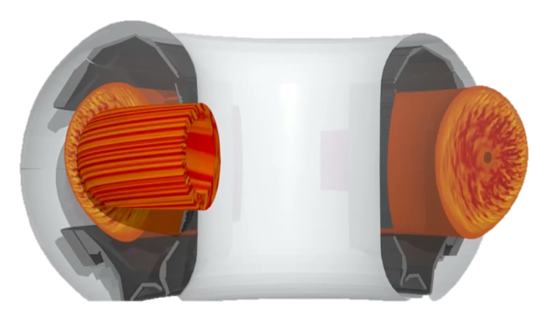
Continue to Rethink Applications
24 projects with about 10 people per team
Rely heavily on hardware features and software teams
Several new to HPC, all with new capabilities
We should have another 2 dozen in 10 years!!
Wind Energy
Cancer
Accelerators
Carbon Capture
Combustion
Materials
Astrophysics
Nuclear Energy
Genomics
Photon Science
Subsurface
Chemistry
QCD
Cosmology
xfg
Power Grid
Manufacturing
Climate
Earthquakes
Materials
Fusion
Catalysis
Notes:
DOE should have a facility dedicated to …

Slide 5

Scientific Computing Circa 2007
Exascale report from 2007 Town Halls Entirely focused on modeling and simulation
Simulation $≠$ Scientific Computing $≠$ HPC

Slide 6
New demands for HPC in Science
Simulation
From atoms to the universe
Data
Images, text, to genomes
Learning
Interpret, infer and automate

Slide 7
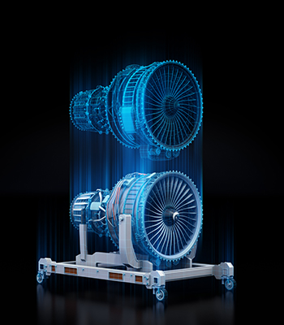
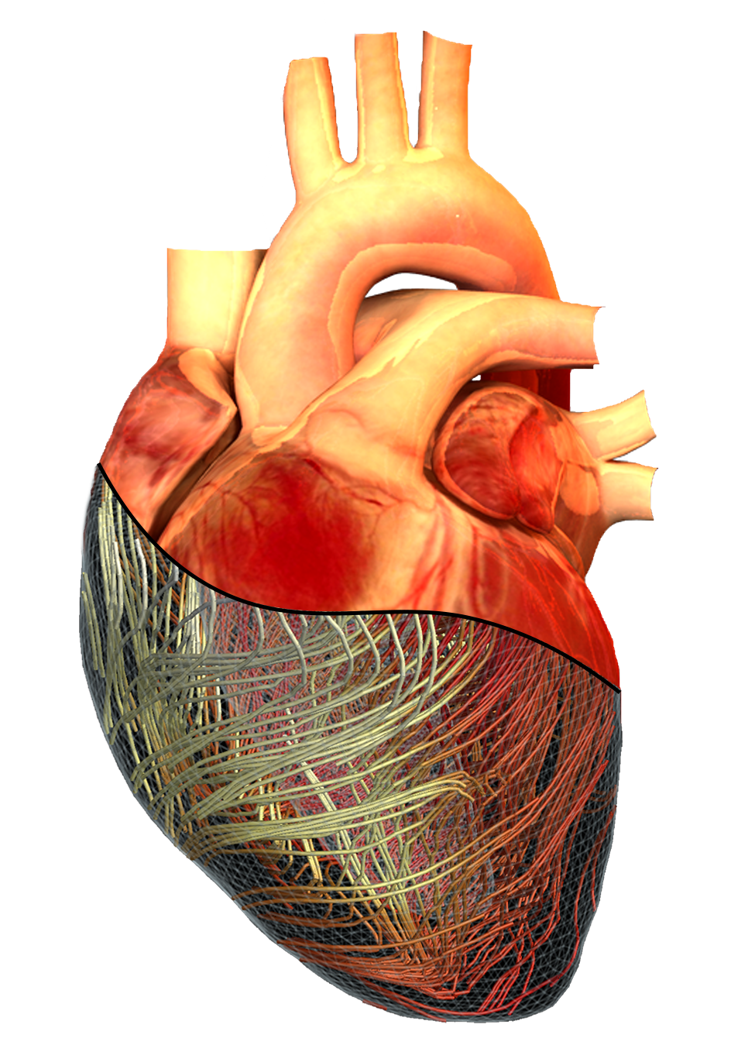
Digital Twins
Simulations
Sensors / data
Multi-level
Real-time

Slide 8
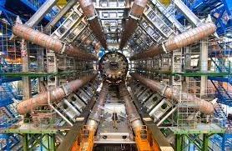
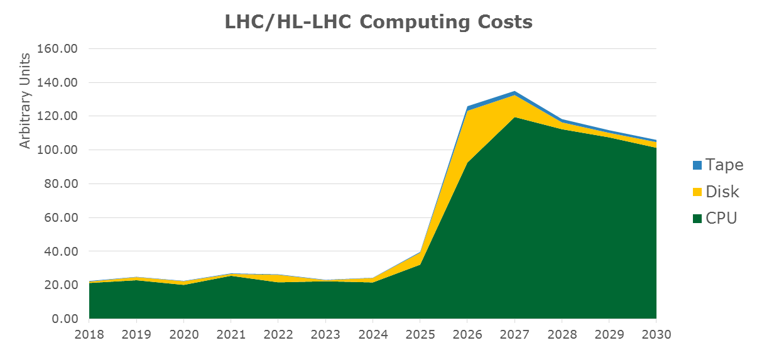
Prediction of Atlas computing +$1B

Slide 9


Microbial Data in the Environment
Tara Oceans Microbial data collected from 2009-13
84 Terabytes assembled on 9000 Frontier nodes
HPC changes observational science

Slide 10
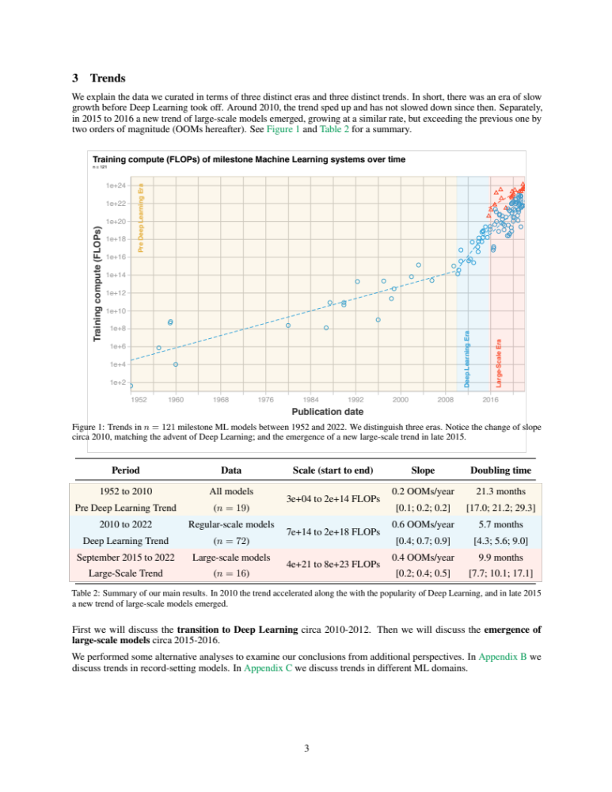
Machine Learning Drives Computational Demand
Pre Deep Learning Era
Deep Learning Era
Large Scale Era
OpenAI estimates 3.4-month doubling!

Slide 11
Is there parallelism?

Slide 12
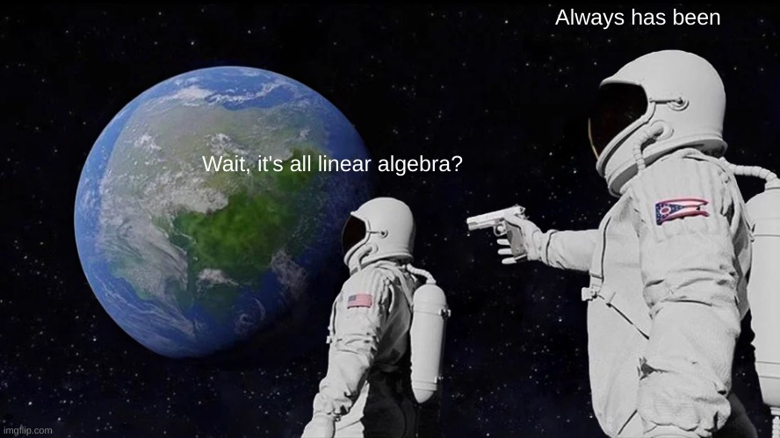

Slide 13
Analytics vs. Simulation Kernels:
7 Dwarfs of Simulation | 7 Giants of Big Data
Particle methods | Generalized N-Body
Unstructured meshes | Graph-theory
Dense Linear Algebra | Linear algebra
Sparse Linear Algebra | Optimization
Spectral methods | Integrations
Structured Meshes | Alignment
Monte Carlo methods | Basic Statistics
Hashing
Sorting
Phil Colella
NRC Report + our paper
Yelick, et al. “The Parallelism Motifs of Genomic Data Analysis”, Philosophical Transactions A, 2020

Slide 14
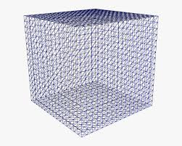
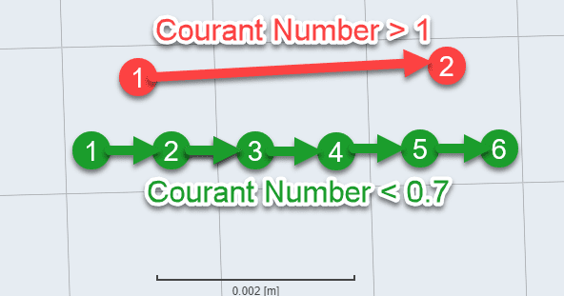
Weak Scaling has Diminishing Returns
Increase resolution by 10x in each dimension
Runtime increases ☹
Increase cores by 1000x

Slide 15
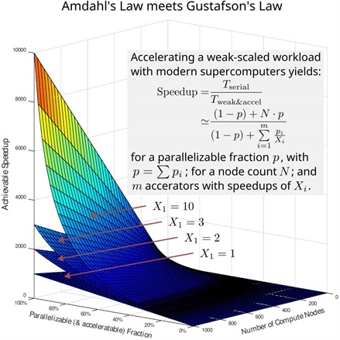
Strong and weak scaling
Strong scaling
  Most desirable for users
  Harder to find (Amdahl)
Weak scaling
  Limited for super-linear algorithms
  Needs memory capacity to scale
  Data problems also need I/O
See SIAM News, 9/22 Satoshi Matsuoka and Jens Domke

Slide 16
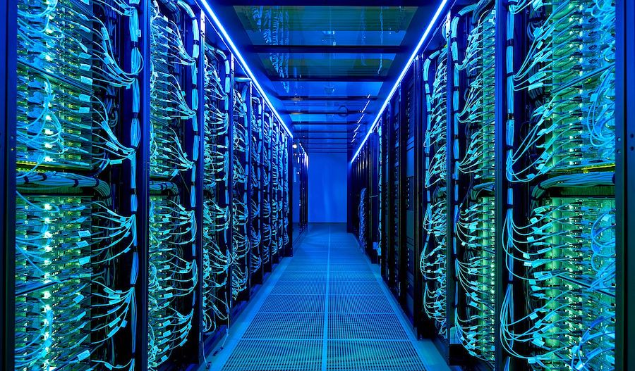
There is and always will be… an insatiable demand for computing in science.
Parallelism may be increasingly difficult to uncover.
HoreKa at Karlsruhe Institute of Technology

Slide 17
Post-Exascale Computing
Computing demand
Disruptions
Technology

Slide 18
Disruptions
AI
Quantum
Cloud
Implied question: Do these make HPC obsolete?

Slide 19
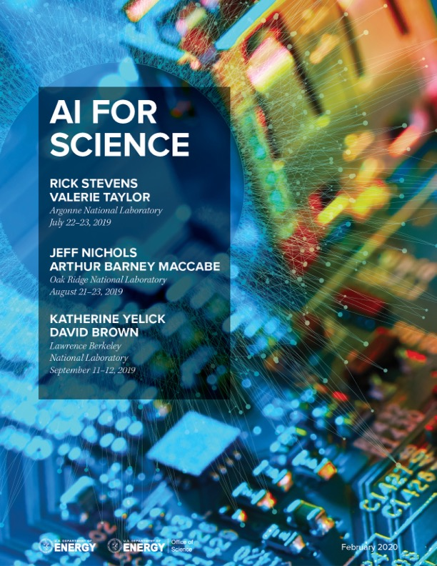
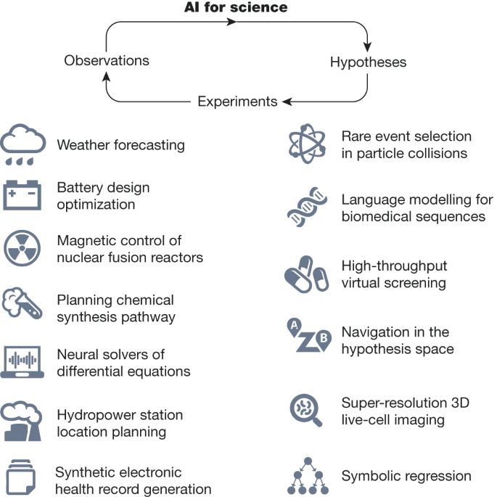
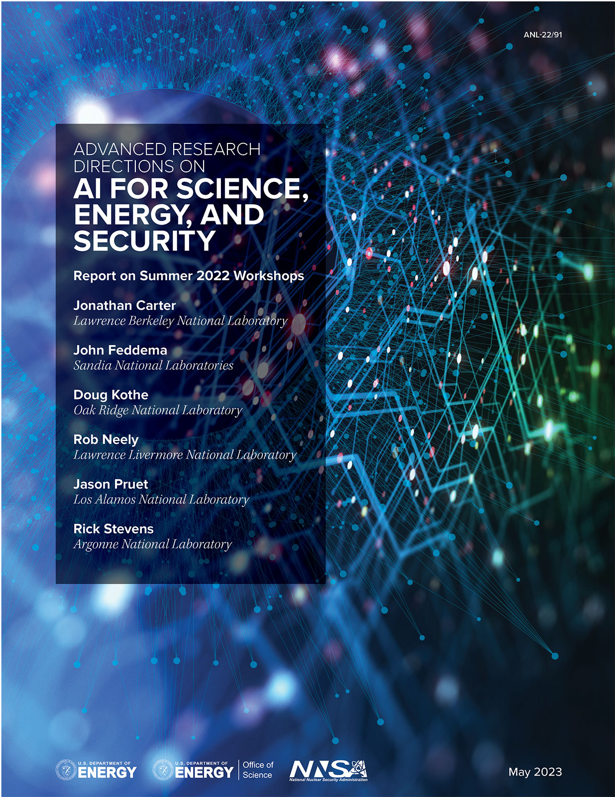
AI for Science
Scientific discovery in the age of artificial intelligence, 2023

Slide 20


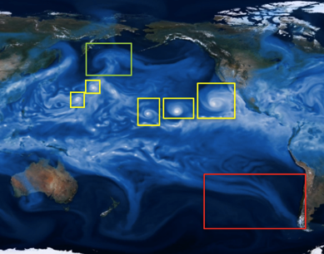
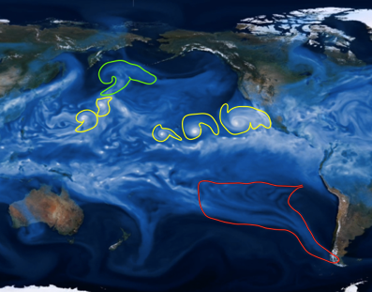
Analyze Simulations to Find Hurricanes
Classification
Localization
Detection
Segmentation
Extending image-based methods to complex, 3D, scientific data sets is non-trivial!
Source: Prabhat

Slide 21
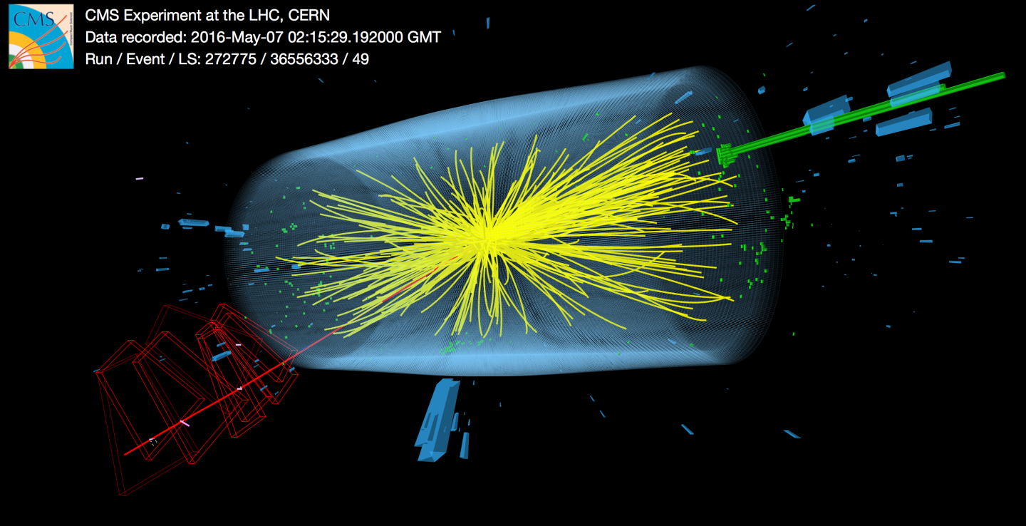


Precision: like adding 4,000 extra tons of detectors!
7
Based on 8/12/2016 slide by Joe Lykken at Fermilab

Slide 22
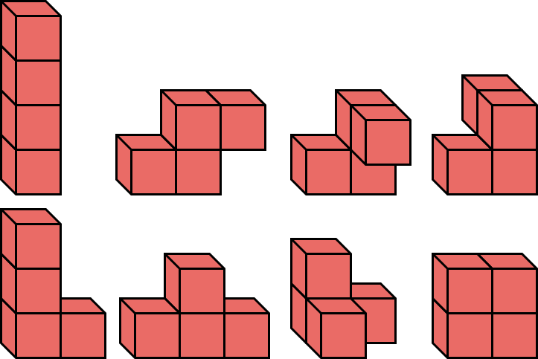
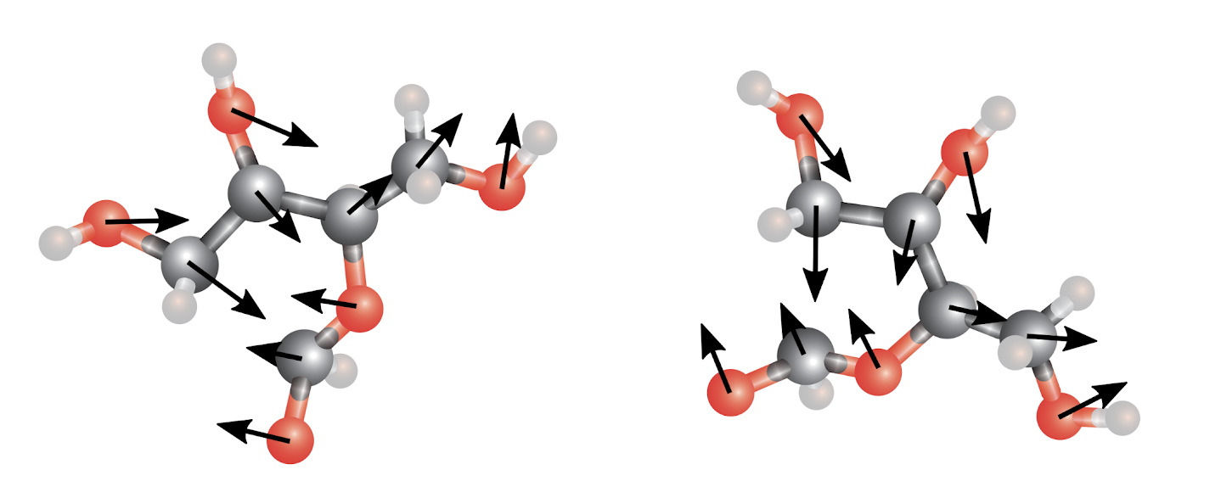
Design with Physical Laws
Physics-aware learning
TRAIN
TEST
A network with 3D translation- and 3D rotation-equivariance
Slides from Tess Smidt and Risi Condor; E.g., 2018 paper by Thomas, Smidt, Kearnes, Yang, Li, Kohlhoff, Riley
Notes:
Phenol group in a big molecule
Existing networks for chem only use topology / distances, not angles

Slide 23
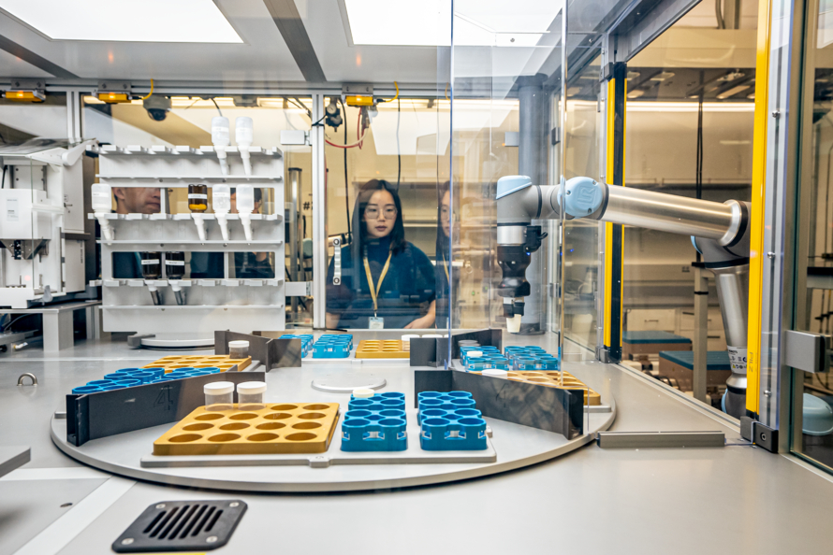
Automation in Self-Driving Laboratories
A-Lab at LBNL

Slide 24

Five Stages of AI
Acceptance
Denial
Anger
Depression
Bargaining
And this includes AI researchers!

Slide 25
AI in Science
Fairness
Interpret-ability
Inverse Design
Learning across scales
Complex, 3D+, sparse data
Transfer learning
Federated learning on sensors
Uncertainty Quantifi-cation
Physics-aware Learning
Control of experiments
The Computational Science and Engineering community should have a leadership role in addressing UQ, safety, alignment, and explainability in AI for science and engineering

Slide 26
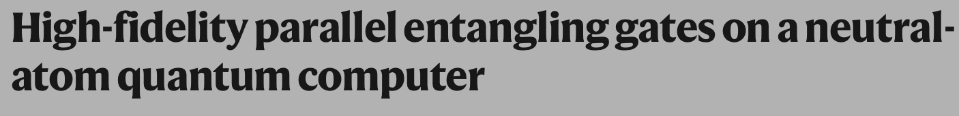
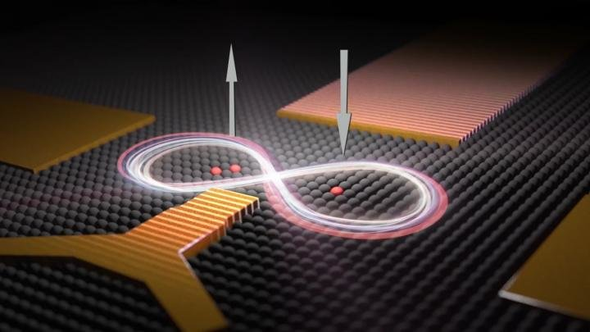
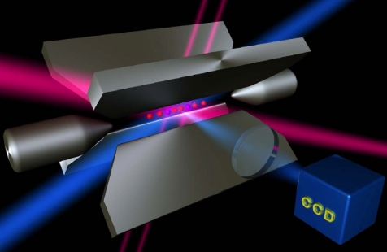
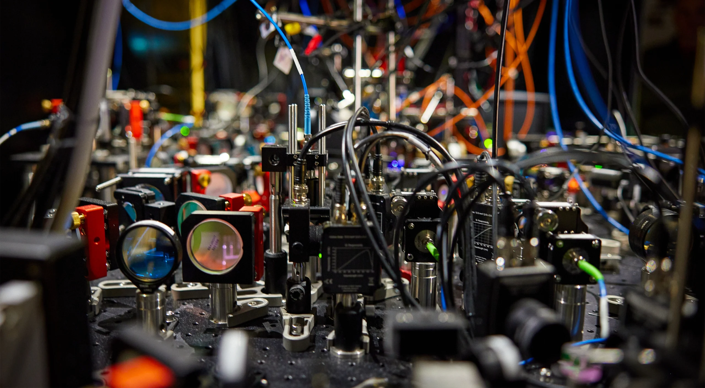
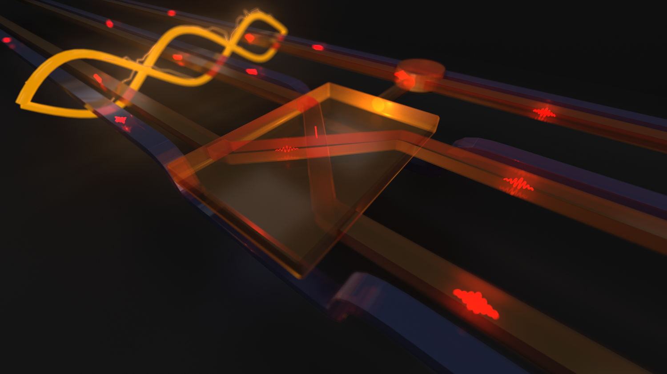
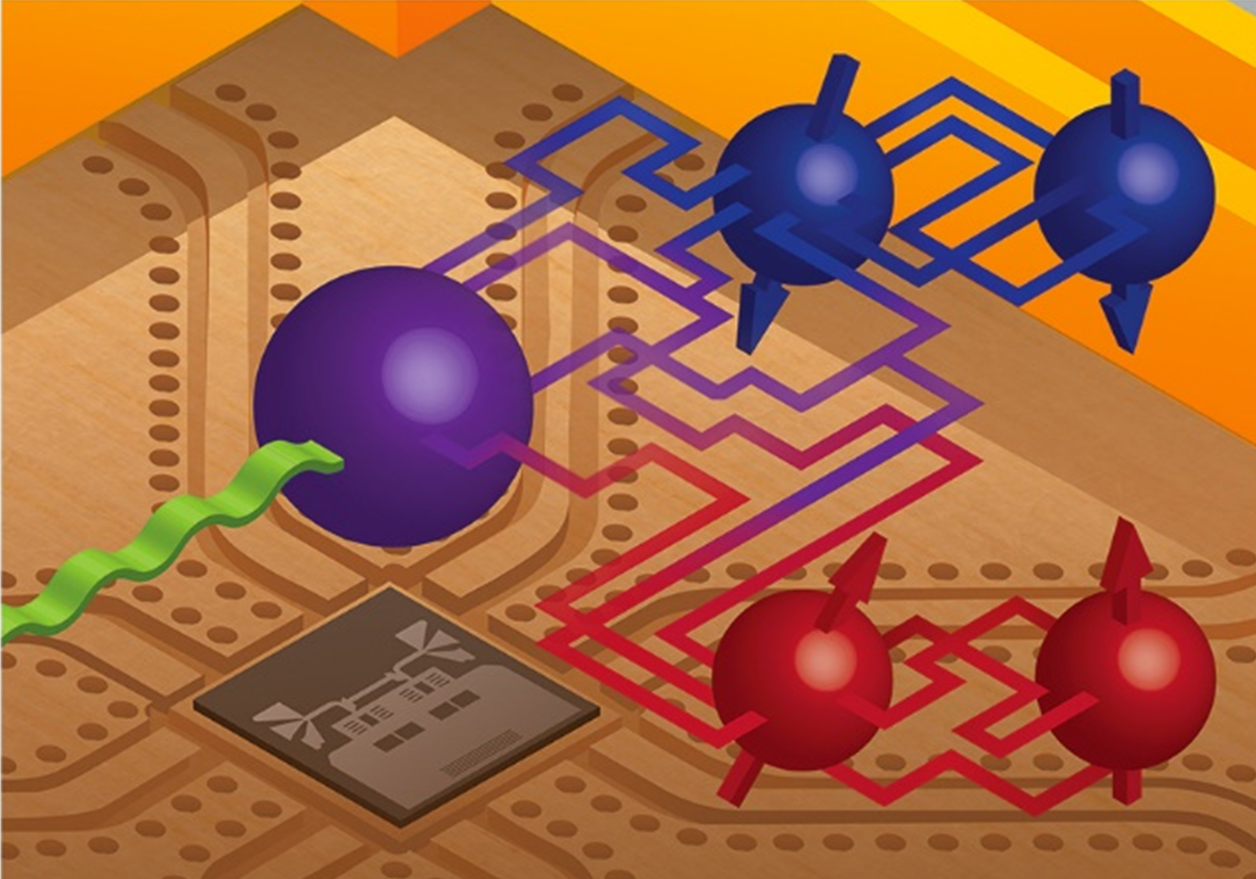
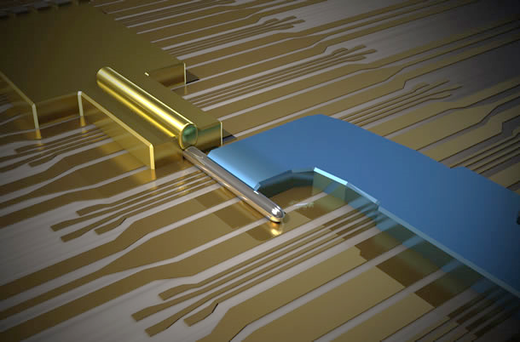
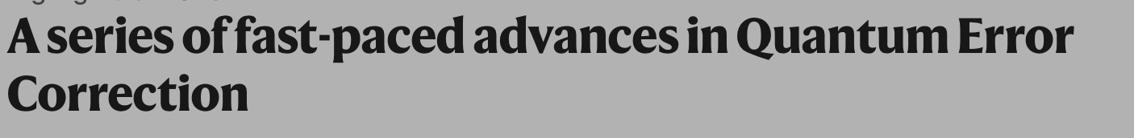
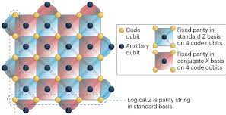
Exciting Progress … But we don’t yet have the IC Transitor
Dopants in
Silicon / Diamond
Trapped
Ions
www.sciencedaily.com
www.quantumoptics.at
Photonic
Circuits
www.phys.org
Superconducting Circuits
Topological
Wires
www.qnl.berkeley.edu
www.microsoft.com

Slide 27

Cloud Computing
The economic model is key

Slide 28

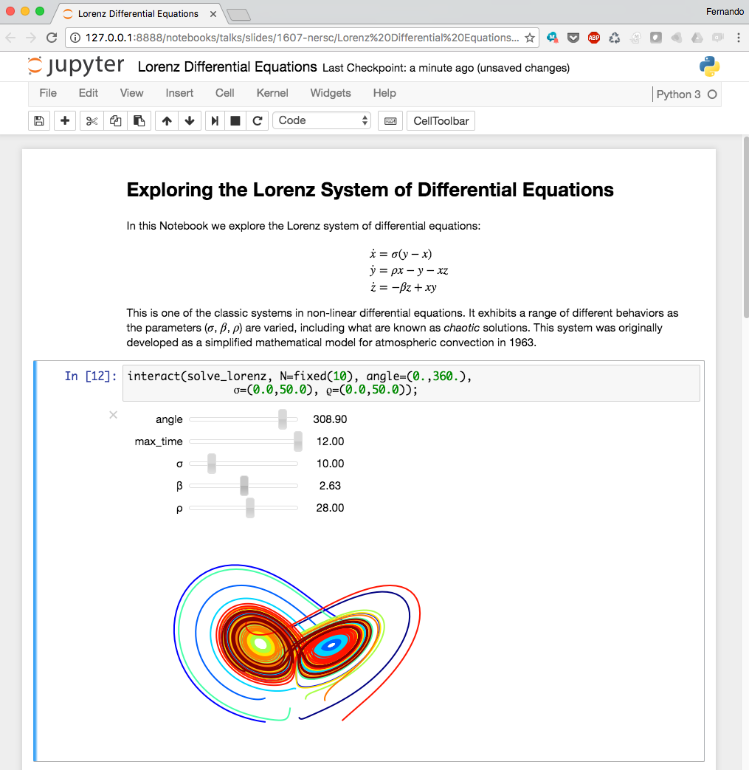
Lessons Learned from Clouds
Cost vs price
Availability and resilience
Higher level programming
Old programming models never die, they just get buried under layers!

Slide 29
Follow the money, understand the implications
Hyperscalers
HPC+AI
Market capitalizations
Billions $ (USD)
“Traditional” computing
(~1.7T$ (USD) aggregate)
BAT
Source: Reed, Gannon, Dongarra
Notes:
Market capitalization is, of course, only one measure of influence, but the fact that the hyperscalers and NVDIA are the companies with >$1T market capitalization speaks to how the world has changed.
Source:
Reed, D., Gannon, D., Dongarra, J., HPC Forecast: Cloudy and Uncertain, Communications of the ACM, February 2023, Vol. 66 No. 2, pp. 82-90, February 2023, available at: https://doi.org/10.1145/3552309
Reed, D., Gannon, D., Dongarra, J., Reinventing High Performance Computing: Challenges and Opportunities, March 2022, available at https://arxiv.org/abs/2203.02544
University of Utah

Slide 30

HPC community has always punched above its weight

Slide 31
Post-Exascale Computing
Computing demand
Disruptions
Technology

Slide 32

From https://www.unite.ai/moores-law/

Slide 33

10 µm | 6 µm | 3 µm | 1.5 µm | 1 µm | 800 nm | 600 nm | 350 nm | 250 nm | 180 nm | 130 nm | 90 nm | 65 nm | 45 nm | 32 nm | 22 nm | 14 nm | 10 nm | 7 nm | 5 nm | 3 nm

Slide 34

https://www.economist.com/technology-quarterly/2016/03/10/horses-for-courses

Slide 35

Dennard Scaling is Long Dead; Moore’s Law Will Follow
M. Horowitz, F. Labonte, O. Shacham, K. Olukotun, L. Hammond, C. Batten, and K. Rupp
Notes:
Single-thread performance has stagnated --- need parallelism to hit peak flops.
Image reconstruction typically memory bandwidth bound:
Need parallelism to saturate memory bandwidth.
Must design code well to leverage memory hierarchy.
Caches on multi/many-core systems
Coalescing on GPU systems.
Problem is getting worse---50-60% flop improvements, 23% bw---machines becoming more imbalanced.
Compute bound now ⇒ maybe not in future.
Takeaway: growing burden on software to deliver performance.

Slide 36

Performance Programming pre 2005

Slide 37
Exascale Architecture Plans (2008)
Petascale X 10x more energy X 100x more Performance per Joule = Exascale
Accelerators (GPUs)
100x more cores
Faster clocks + wider SIMD

Slide 38



Exascale Era Architectures (US DOE Office of Science)
US DOE Office of Science Systems
Exascale
HPE AMD+AMD
Exascale
HPE Intel+Intel
Pre-exascale
HPE AMD+NVIDIA
1 Architecture (3 GPUs), 1 Integrator!

Slide 39
First-in-Class HPC Systems (Top500)
 | First Teraflop | First Petaflop | First Exaflop
 | ASCI Red | Roadrunner | Frontier
Year | 1997 | 2008 | 2022
Best Tech (nm) | 500 | 65 | 6
Power (MW) | 0.9 | 2.4 | 21.1
Efficienty (GF/W) | 0.001 | 0.4 | 52
Memory (PB) | 0.001 | 0.04 | 9
FPUs (K) | 9 | 464 | 534,000
Foorspace (m^2) | 150 | 557 | 678
10x
10x
2x
10x
400x
100x
40x
200x
100x
1000x
4x
1x
Kogge and Dally: Frontier vs the Exascale Report + Wikipedia for ASCI Red

Slide 40

Energy efficiency didn’t track technology scaling
Rumors of 2nm fabs, but how much will it help?
Kogge and Dally: Frontier vs the Exascale Report: Why so long? and Are We Really There Yet?

Slide 41
Post-Exascale Architecture Plans 2024 (Strawperson-v0)
Exascale X 2x more energy X 500x more Performance per Joule ??
Specialized for AI
Specialized for Simulation
GPUs
Influenced to make AI better (e.g., sparsity)?
Designed by “us”…?

Slide 42

Another Exponential?
Jensen Huang's Nvidia GTC Keynote

Slide 43
Specialization: Is deep learning the only application?
Remember when the Linpack Benchmark represented scientific computing?

Slide 44

Everyone is Making AI Chips…Not everyone is selling them!
Startups
NVIDIA
AMD
Intel
IBM
Traditional chip makers
“Software” companies
Facebook + Intel
Amazon (Echo, Oculus)
Google (TPU, Pixel)
Apple (SoCs)
Microsoft (“AI chip”)
Graphcore, Nervana Cerebras, Wave Computing, Horizon Robotics, Cambricon, DeePhi, Esperanto, SambaNova, Eyeriss, Tenstorrent, Mythic, ThinkForce, Groq, Lightmatter

Slide 45


Specialization for the masses?
Chiplets

Slide 46

Technology and Marketplace: Radically Different than 2008!
What’s a post-Exascale strategy for the science community?
Beat them
  Design processors for science
  More Co-Design and
  don’t forget the math and software
Join them
  Leverage AI Hardware
  for AI in Science
  and Simulation ?

Slide 47
Post Exascale Computing: Not Business at Usual
Computing demands continue to grow
The benefits of more weak scaling are limited
Computing technology has hit several “walls”
The computing industry has changed dramatically
AI methods are having huge impacts elsewhere
Quantum computing potential for science still unknown
Cloud computing is dominating the computing industry
Global supply chain issues present uncertainties

