Slide 1
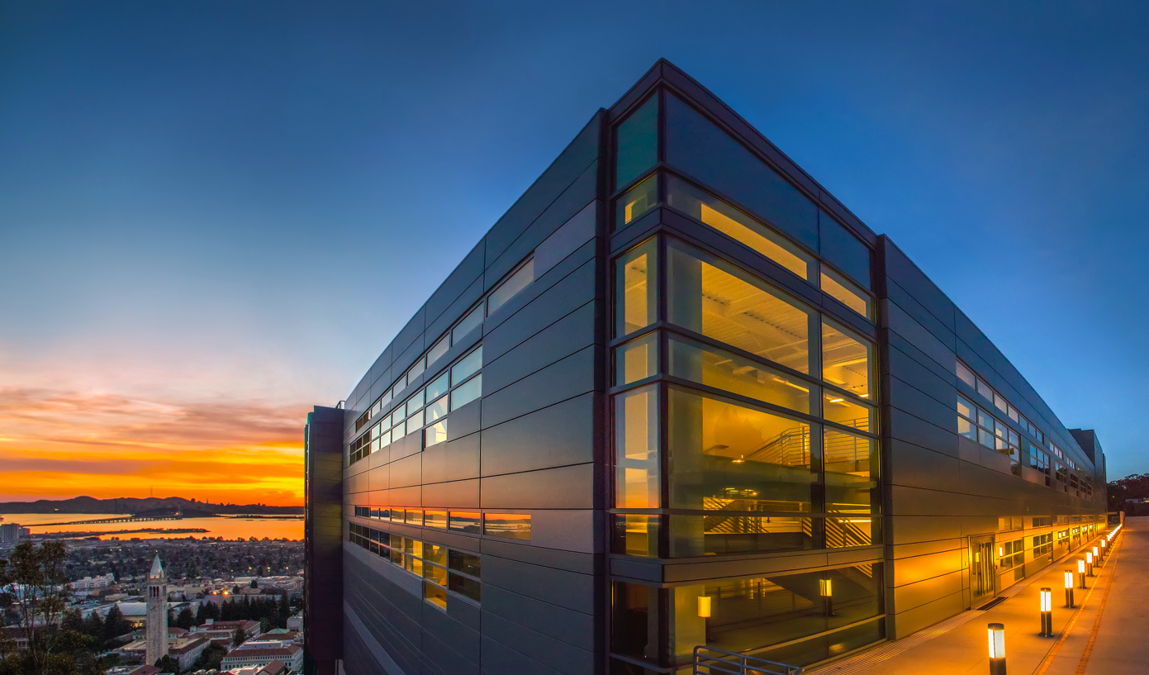
  Beyond Exascale Computing
Kathy Yelick
Vice Chancellor for Research
and Robert S. Pepper Professor of
Electrical Engineering and Computer Sciences
U.C. Berkeley
Senior Faculty Scientist
Computing Sciences
Lawrence Berkeley National Laboratory

Slide 2

National Academies Study
Kathy Yelick (Chair)
John Bell
Bill Carlson
Fred Chong
Dona Crawford
Jack Dongarra
Mark Dean
Ian Foster
Charlie McMillan
Dan Meiron
Daniel Reed
Karen Willcox
(report at www.cstb.org)

Slide 3
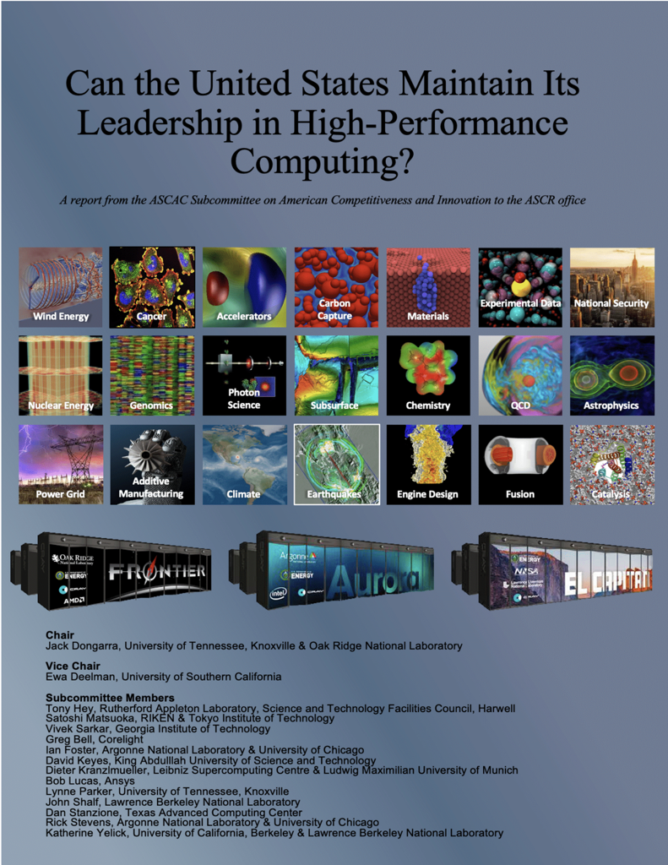
DOE ASCR Report
Jack Dongarra (Chair)
Ewa Deelman (Vice Chair)
Tony Hey
Satoshi Matsuoka
Vivek Sarkar
Greg Bell
Ian Foster
David Keyes
Dieter Kranzlmeuller
Bob Lucas
Lynne Parker
John Shalf
Dan Satanzione
Rick Stevens
Katherine Yelick
(report at www.osti.gov/)

Slide 4
Post-Exascale Computing
Computing demand
Available technology
Disruptions

Slide 5

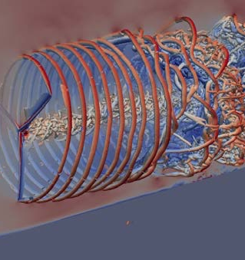
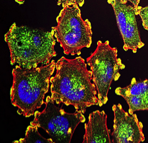
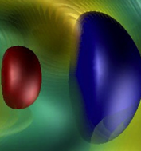
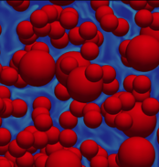
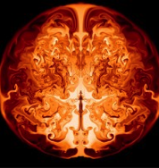
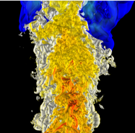
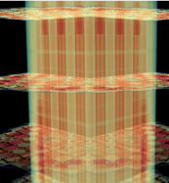

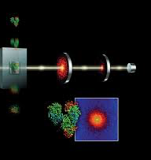
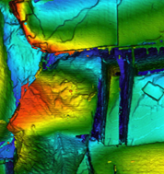
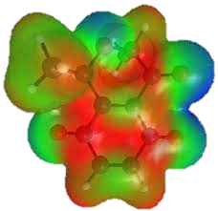
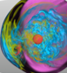
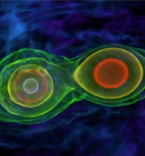
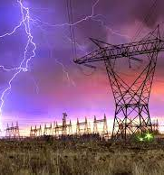
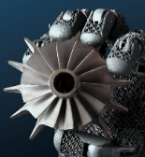
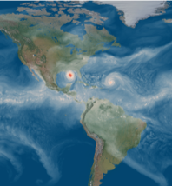
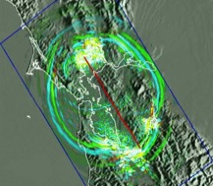
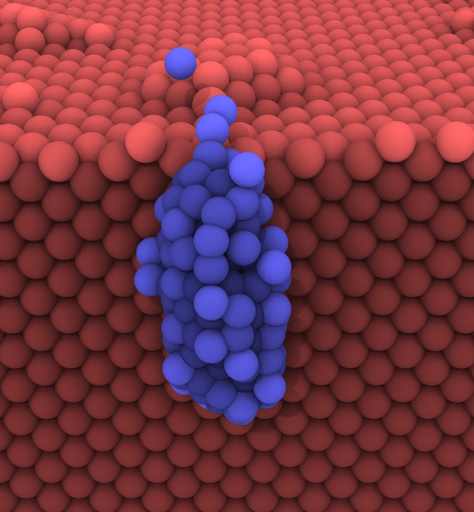
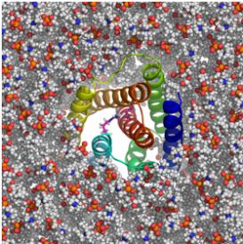
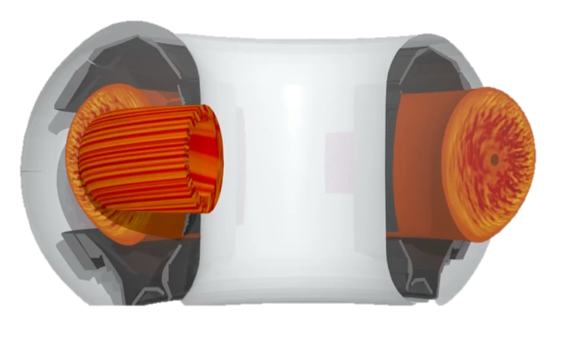
Continue to Rethink Applications
24 projects with about 10 people per team
Rely heavily on hardware features and software teams
Several new to HPC, all with new capabilities
We should have another 2 dozen in 10 years!!
Wind Energy
Cancer
Accelerators
Carbon Capture
Combustion
Materials
Astrophysics
Nuclear Energy
Genomics
Photon Science
Subsurface
Chemistry
QCD
Cosmology
xfg
Power Grid
Manufacturing
Climate
Earthquakes
Materials
Fusion
Catalysis
Notes:
DOE should have a facility dedicated to …

Slide 6

Scientific Computing Circa 2007
Exascale report from 2007 Town Halls Entirely focused on modeling and simulation
Scientific Computing is often used synonymously with Simulation and HPC
Simulation $⊂$ Scientific Computing $⊂$ HPC

Slide 7
Runtime of “hero” calculations are too long
Number of Nodes | Memory Footprint | Wall-Clock Time
2400 | ~300–400 TB | 6 months
4990 | ~600 TB | 3–4 months
288 | ~20 TB | 1 month
3250 | 104 TB | 5.8 days
512 | 32.8 TB | 2 months
Iterative design does not happen on 6 month cycles

Slide 8
Subset of Application Challenges Beyond Exascale
Reentry
Complex geometry
Combustion
Extreme Environs

Slide 9
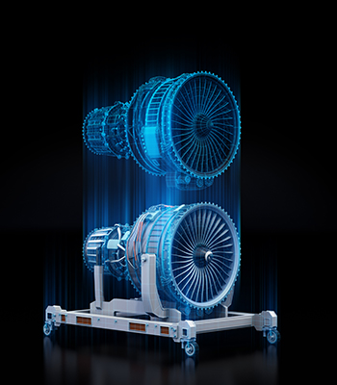
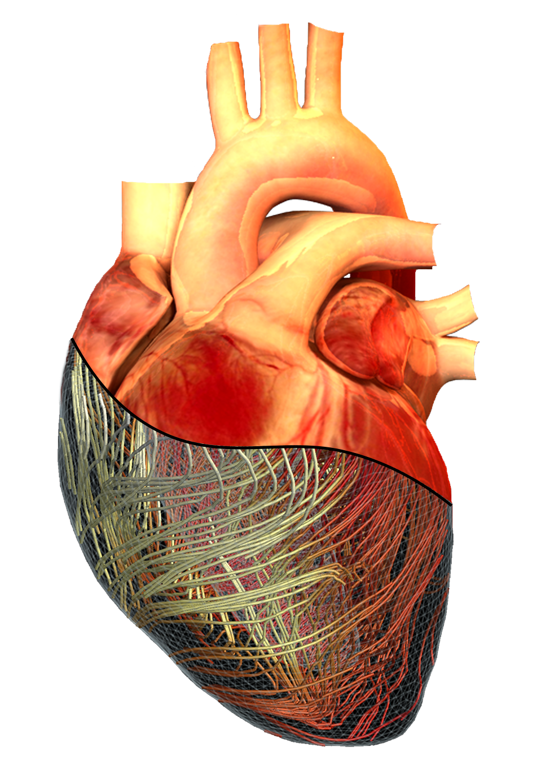
Digital Twins
Simulations
Sensors / data
Multi-level
Real-time

Slide 10
National Academies Study
Finding: The demands for advanced computing continue to grow and will exceed the capabilities of planned upgrades across the NNSA labs.

Slide 11
New demands for HPC in Science
Simulation
From atoms to the universe
Data
Images, text, to genomes
Learning
Interpret, infer and automate

Slide 12
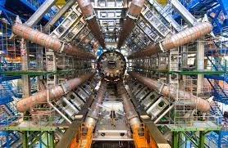
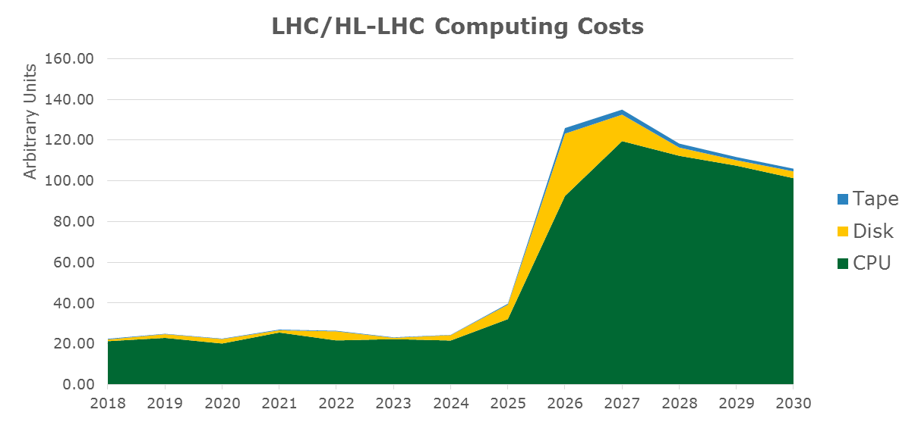
Prediction of Atlas computing +$1B

Slide 13


Microbial Data in the Environment
Tara Oceans Microbial data collected from 2009-13
84 Terabytes assembled on 9000 Frontier nodes
HPC changes observational science

Slide 14
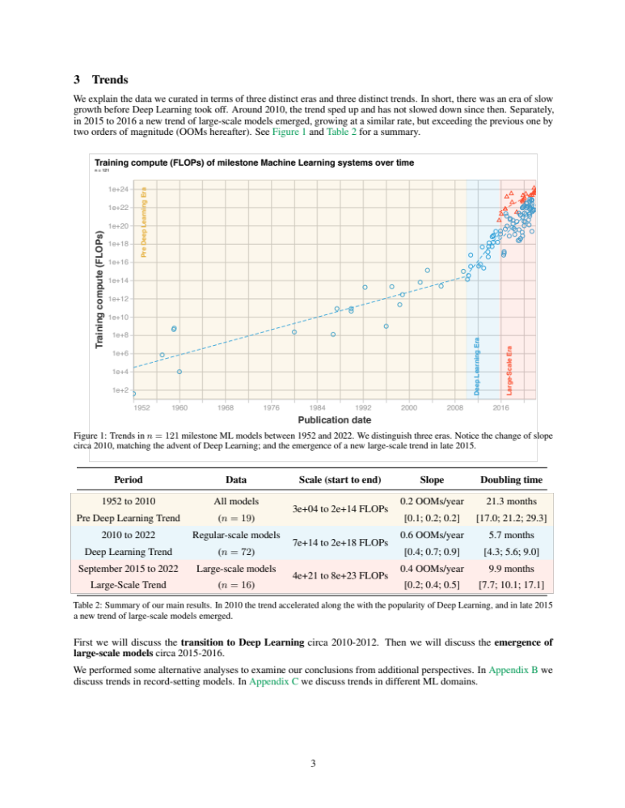
Machine Learning Drives Computational Demand

Slide 15
Computing Requirements in Machine Learning
300,000x increase from 2011 (AlexNet) to 2018 (AlphaGoZero)
From 2011-2018 the fastest Top500 machine grew < 15x
A petaflop/s-day = 10¹⁵neural net operations per second for one day, ~= 10²⁰operations
OpenAI estimates 3.4-month doubling!
https://blog.openai.com/ai-and-compute/

Slide 16
Is there parallelism?

Slide 17
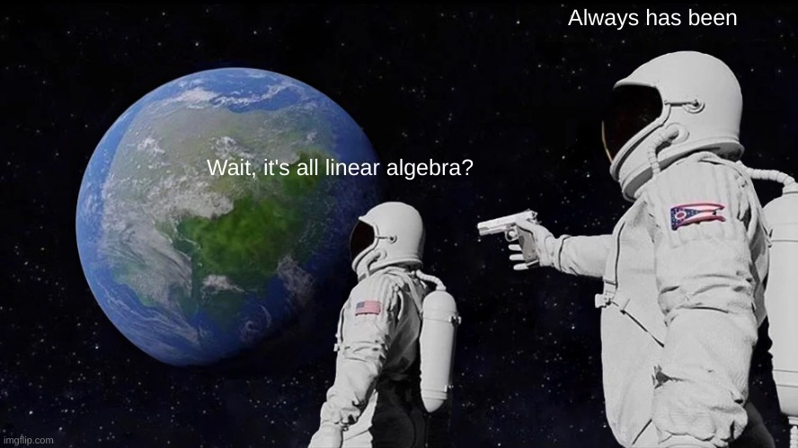

Slide 18
Analytics vs. Simulation Kernels:
7 Dwarfs of Simulation | 7 Giants of Big Data
Particle methods | Generalized N-Body
Unstructured meshes | Graph-theory
Dense Linear Algebra | Linear algebra
Sparse Linear Algebra | Optimization
Spectral methods | Integrations
Structured Meshes | Alignment
Monte Carlo methods | Basic Statistics
Hashing
Sorting
Phil Colella
NRC Report + our paper
Yelick, et al. “The Parallelism Motifs of Genomic Data Analysis”, Philosophical Transactions A, 2020

Slide 19
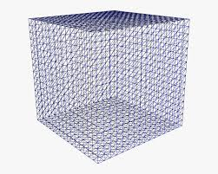
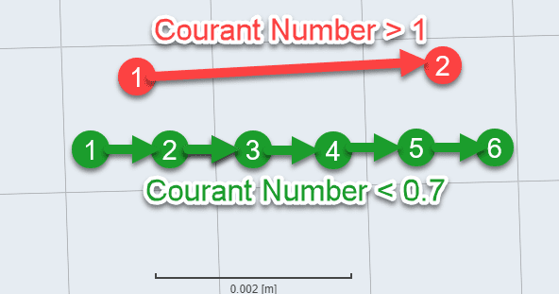
Weak Scaling has Diminishing Returns
Increase resolution by 10x in each dimension
Runtime increases ☹
Increase cores by 1000x

Slide 20
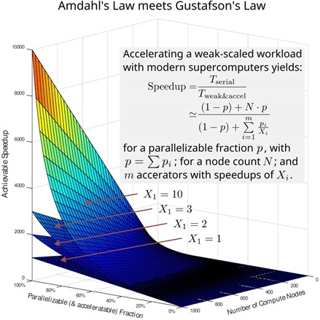
Strong and weak scaling
Strong scaling
  Most desirable for users
  Harder to find (Amdahl)
Weak scaling
  Limited for super-linear algorithms
  Needs memory capacity to scale
  Data problems also need I/O
See SIAM News, 9/22 Satoshi Matsuoka and Jens Domke

Slide 21
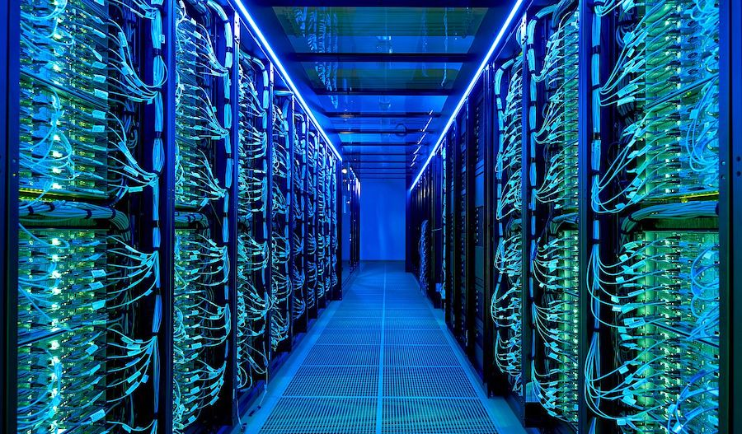
There is and always will be… an insatiable demand for computing in science.
Parallelism may be increasingly difficult to uncover.
HoreKa at Karlsruhe Institute of Technology

Slide 22
Post-Exascale Computing
Computing demand
Disruptions
Technology

Slide 23
Disruptions
AI
Quantum
Cloud
Implied question: Do these make HPC obsolete?

Slide 24
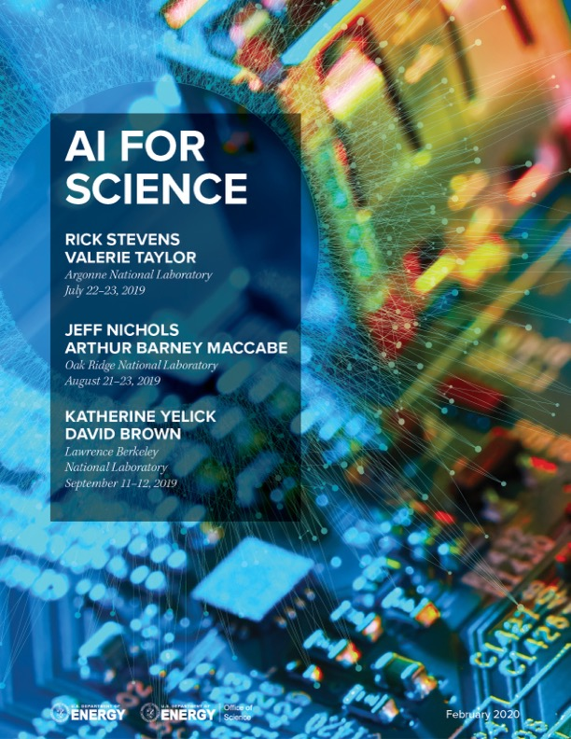
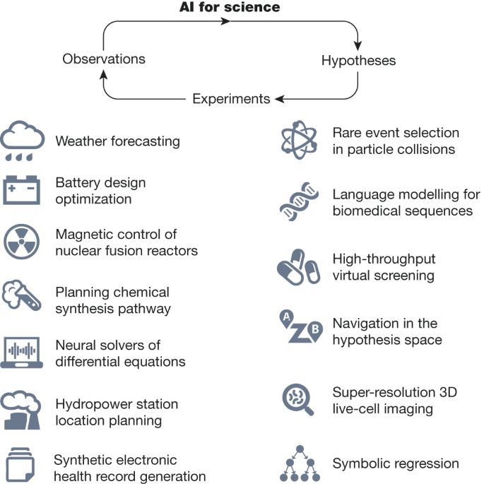
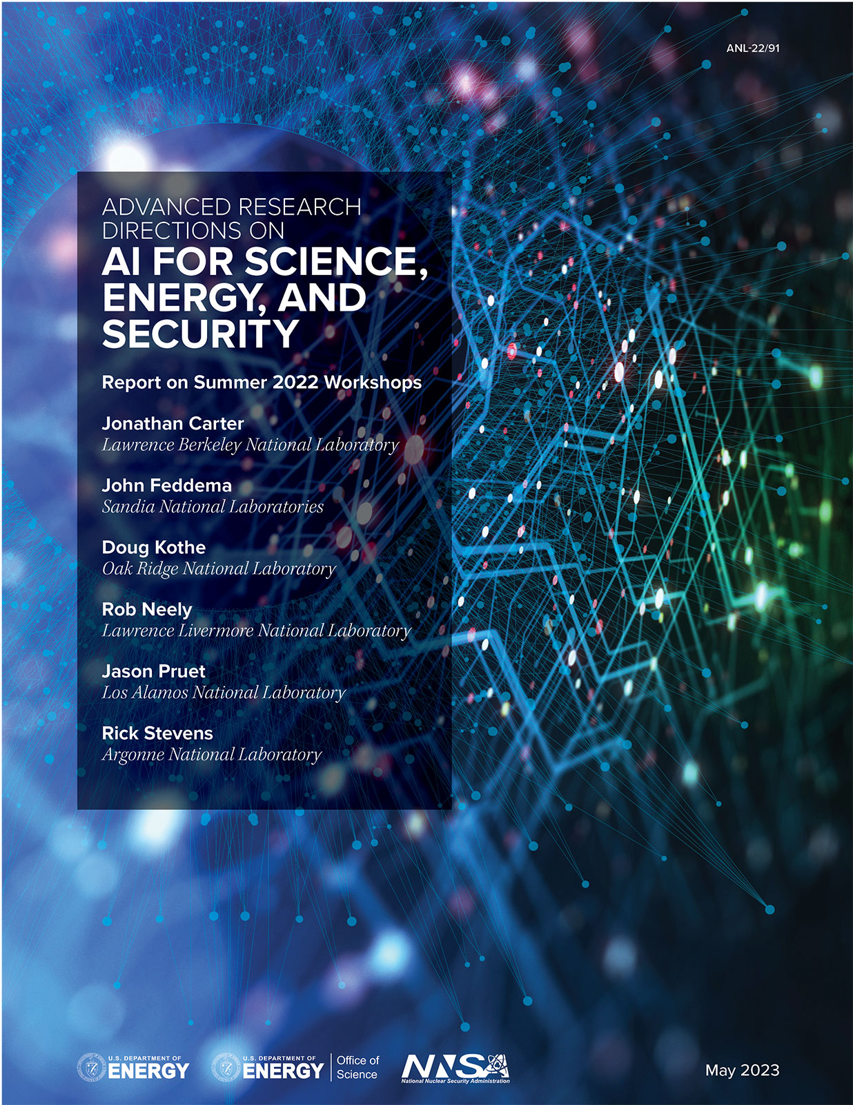
AI for Science
Scientific discovery in the age of artificial intelligence, 2023

Slide 25


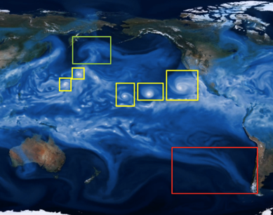
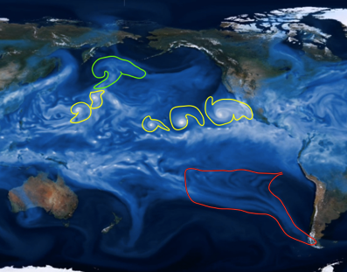
Analyze Simulations to Find Hurricanes
Classification
Localization
Detection
Segmentation
Extending image-based methods to complex, 3D, scientific data sets is non-trivial!
Source: Prabhat

Slide 26
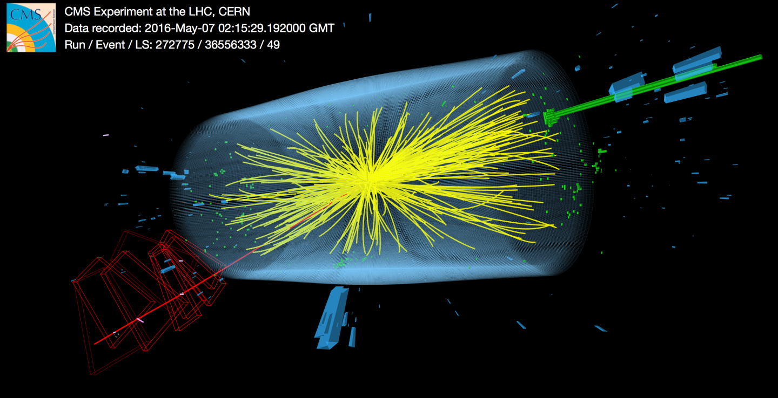


Deep Learning: like adding 4,000 extra tons of detectors!
7
Based on 8/12/2016 slide by Joe Lykken at Fermilab

Slide 27
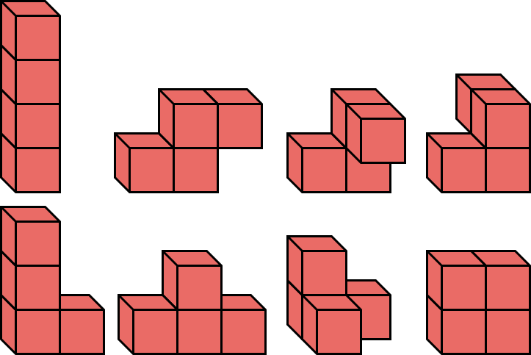
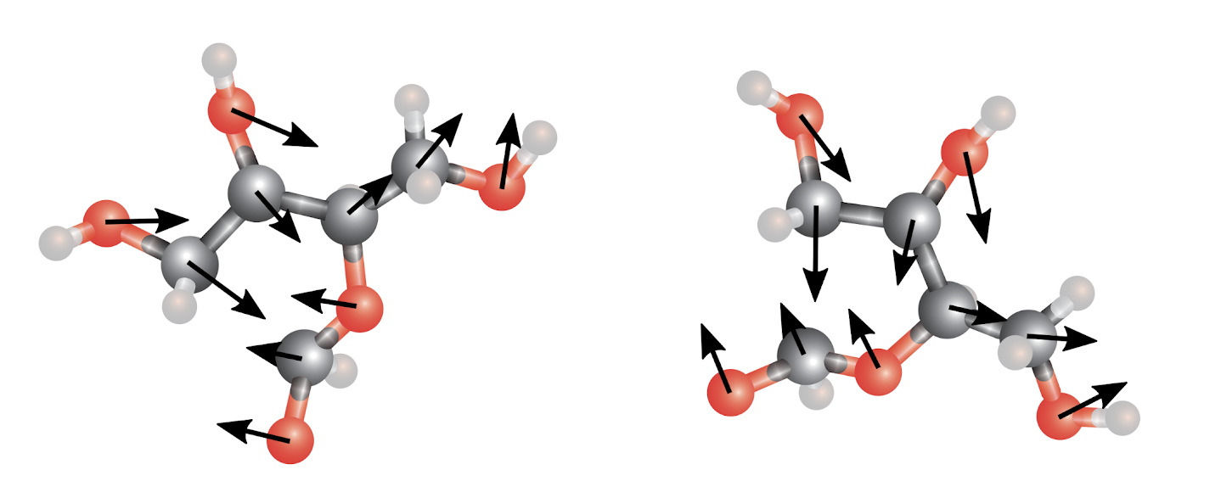
Deep Learning with Physical Laws
Physics-aware learning
TRAIN
TEST
A network with 3D translation- and 3D rotation-equivariance
Slides from Tess Smidt and Risi Condor; E.g., 2018 paper by Thomas, Smidt, Kearnes, Yang, Li, Kohlhoff, Riley
Notes:
Phenol group in a big molecule
Existing networks for chem only use topology / distances, not angles

Slide 28
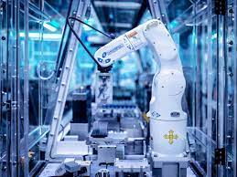
Automation in Self-Driving Laboratories
E.g., Strateos Cloud Lab
14K square feed
200+ instruments

Slide 29

Five Stages of AI
Acceptance
Denial
Anger
Depression
Bargaining
And this includes AI researchers!

Slide 30
AI in Science
Fairness
Interpret-ability
Inverse Design
Learning across scales
Complex, 3D+, sparse data
Transfer learning
Federated learning on sensors
Uncertainty Quantifi-cation
Physics-aware Learning
Control of experiments
The Computational Science and Engineering community (including NNSA) should have a leadership role in addressing UQ, safety, alignment, and explainability in AI for science and engineering

Slide 31
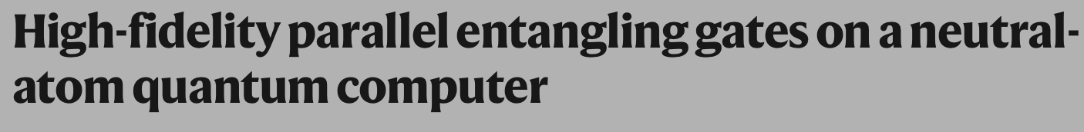
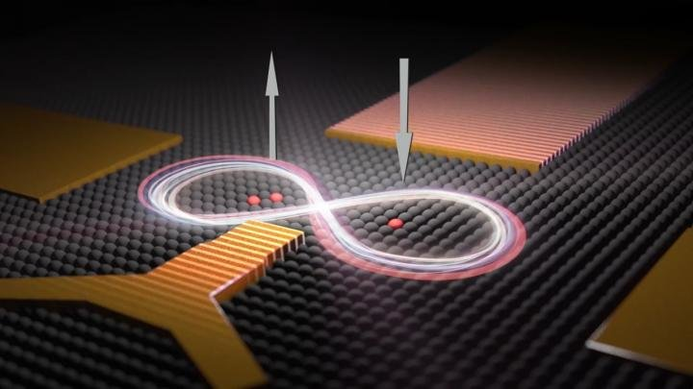
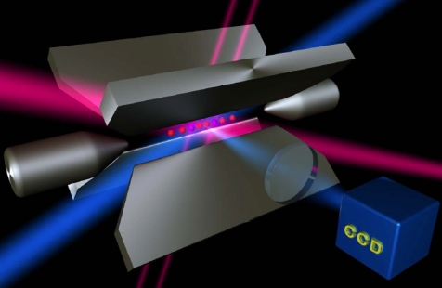
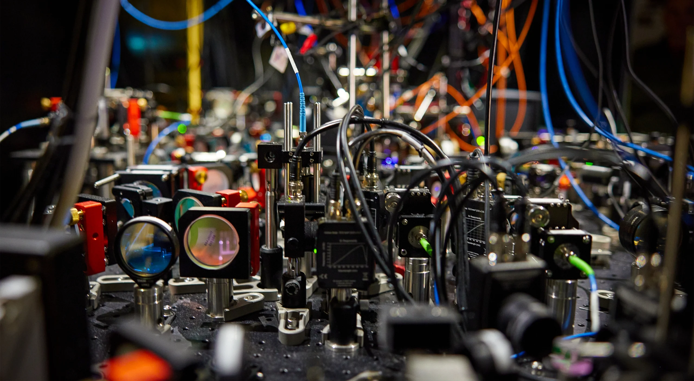
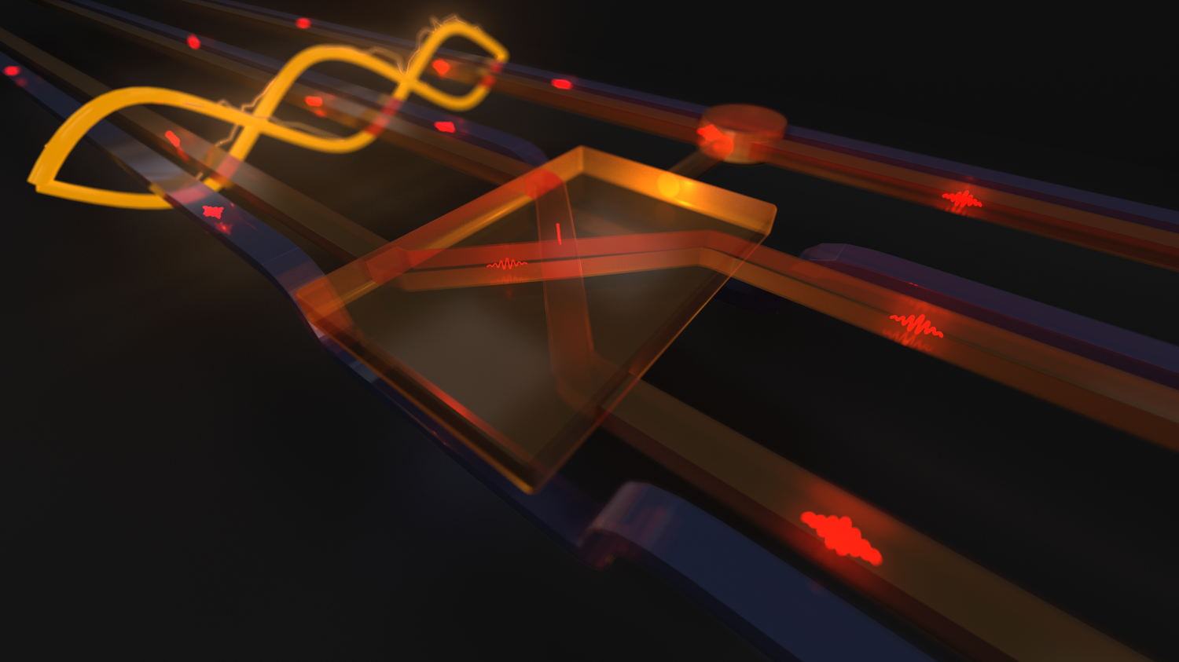
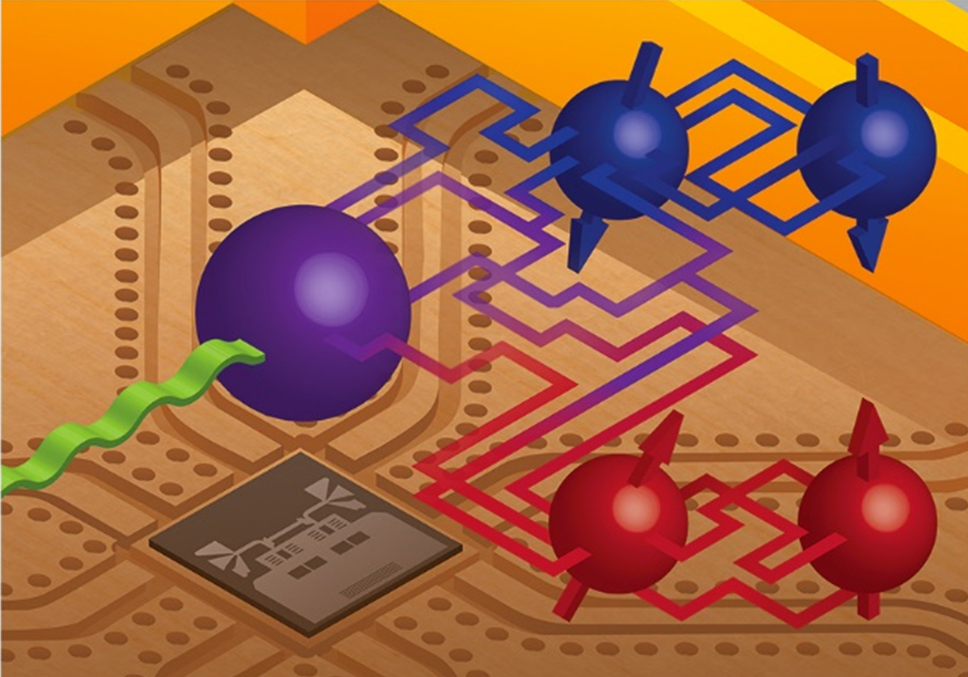
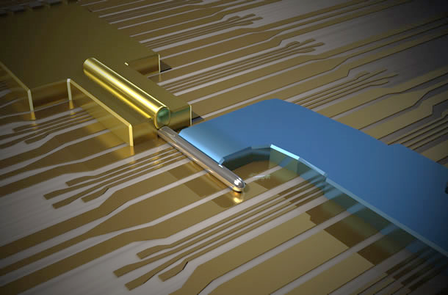
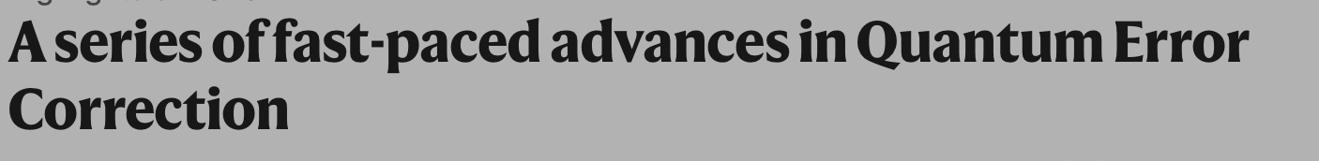
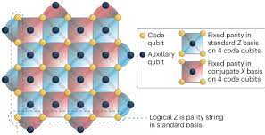
Types of Quantum Bits Diversity & Progress
Dopants in
Silicon / Diamond
Trapped
Ions
www.sciencedaily.com
www.quantumoptics.at
Photonic
Circuits
www.phys.org
Superconducting Circuits
Topological
Wires
www.qnl.berkeley.edu
www.microsoft.com

Slide 32
National Academies Study
Finding: Quantum technology has the potential to improve the fundamental understanding of material properties.
However, breakthroughs in quantum algorithms and systems are needed to make quantum computing practical for multiphysics stockpile modeling.
Quantum computing is more likely to serve as a special-purpose accelerator than to replace leading-edge computing.

Slide 33

Cloud Computing
The economic model is key

Slide 34

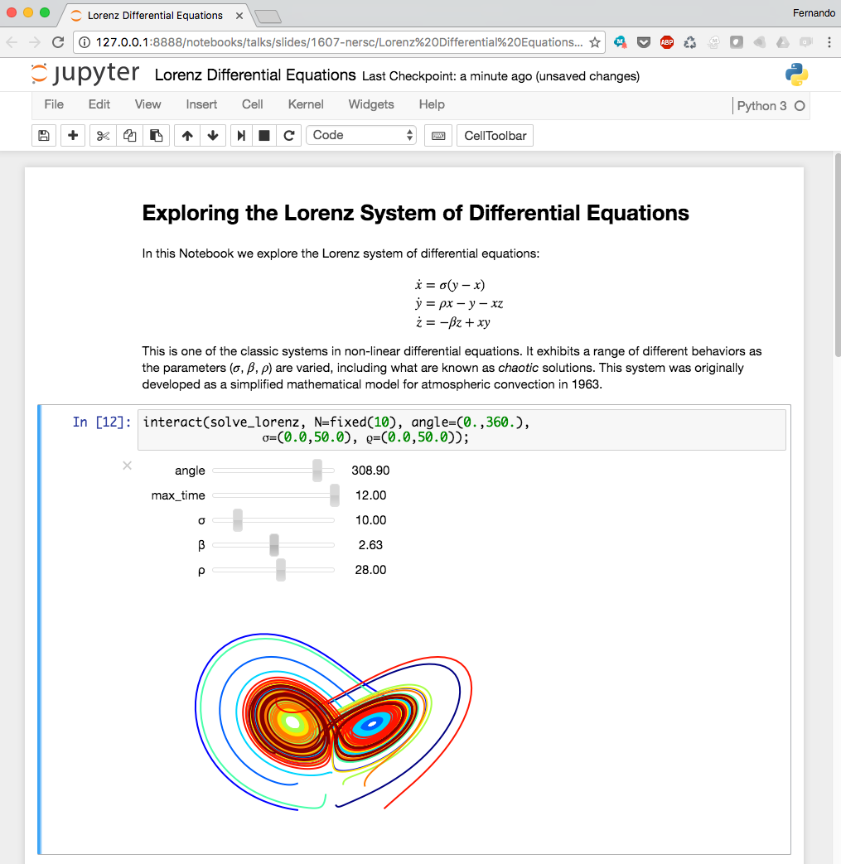
Lessons Learned from Clouds
Availability
Cost vs price
Higher level programming
Old programming models never die, they just get buried under layers!

Slide 35
Follow the money, understand the implications
Hyperscalers
HPC+AI
Market capitalizations
Billions $ (USD)
“Traditional” computing
(~1.7T$ (USD) aggregate)
BAT
Source: Reed, Gannon, Dongarra
Notes:
Market capitalization is, of course, only one measure of influence, but the fact that the hyperscalers and NVDIA are the companies with >$1T market capitalization speaks to how the world has changed.
Source:
Reed, D., Gannon, D., Dongarra, J., HPC Forecast: Cloudy and Uncertain, Communications of the ACM, February 2023, Vol. 66 No. 2, pp. 82-90, February 2023, available at: https://doi.org/10.1145/3552309
Reed, D., Gannon, D., Dongarra, J., Reinventing High Performance Computing: Challenges and Opportunities, March 2022, available at https://arxiv.org/abs/2203.02544
University of Utah

Slide 36
National Academies Study
Finding: Cloud providers are engaged in hardware and software innovations and will have more market influence in technology and talent but are not aligned with NNSA requirements.

Slide 37

HPC community has always punched above its weight

Slide 38
Post-Exascale Computing
Computing demand
Disruptions
Technology

Slide 39

From https://www.unite.ai/moores-law/

Slide 40

10 µm | 6 µm | 3 µm | 1.5 µm | 1 µm | 800 nm | 600 nm | 350 nm | 250 nm | 180 nm | 130 nm | 90 nm | 65 nm | 45 nm | 32 nm | 22 nm | 14 nm | 10 nm | 7 nm | 5 nm | 3 nm

Slide 41

https://www.economist.com/technology-quarterly/2016/03/10/horses-for-courses

Slide 42

Dennard Scaling is Long Dead; Moore’s Law Will Follow
M. Horowitz, F. Labonte, O. Shacham, K. Olukotun, L. Hammond, C. Batten, and K. Rupp
Notes:
Single-thread performance has stagnated --- need parallelism to hit peak flops.
Image reconstruction typically memory bandwidth bound:
Need parallelism to saturate memory bandwidth.
Must design code well to leverage memory hierarchy.
Caches on multi/many-core systems
Coalescing on GPU systems.
Problem is getting worse---50-60% flop improvements, 23% bw---machines becoming more imbalanced.
Compute bound now ⇒ maybe not in future.
Takeaway: growing burden on software to deliver performance.

Slide 43

Performance Programming pre 2005

Slide 44

End Game for Moore’s Law: Parallelization and Specialization
From Chris Batten, Cornell ENGRI 1210 citing
C. Batten, M. Horowitz, F. Labonte, O. Shacham, K. Olukotun, L. Hammond, K. Rupp & [Y. Shao, IEEE Micro'15] & [C. Leiserson, Science'20]
Notes:
Single-thread performance has stagnated --- need parallelism to hit peak flops.
Image reconstruction typically memory bandwidth bound:
Need parallelism to saturate memory bandwidth.
Must design code well to leverage memory hierarchy.
Caches on multi/many-core systems
Coalescing on GPU systems.
Problem is getting worse---50-60% flop improvements, 23% bw---machines becoming more imbalanced.
Compute bound now ⇒ maybe not in future.
Takeaway: growing burden on software to deliver performance.

Slide 45
Exascale Architecture Plans (2008)
Petascale X 10x more energy X 100x more Performance per Joule = Exascale
Accelerators (GPUs)
100x more cores
Faster clocks + SIMD

Slide 46



Exascale Era Architectures (US DOE Office of Science)
US DOE Office of Science Systems
Exascale
HPE AMD+AMD
Exascale
HPE Intel+Intel
Pre-exascale
HPE AMD+NVIDIA
1 Architecture (3 GPUs), 1 Integrator!

Slide 47
First-in-Class HPC Systems (Top500)
 | First TF | First PF | First EF
 | ASCI Red | Roadrunner | Frontier
Month-Year | Jun-97 | Jun-08 | Jun-22
Best Tech (nm) | 500 | 65 | 6
Peak (PF/s) | 0.001453 | 1.38 | 1686
Sustained (PF/s) | 0.001068 | 1.04 | 1102
Power (MW) | 0.85 | 2.35 | 21.1
Efficienty (GF/W) | 0.00125647 | 0.44 | 52.2
Memory (PB) | 0.001212 | 0.04 | 9.4
FPUs (K) | 9 | 464 | 534,000
Cabinets | 104 | 296 | 74
Foorspace (m^2) | 150 | 557 | 678
Kogge and Dally: Frontier vs the Exascale Report: Why so long? and Are We Really There Yet?
+Wikipedia for ASCI Red

Slide 48

Energy efficiency didn’t track technology scaling
Rumors of 2nm fabs, but how much will it help?
Kogge and Dally: Frontier vs the Exascale Report: Why so long? and Are We Really There Yet?

Slide 49

The “Aggressive” Strawman was a bit early, but close to Summit
Resilience would have been a bigger problem with a 7x larger Summit
Kogge and Dally: Frontier vs the Exascale Report: Why so long? and Are We Really There Yet?

Slide 50
Post-Exascale Architecture Plans 2024 (Strawperson-v0)
Exascale X 2x more energy X 500x more Performance per Joule ??
Specialized for AI
Specialized for Simulation
GPUs
Influenced to make AI better (e.g., sparsity)?
Designed by DOE, DoD, …?

Slide 51

Another Exponential?
Jensen Huang's Nvidia GTC Keynote

Slide 52
Specialization: Is deep learning the only application?
Remember when the Linpack Benchmark represented scientific computing?

Slide 53

Everyone is Making AI Chips
NVIDIA
AMD
Intel
IBM
Traditional chip makers
“Software” companies
Facebook + Intel
Amazon (Echo, Oculus)
Google (TPU, Pixel)
Apple (SoCs)
Microsoft (“AI chip”)
Graphcore, Nervana Cerebras, Wave Computing, Horizon Robotics, Cambricon, DeePhi, Esperanto, SambaNova, Eyeriss, Tenstorrent, Mythic, ThinkForce, Groq, Lightmatter
Not everyone is selling those chips!

Slide 54


Specialization for the masses?
Chiplets

Slide 55

Technology and Marketplace: Radically Different!
What’s a post-Exascale strategy for the science community?
Beat them
  Design processors for science
  More Co-Design and
  don’t forget the math and software
Join them
  Leverage AI Hardware
  for AI in Science
  andSimulation ?

Slide 56

Workforce

Slide 57



It’s hard to think exponentially

Slide 58
But it’s also hard to stop

Slide 59
Finding: The NNSA laboratories face significant challenges in recruiting and retaining the highly creative workforce that NNSA needs, owing to competition from industry, a shrinking talent pipeline, and challenges in hiring diverse and international talent.
The U.S. national security enterprise has benefited enormously from inclusion of global talent.

Slide 60
Where are the US Computer Science PhDs student doing?
Taulbee Survey 2022

Slide 61

The importance of diversity
https://cset.georgetown.edu/article/levers-for-improving-diversity-in-computer-science/

Slide 62

STEM Graduates Around the World

Slide 63


Slide 64

Reasons are Systemic

Slide 65


Using Scientific Computing (Broadly) to Attract and Retain Talent
super
  Saving the World with Computing
Kathy Yelick
Vice Chancellor for Research
Professor of Computer Science
UC Berkeley
Senior Faculty Scientist
Lawrence Berkeley National Laboratory
Often over 50% women with (relatively) high representation of other historically underserved groups

Slide 66
Post Exascale Computing: Not Business at Usual
Computing demands continue to grow
The benefits of more weak scaling are limited
Computing technology has hit several “walls”
The computing industry has changed dramatically
AI methods are having huge impacts elsewhere
Quantum computing potential for science still unknown
Cloud computing is dominating the computing industry
Global supply chain issues present uncertainties

